Slide 1
WEL COME TO ALL

Slide 2
Todays Lesson
Making WH Questions (Part-2 )
For class 4

Slide 3
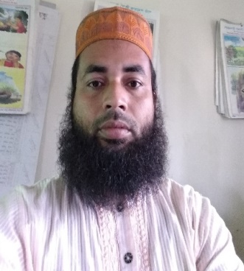
Presented by
Md. Afzal Hossain
Assistant teacher
Kuralia Govt. Primary School
Madhupur, Tangail

Slide 4
Learning out comes:
The students will be able to –
i) Know about WH words.
ii) Learn how to make WH questions.

Slide 5
Practice
Use -do/does/did
1. The students go to school to learn.
Why
do
the students go to school?
2. Fariha likes her mother very much.
Whom
does
Fariha like very much?

Slide 6
3. My father reached home at 8 p.m.
When
did
your father reach home?
We learnt
Verb( present simple)
do
Verb + s
does
Verb + es
does
Verb(past simple)
did

Slide 7
Complete the sentences
Why
Who
When
What
Which
1. ________does Lima come here?
2. ________book do you want?
3. _______goes to Dhaka?
4. _______is your mother?
5. _______do they work extra hours?

Slide 8
Nomore today
Good bye

