Slide 1
Wellcome Everybody.

Slide 2
Introduction of the teacher.
Mijanur Rahman
Assistant Teacher
Gopalpur Uttar Gov’t Primary School.
Durgapur, Netrakona
Bangladesh.

Slide 3
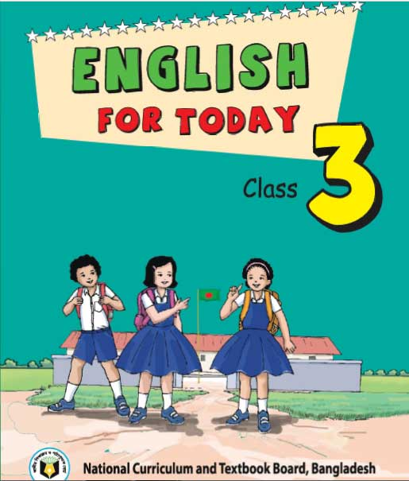
Lesson Introduction:
Subject: English
Class: 3
Lesson type: Story
Lesson Headline: The Crow
Unit: 39
Lesson: 1-3
Class Duration: 40 minutes

Slide 4
Learning Outcomes:
Listening:
4.3.1-enjoy and understand simple stories.
Reading:
5.1.2- read simple stories.

Slide 5
Good Morning dear students….
How are you today?
Let’s watch a video clip….

Slide 6
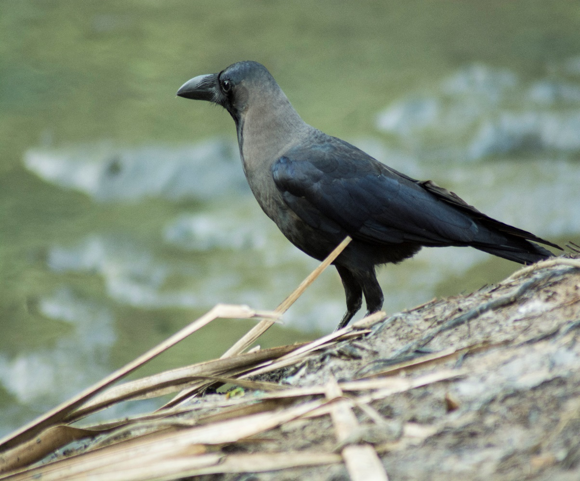
Do you know this bird?

Slide 7
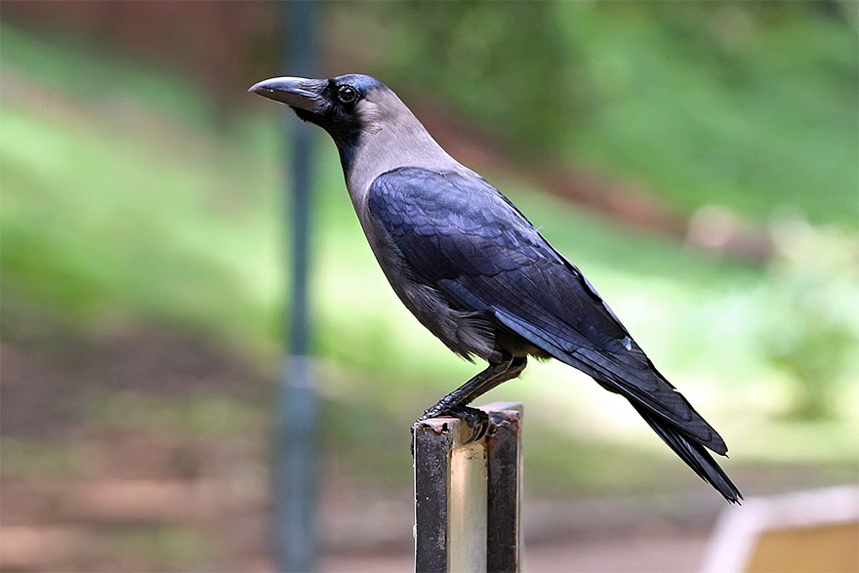
Have you ever seen this bird?
What’s the name of this?
Crow

Slide 8
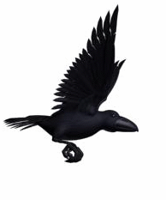
What colour is the crow?
Black
What is it doing?
Flying

Slide 9
Today we are going to read …….
Story : The crow

Slide 10
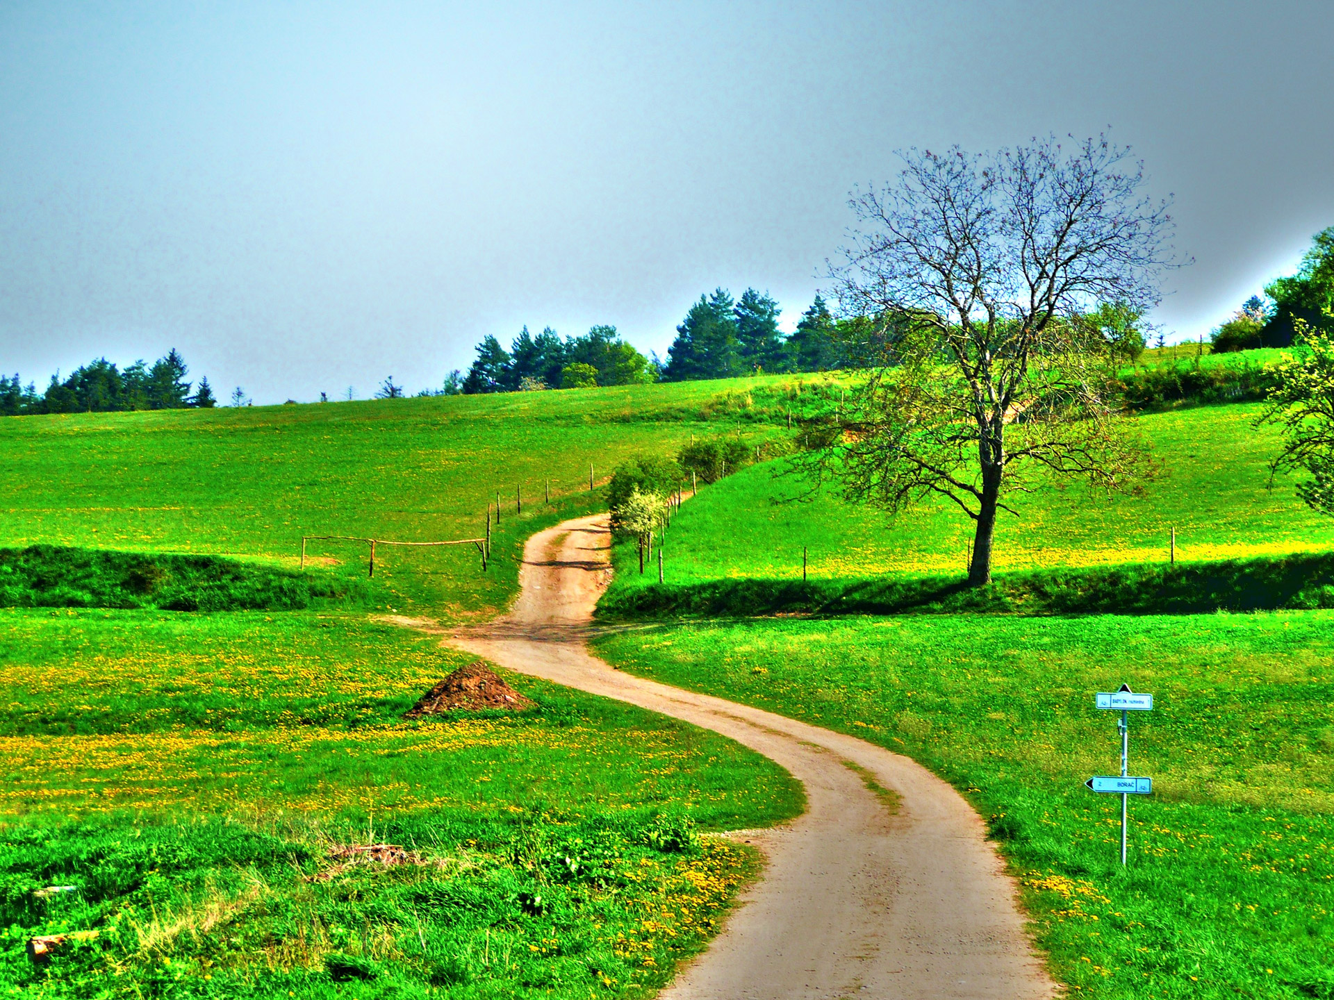
It’s Summer.

Slide 11
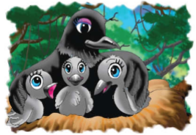
Mother Crow and her young crows are living in a nest.

Slide 12
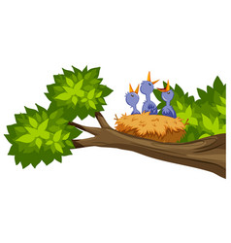
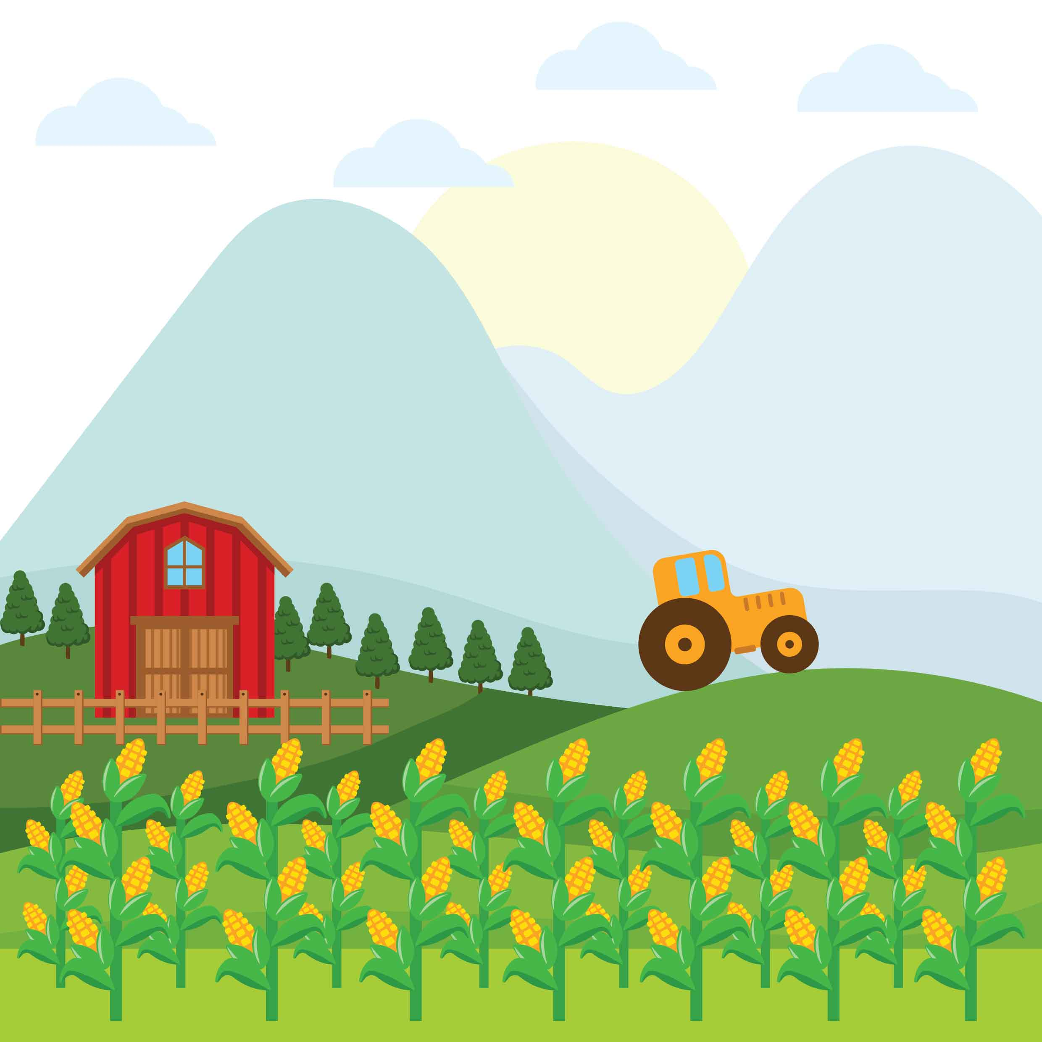
The nest is above a corn field.

Slide 13
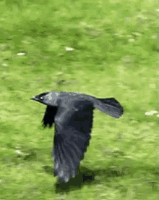
Every morning, Mother Crow flies away.

Slide 14
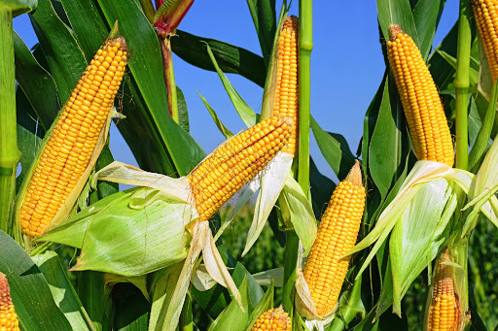
to get corn.

Slide 15
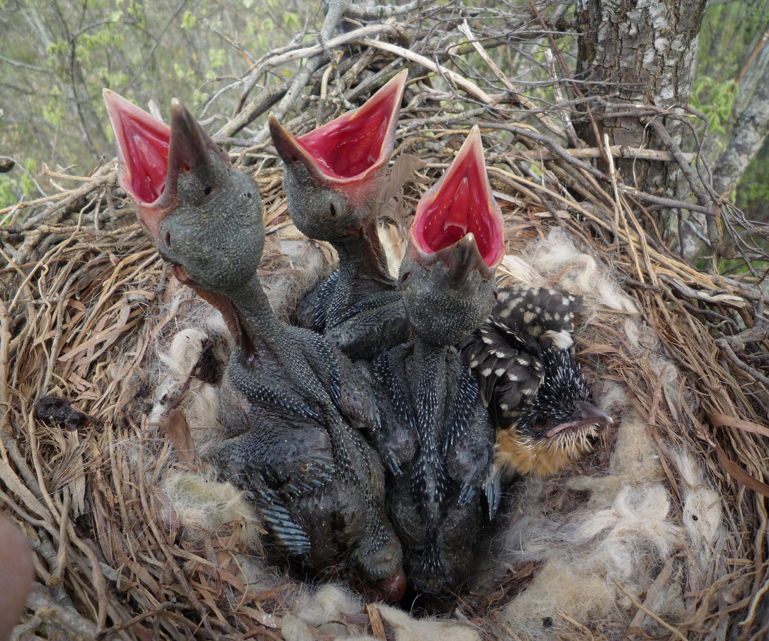
She leaves the young crows.

Slide 16
New words:
Summer
Nest
Above
Corn field
Flies away
Leave

Slide 17
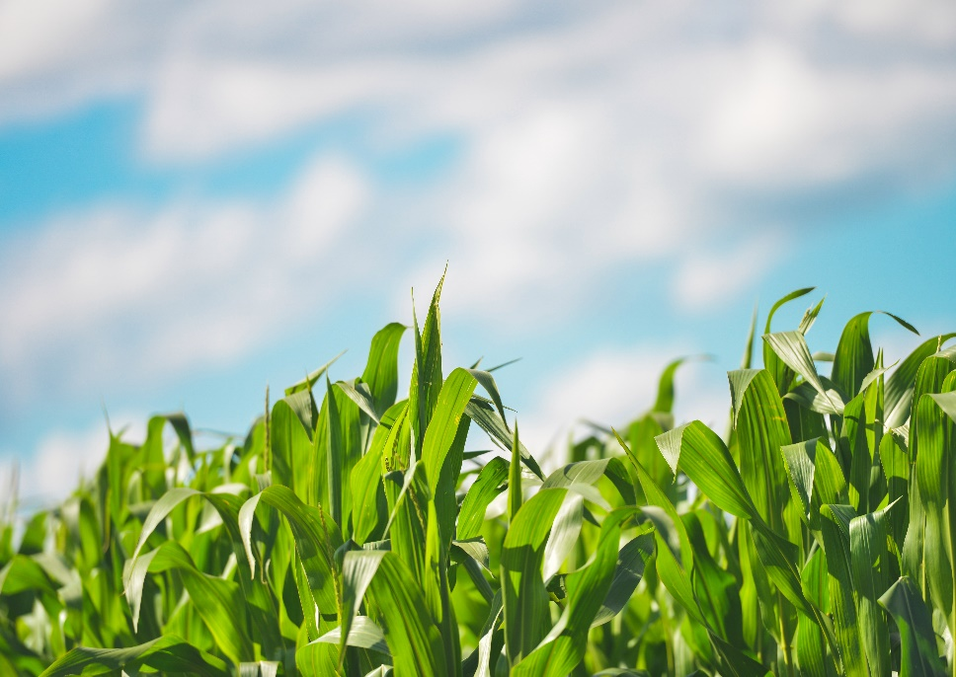
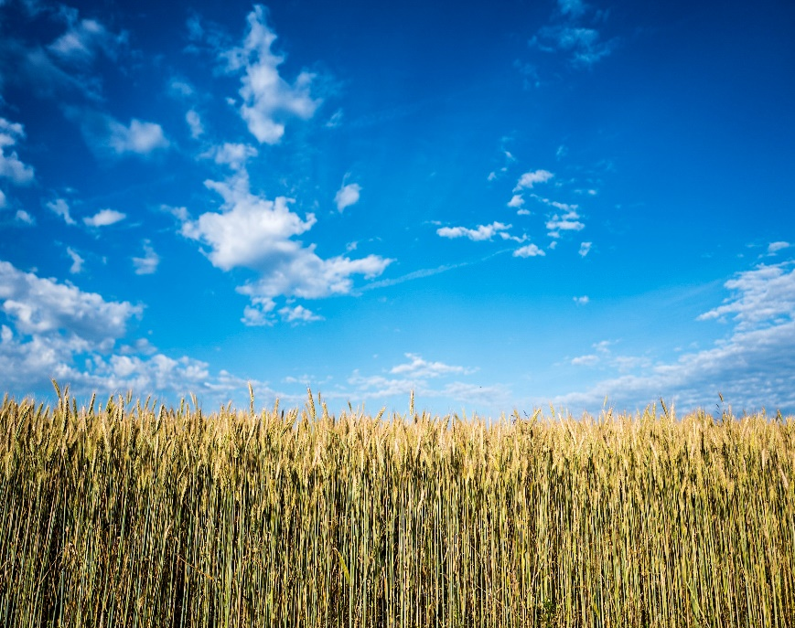
One day one word
Corn Field
শস্যক্ষেত্র

Slide 18
Open at page 78

Slide 19
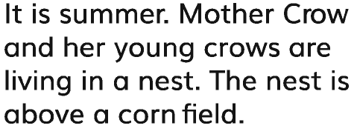
Magpie
Notes:
GW:Magpie.

Slide 20
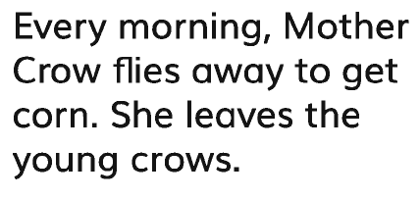
Parrot
Notes:
GW: Parrot.

Slide 21
Read Individualy

Slide 22
1. How many crows live in the nest?2. 2.Where is the nest?
Dear students try to answer the questions.
Notes:
Evaluation:

Slide 23
Bye Bye
Good Bye.

