Slide 1

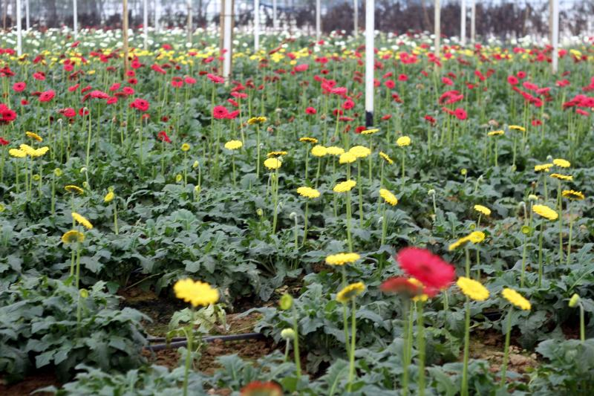
my
dear
students

Slide 2

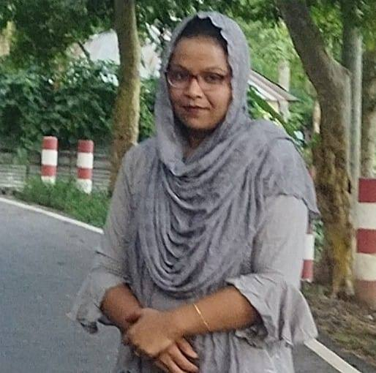


INTRODUCTION
MARGAET ADHIKARI
ASSISTANT TEACHER
BALIGOAN GOVT. PRIMARY SCHOOL
KAMALGONJ,MOULVIBAZAR
ENGLISH FOR TODAY
CLASS – TWO
UNIT -- 13
LESSON – 1-3

Slide 3
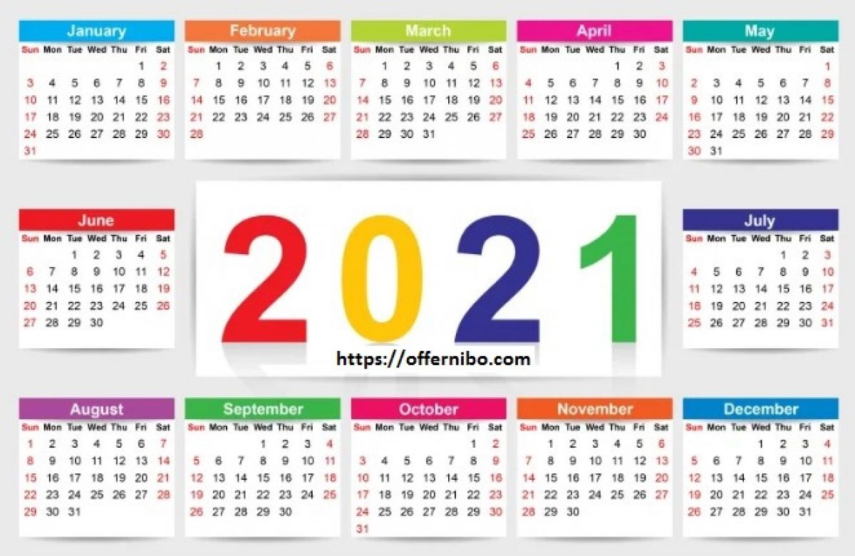
LOOK AT THE PICTURES .
Who do you identify in the pictures ?
What do you see in the pictures ?
Can you guess what lesson today we are going to learn ?
Can you identify what’s the date and year ?

Slide 4
This is a tree of 7 days

Slide 5
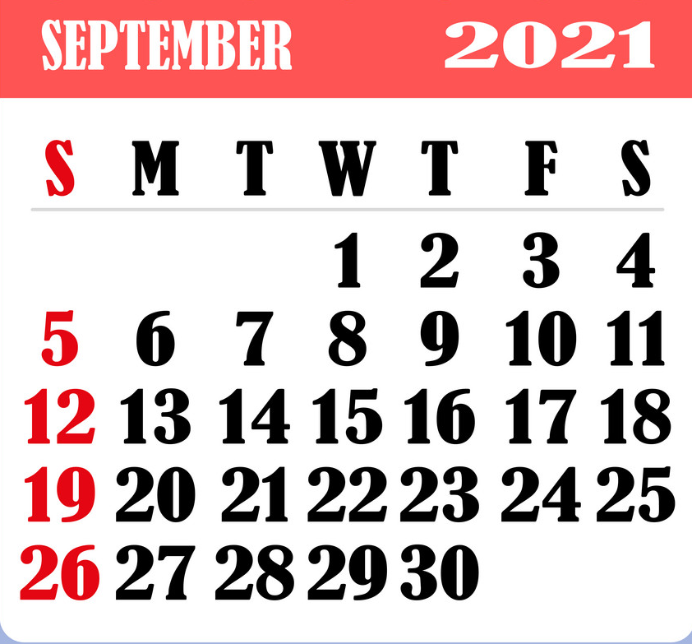
Do you know what is this?
Days of the week
Count and say how many days in a week?
A calendar

Slide 6
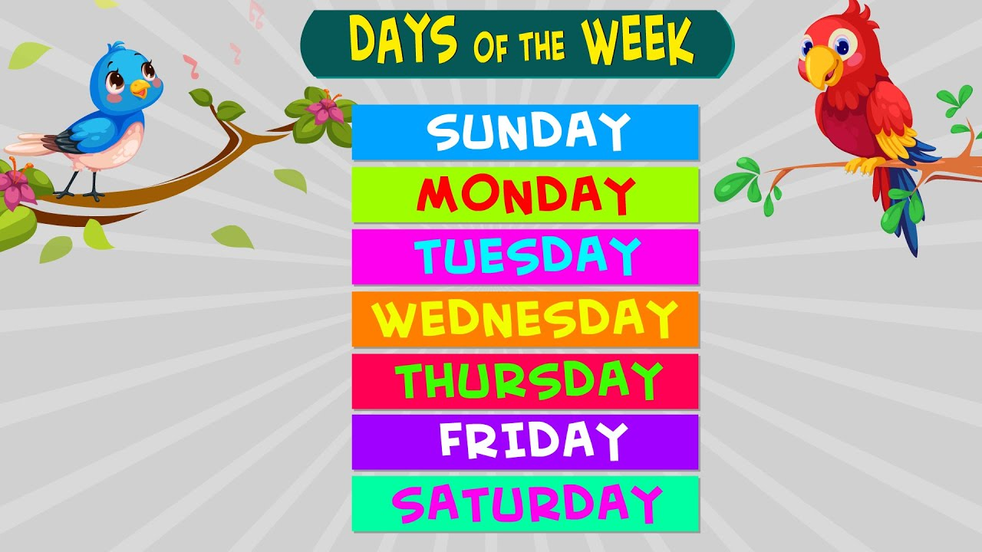
Today We are going to read

Slide 7
Learning outcomes
By end of the lesson students will be able to-------
Listening: 1.1.1 become familiar with English sounds by listening to common
English words.
Speaking: 1.1.1 repeat after the teacher simple words and phrases with proper
sounds and stress.
Reading: 3.1.1 Recognize and read the days of the week.

Slide 8
Days of the week
Saturday
Sunday
Monday
Sat
Sun
Mon
Tue
Wed
Thu
Fri
Tuesday
Wednesday
Thursday
Friday

Slide 9
Practice
Saturday
Sat
Sun
Sunday
7Days
Mon
Monday
Tuesday
Tue
Wed
Wednesday
Thu
Thursday
Fri
Friday

Slide 10
Say with me
Saturday
Tuesday
Wednesday
Sunday
Monday
Thursday
Friday

Slide 11
Say alone
Saturday
Wednesday
Sunday
Thursday
Monday
Friday
Tuesday
Individual work

Slide 12
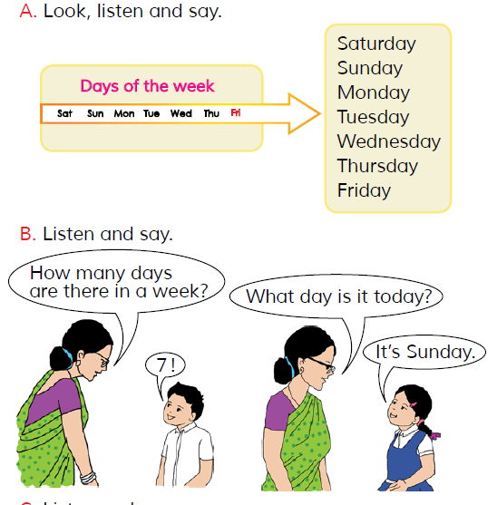
Dear students, open your English book at page 26 I am reading the text loudly, please put your fingers on the text.

Slide 13
Match the days name of the week
Sun
Saturday
Fri
Sunday
Wed
Monday
Tue
Tuesday
Thu
Wednesday
Sat
Thursday
Mon
Friday

Slide 14
Rearrange the days of the week
Evaluation
Saturday
Wednesday
Thursday
Monday
Sunday
Friday
Tuesday

Slide 15
Answer the question
Evaluation
Qus – How many days in a week ?
Ans – 7 days.
Qus – Can you say name of 7 days ?
Saturday
Sunday
Monday
Tuesday
Ans –
Wednesday
Thursday
Friday

Slide 16
Let’s us learn a word
Week
There are 7 days in a week .
সপ্তাহ

Slide 17
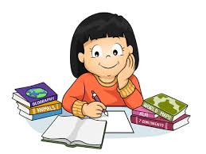
Task
Home work
Practice 7days name in your home.

Slide 18
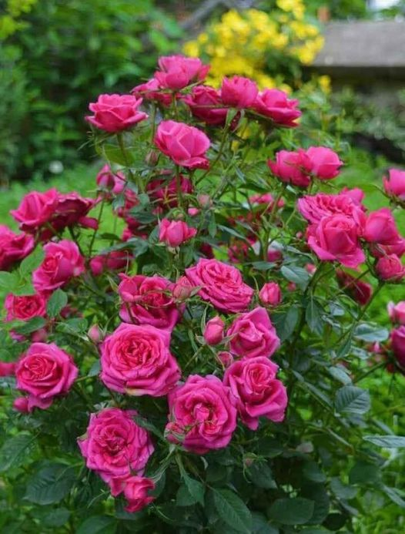
Dear student, please stay safe and use musk.
See you later, bye………

