Slide 1
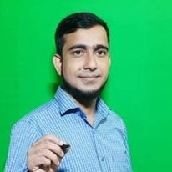
Welcome to my class

Slide 2
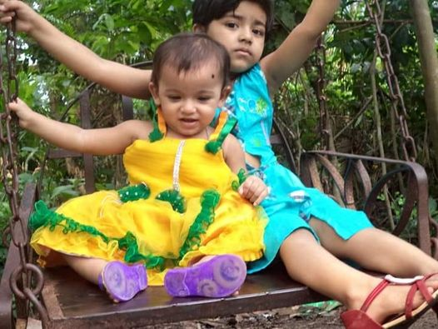
How are you my lovely students

Slide 3
Introduction
About myself
About my class
Md. Ariful Islam
Lecturer in English
Shaistagonj Kamil Madrasah
Shaistagonj , Habigonj
Cont: 01711857580
Email: arif046980@gmail.com
Class: Twelve
Sub: English 2nd Paper
Period: 1st
Topic: Modifiers
Date: 23/08/2021
Time: 45 minutes
Number of students: 25

Slide 4
Look at the pictures and tell me what we are going to read today

Slide 5
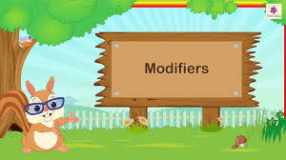
Yes, you are right. Our today’s topic is modifiers

Slide 6
Lesson out come
After the lesson the students will be able to:
Tell about modifiers
Classify modify
Use different modifiers in real life

Slide 7
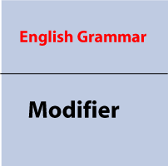
Let’s know what modifiers are!

Slide 8
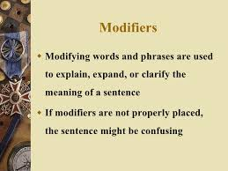
Definition of modifiers

Slide 9
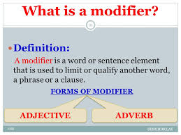
More about modifiers

Slide 10
Classifications of modifiers

Slide 11
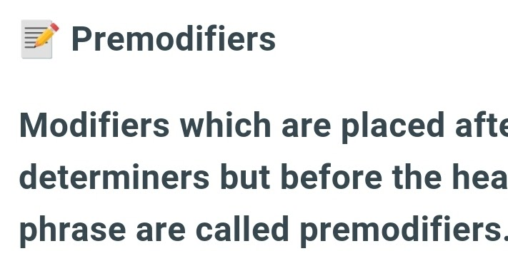
Pre-modifiers

Slide 12
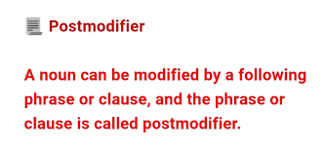
Post-modifiers

Slide 13
Lists of modifiers

Slide 14
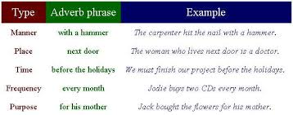
Adjective phrases as modifiers

Slide 15
Adverb phrases as modifiers

Slide 16
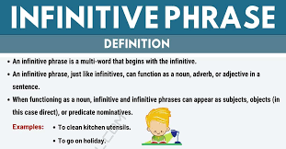
Infinitive phrases as modifiers

Slide 17
Noun as modifiers

Slide 18
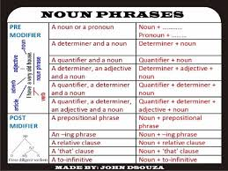
Noun phrases as modifiers

Slide 19
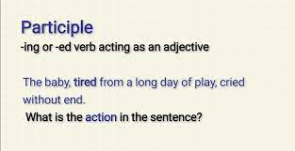
Participles as modifiers

Slide 20
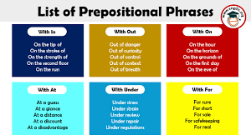
Prepositional phrases as modifiers

Slide 21
Participle phrases as modifiers

Slide 22
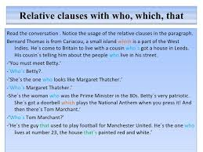
Relative clauses as modifiers

Slide 23
Determiners as Modifiers

Slide 24
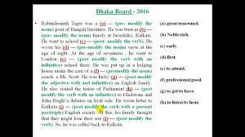
Group work

Slide 25
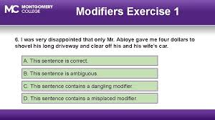
Pairwork

Slide 26
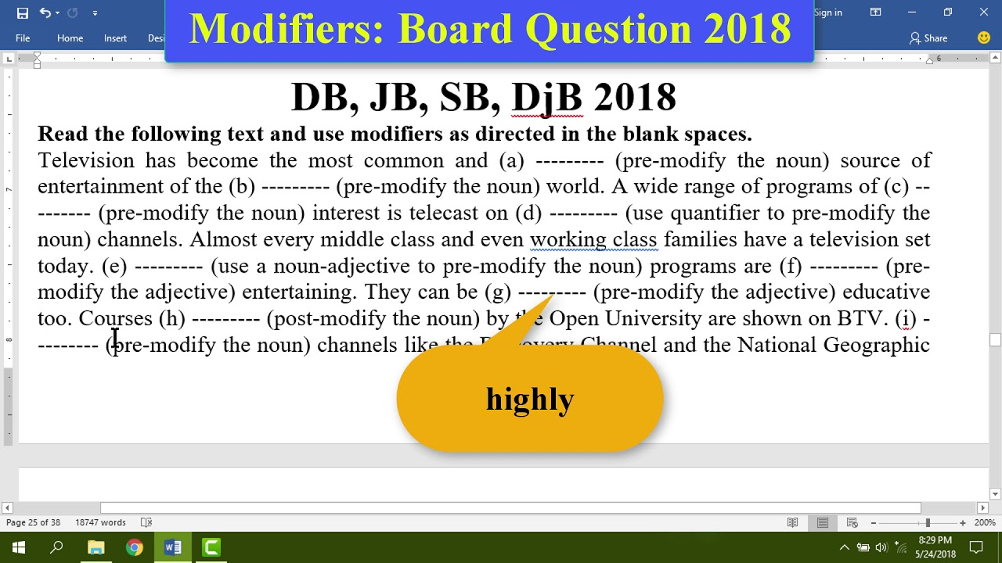
Evaluation

Slide 27
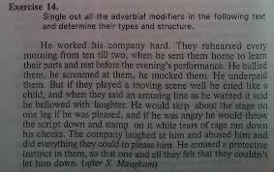
Homework

Slide 28
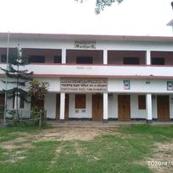
Thank you all

