Slide 2
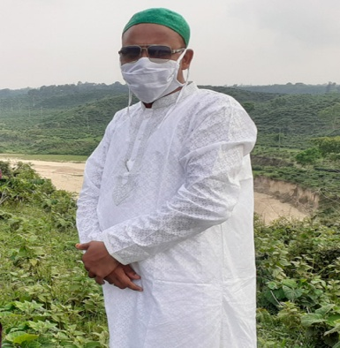
Identity
Md. Enamul Haque
Assistant Teacher
Chalitar Abda Afsar Talukdar Mahila Dakhil Madrasah
Chunarughat, Habigonj
Class: VII
Sub: English Ist Paper
Unit: 5
Lesson: 1
Time: 45 minutes

Slide 3
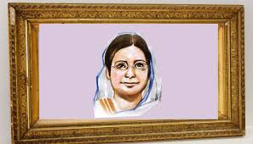
Look at the picture below.
Who is the woman?
What do you know about her?

Slide 4
Begum Rokeya

Slide 5
**By the end of the lesson, the learners will be able to-
* read and understand text;
* talk about Begum Rokeya;
* ask and answer questions;
* write short paragraph.

Slide 6
Individual Work
Read the text silently.

Slide 7
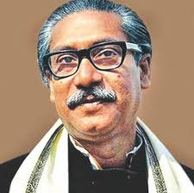
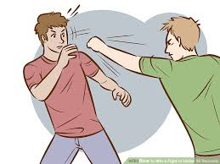
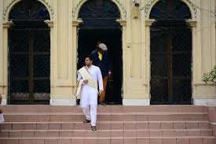
**Let us introduce with some words.
Root words
Meaning
Famous
Well known
Fought
Struggled
Learned
Educated
Landlord
Landowner

Slide 8
** Let us know something about Begum Rokeya.
* Begum Rokeya was a famous writer and social worker.
*Her father Jahiruddin Muhammad Abu Ali Haider Sakhawat Hussain was an educated and landlord.
* She learnt Bangla and English from her eldest brother Ibrahim.

Slide 9
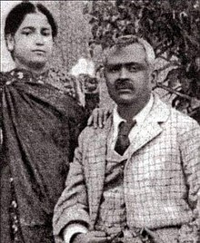
* We can see a picture with two person. Yes, the female person is Begum Rokeya and the male person is Khan Bahadur Shakhawat Hussain, husband of Begum Rokeya, was the Deputy Magistrate of Bhagalpur now India.

Slide 10
*Complete the following chart with correct information.
Begum Rokeya
occupation | born in | married in | family | language
writer
1996
1980
educated
bangla,english

Slide 11
**Group work**
* Group-1
Q. What was Begum Rokeya’s belief?
* Group-2
Q. What did she fight for?
* Group- 3
Q. Why did Rokeya learn Bangla and English?

Slide 12
** Evaluation**
** Find out the correct answer.
1. Begum Rokeya fought for…
a. democracy
b. women’s right
c. independence
2. Rokeya was born in…
a. a town
b.a slum
c. a village

Slide 13
3. Begum Rokeya Loved…
a. English
b.Bangla
c.Urdu
4. Bhagalpur is a district in…
a.Bangladesh
b. West Bengal
c.Bihar
5. Shakhawat Hussain worked at…
a. Pairabandh
b.Bhagalpur
c.Rangpur
6. Shakhawat Hussain was a…
a.Magistrate
b.Farmer
c.Lowyer

Slide 14
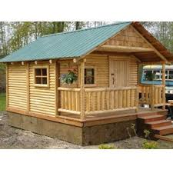
** Home Work**
** Write a paragraph about Begum Rokeya.

