Slide 1
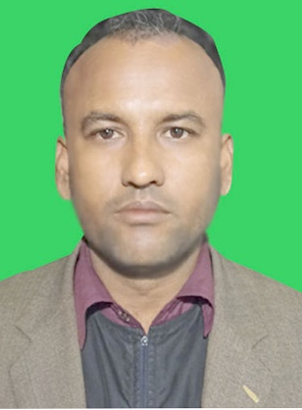
INTRODUCTION
MD MANZURUL ISLAM
AT
ANDHARIJHAR A M A HIGH SCHOOL
KURIGRAM
Class: Six
English Second Paper

Slide 2
Our today’s TOPICE is- WH QUESTION

Slide 3
Learning outcomes
After completing this lesson, we will be able to—
apply the use of auxiliary/principal verbs with negative
apply question word (‘wh’ word) in interrogative
change from assertive to interrogative

Slide 4
Change the sentences into WH Question (Home work)
1.He is a teacher.
2.They live in Kurigram.
3. Rana plays foodball.
4. I am 12 years old.
5. She spoke them.
6. We get up at 6, o clock.
7. That is my pen.
8.Mango was ripe.
9.Mr Alam is new person.
10. My mother is a teacher.

Slide 5
দেশকে ভালবাস, মাতৃভাষাকে শ্রদ্ধা করো।

