Slide 2
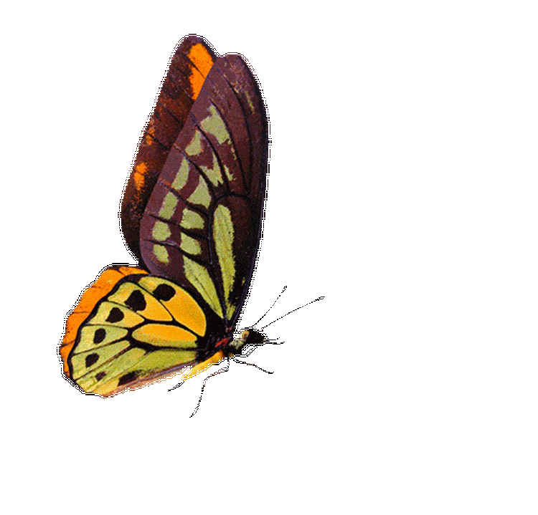
IDENTITY
MD. AFSAR ALI
SENIOR ASST. TEACHER (English)
MAJHIRA MODEL HIGH SCHOOL
SHAJAHANPUR, BOGURA

Slide 3
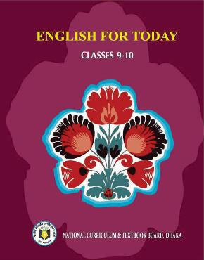
INTRODUCTION
ENGLISH FOR TODAY
CLASS: NINE-TEN

Slide 4
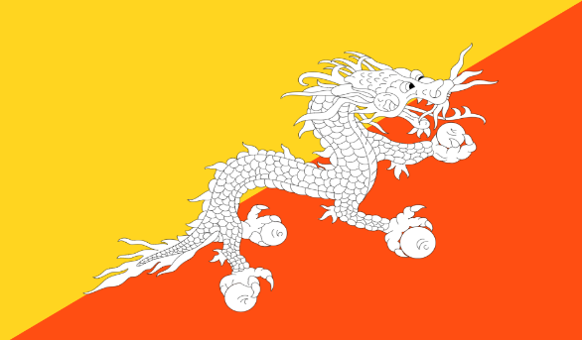
Which country's map is this?
What can you see in the following picture?
The map is of Bhutan.
I can see a map in the picture

Slide 5
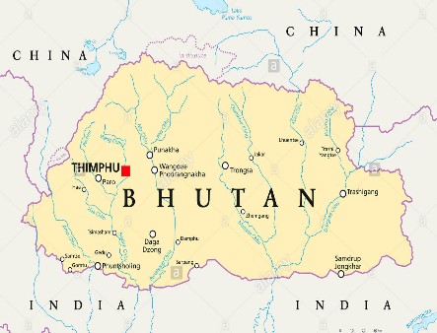

Slide 6
After we have studied this lesson, the students will be able to
tell synonym of some key words
read, comprehend and summarie texts
choose the best answer
ask and answer questions
fill up blanks
write a letter

Slide 7
Let’s know some new words

Slide 8
Let’s introduce with some key words
Word | Meaning | synonym
Slope | A non flat area of ground that tends upwards or downwards | Gradient, slant
Official | Relating to an authority or public body and its activities and responsibilities | Authorized, accredited
Thunder | The loud noise displaying a violent or ferocious aggressiveness | Lightning, bolt
Evolve | To develop gradually | Develop, progress
Monk | A member of a religious community of men who live apart from the rest of the society | Eremite, religioner
Enact | To perform a a part | play
Existence | The fact or state of living | extant
Flora | The plants of a particular region | Vegetation, plants
Fauna | The animal of a particular region | Animals
Diversity | A range of different things | variety., assortment

Slide 9
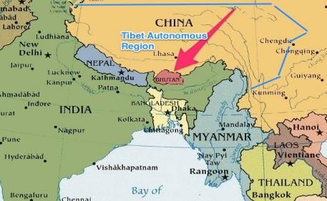
Where is Bhutan located?
Bhutan, small, landlocked country is located along the southern slopes of the Himalayan range, bounded by Tibet in the North and India from the other sides.
Notes:
The teacher will show the location of Bhutan with a stick.

Slide 10
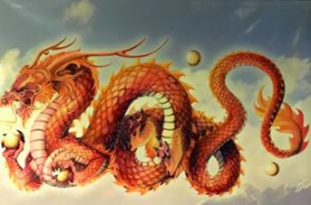
What else is Bhutan called?
Bhutan is called the Jewel of the Eastern Himalayas. The official name of Bhutan is Durk-yul, which means ‘land of the thunder dragon.’ It earned this name because of the fierce storms that often roll in from the Himalayss.

Slide 11
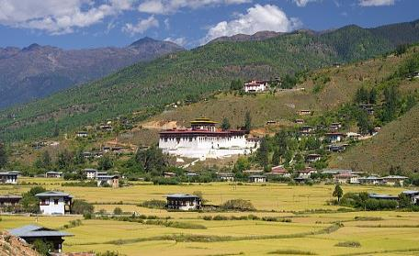
What is the area of Bhutan?

Slide 12
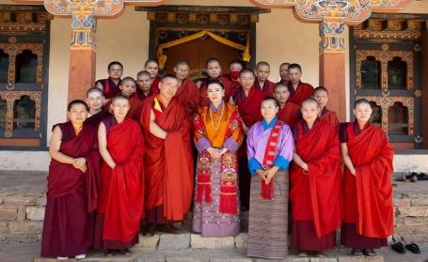
Do you know the population of Bhutan?
The population of Bhutan is 7,16,896

Slide 13
Since it is cut off from the rest of the world by the Great Himalayas, a unique culture and tradition based on gentle Buddhist beliefs have evolved over time.

Slide 14
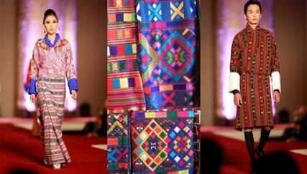
What is the dress of Bhutanese?
Bhutanese men wear Gho - a knee length robe –
and women wear Kira - a sheet like cloth piece.

Slide 15
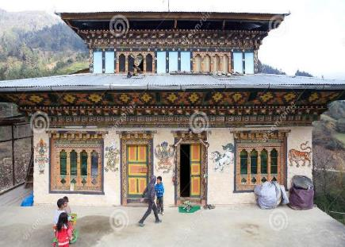
How are the houses in Bhutan?
Bhutanese houses are built from mud and stone, with wooden shingle roof. The Bhutanese never use iron nails in their buildings. Usually, the Bhutanese build each-other’s house by exchanging labour within the community.

Slide 16
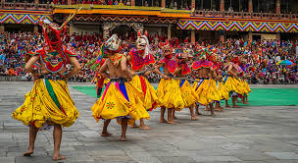
What kind of festivals do Bhutanese celebrate?
Different Festivals are celebrated all year round in Bhutan. Colourful masks are used in the festivals which reflect the rich Bhutanese culture. Dances are performed by the Buddhist monks to protect the valleys and ward off evil spirits. The main religious festival is called Tshechus.
The teaching of Lord Buddha are enacted through mask dances for three to five days in the courtyard of the monasteries. People attend these events in their best clothes, carrying picnic baskets.

Slide 17
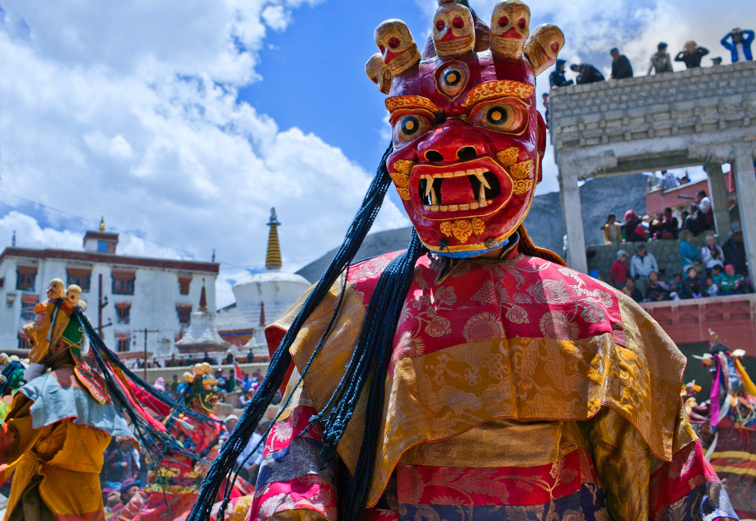
What is Losar?
Another major festival is called Losar. It is celebrated on Lunar New Year. People cook special dishes and wear new clothes. It is a time for family get-together. Men play archery or darts while women sing and dance.

Slide 18
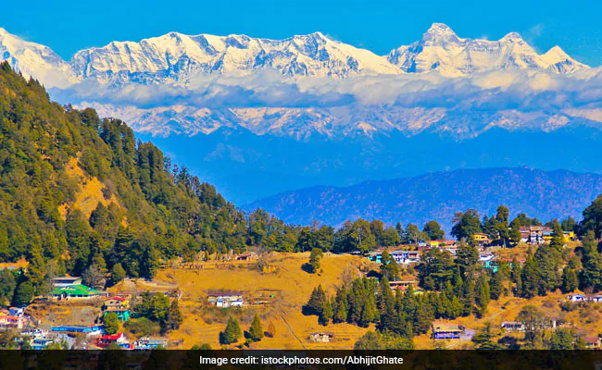
How is Bhutan’s environment?
Pure mountain air, crystal blue skies and pristine vegetation cover have made this small country an ideal destination for the environment lovers.

Slide 19
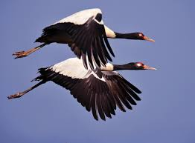
The ecosystem of of Bhutan?
The ecosystem of this small nation supports the existence of rich flora and fauna which are protected by strict laws. Anyone found guilty of killing a black-nacked crane could be sentenced to life in prison.

Slide 20
The ecosystem of of Bhutan?

Slide 21
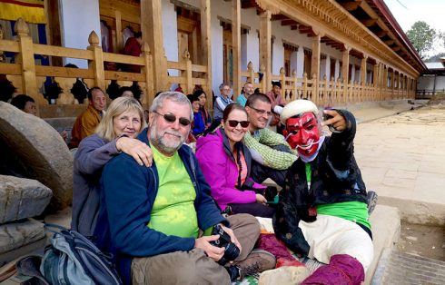
The ecosystem of of Bhutan?
Efforts are also taken to protect the nation against the intrusion of foreign cultures and values. The first foreign tourists were allowed into Bhutan in 1974. Now, tourism is encouraged but is controlled and limited to about 6,000 visitors a year.

Slide 22
The ecosystem of of Bhutan?
Bhutan is one of the last countries in the world to introduce television and the Internet to its people. The government lifted a ban on TV and the Internet only in 1999. The Bhutanese government has made it mandatory for all Bhutanese to wear only their national dress in public.

Slide 23
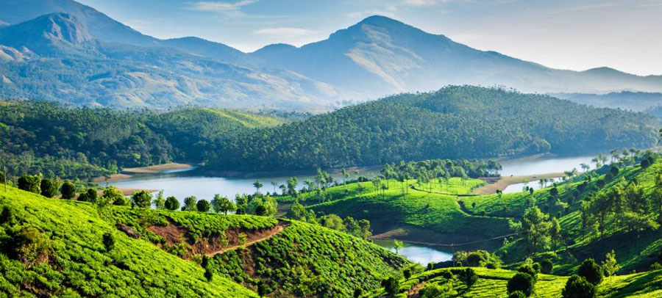
The ecosystem of of Bhutan?
Finally, the most interesting fact about Bhutan is that they are the only country that measures success in Gross National Happiness rather than Gross National Product!
In 2006, Business Week rated Bhutan as the happiest country in Asia and the eighth happiest country in the world.

Slide 24
Individual work
1. Which of the following describes the passage best?
a. Humorous
b. Technical
c. Historic
d. Informative

Slide 25
Sorry, your answer is incorrect
Try again

Slide 26
Congratulations, your answer is correct
Go to next page

Slide 27
2. Which of the describes the festival of Bhutan best?
a. religious
b. dance and song
c. traditional and colorful
d. dull and boring

Slide 28
Sorry, your answer is incorrect
Try again

Slide 29
Congratulations, your answer is correct
Go to next page

Slide 30
3. The opposite meaning of the word ‘slope’ is
a. smooth
b. level
c. undivided
d. untroubled

Slide 31
Sorry, your answer is incorrect
Try again

Slide 32
Congratulations, your answer is correct
Go to next page

Slide 33
4. What does the term ‘cut off’ mean?
a. interrupt
b. discontinue
c . turn off
d. separate

Slide 34
Sorry, your answer is incorrect
Try again

Slide 35
Congratulations, your answer is correct
Go to next page

Slide 36
5. The synonym of the word is ‘Jewel’?
a. Stone
b. ornament
c. germ
d. charm

Slide 37
Sorry, your answer is incorrect
Try again

Slide 38
Congratulations, your answer is correct
Go to next page

Slide 39
6. Which is the following is not adjacent to Bhutan?
a. Himalaya
b. Tibet
c. India
d. Bangladesh

Slide 40
Sorry, your answer is incorrect
Try again

Slide 41
Congratulations, your answer is correct
Go to next page

Slide 42
Discuss with your partner and then fill in the blanks of the following passage with suitable words.
Bhutan is a small, land locked country, .....................is located along the southern ....................of the Himalyayan range. It has a ..............culture and tradition. Bhutanese men and women have to wear their..........................dress in public. They also .................different festivals throughout the year, which are mostly based on their.................
which
slopes
unique
traditional
celebrate
religion

Slide 43
Divide into six groups having five students and answer the following questions.
What specialty do you notice in culture and tradition of Bhutan?
How do the Bhutanese celebrate their main religious festival?
Do you think Bhutan is a country of rich cultural heritage? why?
“Bhutan is called the Jewel of the Eastern Himalayas” explain the line.
What do you know about the clothes or attire of the Bhutanese?

Slide 44
Evaluation
Write the story in a brief at least ten sentences.

Slide 45
Write a letter to your friend describing what type of steps have been taken to protect Bhutan’s bio-diversity.

