Slide 1
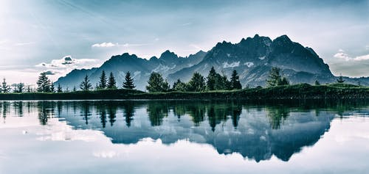

Slide 2
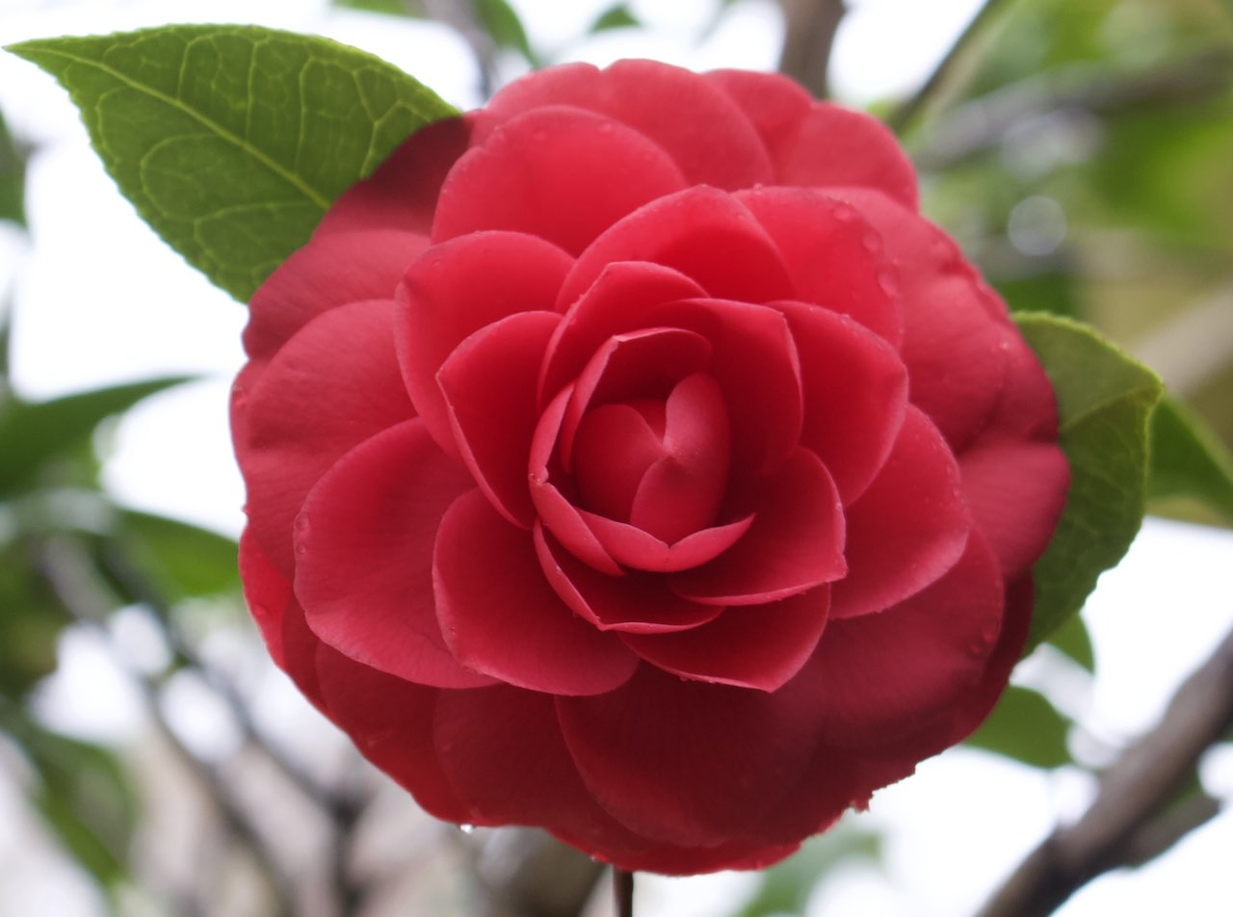
Welcome

Slide 3
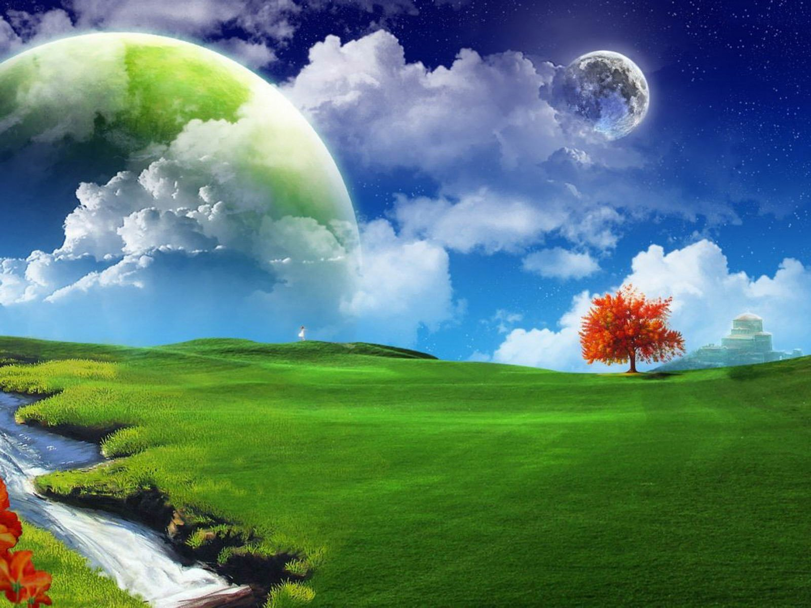
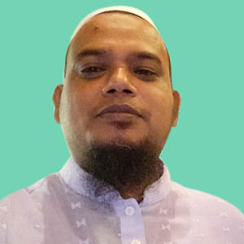
Teacher’s Introduction
Kamal Uddin, Assistant Teacher, Kuliarchar Bazar Model Govt. Primary School, Kuliarchar, Kishoregonj.

Slide 4
Introduction of the lesson
Subject: English
Class : 4
Unit : 14
Lesson : 1-2

Slide 5
Learning outcomes:
Students will be able to
Listening :
1.1.1 recognize sound differences in the context of the words.
1.2.1 recognize which syllable in a word is stressed.
1.3.1 recognize which words in a sentence are stressed.
Speaking :
1..1.1 repeat after the teacher and says words, phrases and sentences with proper sounds, stress and
intonation.
5.1.1 tell the time (hours only and mention a.m / p.m)
Reading :
1.4.1 read words, phrases and sentences in the text.
1.5.1 read words, phrases and sentences in the text with proper
pronunciation, stress and intonation.
3.2.1 read the clock(hour only) and mention a.m/p.m
Writing :
7.2.1 write time (hours only) and mention a.m/p.m

Slide 6
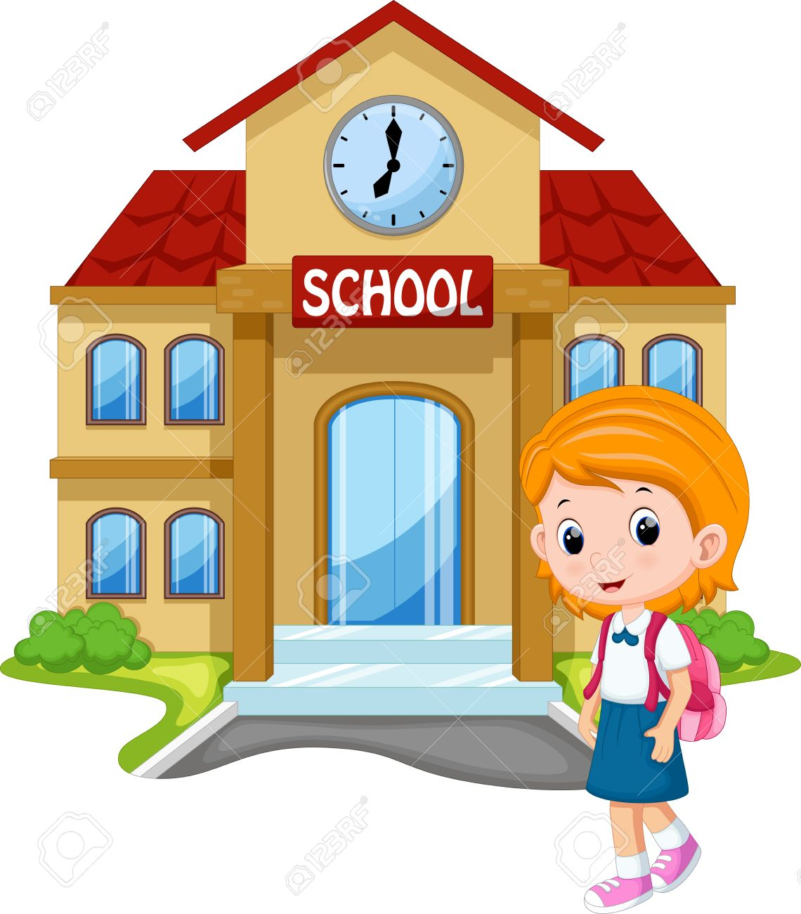
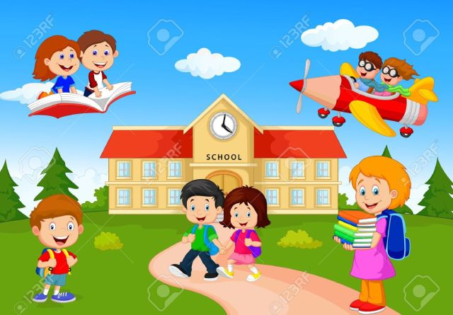
Look At the pictures and think about the pictures.

Slide 7
Today our lesson is
“ Mita’s day”

Slide 8
First I read the lesson. Follow me and next share with me
Mita is in class 4. She gets up at six o’clock . She washes her face. She has breakfast at seven o’clock . Then she brushes her teeth . She goes to school at nine o’clock. She walks to her school . She visites her grand mother at three o’clock . Then, Mita returns home at five o’clock.

Slide 9
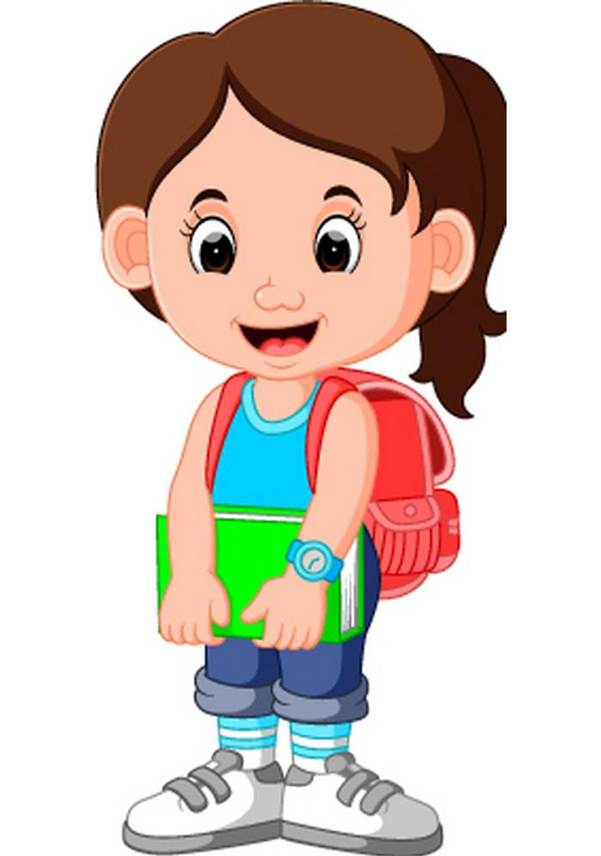
Mita is in class four.

Slide 10
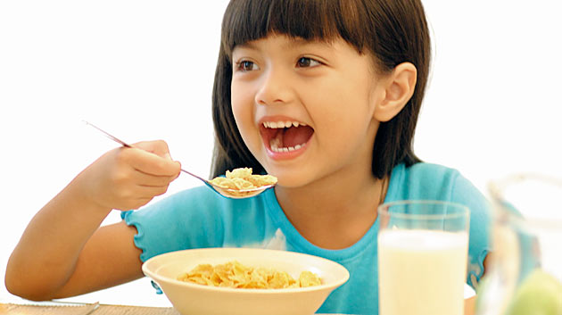
She has breakfast at seven o’clock

Slide 11
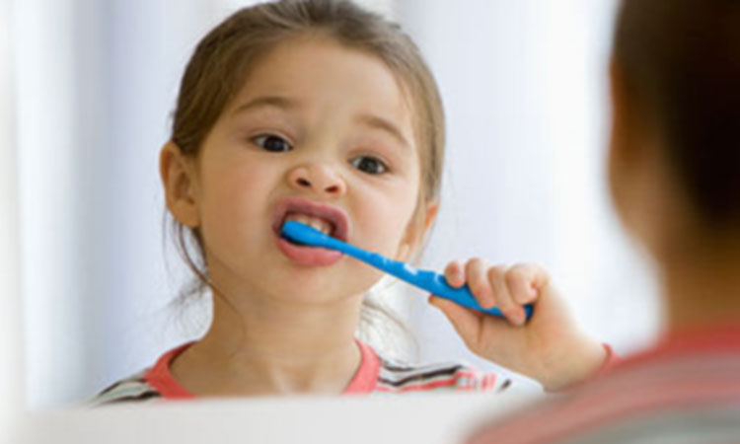
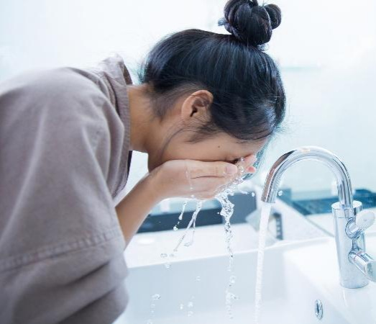
She brushes her teeth and wash face.

Slide 12
She goes to school at nine o’clock

Slide 13
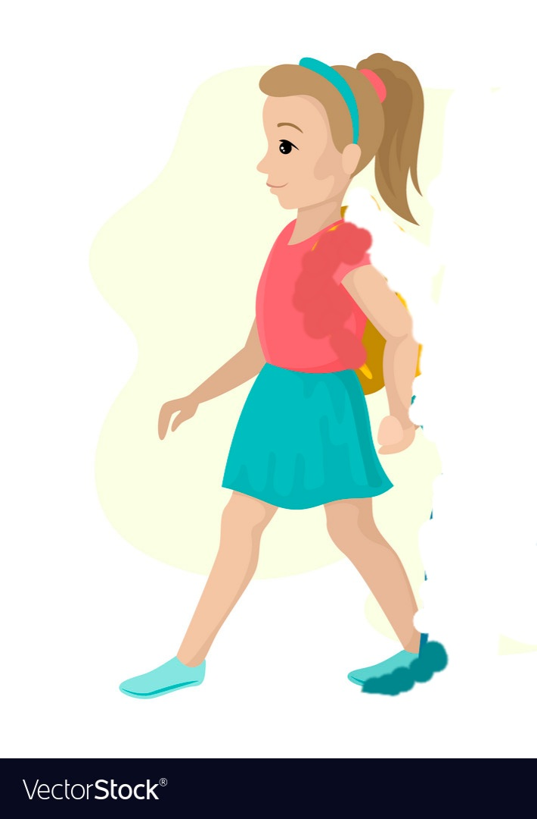
After school she visits to grandfather.

Slide 14
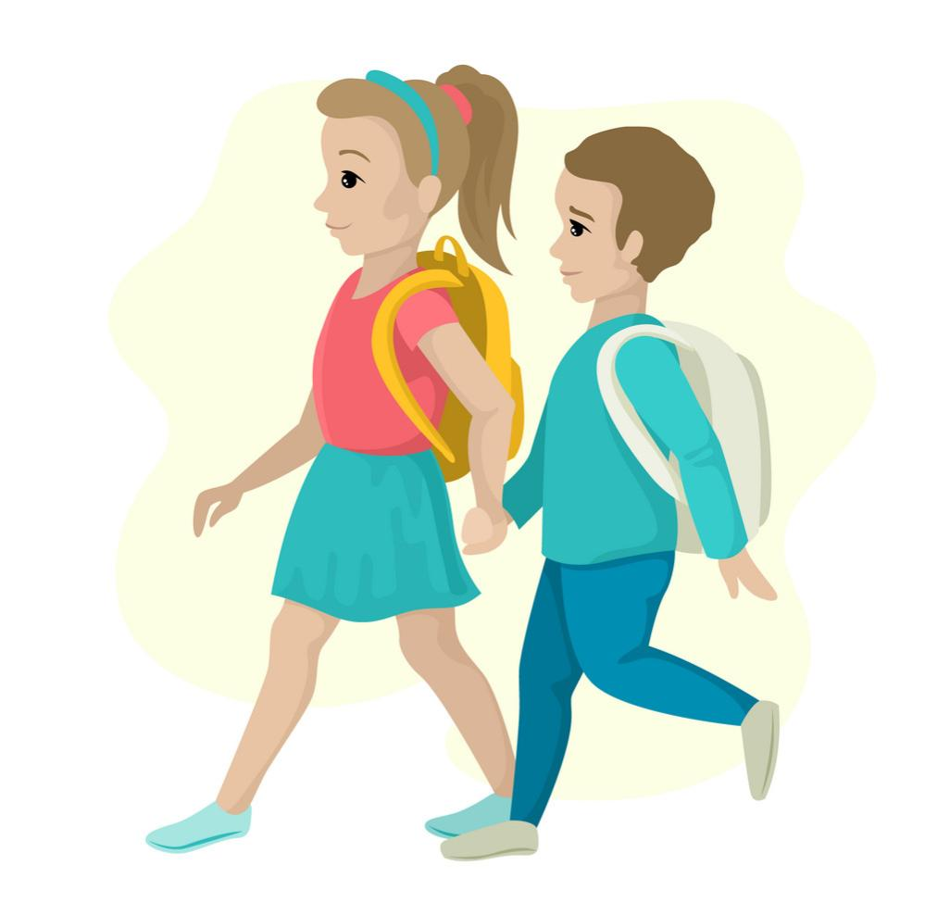
Mita return to home at five o’clock.

Slide 15
Walk
Face
Washes
Let’s play a game
Visit
Return
Grandmother
Breakfast

Slide 16
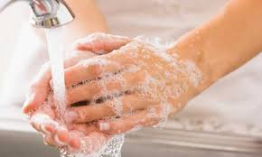
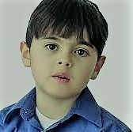
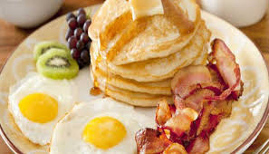
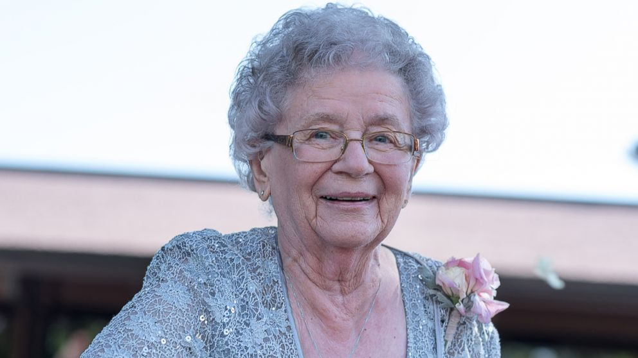
Word meaning
Washes
Clean something with water and soap
Face
mouth
Breakfast
Morning meal
Grandmother
Mother of father

Slide 17
Pair work
Complete the sentences with time in numbers. Use a.m or p.m.
Mita gets up at -----------.
She has breakfast at -------.
She goes to school at ------.
She visits her grandmother at -----.
She returns home at-------’

Slide 18
Group work: Answer the following question.
What time does Mita get up ?
When does she have breakfast ?
What time does she go to school ?
When does she return home ?
What time does she go to bed ?

Slide 19
Home work
Write 5 sentences about your daily routine.

Slide 20
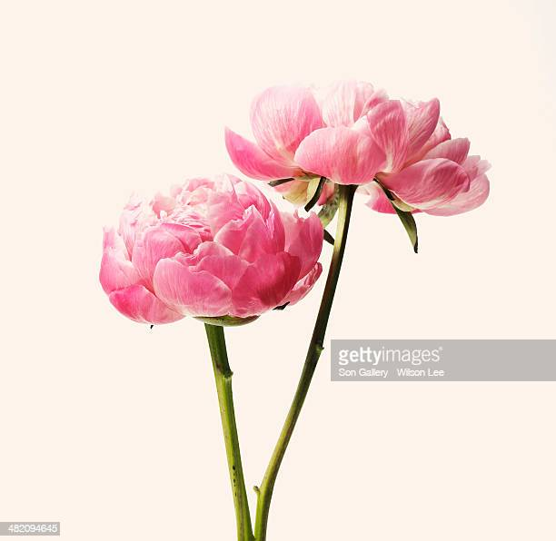
Bye Bye

