Slide 1
Good morning
ALL THE STUDENTS

Slide 2
IDENTITY
MD.Jahangir alam
Assistent Teacher
Vedvedi Govt.Primari School,
Rangamati, sadar.

Slide 3
LESSON IDENTITY
Class:1
Subject: English
Lesson : 1-3
Unit : 15 ( 1,2,3,4,5,6 numbers)
Time : 35 mn

Slide 4
Learning outcomes: Students will be able to:-
2.1.1 recognize and read cordinal numbers up to 6.

Slide 5
Warm up

Slide 6
Think back lesson
Let’s coutn
1
2
3

Slide 7
What is this?
Banana
How many banana?
4
4 Bananas

Slide 8
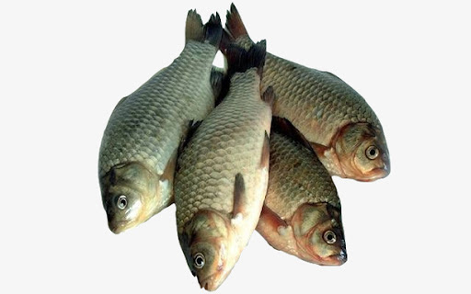
What is this?
Fish
How many Fish?
4
4 Fishs

Slide 9
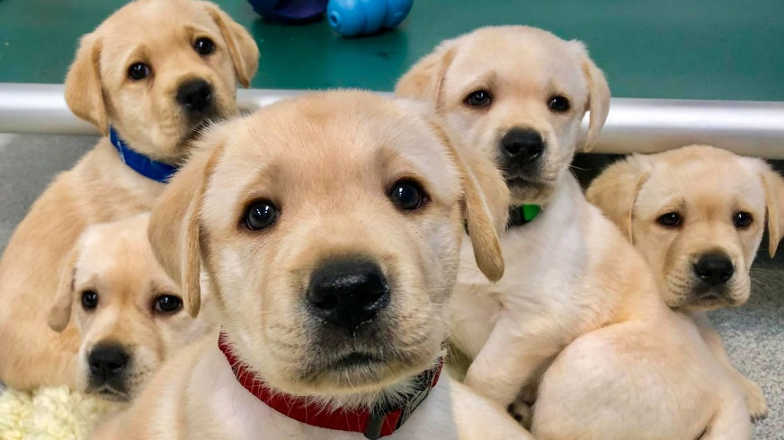
What is this?
Dog
How many Dog?
5 Dogs
5

Slide 10
What is this?
How many Apple?
Apple
5
5 Apples

Slide 11
What is this?
How many Car?
Car
6 Cars
6

Slide 12
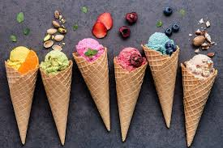
What is this?
Ice Cream
How many Ice Cream?
6
6 Ice Creams

Slide 13
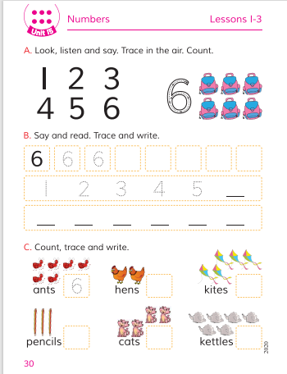
Open your Book at page-30.

Slide 14
Open your Book at page-30.

Slide 15
Lets coutn
4
5
6

Slide 16
Match the number with the pictures
6
4
5

Slide 17
Say and read. Trace and write.
4
5
6

Slide 18
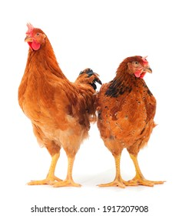
Count trace and write.
2
5
3
1
6
4

Slide 19
Thanks
All
the
students

