Slide 1
Welcom
Burischar Ziaul Ulum Kamil Madrasah Hathazari, Chattagram
Online Class
Introduce Mohammad Tofazzal Hossan Senior Assitant Teacher

Slide 2
Class: Dakhil Nine
Subject: English for today
Unit: Six
Lesson: 03

Slide 3
Learning outcomes
Students came to different parts of the world
They can know the nature and climates
They can to know the history of differnt lands
They able to read and understand the text

Slide 4
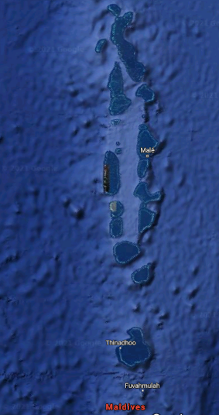
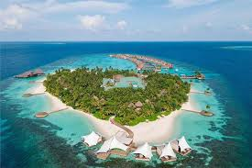
A Island of Maldives
Maldives

Slide 5
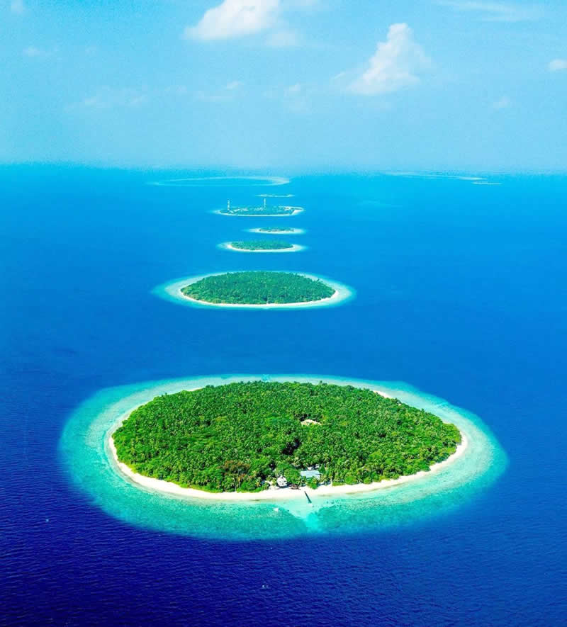
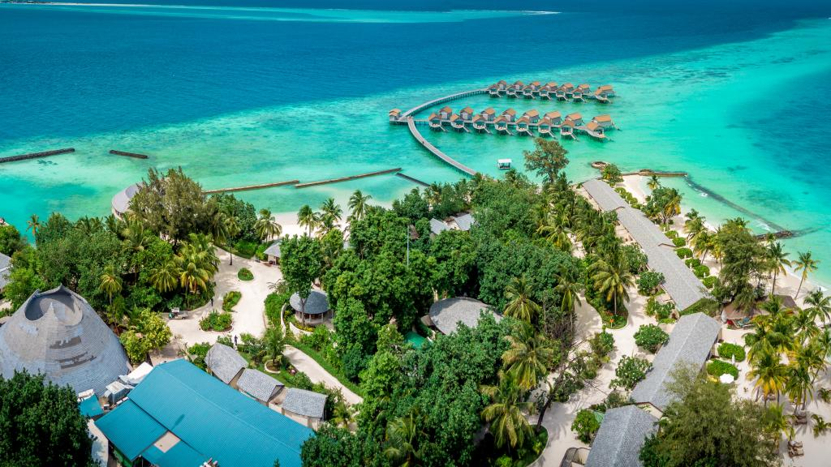

Slide 6
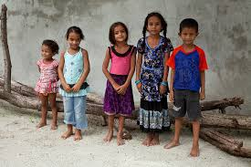
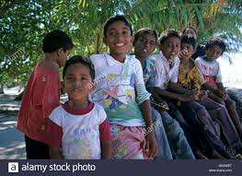
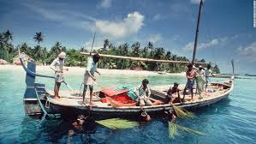
Children of Maldives
Fisihing Boat

Slide 7
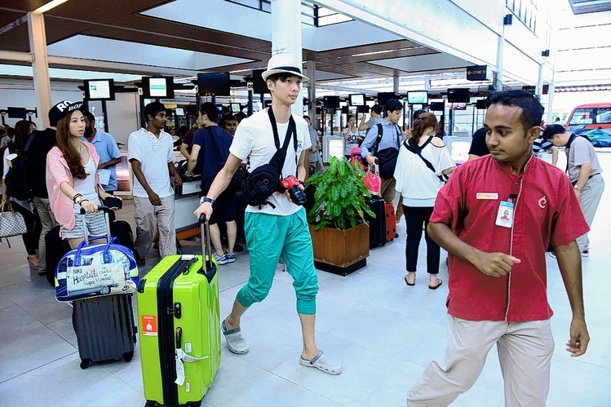
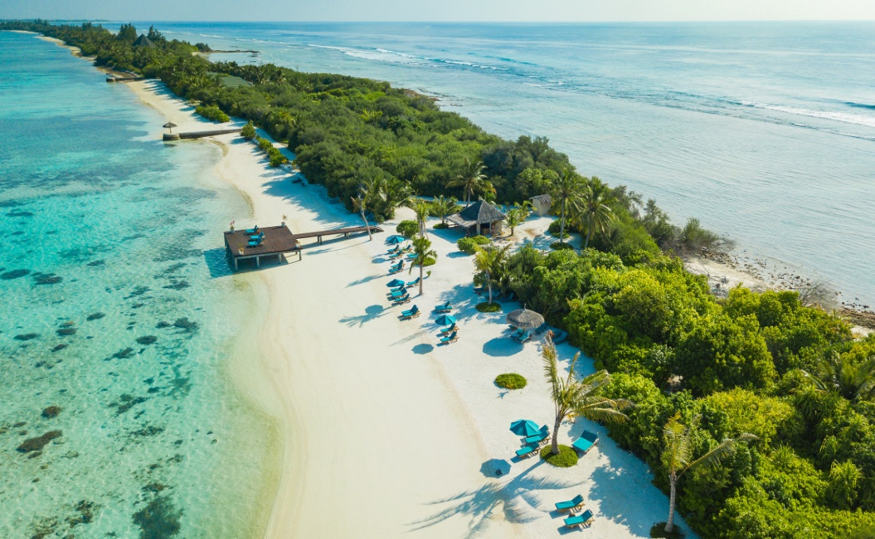
Tourists

Slide 8
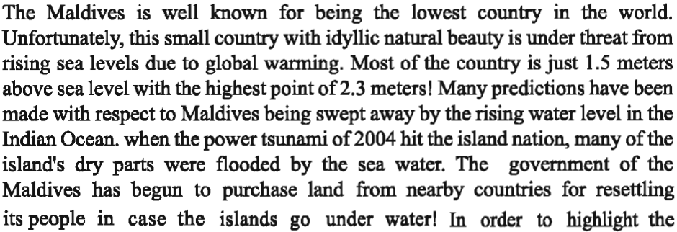
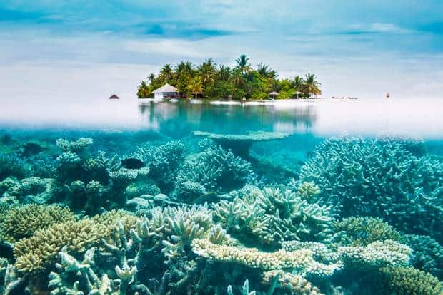
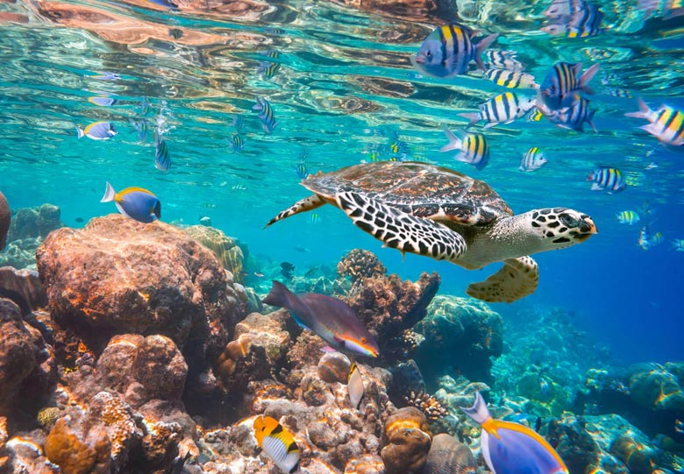
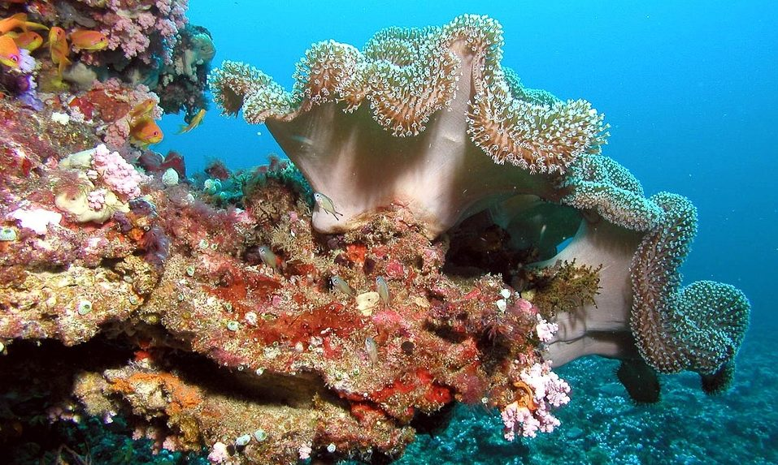
Beauty of Nature

Slide 9
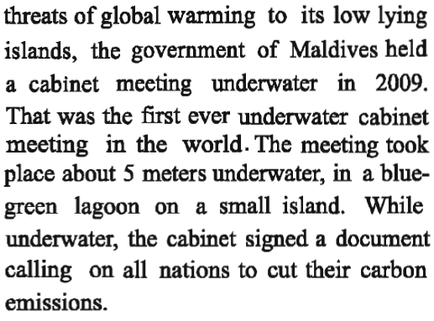
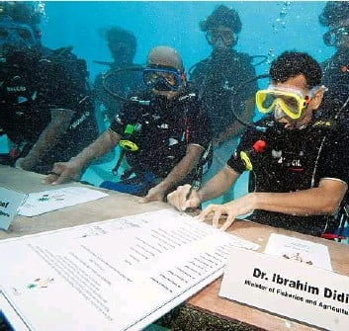
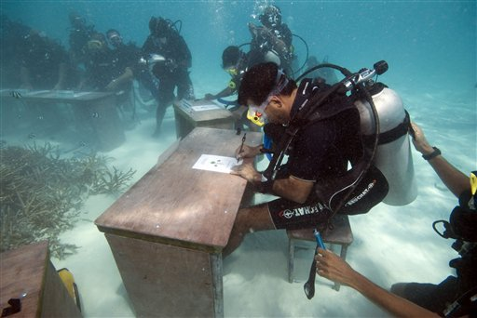
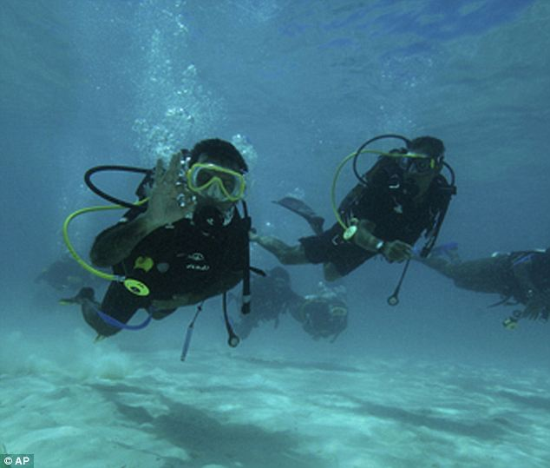
Cabinet Meeting Under water

Slide 10
Word Meaning
Republic – প্রজাতন্ত্র
democracy
Cluster-গুচ্ছবদ্ধ হওয়া
Bunch, group, bundle
Convert –পরিবর্তন করা
proselytize
Travel-ভ্রমণ করা
Visit, tour , journey
Conquer–জয় করা
win
Independent–স্বাধীন
Free,
Colony-উপনিবেশ
subjugation
Operate-পরিচালনা করা
Manage, conduct
Abolish-বিলুপ্ত বা রহিত করা
Annual, cancel, reject

Slide 11
Word Meaning
Pleasant –সুখকর, মনোহর
Idyllic, ageeable
Relaxation–আয়েশ, আরাম
Enjoyment, refreshment
Unfortunately –দুর্ভাগ্যক্রমে
Unluckily
Pridiction-ভবিষ্যদ্বাণী
Prophecy
Shrink – সংকুচিত করা
Contract
Purchase–ক্রয় করা
Buy
Threat-হুমকি
Warning
Document –দলিল বা প্রমাণ পত্র
Record

Slide 12
1.What do you know about Maldives?
Questons and Answers
Ans: Maldives is a small. It is a group of Island.
2. How many Island in Maldives?
Ans: There are 1199 Islands in Maldives.
3. From When the people live in Maldives?
Ans. About 3000 years ago the people started living in Maldives.

Slide 13
Questons and Answers
4. What is cabinet meeting of Maldives?
Ans: In 2009 The government of Maldives held a meeting under water. It is called cabinet metting
5. When the people of Sri Lanka started living in Maldives?
Ans: They started living in these islands in the fourth and fifth centuries BC.

Slide 14
Fill In the blanks
coral
historian
became
country
different
Maldives is a Small ------- consist with many islands. It is the smallest country in Asia. Most of the island has -------- reefs. About three thousand years ago the people started living in these islands. The people come from -------- lands. A famous ------ Ibn Batuta came in the country in 1344. In 16th century, the portuguese conquered the Maldives and ruled it for 15 years. In 1965 the country ------ independent from Britain.

Slide 15
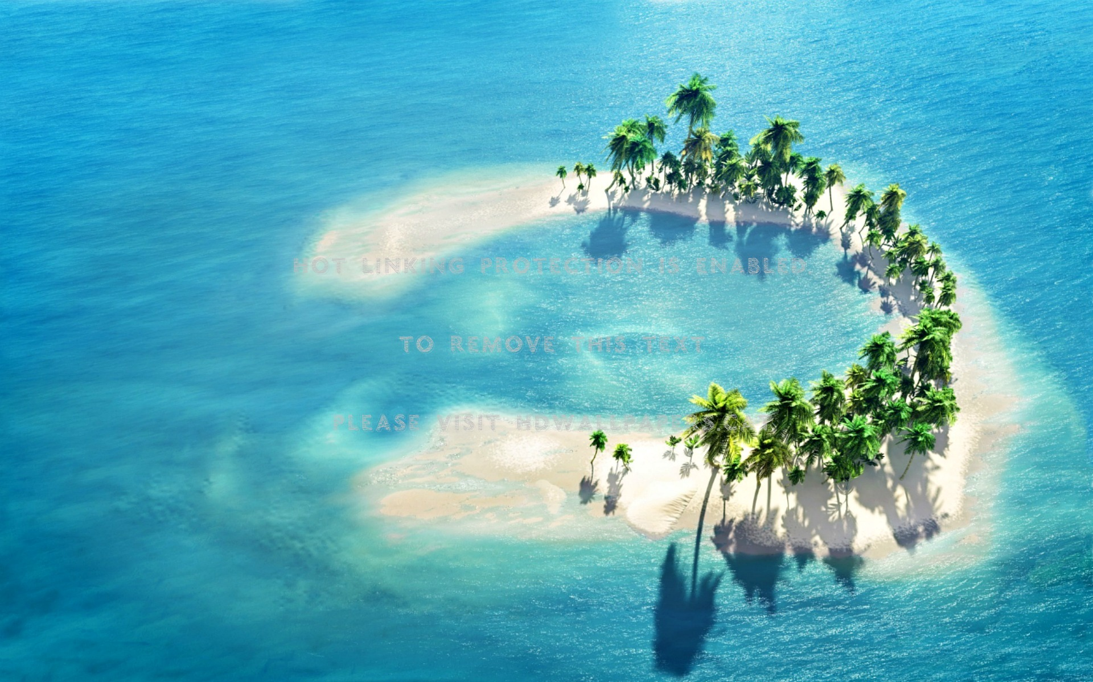
Team work
Write a paragraph about Maldives in 10 sentences.

Slide 16
Thank You All

