Slide 1
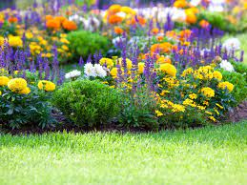
Welcome to my class

Slide 2
Lesson Contacts:
Class: Two
Subject: English For Today
Unit: 17
Colours
Lesson: 1-3
Page: 34
Teachers identity.
Md Abdullah Al Ahad Reza
Assistant Teacher
Ramchandrapurhat Govt. Pri. School
Chapai Nawabganj sadar
Chapai Nawabganj.

Slide 3
Learning Outcomes:
Students will be able to……
Listening:
3.1.2 Understand simple questions and statements about familiar objects.
4.1.1 Enjoy the rhythm and music of simple rhythm.
Speaking:
1.1.2 Say simple words and phrases with proper sound and stress.
4.1. Repeat rhymes after the teacher.
4.1.2 Recite rhymes independently.
Reading:
1.4.1 Reads words and phrases with the help of visual clues and simple sentences.

Slide 4
How are you students?
OK. Now we see a picture.

Slide 5
Now we read the rhyme again.
Rainbow, rainbow,
I see you!
Red and orange,
Yellow, green and blue,
Indigo and violet, too !

Slide 6
Our today’s lesson is COLOURS
What colour is this?
Red
What colour is this?
green
What colour is this?
orange
What colour is this?
Yellow
What colour is this?
What colour is this?
What colour is this?
Blue
Indigo
violet

Slide 7
Look at the picture.
How many colours are there in a rainbow?

Slide 8
How many colours are there in a rainbow?

Slide 9
There are 7 colours in a rainbow.
Red
Yellow
orange
violet
Blue
Indigo
green

Slide 10
Group work
Every 7 students make a group.
Anyone say red. Next student say orange. Say the other colours like that in chain.

Slide 11
Open your textbook page at 34 and see the activity B.
Say the colours name each other.

Slide 12
Evaluates
Colour the wings according to colours name.

Slide 13
Match the name with there colours.
Evaluates
Yellow
Indigo
green
violet
orange
Blue
Red

Slide 14
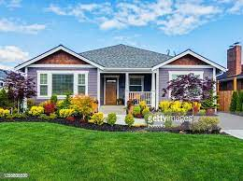
Home work
Draw and colour a rainbow at home.

