Slide 1
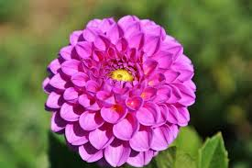
Good morning
Welcome to my English for today class

Slide 2
IDENTITY
Mazada akther
Lecture in English
Barabor Alim Madrasha
Phone:01798003534
mazadakter3@gmail.com
class:xi

Slide 3
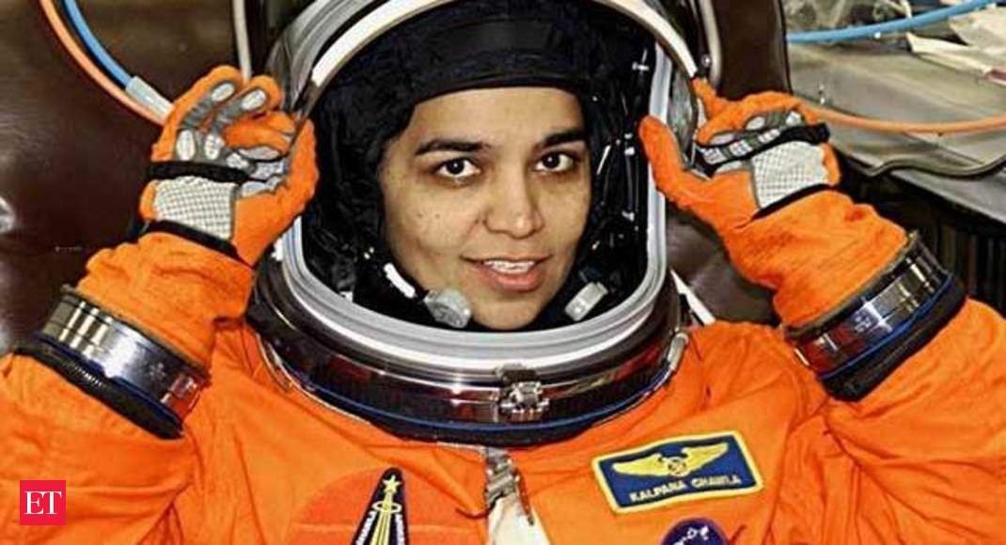
Look at the picture and guess who she is.
She is no other than Kolpona Chawla.

Slide 4
Our today’s topic
Unit: One (People or institutions making history)
Lesson: three (Kalpana Chawla)
Class: Eleven

Slide 5
Learning outcome
After the lesson the students will be able to-
→ say the meaning of some new words.
→ say about the life story of Kalpana Chawla .
→ tell something about the NASA

Slide 6
Choose the correct answers
i .---- crew lost their lives in the challenger disaster
a) five b) seven c) nine d) eleven Ans.
In the year of ----- Chawla got U.S. citizenship.
a. 1991 b. 1993 c. 1995 d. 1997 Ans.
Chawla belonged to NASA as an astronaut in -----
a. 1982 b. 1984 c. 1986 d. 1988 Ans.
iv. ‘the challenger disaster 1986’ refers to
a. The space shuttle challenger crash occurred in 1986
b. the challenger was recovered in 1986
c. the challenger returned to the earth in 1986
d. the challenger moved to the space in 1986 Ans.
v. The statement “You are just your intelligence” means---- .
a. intelligence helps one to do everything strategically
b. intelligence is valueless
c. physical strength is more important than intelligence
d. physical strength is more useful Ans.

Slide 7
Pair work
a) Who was Kalpana Chawla ?
b) Describe her educational life in short?
c) What is meant by astronaut?
d) When did Chawla start her career as a NASA astronaut?
e) What inspiration do you get from Chawla’s life?

Slide 8
Thanks

