Slide 1
Good Morning

Slide 2
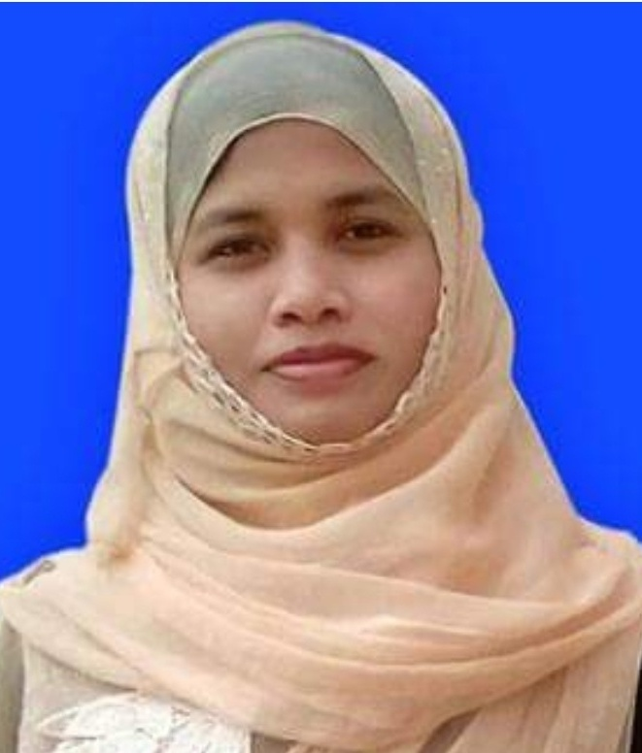
Teachers Introduction
Kuhinur Jannat
Assistant Teacher
Fakirakata Govt. Primary School

Slide 3
Lesson Introduction
English For Today
Class – Five
Unit – 3
Lesson – (3-4)
Actvity – D & E
Title – Saikat’s Family

Slide 4
Learning Outcomes
At the end of the lesson, Students will be able to-
Listening :
1.4.1 recognize and use intonation patterns for Yes/No and Wh questions.
Speaking :
1.1.1 say words, phrases and sentences with proper sounds and stress.
1.1.2 say sentences with proper intonation.
3.1.1 ask and answer Wh questions.
6.1.2 say what others are doing.
Reading :
1.5.1 read words, phrases and sentences in the test with proper pronunciation, stress and intonation.
1.6.1 recognize and read statements, commands, greetings, questions and answers.
5.1.1 read silently with understanding paragraph.
5.1.4 read silently with understanding personal letters and other test materials.

Slide 5
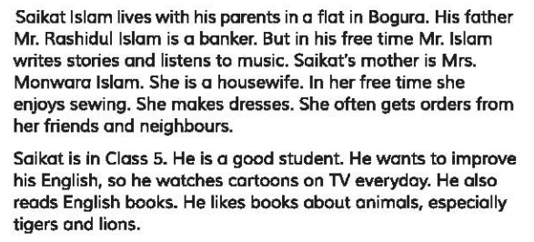
Students silent reading

Slide 6
Answer the questions:
What does Saikat do in his free time?
What do his father do in his free time?
What do his mother do in his free time?

Slide 7
Teachers loud reading
Name | 6 p.m. | 8 p.m. | 9 p.m. | 10 p.m. | 11 p.m.
Saikat | Study | Watch TV | Eat dinner | Help mum | Go to bed
Father | Cook | Sew | Eat dinner | Wash dishes | Watch TV
Mother | Read | Watch TV | Eat dinner | Help his wife | Write
Read this table silently

Slide 8
Answer the questions:
Whom the first row in the table is about?
(Saikat)
Third rows activities are related with whom?
(Saikat’s mother)
Second rows activities are related with whom?
(Saikat’s father)

Slide 9
Summary of Table
Generally from 6 p.m. to 11 p.m. Saikat studies, watches TV, eats dinner, helps mum in cleaning and finally goes to bed.

Slide 10
Pair Work
What does Saikat do at 6 o’clock?
He studies.
Who sew at 8 o’clock?
Saikat’s mother.
When does Saikat’s father read?
At 6 o’clock.

Slide 11
Assessment
What does Saikat do at 10 o’clock?
( He helps his mother)
Who cook dinner at 6 o’clock?
( Saikat’s mother)
When does Saikat’s father write?
( At 11 o’clock)
When do they eat dinner togather?
( At 9 o’clock)

Slide 12
What have you learnt from this lesson?
We’ve learnt about Saikat’s and his parents evening activities.

