Slide 2
Identity
Sabina Yeasmin
Lecturer in English
Baridhara Nazmul Ulum Alim Madrasah
Badda, Dhaka

Slide 3
Class : Alim /HSC
Subject : English 1st Paper

Slide 4
Let’s enjoy the video
Fetching...
https://www.youtube.com/watch?v=ZsQfqlkayJ4

Slide 5
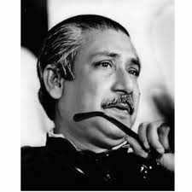
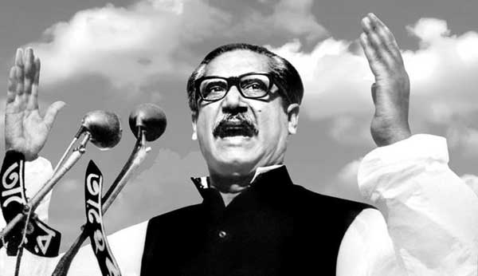
Let’s watch some images attentively

Slide 6
Can you guess what’s the today’s topic by watching the video & these images?
Part-3
Exactly today’s topic is-
Unit:1, Lesson: 1
The Unforgettable History

Slide 7
Learning outcome
At the end of the lesson, students will be able to-
Increase vocabulary
1
2
Achieve the reading skill.
Answer the questions easily.
3
Fill in the blanks without clues spontaneously.
4

Slide 8
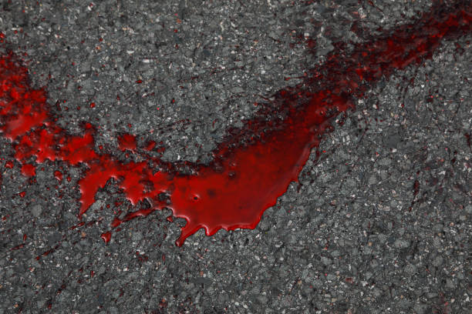
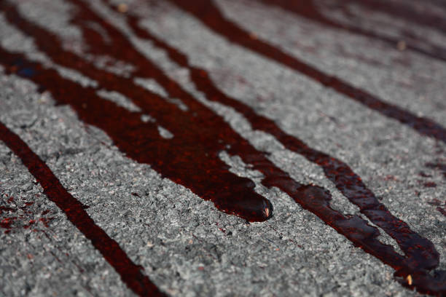
spilled
Vocabulary
Mean: A quantity of liquid that has spilled
Syn: Dropped, shed, exuded
Ex: The Bengali people spilled their blood in 1971.

Slide 9
wading
Vocabulary
Mean: walk through blood or another liquid substance
Syn: walking, wandering,
Ex: Mujibur Rahman won’t join the conference wading over the blood of his people.

Slide 10
investigate
Vocabulary
Mean: carry out a systematic inqury to examine the facts.
Syn: inquire, search
Ex: Mujibur Rahman said to Mr. Yahya, “You have to investigate about the murder of my people.

Slide 11
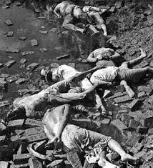
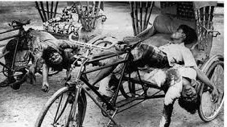
sacrifice
Vocabulary
Mean: an act of slaughtering person.
Syn: forsake, butcher
Ex: The Bengali people had to sacrifice their lives in 1971.

Slide 12
starve
Vocabulary
Mean: Suffer severely or die from hunger
Syn: fast, famish
Ant: Be full, feed
Ex: The Bengali people starved a lots in 1971.

Slide 13
confront
Vocabulary
Mean: Meet face to face with hostile intent.
Syn: Tackle, envisage
Ant: avoid, abstain
Ex: The Bengali people confronted the Pakistani Army.

Slide 14
Now read the text.
My brothers,
The Assembly has been called in to session on the 25th of March. But the blood spilled on our streets has not yet dried.

Slide 15
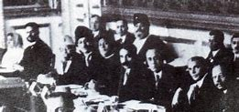
About the 10th of this month, I have told them Mujibur Rahman won’t join the Round Table Conference because that would mean wading over the blood that has been shed. Although you have called the Assembly into session.
Round table

Slide 16
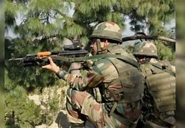
You will have to listen to my demands first. You will have to withdraw Martial Law. You will have to return all army personnel to their barracks. You will have to investigate the way our people have been murdered. And you will have to transfer power to the representatives of the people.
Army
murdered

Slide 17
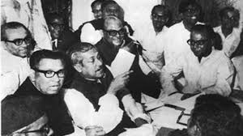
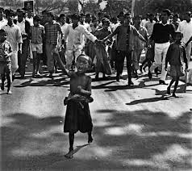
It is only then that I will decide whether we will take our seats in the Assembly or not. I don’t want the Prime Minister’s office. We want the people of this country to have their rights.
Assembly
Rights

Slide 18
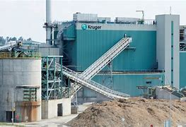
I want to state clearly from this day Bangladesh’s courts, magistracies, government offices and educational institution will be shut down indefinitely. So that the poor don’t have to suffer,
Mujib
Shut down

Slide 19
so that my people don’t have to go through hardships, all other things will be exempted from the general strike from tomorrow. Rickshaws, horse carriages, trains and launches will be allowed to move.
Mujib

Slide 20
Only the Secretariat, the Supreme Court, the High Court, judges’ Court and semi-government organizations such as WAPDA will not be allowed to work. On the 28th employees will go and collect their salaries.
Supreme Court
salary

Slide 21
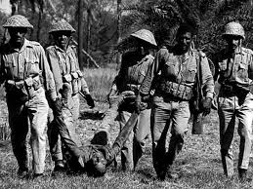
If their salaries are not paid, if another bullet is fired, if my people are shot dead again, I request all of you: convert every house into fort; confront the enemy with whatever you have.
Shot dead
Fort

Slide 22
And even at the risk of your life, and even if I am not around to direct you, shut down all shops and make sure that traffic on all roads and ports are brought to a standstill. If need be, we will starve to death, but we will go down striving for our rights.
Mujib
standstill

Slide 23
To those in the armed forces I have this to say: you are my brothers: stay in your barracks and no one will bother you. But don’t try again to aim your bullets at our chests.
barrack
Army

Slide 24
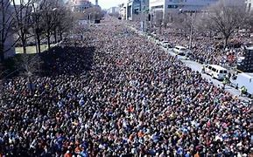
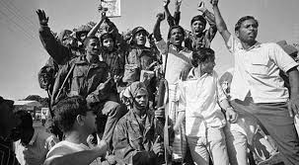
You can’t suppress seventy million people forever. Since we have learned to sacrifice ourselves no one can suppress us anymore.
procession
unity

Slide 25
Individual work
Fill in the blanks
been prorogued
After the Assembly’s session had (a)
the Bengalis protested. Bangabandhu told his countrymen (b) observe the strike (c) . People of east Bengal responded to (d) . A firm determination came from their side to (e) out his order. Then Sheikh Mujib had a (f) with Mr. Yahya Khan in which he requested Yahya Khan (g) observe the situation of East Bengal and her(h) with his own eyes. But the talk (i) no effect. Mr. Yahya Khan (j) the people of East Bengal.
peacefully
to
him
carry
talk
to
people
had
blamed

Slide 26
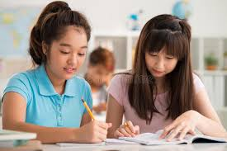
Pair work
Discuss about Bangabandhu’s Political life.

Slide 27
Choose the correct answer from the alternatives
Group work
1. What is the meaning of the word ‘starve to death’?
(a) die without food (b) die from over eating (c) death (d) demise
2. What does the word ‘exempted’ mean?
(a) enlisted (b) excluded (c) discharged (d) cleared
3.The word ‘Martial’ could be replaced by-
(a) civil (b) unsoldierly (c) lawfully (d) soldierly
√
√
√

Slide 28
Choose the correct answer from the alternatives
Group work
4. What was the effect of the alert Bangabandhu about courts, magistracies, government offices?
(a)They were shut down indefinitely (b) they were closed (c) They were burnt with fire
(d) They were damaged
5.The word ‘spilled’ refers to-
(a) shed (b) gained (c) acquired (d) demolished
√
√

Slide 29
Evaluation
Answer the questions
1.What were employees asked to do by Bangabandhu? Explain in brief.
2.When was the assembly called into session?
3.Why did bangabandhu disagree to join the Round Table Conference ?
4.Who imposed Martial Law and why?
5.What did Bangabandhu say to the armed forces and why?

Slide 30
Home work
Write a short paragraph on ‘Historical Speech of Sheikh Mujibur Rahman’.

Slide 31
Thank you so much
For watching

