Slide 1
Welcome to you all

Slide 2
Teacher’s Information
Md. Shamsul Alam
BA(Hons.)MA in English.
Assistant Teacher( English)
Nabodoy Girl’s High School
Shailkupa Jenaidah.
Phone:01917-452052,01722-922691
Email:shamsul101085@gmail.com

Slide 3
Introduction of lesson
Class- Nine & Ten
Subject –English 1st paper
Unit: 5 Lesson: 1
(The greed of the roaring river)

Slide 4
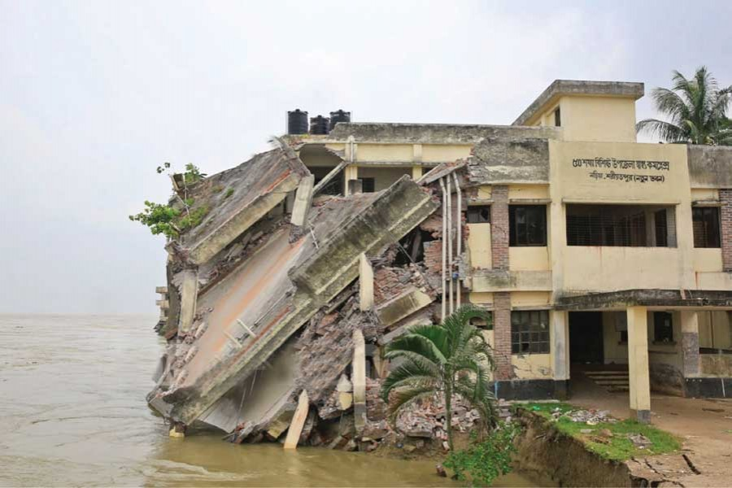
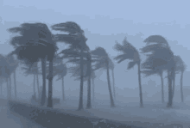
Look at the picture very carefully and guess what our today’s lesson is....
These pictures are about our “Nature and Environment”.

Slide 5
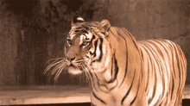
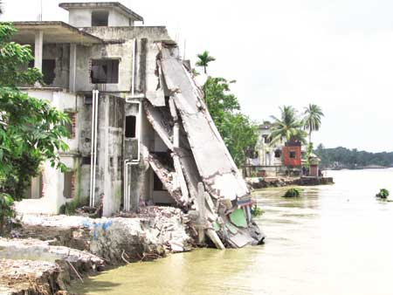
Today’s lesson……
Nature and environment (The greed of the roaring rivers)

Slide 6
Learning outcomes
After this lesson the students will be able to---
read and understand texts through silent reading.
fill in the gaps with right word from the box.
to say the meaning of key words and making sentences.
ask and answer questions .
Notes:
All the four skills will be focused in this lesson.

Slide 7
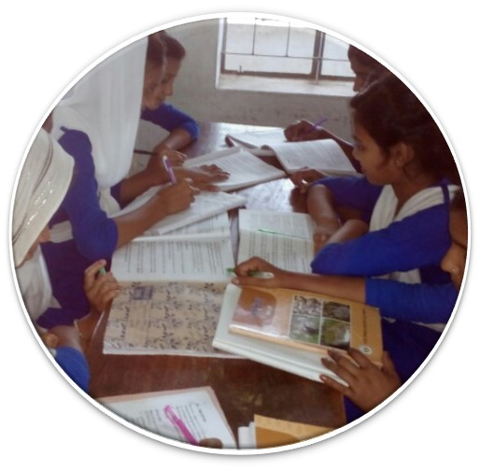
Read the text silently and carefully
Unit-Five
Lesson-1
Page-56

Slide 8
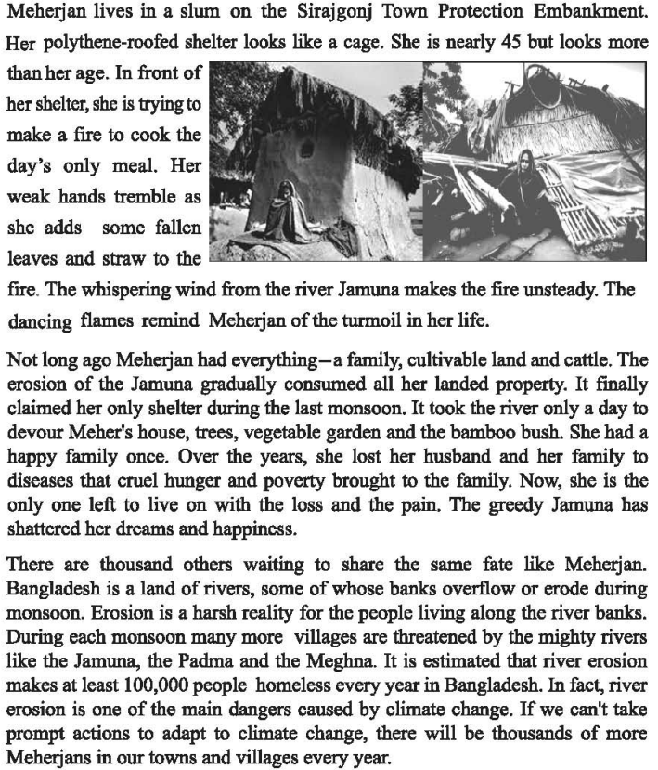

Slide 9
Individual works.
Meherjan is a typical (1)homeless woman who lives in a (1) slum . She lost her shelter and properties (2) due to the erosion of river Jamuna. She also lost her family. Her husband had died of disease caused by shortage of food and (3) slum dweller . Now, she is only a (4) poverty . Like Meherjan there are many people who have become the (5) victims of river erosion. River erosion is still possing (6) threats to the lives and properties of thousands of people. People living (7) close to Rivers are most likely victimes of river erosion. Each year about one lakh people become (8) homeless due to river erosion in Bangladesh. Meherjan’s life is just one (9) affects of how climate change (10) Story the lives of thousands of people.

Slide 10
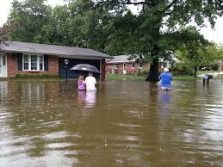
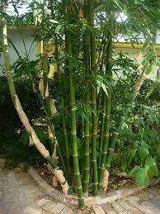
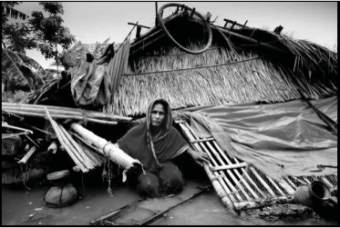
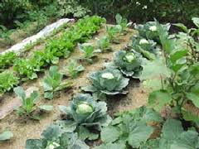
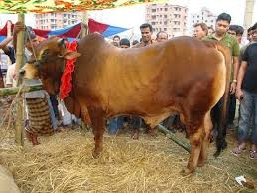
What do you see in the pictures ?
Look at the above pictures and discuss with your mates then write down about the “past life of Meherjan”.

Slide 11
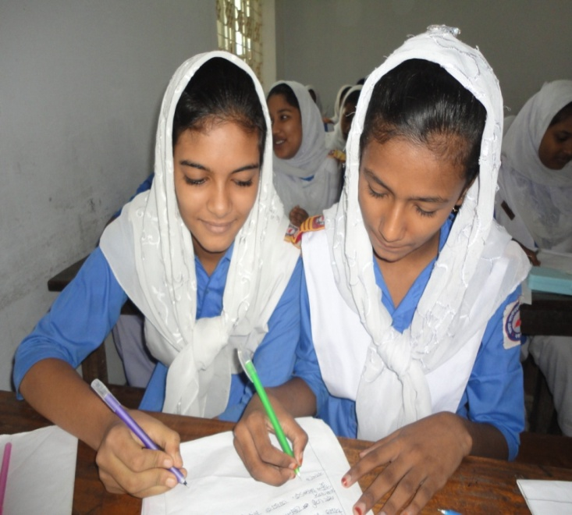
Pair Work
Discuss in pairs and write an answer the following questions:
a) What do you know about Meherjan`s family?
b) What is the name of three mighty river?

Slide 12
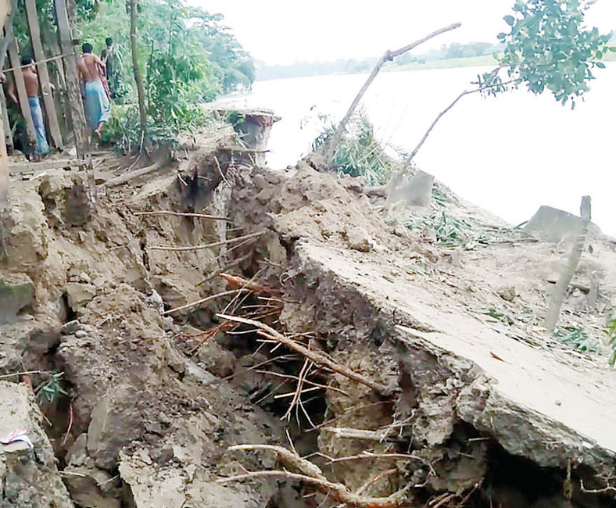
Key Word
The process of eroding or being eroded by wind, water, or other natural agents.
Erosion
Meherjan lost all her property due to river erosion.

Slide 13
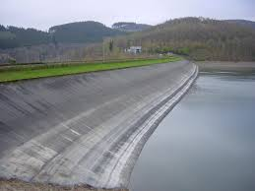
Key Word
A wall of stone or soil made to keep water back.
Embankment
Meherjan lives in a slum on the Sirajgong Town Protection Embankment.

Slide 14
Key Word
To speak very quietly to somebody so that other people cannot hear what one is saying.
Whisper
The Mother whispered to me never tell a lie.

Slide 15
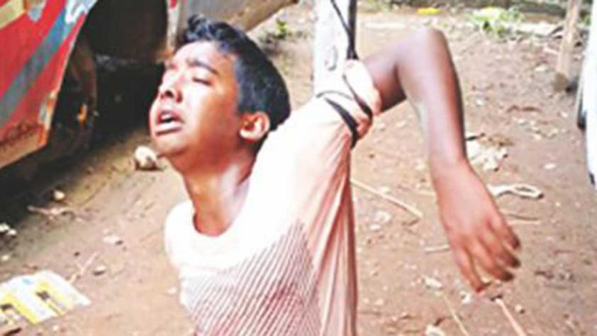
Key Word
Something Dangerous, Fearful.
Cruel
Meherjan lead her life in cruel proverty.

Slide 16
Key Word
To make a loud deep harsh sound of tiger, river or any animals etc.
Roar
The tiger is roaring for daily meals.

Slide 17
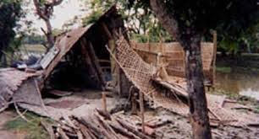
Key Word
A overcrowded urban area inhabited by very poor homeless people.
Slum
Meherjan lives in a slum on the Sirajgong Town Protection Embankment

Slide 18
Key Word
A libel to fall or shake or moving.
Unsteady
The flame of this candle is unsteady.

Slide 19
Group Work
Q 1. What is river erosion?
Q 2. How many people become homeless in every year?

Slide 20
Evaluation
Choose the best answer
1.What does adapt mean ? (i) adjust (ii) unchanged (iii) chaos (iv) dam 2. Embankment represents …………. . (i) dam (ii) river (iii) Erosion (iv) quiver 3. The river Jamuna has consumed (i) the cultivable land (ii) houses
(iii) bamboo bush of Meherjan (iv) all of the above
4. How many peoples become homeless by river erosion?
(i) 2,00,000 (ii) 3,00,000 (iii) 1,00,000 (iv) 4,00,000 .

Slide 21
Write a dialogue with your friend about climate change.
Home work

