Slide 2
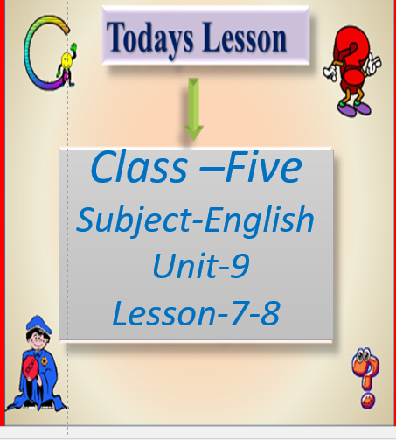

Slide 5
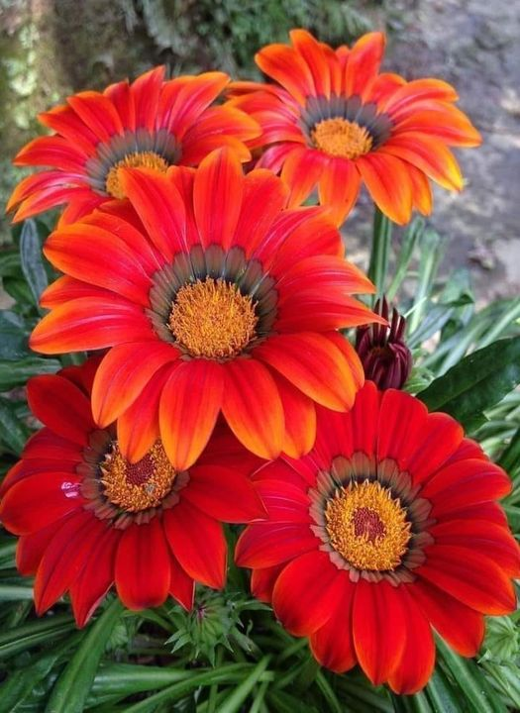
Let’s watch a video
https://youtu.be/LdCOswMeXFQ

Slide 8
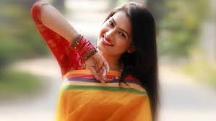
Use of Capital Letters
The name of a person begins with a capital letters
I am Bithi .
Bithi is a singer

Slide 12
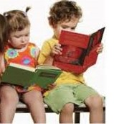
Pair work
Check for correct use of capital letters and full stops
a dressmaker makes dresses
she sells fruits
she writes stories or poems
he is a firefighter
he bakes bread

