Slide 1
GOOD MORNING

Slide 2
Teacher’s Identity
Md. Ariful Islam
Lecturer in English
Shayestaganj Model Kamil Madrasah
Shayestaganj, Sylhet.

Slide 3
Introduction of the lesson
Class: Eleven
Subject: English 1st Paper
Unit 4, Lesson 1
Time: 40 Minutes
Date: 19/11/2021

Slide 4
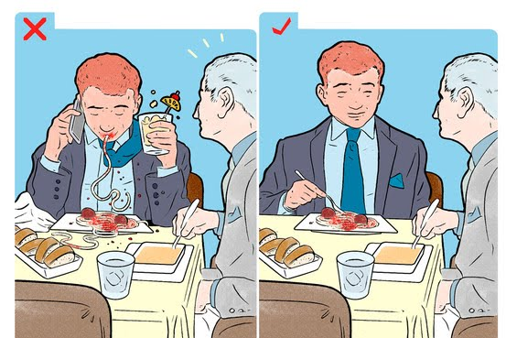
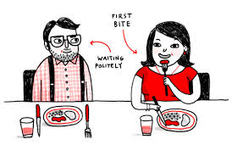
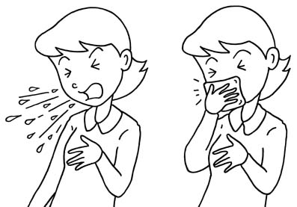
Look at the Pictures

Slide 5
Let’s enjoy the conversation
How are you?
Great, how is you parents?
Welcome
Good Morning, Santa
Good Morning, Teacher
They are also fine. Thank you
Fine, you?

Slide 6
Now dear students, in the conversation we have seen to use the words – good morning, how are you, thank you, welcome.
Why these words are used?
Expected answer will be: ways/style of speaking, behavior, manner, custom, good conduct etc.

Slide 7
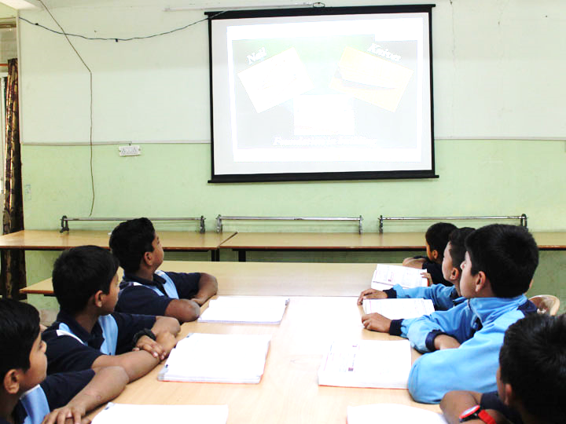
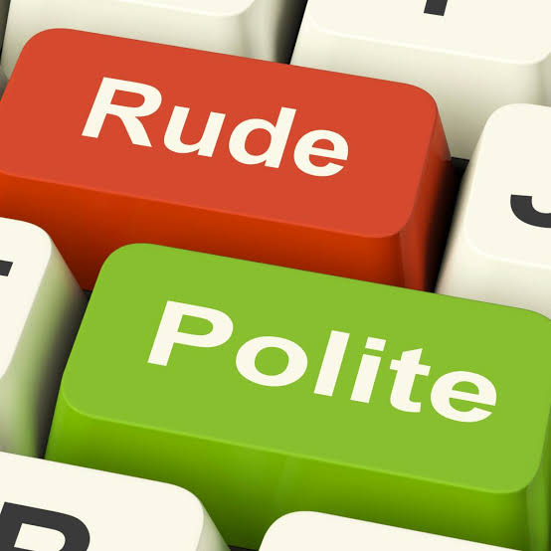
Announcement of the Lesson
Etiquette and Manners

Slide 9
Etiquette: ‘Etiquette’ is a French word and it means the rules of correct behavior in society. In a word, etiquette is the set of rules.
Manners: The word ‘manners’ means the behavior that is considered to be polite in a particular society or culture. Manners can be good or bad. In a word, manners are the action.

Slide 10
Read the following words/phrase and find out which one is Etiquette & which one is Manner
How one should talk, How one should eat, Respecting the elders, Not speaking in a rude manner, How one should address people of different stature, Respecting other people’s property, How one should walk
Pair Work

Slide 11
Individual Work
Silent Reading
Read the passage to answer the questions
“Etiquette and manners vary from culture to culture and society to society.” Do you agree or not? Explain your answer in two sentences.
How can one learn etiquette and manners?
Why should you need to be careful about etiquette and manners?

Slide 12
Some important words that are used in our everyday life.

Slide 13
Some basic rules of etiquette:
Respect others’ personal space.
Don’t interrupt when someone else is talking.
Be a helper.
Be on time
Don’t yell in public places.
Eat politely
Chew with your mouth closed
Stand in queue

Slide 14
Different situations call for different etiquette and manners. These are divided into three groups: family etiquette, social etiquette and professional etiquette.
Now write what are the family etiquette, social etiquette and professional etiquette.
Group Work
Match the answer

Slide 15
Family etiquette:
Respect each other’s belongings.
Do not shout at children.
Treat them kindly.
Listen to your parents.

Slide 16
Basic social etiquette:
Always be on time. Showing up late is rude and shows a lack of respect for other People’s time.
Never interrupt the other person while he/she is talking.
Give and receive compliments graciously.

Slide 17
Professional etiquette:
Dress properly.
Shake hands when appropriate.
Never take credit for other people’s work.
Use indoor voice while talking to people.

Slide 18
HOME WORK
Write a paragraph on “Etiquette and Manners”

Slide 19
Thanks a lot

