Slide 1
WELCOME

Slide 2
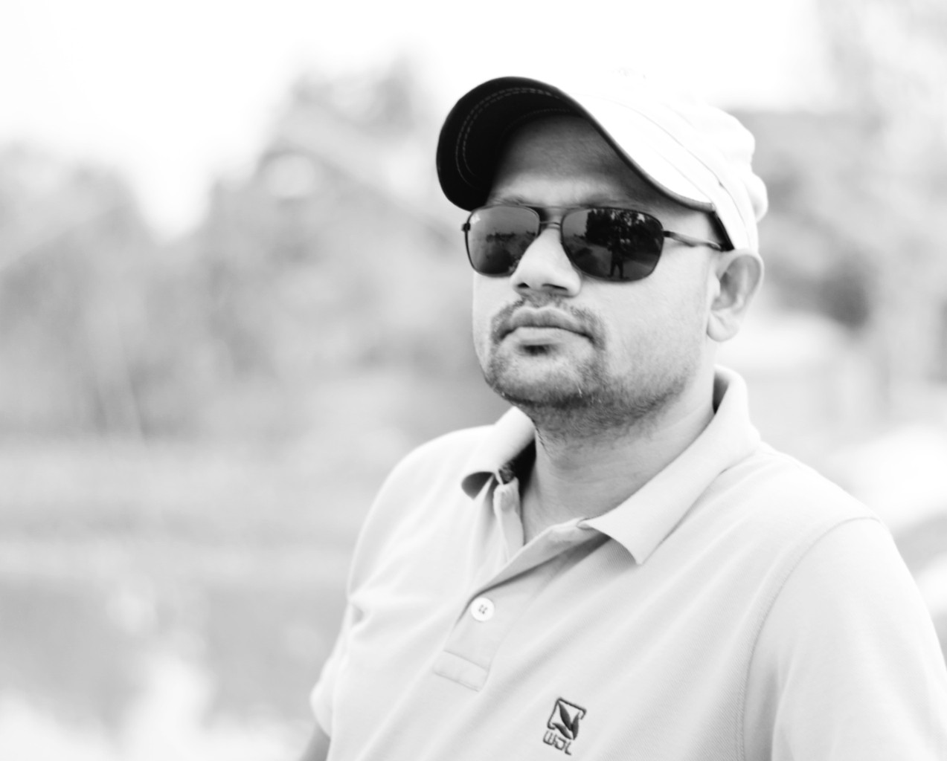
Introduction
Md. Rakibul Alam
Assistant Teacher
Dharmapur PN. Girls’ High School, Sundarganj. Gaibandha.
The Best Teacher-2016
( Gaibandha District)
Master Trainer- CA (English)
Founder, EEE Academy

Slide 3
Look at the following sentences and try to tell the name of parts of speech:
The boy catch fish regularly in the river.
They fish in the pond regularly.
So Today’s topic is the same word used as different parts of speech.
The underlined words are- 1. noun and 2. verb
Yes, You are right. Fish- the same word in both sentence but used as different parts of speech

Slide 4
English Grammar and Composition
Class- Nine to Ten
Topic: Same words used as different Parts of Speech
Time: 45 minutes

Slide 5
Lesson Outcome:
After finishing this lesson students can be able to ----
Describe the different kinds of parts of speech of same word.

Slide 6
Back-
He showed me his back.
The thief escaped by the back door.
Come back as soon as possible.
The driver backed the car into the garage.
1. Noun 2. adjective 3. adverb

Slide 7
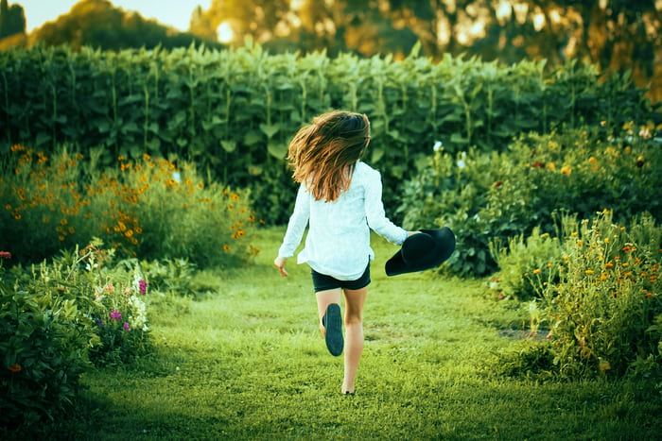
Before-
I have seen her before.
She stood before me.
She had gone away before I came.
Adverb
2.Preposition 3.Conjunction

Slide 8
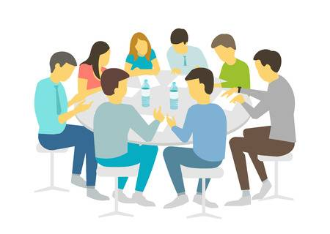
Better-
We should follow our betters.
I think yours is a better plan.
I must better my condition.
I know her better.
1. Noun 2. Adjective 3. Verb 4. Adverb
We should follow our betters.

Slide 9
Both-
Both of them were present.
There are trees on both sides of the road.
He is both active and brilliant.
Both Mim and Mantasa are brilliant.
1.Pronoun 2. Adjective 3. Adverb 4. Conjunction

Slide 10
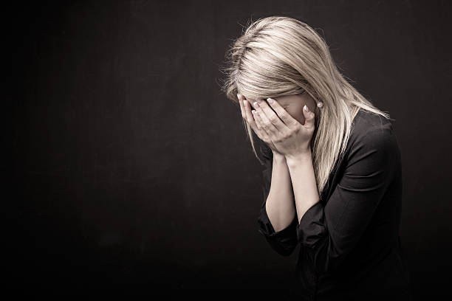
But-
But me no buts.
There is no body but wishes to be happy.
But me no buts.
None but the brave deserve the fair.
He tried hard but did not succeed.
She tried hard but failed.
Noun 2. Pronoun 3. verb
4. Preposition 5. Conjunction

Slide 11
By-
Her actions surprised by-standers.
Time goes by fast.
Come and sit by me.
1. Adjective 2. Adverb 3. Preposition

Slide 12
Break-
Let us have an hour’s break for lunch.
There is a break in the wall.
Who broke the window?
Did you enjoy the break dance?
Let us have a break.
Noun 2. Noun
3. verb 4. Adjective

Slide 13
Pair works: Name the parts of speech of the underlined words:
1. She looks for help from above.
2. I want to tell something about my childhood.
3. Never break the rules.
4. You can plant trees by the roadside.
5. I wanted to help her but she did not accept it.
6. Return the books as early as possible.
7. Any of the pens will do.
8. He is a better player than I.
9. They visited Dhaka long before.
10. Go back.

Slide 14
Solution:
1. Noun
2. Preposition
3. Verb
4. preposition
5. conjunction
6. adverb
7. pronoun
8. adjective
9. adverb
10. adverb

Slide 15
Thanks For Enjoying The Class.

