Slide 1
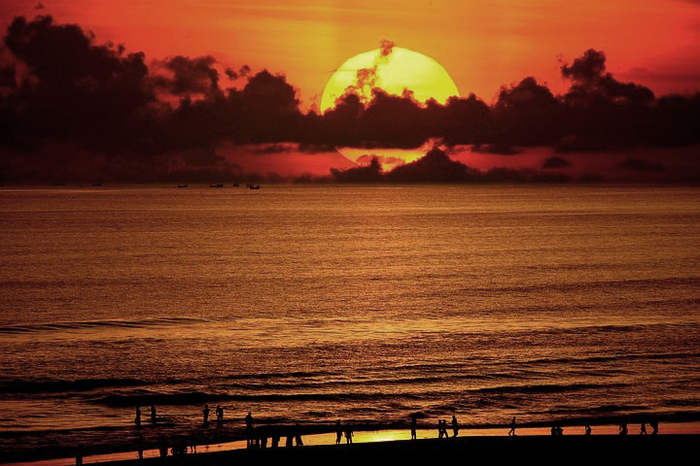
WELCOME

Slide 2
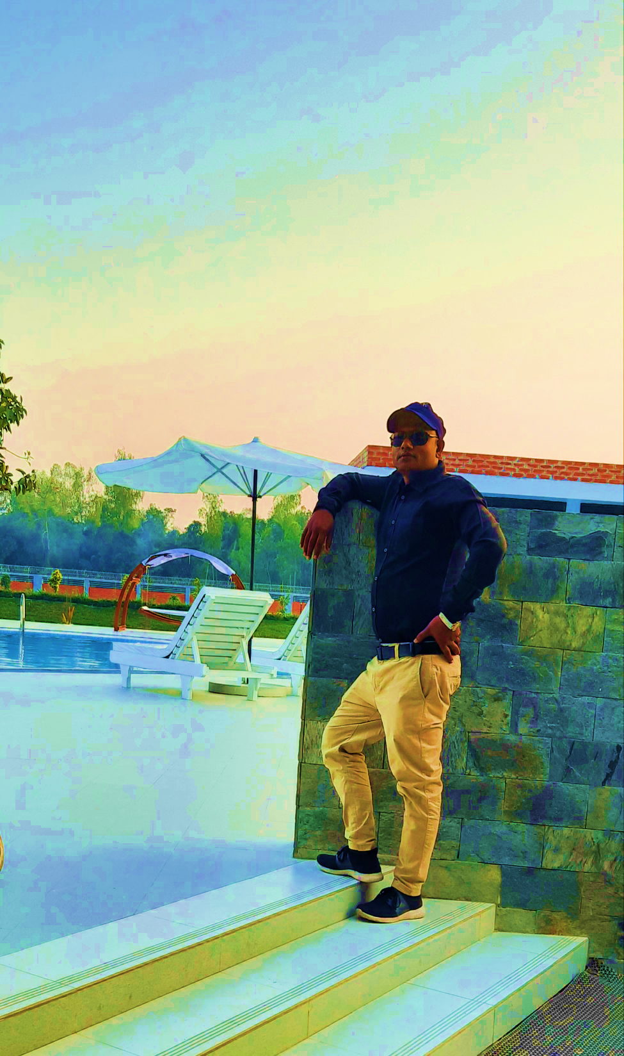
Introduction
Md. Rakibul Alam
Assistant Teacher
Dharmapur PN. Girls’ High School, Sundarganj. Gaibandha.
The Best Teacher-2016
( Gaibandha District)
Master Trainer- CA (English)
Founder, EEE Academy

Slide 3
Look at the following sentences and try to tell the name of parts of speech:
Please, water the plants regularly.
Please, give me a glass of water.
So Today’s topic is the same word used as different parts of speech.
The underlined words are- 1. verb and 2. noun
Yes, You are right. water- the same word in both sentence but used as different parts of speech

Slide 4
English Grammar and Composition
Class- Nine to Ten
Topic: Same words used as different Parts of Speech
Time: 45 minutes

Slide 5
Lesson Outcome:
After finishing this lesson students can be able to ----
Describe the different kinds of parts of speech of same word.

Slide 6
Up-
Every man has ups and downs in life.
The next up train will leave within one hour.
Climb up.
You should not climb up the hill.
(Here, 1= Noun, 2= Adjective, 3= Adverb, 4= Preposition)

Slide 7
Till-
She will stay here till tomorrow.
Don’t start the work till I give the order.
(Here, 1= Preposition, 2= Conjunction)
She will read till afternoon.

Slide 8
Then-
I shall be ready by then.
The then Government approved the bill.
We lived in Dhaka then.
(Here, 1= Noun, 2= Adjective, 3= Adverb)

Slide 9
The-
The cat loves fish.
The sooner, the better.
The wiser he is, the better.
(Here, 1= Demonstrative Adjective/Definite Article,
2= Adverb)
The bird fly at large in the sky.

Slide 10
That-
That is her pen.
I want that book.
It is certain that he will come here.
(Here, 1= Pronoun, 2= Adjective, 3= Conjunction)
I like that one.

Slide 11
Still-
She came here in the still of night.
Mosquitoes lay eggs in still water.
Mothers still their babies with a lulling song.
He is still in idleness.
Still water produces moss.
(Here, 1= Noun, 2= Adjective, 3= Verb, 4= Adverb, 5= Adjective)
They are still in meeting.

Slide 12
Some-
Some say that.
She needs some sugar.
Some ten members were in the meeting.
(Here, 1= Pronoun,
2= Adjective, 3= Adverb)
Some 200 persons attended the seminar.

Slide 13
So-
Don’t say so.
I am so sorry.
She was busy, so she could not come here.
(Here, 1= Pronoun, 2= Adverb, 3= Conjunction)
She was so upset that she could not pay concentration on her study.

Slide 14
Pair Work: Write down the proper name of parts of speech of the underlined word given in the sentence.
Some say right and some say wrong.
She has liked the dress you gave her.
They were so indolent that they could not do their daily activities.
Still water gives off bad smell.
It was unfortunate that they failed in the exam.
Now you are here, but where were you then?
Wait here till I come back.
Can you climb up the coconut tree?

Slide 15
Thanks For Enjoying The Class.

