Slide 1
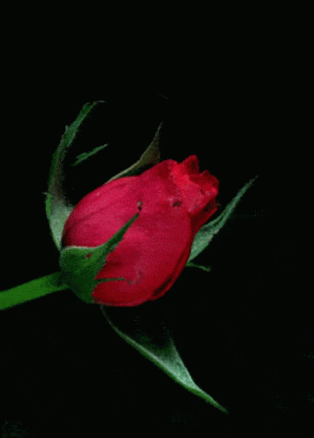
Welcome to class eight

Slide 2
Identity
Edited by
Md.firoj Hossain
Assistant Teacher( Social science)
Subrajpur High School
Patnitola,Naogaon
E-Mail:firojpatnitola@gmail.com
Mob: 01716697972
Class : Eight
Subject : English 2nd paper
Unit: Seven
Time : 50 Minutes
Date : 12/12/2021

Slide 3
Introduction
MD. NOOR ISLAM
ASSISTANT TEACHER
KOMORPUR HIGH SCHOOL
MUJIBNAGOR , MEHERPUR.

Slide 4
Lesson Identity
English second paper
Class: 8

Slide 5
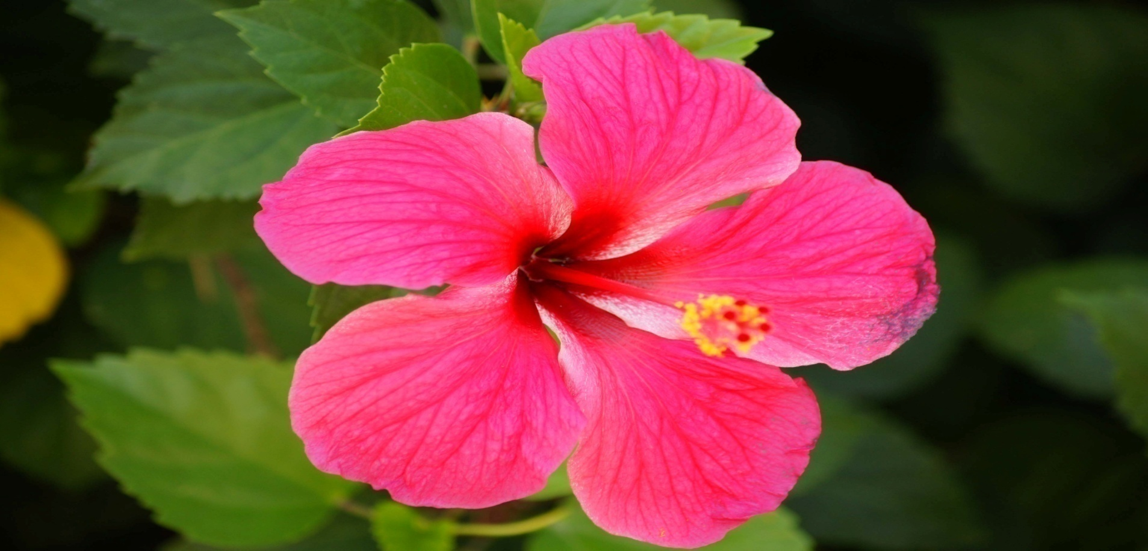
A flower is a sign of beauty.

Slide 6
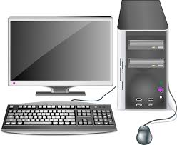
Everyone should know how to operate a computer.

Slide 7
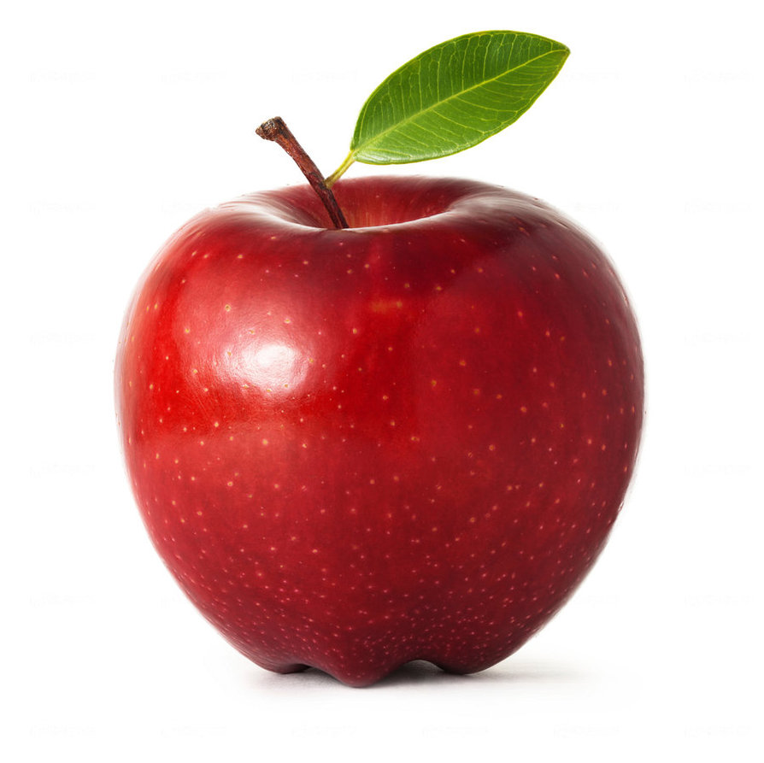
Eat an apple everyday

Slide 8
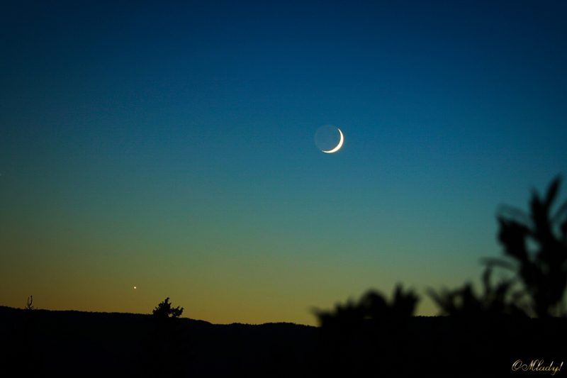
The moon shines at night.

Slide 9
Rahim bought an umbrella.

Slide 10
Mother reads the Quran.

Slide 11
Can you guess about what are the pictures and sentences ?

Slide 12
Our todays lessons is “Article’’

Slide 13
Learning outcomes
At the end of the lesson , ss will be able to-
1.Define article.
2classify of article .
3.Use article ‘ a’ and ‘ an ‘ properly.

Slide 14
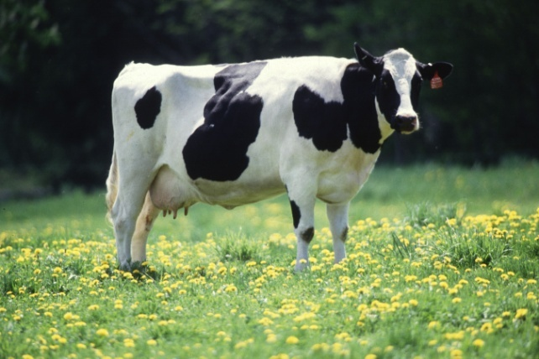
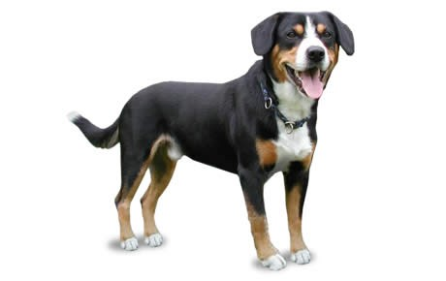
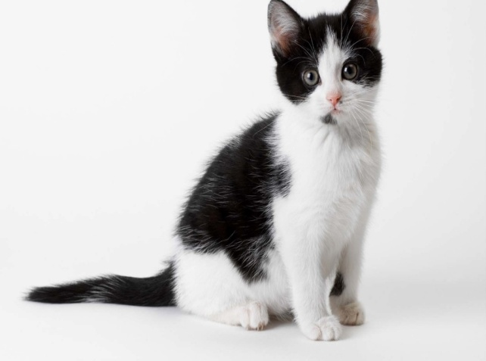
The cow is a useful animal.
The dog is a faithful animal.
A cat is compered with a tiger.

Slide 15
What are called article
Definate Article
The
Indifinate Article
A,An

Slide 16
.
1.He is a European.
.
2.Give me a one taka note.
A is used before the sound of ইউ,ওয়া

Slide 17
Follow some example
A European
A union
A university
A useful book
A one taka note

Slide 18
1.
Mr. Anas is an M B B S
He is an honestman
I will comeback after an hour.
An is used before the sound of এ,অ,আ
2.
3.

Slide 19
Follow some example
An hour
An honest
An M.A
An L.LB
An M.P

Slide 20
AS the first letter of consonant , use of article-
He is a boy.
She is a girl.

Slide 21
AS the first letter of vowel, A.E.I.O.U , you have to write ‘an’ before the word.
It is an inkpot.
This is an egg.
I have an umbrella.
He eats an orange.
This is an ant.

Slide 22
Some common used articles of’ A’
A pen
A bag
A cat
A dog
A horse

Slide 23
Used of ‘ an’
An ass
An elephant
An orange
An inkpot
An ant

Slide 24
Special use of ‘A’
You are a Nazrul, I see.
The superlative ‘most’ when it means ‘very’.
It is a most interesting story.

Slide 25
Group work
1.Dr. Nusrat is------- FRCS
2.He is-------- one-eyed boy.
3.Hassan is------ B.A.
4.She is ----- girl.

Slide 26
Individually work
1.This is -------- unique.
2.Let us go out for -------walk.
3.This is ------- ewe.

Slide 27
Evaluation
Fill in the gap use of article
1.I have -------- mobilephone.
2.Karim is --------- university student.
3.He is --------- brillant boy.
4. She is ----- girl.
a
a
a
a
Use of a

Slide 28
Hometask
Fill in the blanks with a /an
Jamil is -------meritorious student. He studies in -------- renowed school.There is -------- expert Headmaster in the school. He is------- honestman.The school achieved ------ unique position in regard of resuld.

Slide 29
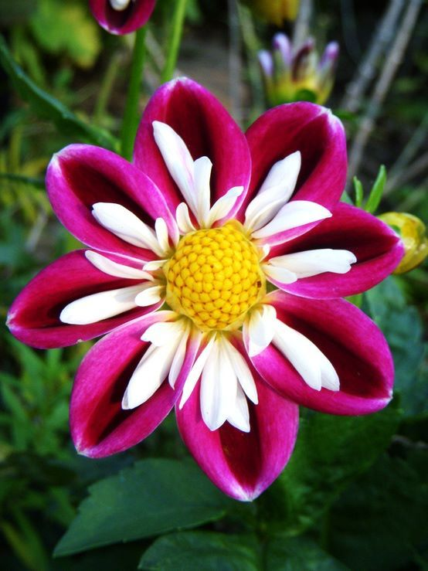
May Allah bless you.

