Slide 1
Welcome
Notes:
Welcome slide.

Slide 2
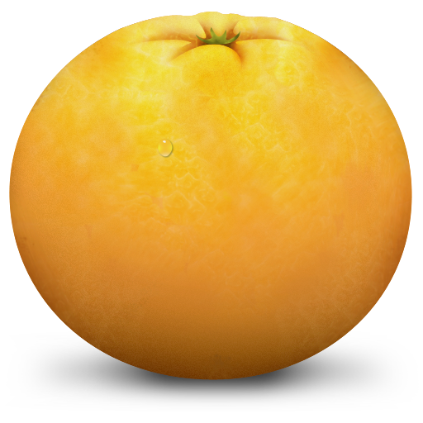
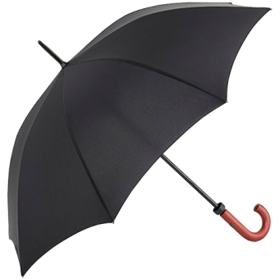
Introduction
12-12-2022 Md. Shahidul Islam Assistant Teacher In English Parulia High School & College | Class-VIII English 2nd Paper Subject: Article Time-50 minutes
Notes:
Details about the teacher.

Slide 3
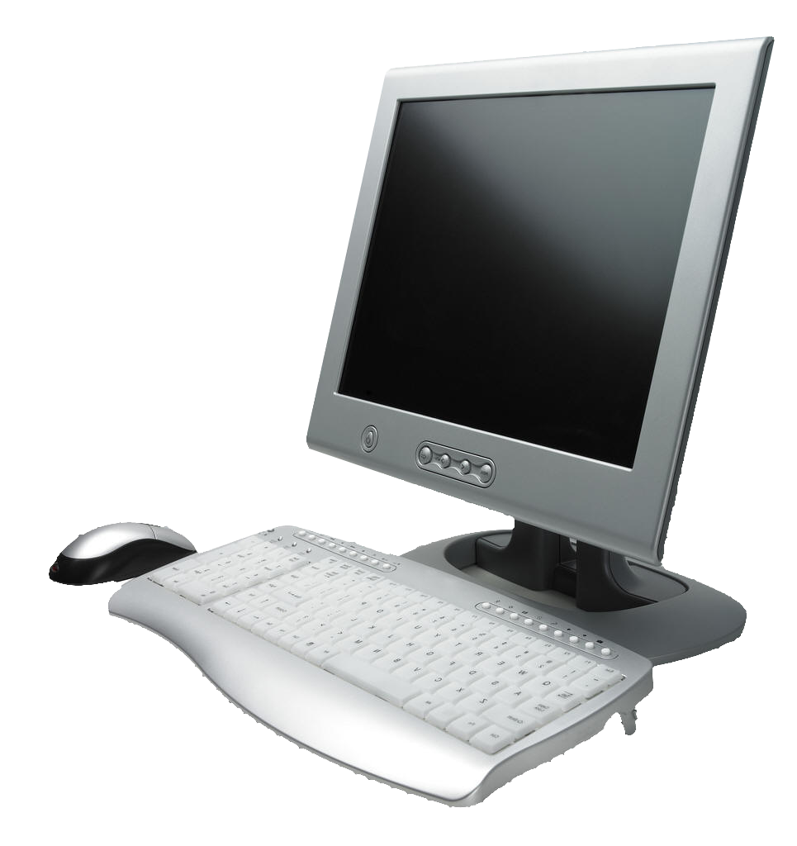
A flower is a sign of beauty.
Everybody likes flower. The flower is a sign of purification.
Everyone should know how to operate a computer. Now a days it is a part of percale of our life.
Notes:
Teacher may use it as suspension.

Slide 4
Try to eat an orange everyday.
An umbrella is useful in rain. We use it in hot sun and rain
Notes:
These pictures are for suspension.

Slide 5
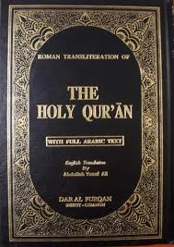
The sun gives light to all equally.
Study the Quran to know Islam.
Notes:
Suspension on the.

Slide 6
Can you guess what
are the pictures about?
Article
Notes:
This slide is for taking out the lesson declaration from the students.

Slide 7
Our today’s lesson is-
Article (Part-1)
Unit- 11, Lesson-1
Notes:
Declaration of Lesson.

Slide 8
Learning outcomes
At the end of the lesson, we will be able to----
define article
use article ‘a’ & ‘an’ properly
use special use of articles
Notes:
Target of this lesson.

Slide 9
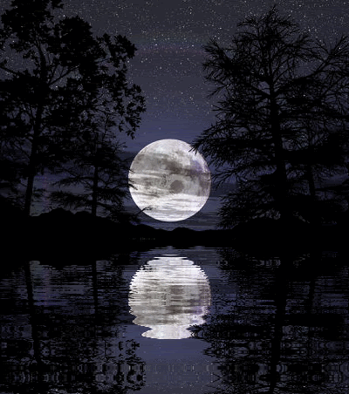
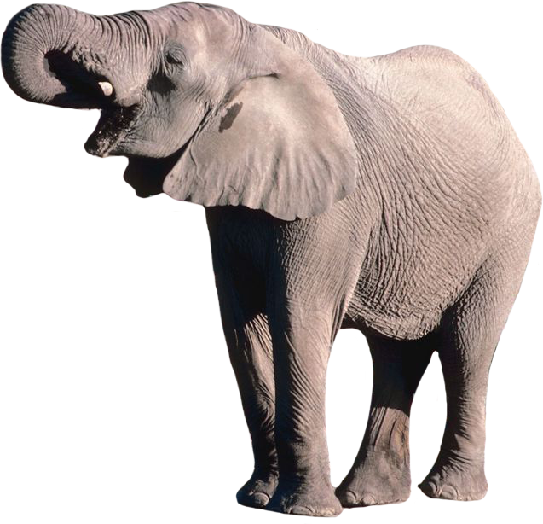
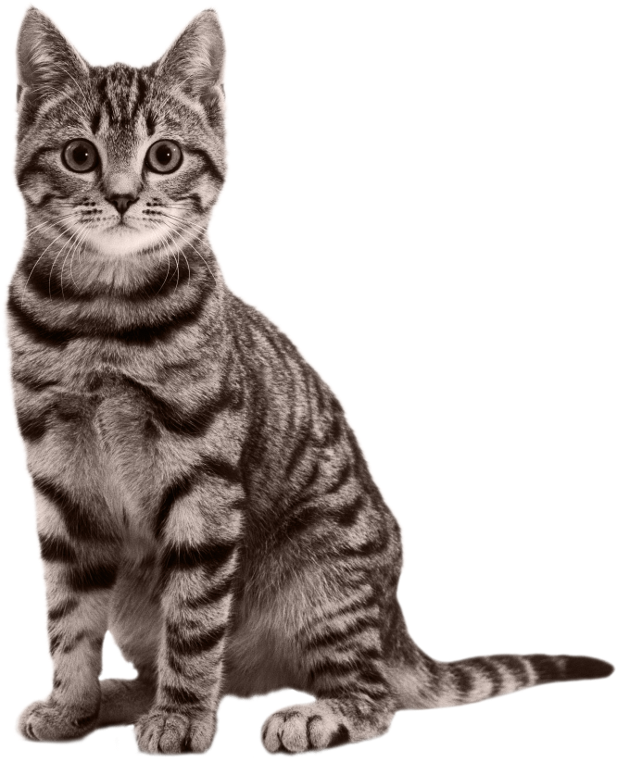
The moon shines at night.
An elephant is bigger than a lion.
A cat is compered with a tiger.
Notes:
Teacher may take out the classifications of article from the students showing the slides.

Slide 10
What are called article?
Article
Determiner
(পদাশ্রিত নির্দেশক)
The
An
A
Notes:
Starting the main lesson.

Slide 11
What are the divisions of article?
Article
Definite
Indefinite
The
A, An
Definite article is used to particularize a noun.
Indefinite article is used to generalize a noun.
Notes:
Classification details.

Slide 12
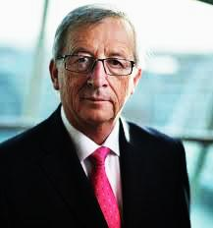
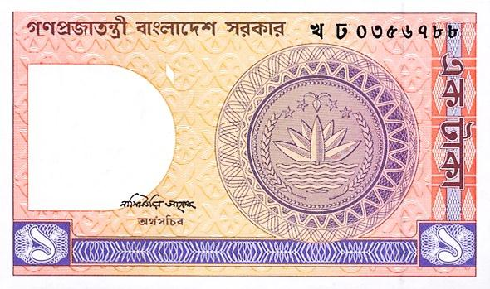
a
He is __ European.
ইউ
Give me __ one taka note.
a
ওয়া
‘A’ is used before the sound of-
ইউ,ওয়া
Notes:
Teacher may start teaching the use of ‘a’ according to pronunciation.

Slide 13
Follow some examples
a European
a union
a university
a useful book
a unique scene
a one-rupee note
a one-eyed deer
a High / Higher- Secondary School
Notes:
Teacher may use it as common examples.

Slide 14
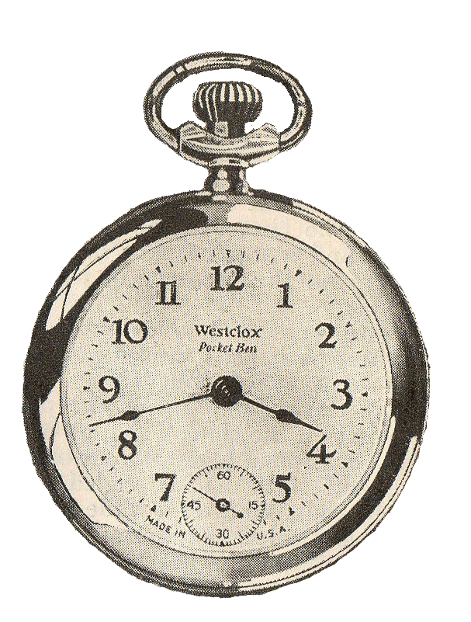
Mr. Amin is _____ MBBS.
an
এ
He is ____ honest man.
an
অ
I will come after_____ hour.
an
আ
‘An’ is used before the sound of-
এ,অ,আ
Notes:
Teacher may start teaching the use of ‘an’ according to pronunciation.

Slide 15
Follow some examples
an hour ( ‘h’ silent)
an honest ( ‘h’ silent)
an M.A.
an M.P.
an L.L.B.
an M.L.A.
an S.D.O.
an H.S. School
Notes:
Teacher may use it as common examples.

Slide 16
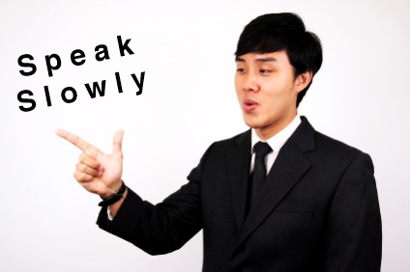
But remember.
Notes:
Teacher may go to teach article without pronunciation system.

Slide 17
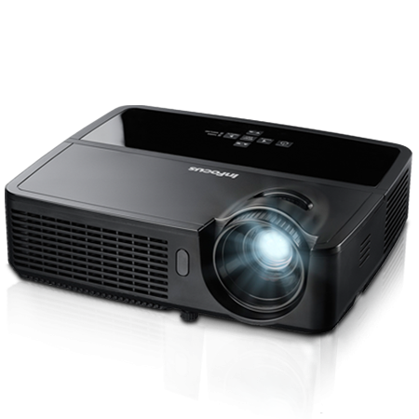
a
We have ______ projector in our class.
প
ইউ, ওয়া, এ,অ,আ
an
He sent me _______ email.
ই
Notes:
There is no use of এ,অ,আ,ইউ,ওয়া। So you have to follow the first letter of the word to use article. If the first letter is a consonant, you have to use ‘a’ and if the first letter of the word is a vowel, you have to use ‘an.’

Slide 18
When you will find no sound of -
ইউ/ওয়া
এ,অ,আ
What will you do?
Notes:
What to do in case of having no presence of 5 pronunciations.

Slide 19
If you find a consonant as the first letter of the word , that means (b, c, d, f, g, h, j, k, l, m, n, p, q, r, s, t, v, w, x, y & z)
You have to write ‘a’ before the word.
a
He is __boy.
Consonant
ইউ, ওয়া, এ,অ,আ
ব
Notes:
Normal use of ‘a’

Slide 20
If you find a vowel as the first letter of the word , that means
(a, e, i, o, u)
You have to write ‘an’ before the word.
It is ___ inkpot.
an
Vowel
ইউ, ওয়া, এ,অ,আ
ই
Notes:
In case of having no presence of 5 pronunciations, teacher may conduct this session according to animation.

Slide 21
You have to remember.
A/an is always used before a single noun.
I have a pen.
This is an eggs.
I have a pens.
This is an egg.
Notes:
This is to mention that a, an are used before singular nouns.

Slide 22
Some common used articles
A ( Consonant Sound – before A ) |  | An ( Vowel Sound – before An )
a boy | a lion | an ass | an elephant
a book | a mango | an ant | an inkpot
a bag | a student | an apple | an ice-cream
a cat | a woman | an arm | an idiot
a chair | a table | an egg | an ox
a dog | a tiger | an ear | an orange
a horse | a tree | an eye | an umbrella
Notes:
These articles are normally used.

Slide 23
Special use of ‘a’
‘A’ is used before-
1. The sense of a person-
You are a Nazrul, I see.
2. The superlative ‘most’ when it means ‘very’.
He saw a most wonderful sight.
It is a most interesting story.
Notes:
Special use of articles.

Slide 24
Activities
Orally
&
individually
Notes:
Practicing option.

Slide 25
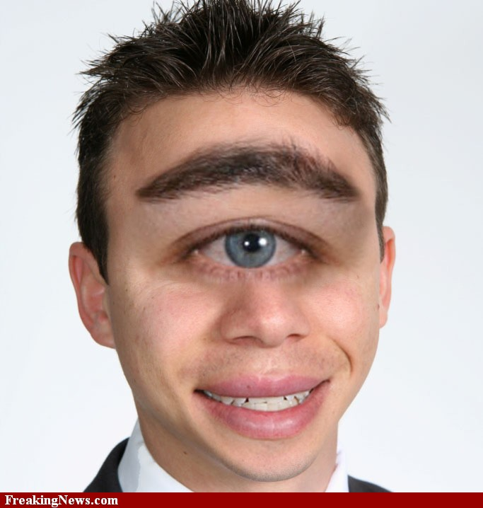
Dr. Rubina is FRCS.
an
He is ____one-eyed boy.
a
Notes:
Practice option.

Slide 26
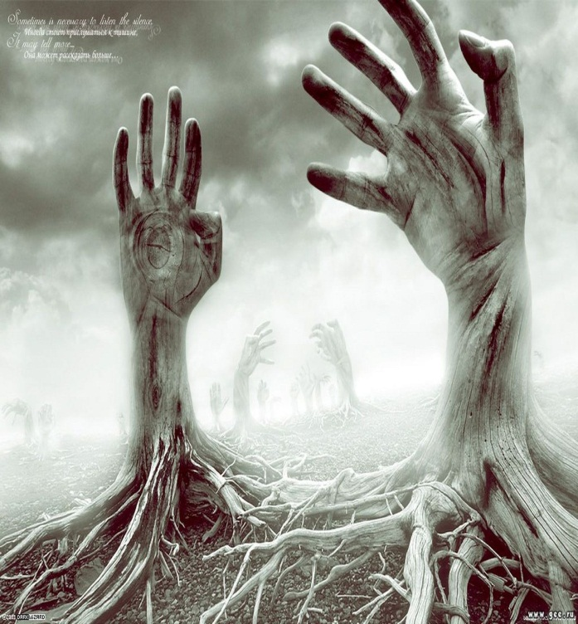
a
Mr. Dohan is ___ B.A.
a
This is __unique picture.
Notes:
Practice option.

Slide 27
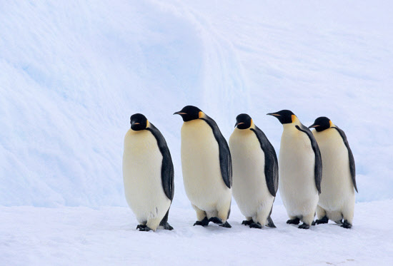
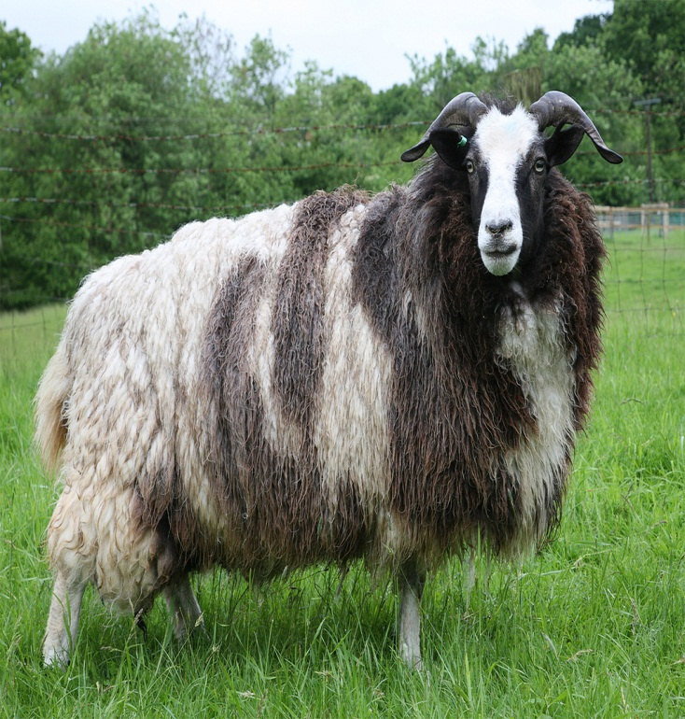
a
Let us go out for______ walk.
a
This is___ ewe.
Notes:
Practice option.

Slide 28
Evaluation
Fill in the blanks with appropriate article-
I have ______ mobile phone.
He is ______ brilliant boy.
You showed ______ excellent performance.
Saadik is ______ university student.
It takes ______ hour to go there.
Notes:
Teacher may evaluate the students through this option.

Slide 29
Home Task
Fill in the blanks with a/an.
Jayeef is _____ meritorious student. He studies in ____ renowned school. There is _____ expert headmaster in the school. He is ____ honest man. The school has achieved ____ unique position in regard of result.
Notes:
Teacher may fix it as home work or not.

Slide 30
Verse Universal
A man of truth is a man of respect.
Notes:
Advice.

Slide 31
May Allah bless you all.
Notes:
Ending slide.

