Slide 1
Welcome to all

Slide 2
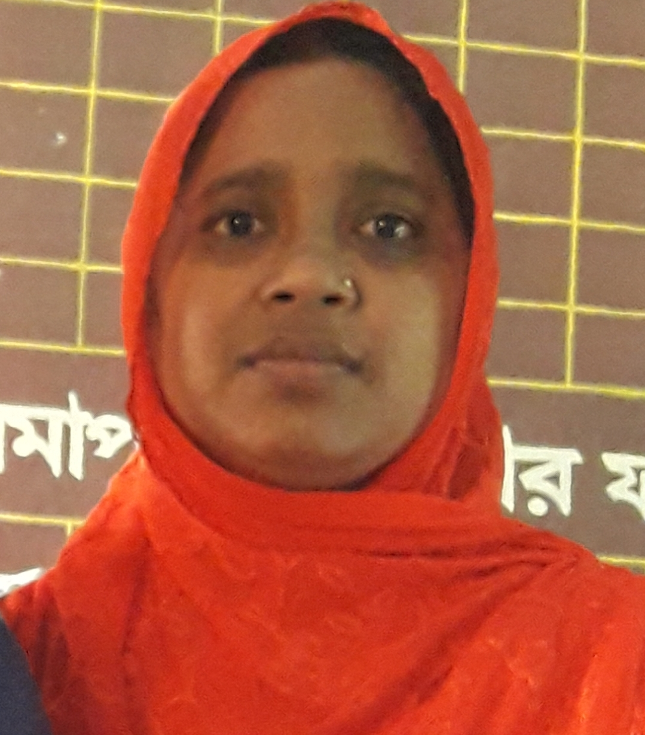
Identity
Class: Two
Sub: English
Unit: 19
Activity:A
Date:16.12.2021
Name: Mosa Amina khatun
Assistant teacher
Karaggram govt primary school .
Raninagar , Naogaon .

Slide 3
Learning outcomes
Listening 1.1.1:become familiar with English sounds by listening to
common English words .
Speaking 1.1.1:Repeat after the teacher simple words and phrases
with proper sounds and stress .
1.1.2:say simple words and phrases with proper sounds and stress .

Slide 4
Now we enjoy a video

Slide 5
Dear Students Look at the pictures,Thinks and Say What it is ?

Slide 6
Todays lesson
shapes

Slide 7
Lets see some objects
Square
These objects has four sides .

Slide 8
Lets go to the another objects .
Circle
These objects are rounds

Slide 9
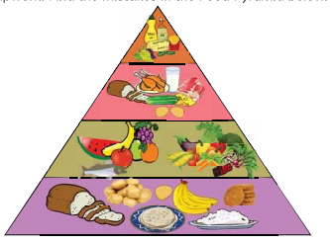
Lets go to the next objects
Triangle
These objects has three sides .

Slide 10
Rectangle
These objects has also four sides .but
two are long and two are shost .

Slide 11
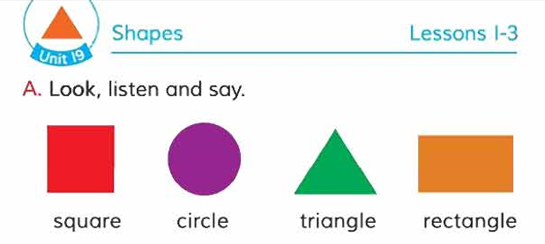
Book Connected

Slide 12
Dear Students Look, Listen and say with me

Slide 13
Look ,listen and say again
shapes

Slide 14
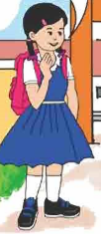
Pair work
It is

Slide 15
Missing game

Slide 16
matching coloum A and coloum B
Coloum A
Coloum B

Slide 17
Look and say
Triangle
circle
Rectangle
Square

Slide 18
Evalutions
Answers the questions orally .
Whats shape has three sides ?
triangle
Whats shape is rounds?
circle
Whats shape has four sides ?
square
Whats shape has straight sides?
rectangle

Slide 19
Home work
Dear students draw a square and colour it .

Slide 20
That’s all for today

