Slide 1
Welcome to my class

Slide 2
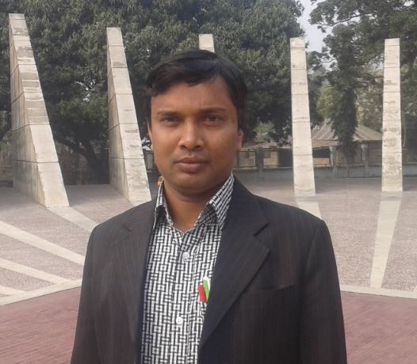
Identity
Md. Faruq Hossain
Assistant teacher
Anandabash Govt. primary school.
Mujibnagar, Meherpur.
Mobile no- 01717406029
E-mail- faruqbd01@gmail.com

Slide 3
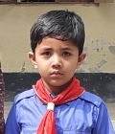
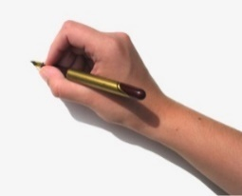
Now what is it?
What is it?
Think about it.
Md. Fardin Hossain
Md. Faruq Hossain
Anandabas, Mujibnagar, Meherpur.
Anandabas Govt. primary school.
Three
9 years.
Fardin
10. o3. 2020
Complete
Form

Slide 4
Today`s lesson
Completing forms
Lessons 1-2.

Slide 6
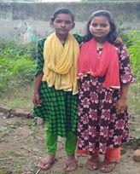
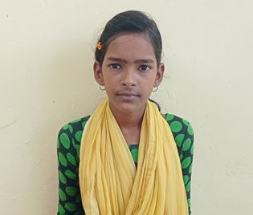
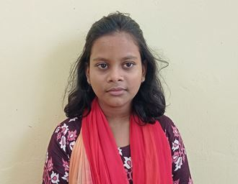
What do you see in the picture?
Think about the picture
Laila
Bithi
Laila and Bithi are friends, but they are very different.

Slide 7
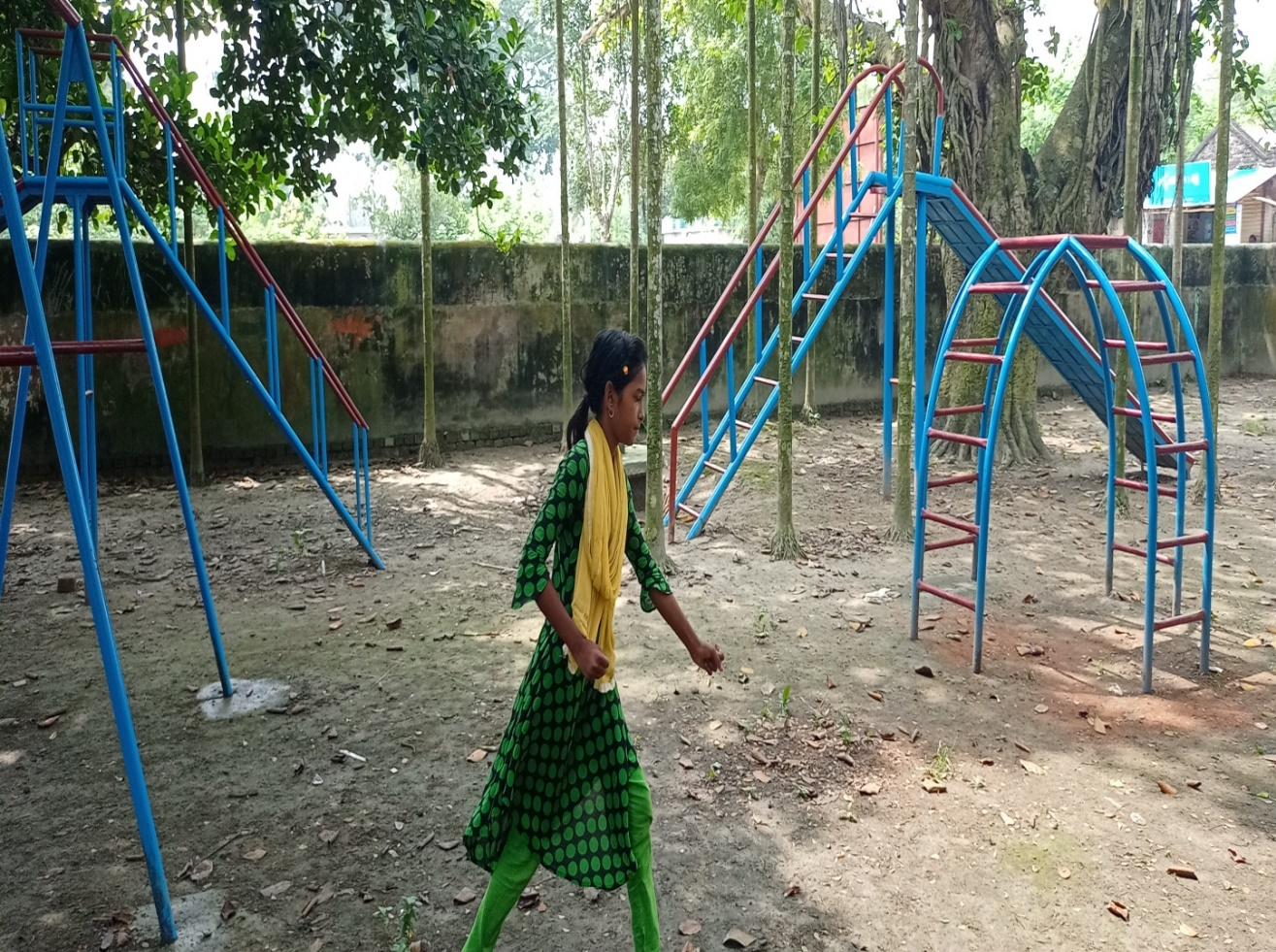
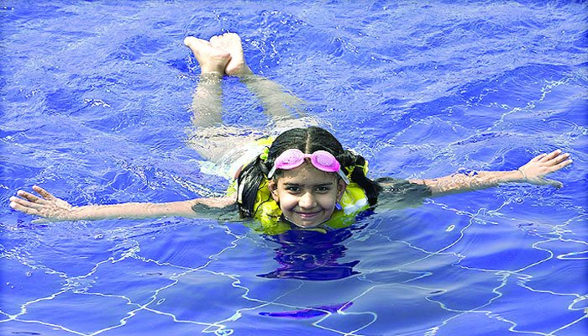
What is Laila doing?
Think about the picture
Running
Swimming
Laila likes to run in the park and swim

Slide 8
Group work
Answer the following questions.
Group-A: Who is Laila`s friend?
Group-B: What does Laila like. ?
Ans: Bithi is Laila`s friend.
Ans: Laila likes to run in the park and swim.

Slide 9
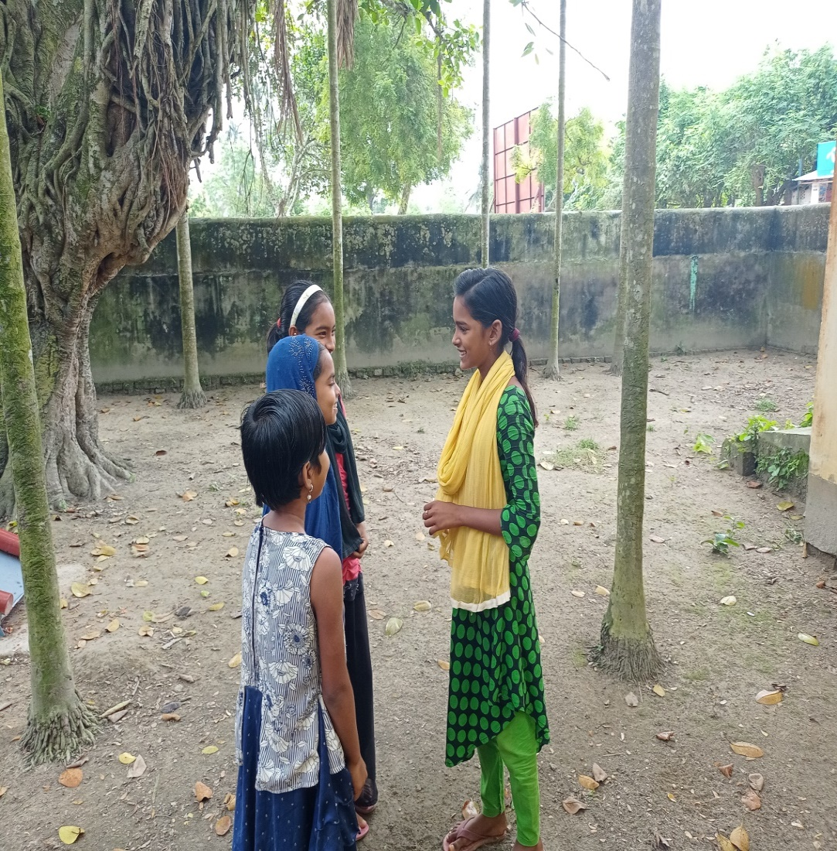
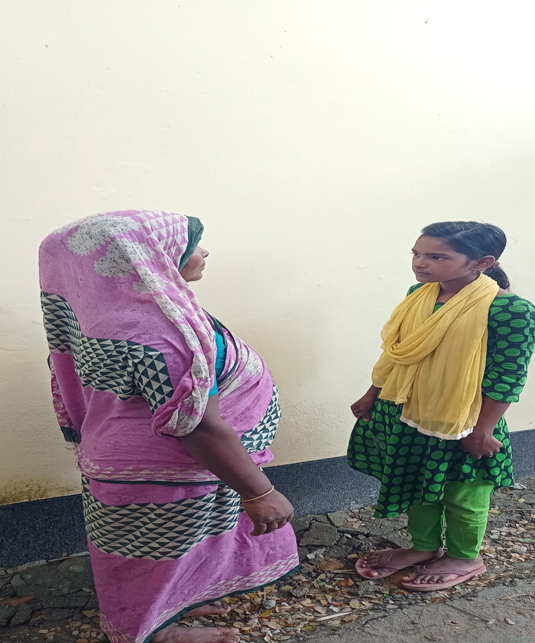
What is Laila doing?
Think about the picture
“Oh, Laila! You`re so talkative.”
Talking
Laila`s mother is talking to her

Slide 10
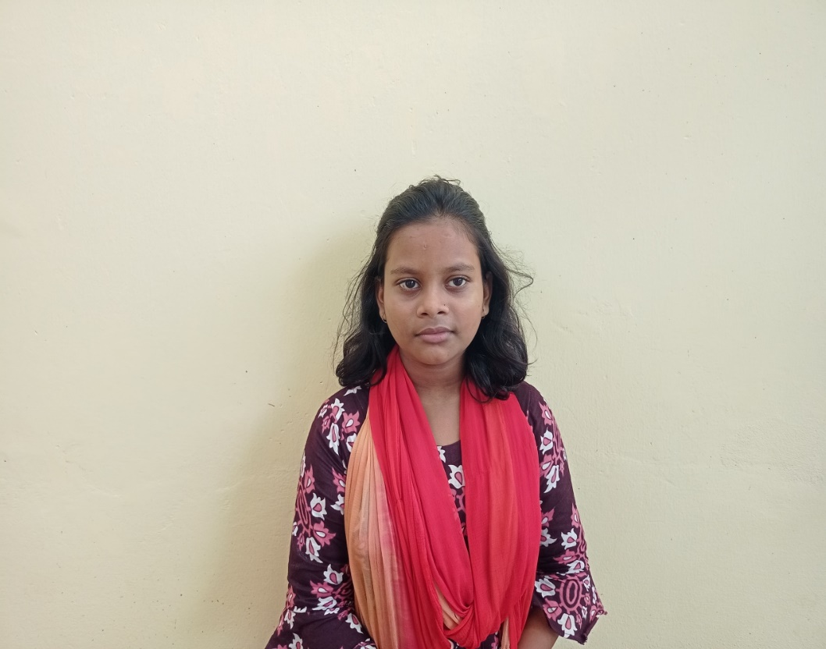
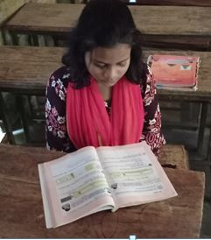
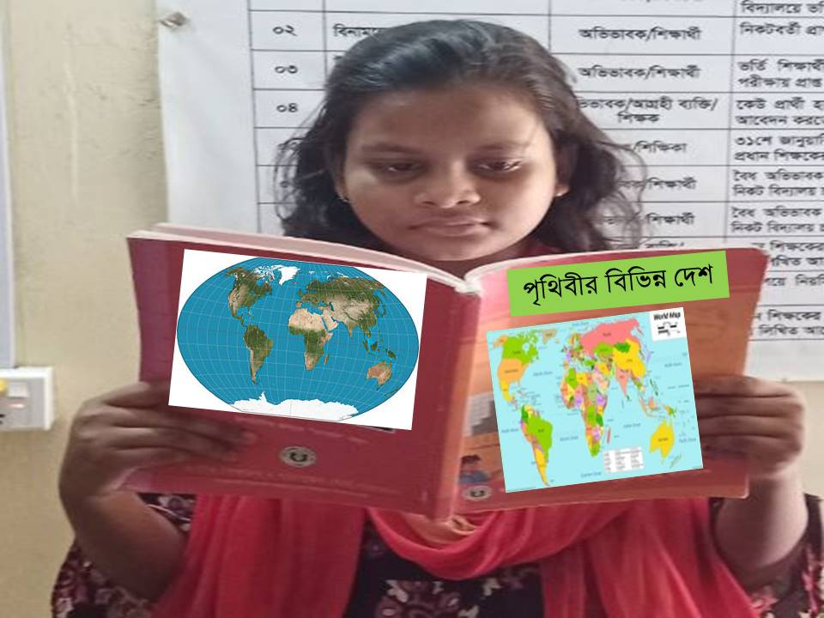
What is the girl doing?
Think about the picture
Bithi
Reading book
Bithi is a quiet person. She enjoys reading. She especially loves stories about other countries.

Slide 11
Pair work
Answer the following questions.
1.What type of person is Bithi ?
2. What does Bithi enjoy?
Ans: Bithi is a quiet person.
Ans: Bithi enjoys reading.

Slide 12
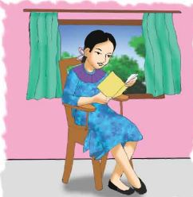
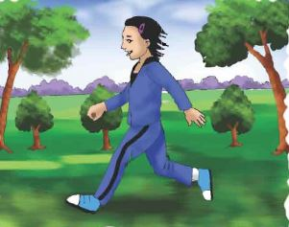
Which picture shows Laila? Which picture shows Bithi? Write the correct name under each picture.
Bithi
Laila

Slide 13
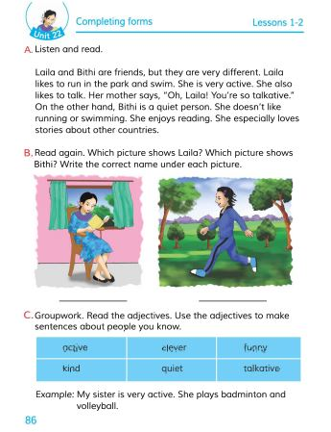
Open your english book at the page no-86.

Slide 14
Some word meanings
Different
Like
Run
Park
Swim
Active
Talk
Talkative
Quiet
ভিন্ন
Person
Enjoy
Especially
Story
Clever
Funny
Show
ব্যাক্তি
পছন্দ করা
উপভোগ করা
দৌঁড়ানো
বিশেষভাবে
উদ্যান/বাগান
গল্প
সাঁতার কাটা
চালাক
কর্মঠ
মজার
কথা বলা
দেখানো
বাচাল
শান্ত

Slide 15
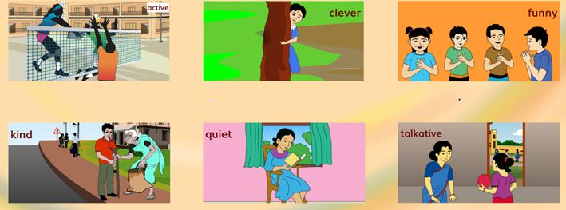
Think about the picture
Active- কর্মঠ
Clever- চালাক
Funny- মজার
Kind- দয়ালু
Quiet- শান্ত
Talkative- বাচাল
Adjective- বিশেষণ

Slide 16
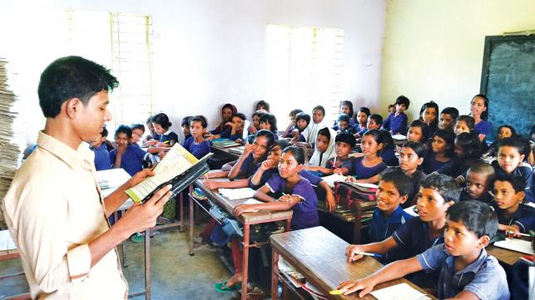
Loud reading

Slide 17
EVALUATION
Write “T” for correct statement or “F” for false statement.
1. Laila and Bithi are cousins.
2. Laila enjoys reading.
3. Bithi is a quiet girl.
B. Answer the following questions.
1. Who talks too much?
2. What things does not Bithi like?
3. What type of girl is Laila?
F
F
T
Ans: Laila talks too much.
Ans: Bithi does not like running or swimming.
Ans: Laila is very active and talkative.

Slide 18
Home work
Write a short composition on “Your likes and dislikes”
in 5 sentences.

