Slide 1
Rangpur Online School
30-11-2021
Md. Shahidul Islam
Senior assistant teacher in English Master trainer in English and ICT
Parulia High School and College
01761511624
Shahidulwww.eia@mail.com

Slide 2
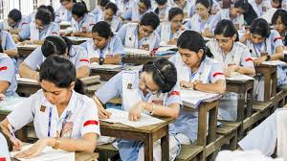
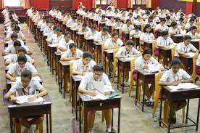
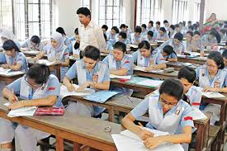

Slide 3
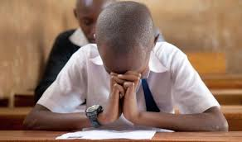

Slide 4
Exam fitness
Exam fitness ????

Slide 5
To full prepare for the examination.
Strategy
Experienced & skilled
Success

Slide 6
Success
Strategy
Exam Strategy

Slide 7
About 40 to 50 percent of your chances of success relate to your examination skill rather than to your Subject knowledge.

Slide 8
What should do and what should not do in as an examinee?

Slide 9
As an examinee must do---
Check and double check your exam dates and times.
Exam Routine
Bangla - 10-09-2020
English -12-09-2020
Math -18-09-2020
Physics---22-09-2020
Biology---26-09-2020
History---01-09-2020

Slide 10
Check what you are allowed and what you are not allowed to take in with you and have these ready the day before.

Slide 11
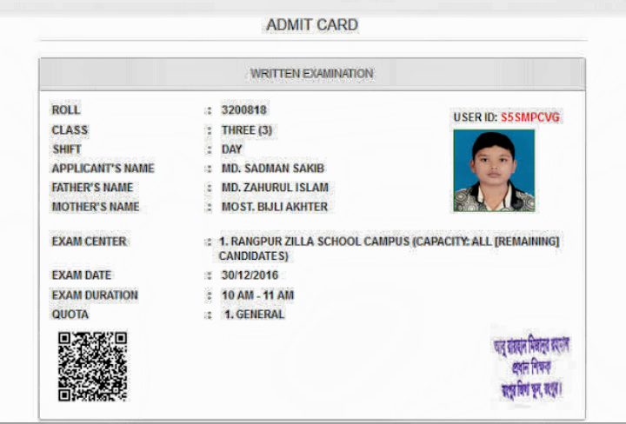

Slide 12
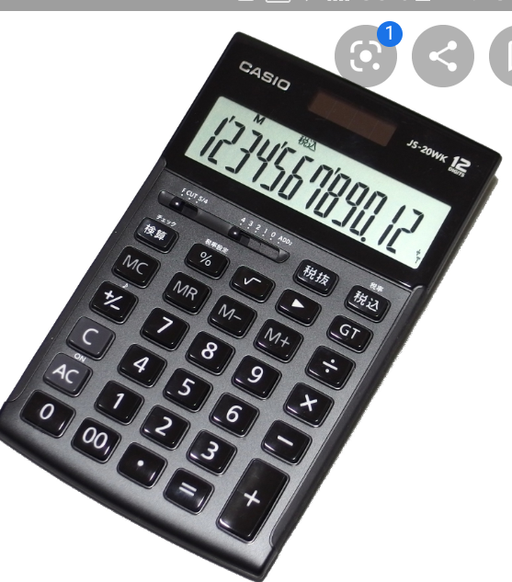
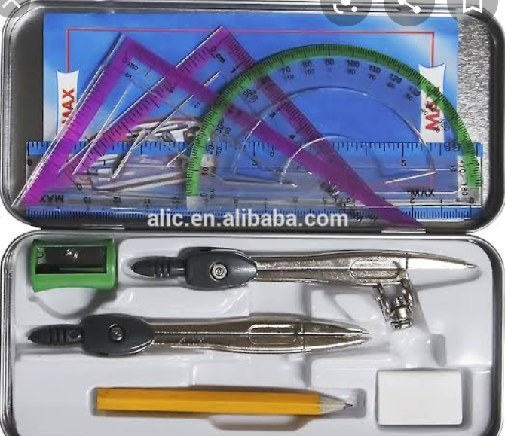

Slide 20
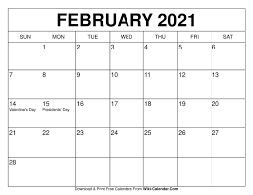
You have to get these ready the day before exam.

Slide 21
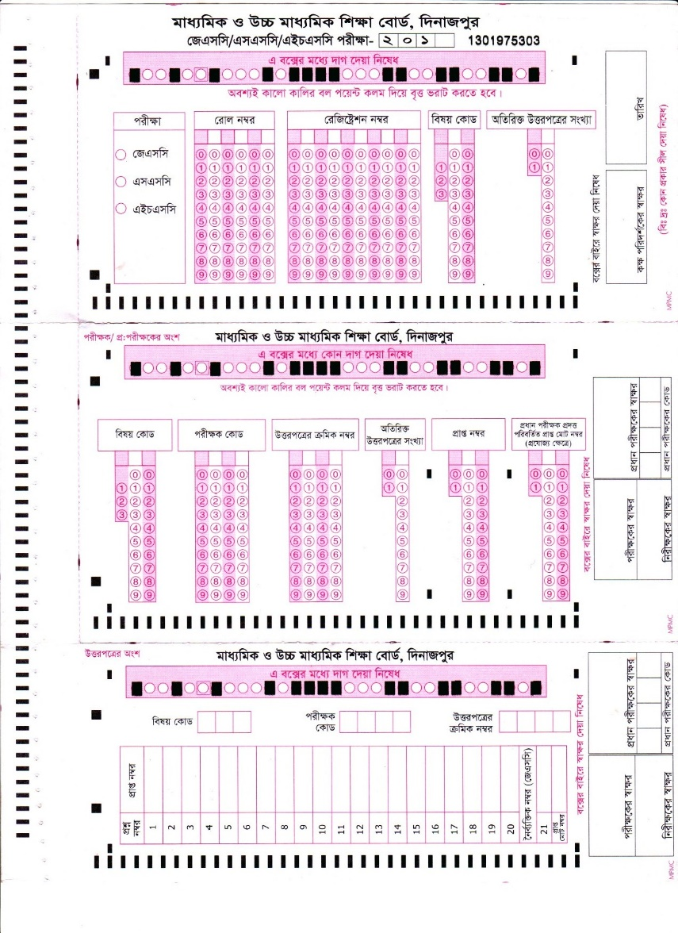
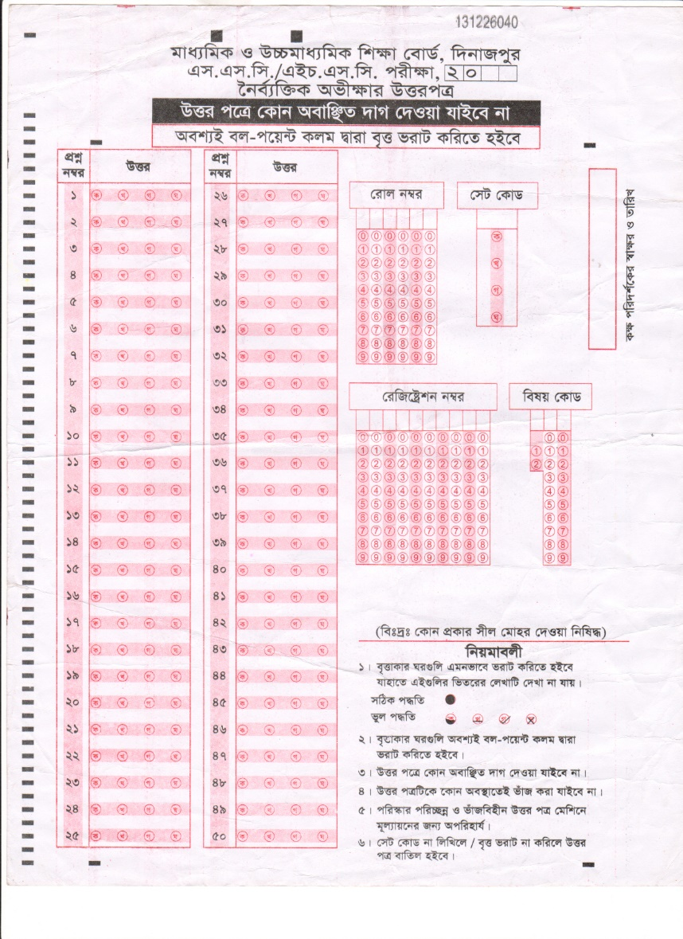
To follow the instructions.

Slide 22
To read through the whole question paper before starting to write.
In the exam hall

Slide 23
To budget your time for each question.
Question Paper
MCQ 5 marks
2. Answering Question 10 marks
3. Column A-B 5 marks
4. Re arrange 7 marks
5. Paragraph 10 marks

Slide 24
To start the easiest question first.

Slide 25
Do not waste time elaborating answers if you want to go to the next question.

Slide 26
Always try to attend to answer all the questions.

Slide 27
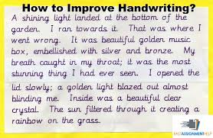
To make your answer/ handwriting legible /clear.

Slide 28
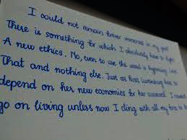
To use double spacing to make it easy on the eye for the reader / Examiner.

Slide 29
To spend at least 5-10 minutes to review your answers.

Slide 30
* Check and double check your exam dates and times.
* Check what you are allowed and what you are not allowed to take in with you and have these ready the day before.
* You have to get these ready the day before exam.
* To follow the instructions.
* To read through the whole question paper before starting to write.
* To budget your time for each question.
* To start the easiest question first.
* Do not waste time elaborating answers if you want to go to the next question.
* Always try to attend to answer all the questions.
* To make your answer/ handwriting legible /clear.
* To use double spacing to make it easy on the eye for the reader / Examiner.
* To spend at least five minutes to review your answers.

Slide 31
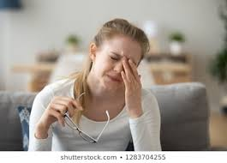
What should not do as an examinee?
To be cool and don’t feel tension.
Don’t follow any rumors.

Slide 32
Don’t forget to use underline the key words.
Bangladesh is (a) an agricultural (b) country in the (c) world.
He is my bosom friend, isn’t he?
Walk fast lest you should miss the train.

Slide 33
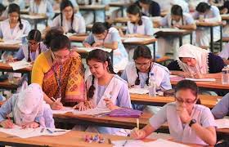
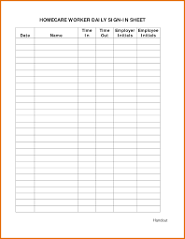
Don’t forget to take signature from hall guard as well as attendance sheet.

Slide 34
Don’t forget to use question number/ wrong number.
Answer to the question Number:
Answer to the question Number : (05)
“Have you taken your meal, Tania?” said the mother. “Yes, I have.
“Have you taken your meal, Tania?” said the mother. “Yes, I have.

Slide 35
Don’t write double questions answer.
Don’t write without understanding.

Slide 36
Don’t write unnecessary .
Don’t depend on others.

Slide 37
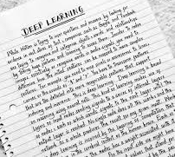
Don’t practice your handwriting beautifully if it is tiny or large.

Slide 38
What should not do as an examinee?
To be cool and don’t feel tension.
Don’t write without understanding.
Don’t practice your handwriting beautifully if it is tiny or large.
Don’t write unnecessary something.
Don’t forget to use question number.
Don’t forget to use question number/ wrong number.
Don’t write double questions answer.

Slide 39
Repetition.
Repetition.
* Do you have any more question?
Notes:
Students will solve it at home to show their teachers next class.

Slide 40
Assignment at home.
May Allah bless you all.
Notes:
Students will solve it at home to show their teachers next class.

Slide 41
Welcome To Rangpur Online School

