Slide 1
WELCOME

Slide 2
IDENTITY
GOLAM HOSSAIN
Senior Teacher (English)
Govt. Science School & College,
Tejgaon, Dhaka
Phone : 01913138642
Class - Eight
Subject – English First Paper
Unit-One
Lesson-Two
Date : 24.12.2021

Slide 3
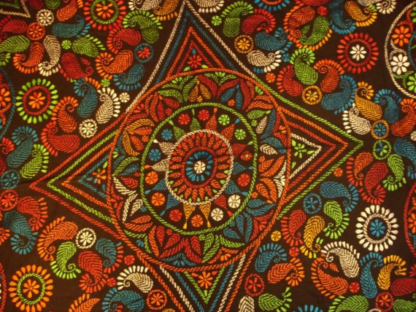
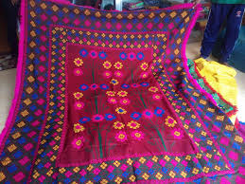
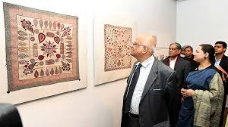

Slide 4
Let’s watch a video

Slide 5
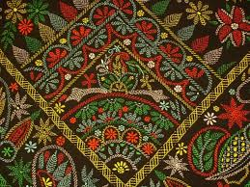
Nakshi Kantha

Slide 6
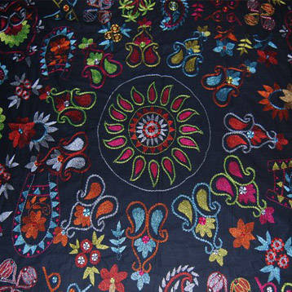

Slide 7
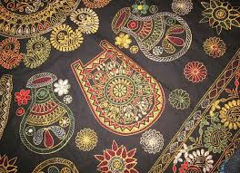

Slide 8
Learning Outcomes
By the end of the lesson learners will be able to …
talk about a picture.
use vocabularies: naksha, artistic, quilt, commercially.
ask and answer questions.
read a text and find out information.
write a paragraph describing something.

Slide 9
Read the text carefully
Nakshi Kantha is a kind of embroidered quilt .The name was taken from the Bengali word, ‘naksha’ which means artistic pattern .It is a kind of traditional craft and is said to be indigenous to Bangladesh and West Bengal in India . The art has been practised in rural Bengal for centuries. The name ‘Nakshi Kantha’ became popular ater the poet Jasimuddin’s poem ‘Nakshi Kanthar Math’ had been published in 1929. Traditional kanthas are made for family use . Old or new cloths and thread are used to make these quilts. Mymensingh, Jamalpur, Rajshahi, Faridpur,Bogura and Jashore are most famous for this craft. Now it is produced commercially.

Slide 10
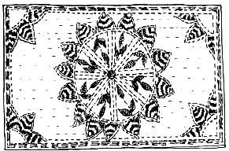
What do you see in the picture?
What is it called?
Have you seen it before? Where?
What do we do with it?

Slide 11
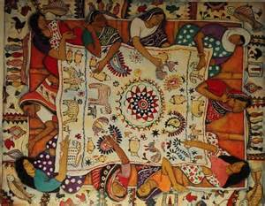
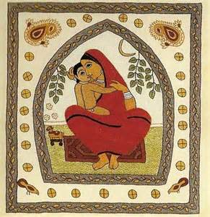
Vocabularies
Naksha
Artistic Pattern
Beautified with work of art
Artistic

Slide 12
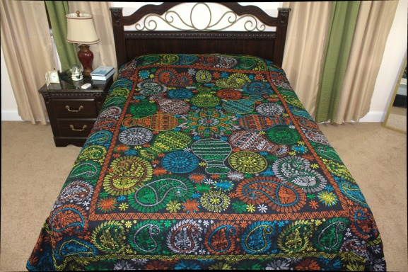
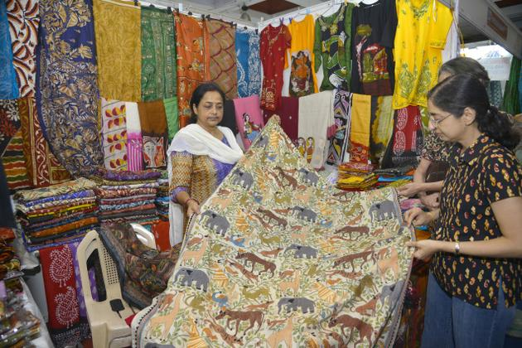
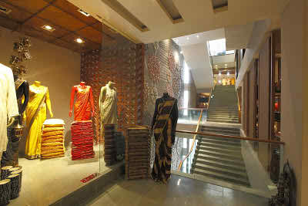
Quilt
Cover
Commer-cially
For business purpose

Slide 13
Now read the text and find out information:
1.Who make Nakshi Kantha?
Rural People
2.Who was Jasimuddin?
Our poet
3.When was Nakshi Kanthar Math published?
1929
4.Why does Nakshi Kantha have great demand?
Because of the colourful patterns and designs

Slide 14
Complete the sentences with clues given
Bengali
patterns
embroidery
years
art
fashion
rural
design
quilt
noksha
1 Naksha means artistic __________.
2 The name was taken from a ______ word ________
3 The art has been practised in ______Bengal for _____
4 Nakshi kanthas are now sold in _____ shops.
5 Nakshi kanthas are in great demand because of their colorful ______and __________.
6 Nakshi kanthas are a kind of ______.

Slide 15
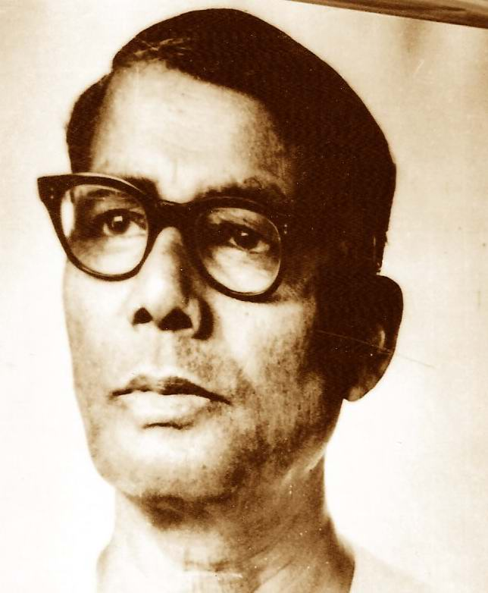
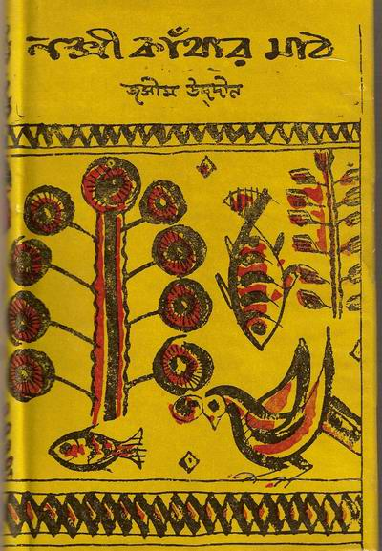
Published in 1929
Jasimuddin

Slide 16
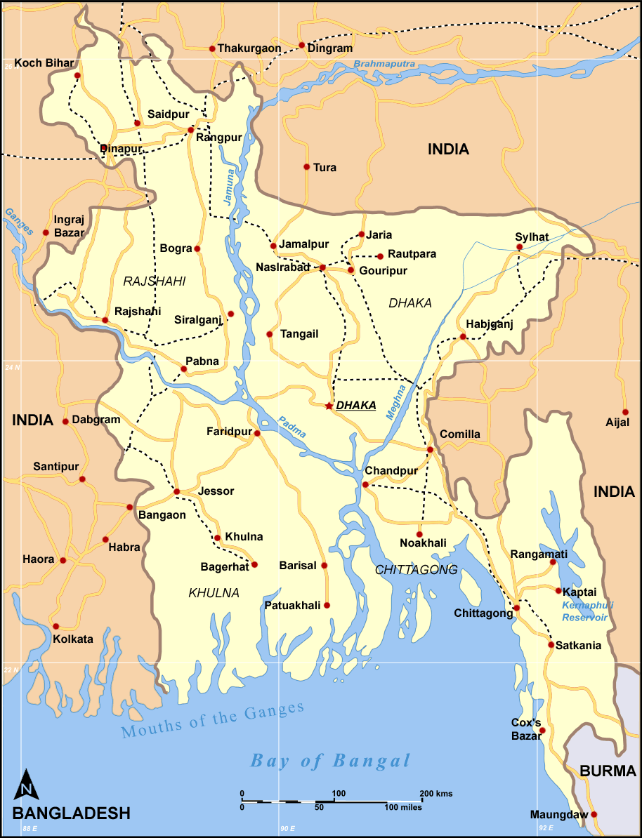
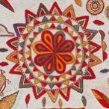
Mymensingh
Nakshi Kantha producing area

Slide 17
Pair Work
Ask question and answer in pairs by using the given clues.
Areas
Artistic
NakshiKantha
Purposes
Uses

Slide 18
Evaluation
Evaluation
How did the name Nakshi Kantha become popular?
What materials are required to prepare Nakshi Kanthas?
Which areas are most famous for this craft?
What does ‘naksha’ mean?

Slide 19
HOME WORK
Write a paragraph on Nakshi Kantha

Slide 20
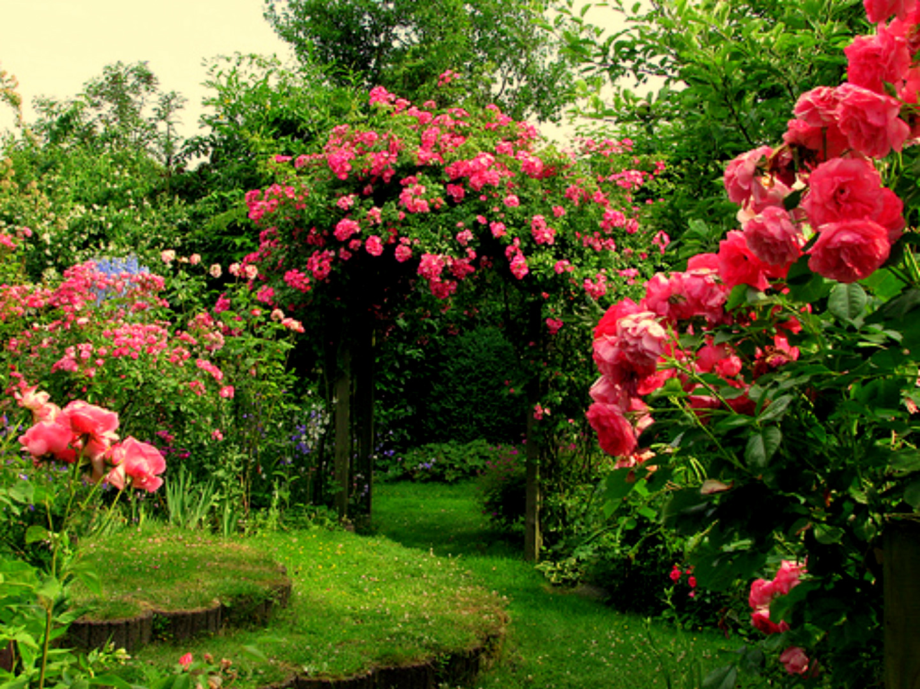
THANK YOU

