Slide 1
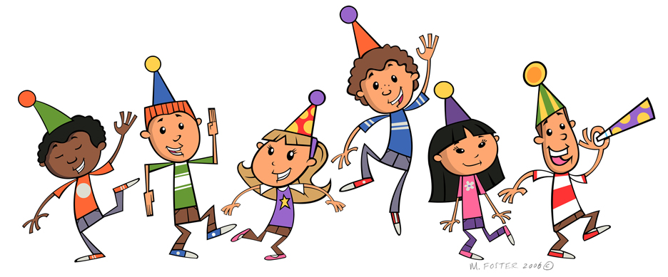

Slide 2
IDENTITY OF PRESENTER
Azmeri Akhter
Assistant teacher (English),
MPO INDEX 211365
Bishwa Zaker Manjil Alia Madrasah
E-mail-azmery198@gmail.com
Air-Contact- 017196791**

Slide 3
Lesson Introduction
Class:Seven
Sub:English 2nd paper
Total SS:70
Time:40 minutes.
Date:1.01.2022

Slide 4
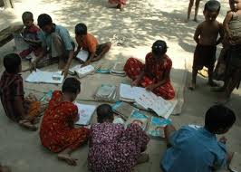
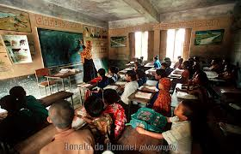
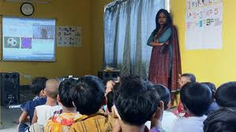
Warming up
What can you see in the picture?
1980
2022
2025
past
Present
Future
Find out the difference among the picture.

Slide 5
Could you guess what your lesson is today?
Todays lesson is
TENSE

Slide 6
Learning Outcomes
After learning this lesson, students will be able to know:
1.What is Tense?
2.How can we change tense?
3.How and where we change it?
4.How can we identify tense?

Slide 7
Form of verb
(V1)Present form | (V2) Past form (past indefinite) | (V3)Past Participle form(have,has,had)
Am/is/are | Was/were | been
Become | became | become
Go | went | gone
Give | gave | given
Read | read | read
Write | wrote | written
Eat | ate | eaten
Drink | drank | drunk
Take | took | taken
Look | looked | looked
Do | did | done
Grow | grew | grown
Play | Played | played
Know | knew | known
See | saw | seen
Swim | swam | swum

Slide 8
Auxiliary verb
Am,is,are,was,were,have,has,had,will,shall,do, does,did.
Modals
Can,could,shall,should,may,migh will,would,must, need,Dare,,used to,ought to.

Slide 9
Present tenses are four types and these are
Present Indefinite
Present Continuous
Present Perfect
Present perfect Continuous

Slide 10
Present indefinite tense | Sub+verb1+obj | I write a poem.
Present continuous tense | Sub+am/is/are+v1+ing+obj | I am writing a poem.
Present perfect tense | Sub+have/has+v3+obj | I have written a poem.
Pres. Perfect continuous tense | Sub+have been/has been+v1ing+obj | I have been writing poem
Past indefinite tense | Sub+verb2+obj | I wrote a poem.
Past continuous tense | Sub+was/were+v1+ing+obj | I was writing a poem.
Past perfect tense | Sub+had+v3+obj | I had written poem.
Past perfect continuous tense | Sub+had been/+v1+ing+obj | I had been writing poem.
Future indefinite tense | Sub+shall+verb1+obj | I shall write a poem.
Future continuous tense | Sub+shall be/ will be+v1ing+obj | I shall be writing a poem.
Future perfect tense | Sub+shall have /will have +v3+obj | I shall have written a poem.
Future perfect continuous tense | Sub+shall have been/will have been+v1ing+obj | I shall have been writing a poem.

Slide 11
Person Change
PERSON | SINGULAR | PLURAL
First | I,ME,MY,MINE | WE,OUR,US
Second | YOU,YOUR | YOU,Your,YOURS
Third | HE,SHE,IT,HIS,HER ,(ONE PERSON/THING) | THEY,THEM,THERE,(MORE….)
Negative
Doesn’t
Affermative: He gives me a pen.
Negative: He doesn’t give me a pen.
We add s or es, ies after the base form of verb, if the subject is third person and singular number.

Slide 12
Present Indefinite Tense
‡h KvR ¸‡jv me mgq Kwi wKš‘ GLb Ki‡ZwQbv
Sub + verb1 + obj
Arien writes a poem
He reads a novel.
Doesn’t
She likes flower.
I go to market.
You catch fish.
Rahim and Karim drink juice.
Negative: Rahim and Karim don’t drink juice.
Interrogative: Don’t Rahim and Karim drink juice?
Habitual : Mother reads the holy Quran.
Universal truth : The sun rises in the east.

Slide 13
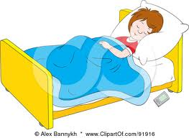
Present Continuous tense
Sub +am,is, are + v(ing) + obj
You are singing a song.
I am eating rice.
He is running in the field.
Neg: He is’nt running in the field.
Int : Is’nt he running in the field.
01.Gradually,day by day , step by step, now,at this moment these words indicate present continuous tense

Slide 14
Present Perfect Tense
Sub + have/has + V3 + obj
I have gone to madrasah.
He . has bit his sister.
You have caught fish.
Neg:You haven’t caught fish.
Int : Haven’t you caught fish?
I,YOU,,WE,THEY=HAVE=HAVE
HE,SHE,IT,ONE PERSON OR THING=HAS
Present Perfect tense means an action that is finished, but the result is not finished yet.

Slide 15
Present Perfect Continuous Tense
Sub + have been/has been + V(ing) + obj + for/since +…….
I have been reading english for 2 hours.
He has been playing cricket since afternoon.
She has been suffering from fever since Friday.
Negative: She hasn’t been suffering from fever since Friday.
Interrogative: Hasn’t she been suffering from fever since Friday?
Saturday, Sunday, Monday, Tuesday, Wednesday,Thursday.Friday, Morning,Afternoon,Evening,=since
1 day,2days,3days …………… =for
1 hour, 2 hours, 3 hours ……….. =for

Slide 16
Past tenses are four types and these are
Past Indefinite
Past Continuous
Past Perfect
Past perfect Continuous

Slide 17
Sub + verb2 + obj
Past Indefinite Tense
Arien wrote a poem
He read a novel.
I went to market
You caught fish.
Rahim and Karim drank juice.
Negatine: Rahim and Karim didn’t drink juice.
Interrogative:Didn’t Rahim and Karim drink juice?

Slide 18
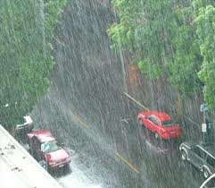
Past Continuous tense
Structure : subject + Was/Were + verb + ing + Obj
I was improving in the English.
It was raining cats and dogs .
You were plucking flower.
Affirmative : He was knowing the matter.
Negative: He wasn’t knowing the matter.
Interrogative: Wasn’t he knowing the matter?

Slide 19
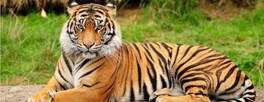
Past Perfect tense
Structure : Subject + had + past participle of verb + Obj
I had gone to madrasah.
He . had seen the tiger.
You had caught fish.
Affermative: H e had opened the book.
Negative: He hadn’t opened the book.
Interrogative: Hadn’t he opened the book?

Slide 20
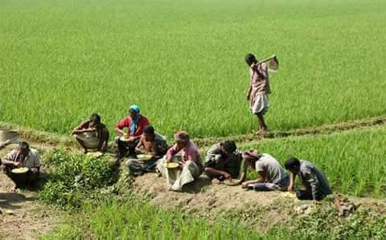
Past Perfect Continuous Tense
Sub + had been + V(ing) + obj for/since +……
Taif had been driving the car for 1 hour.
They had been visiting the place since Sunday.
He had been watching TV since morning.
Neg: He hadn’t been watching TV since morning
Int: Hadn’t he been watching TV since morning?

Slide 21
Future tense are four types and these are
Future Indefinite
Future Continuous
Future Perfect
Future perfect Continuous

Slide 22
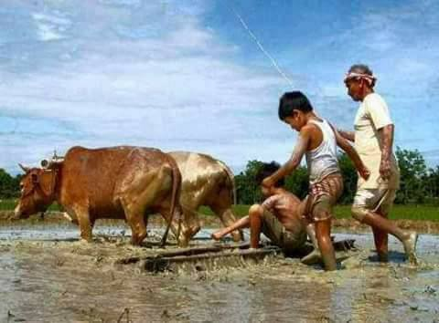
Sub +Shall/Will + verb1 + obj
Futur Indefinite Tense
You will do your work .
She will bring the book.
I shall buy a book.
Neg: I shan’t buy a book
Int: shan’t I buy a book ?

Slide 23
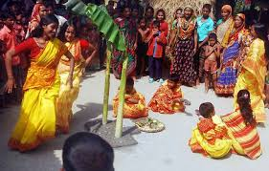
Sub +Shall be/Will be + verb1+ing + obj
Future Continuous tense
The baby will be sleeping.
Rina will be singing a song.
Mother will be cooking for us.
Neg: Karim won’t be preparing his lessons.
Int: Won’t Karim be preparing his lessons?

Slide 24
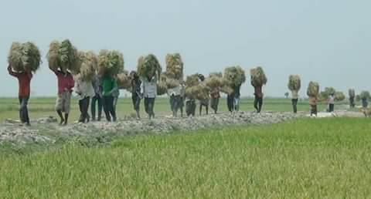
Sub +Shall have/Will have+ verb3 + obj
Future Perfect Tense
We shall have reached the station.
They will have finished the work.
Samira will have taken the duty.
Neg: Samira won’t have taken the duty.
Int: Won’t Samira have taken the duty?

Slide 25
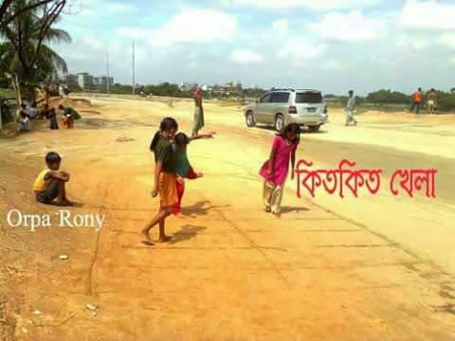
Sub +Shall have been/Will have been +verb1+ing + obj
Future perfect continuous Tense
We shall have been waiting for you.
They will have been playing for long time.
He will have been reading English for 1 hour.
Neg: He won’t have been reading English for 1 hour.
Int: Won’t he have been reading English for 1 hour.?

Slide 26
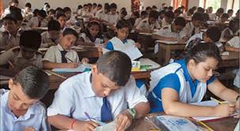
Individual work
Karim plays cricket in the field.
They have helped the boy.
He drew a picture,
He had reached madrasah before the bell rang.
They were selling fruits.
I shall have reached there before he comes.
I shall be waiting for you at the station.
They will have been working for two hours.
The driver had been driving the car for five hours.
The spring will come after the winter.
My mother is cooking rice.
I have been working since Monday.

Slide 27
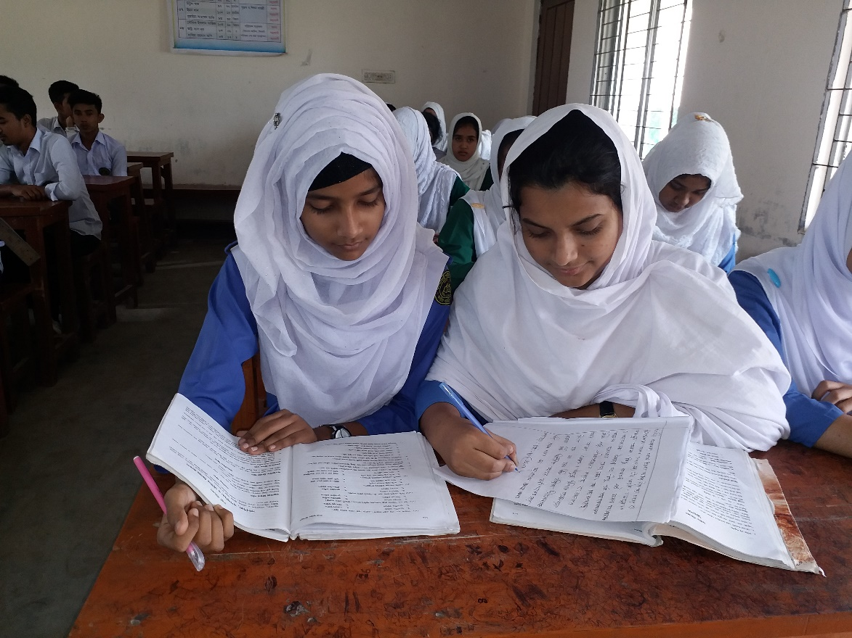
Pair work
Write down five sentences in Present Indefinite , continuous perfect and perfect continuous

Slide 28
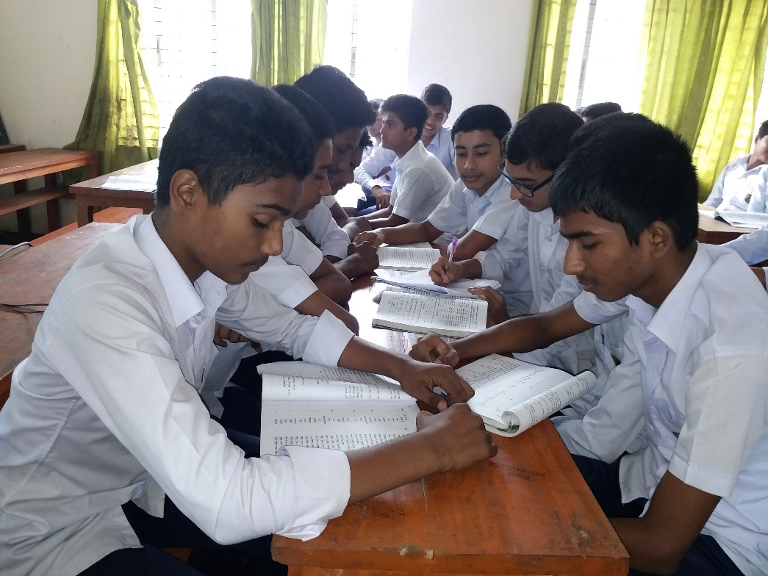
GROUP WORK
GROUP WORK
Write down five sentences in Past Indefinite , continuous perfect and perfect continuous

Slide 29
Evalution
He …….to school regularly(go)
I ………my work already(do)
I………..for two hours(read)
At present woman……an important role(play)
What …….your name?(be

Slide 30
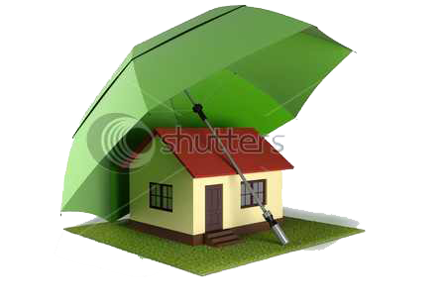
Home Task
Write down structure and examples on verious kinds of Tense.

