Slide 1
WELLCOME

Slide 2
INTRODUCTION
PALASH CHANDRA MONAL
Lecturer in English
Adarsha Degree College
Katakhali, Paba, Rajshahi
01718709334
palashchandra987@gmail.com
Subject : English
Class : Eleven
Unit : Eight
Lesson : FOUR
Topic : Flow Chart
Time : 40 Minutes

Slide 3
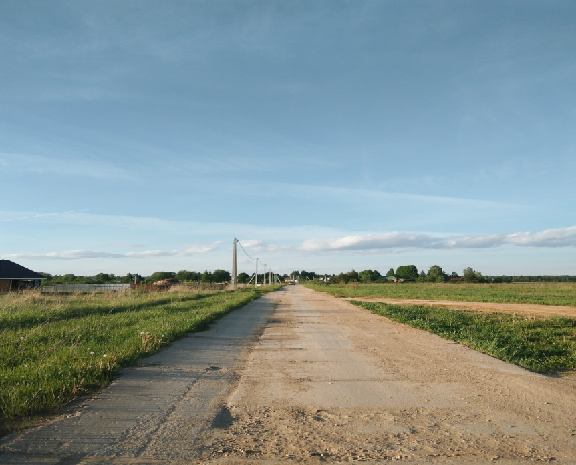
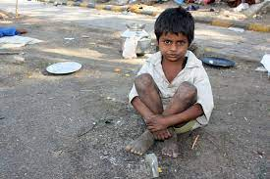
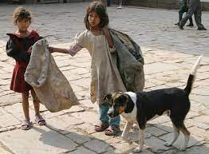
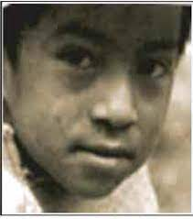
Introduce to Lesson
STREET
CHILD
AMERIGO
STREET CHILD

Slide 4
LEARNING OUTCOME
By the end of the lesson, students will be able to------
❑ write about the street child.
❑ Make correct pronunciation.
❑ New words Meaning & Sentence making.
❑ Summarize of the text.

Slide 5
DISCRIPTION OF LESSON
My name is Amerigo. I am 13 years old and I live on the street, alone. My mother, who is separated from my father, doesn’t want me. She told me to go away .... Now she is married to another man. My father lives very far away. I want to go to him, but he won't take me either. I begged him to send me some money so that I could buy a bus ticket. I am still waiting. He hasn’t answered. The streets are now my home. Sometimes I find work. I used to collect trash and sell it to a vendor. I stopped doing that after I had a serious infection and a doctor told me to stay away from the trash dump. Once I worked for an ice cream shop owner and sold ice cream on the beach. But I got no money in return. The owner of the shop gave me something to eat, and let me sleep in his hut at night. The work was difficult and painful. The ice cream box is quite heavy when it is full. I had to walk for hours, offering my ice cream to whoever wanted to buy. There were days when I could not even sell one ice cream

Slide 6
DISCRIPTION OF LESSON
In a way, I am lucky because I am alive. My friends who work sorting rubbish in dumps often suffer from serious diseases. One of them was recently killed after he fell into a hole that opened up in the pile of trash. Many of us work for 10 to 12 hours, and get so little in return that we can't even buy food. Shoe-shining is very popular among the street kids. A few of my friends also work in factories and workshops. A boy I know lost one of his eyes after a piece of hot glass flew into his eye at the glass factory where he worked. The owner refused to pay for medical help and fired him. For me, like all other children on the street, it is very hard. I am always hungry, and I donÕt know where I will sleep the next night. I would like to live in my own home and sleep there in peace. The nights are very cold in the winter. You can die of cold in the street.

Slide 7
NEW WORDS
Offering
Quite
Dump
VOCABULARY
Workshops
Factories
Suffer

Slide 8
GROUP WORK
3. Answer the following questions:
What is your impression about Amerigo's parents?
What was Amerigo’s first job? What made him stop doing that job?
How is Amerigo’s experience of selling ice cream?
d. How doesAmerigo evaluate his life now?
Does he have any option to change it?
What does Amerigo desire now? Should he desire such things?
Why/Why not? f. If you were Amerigo, what would you do?
Have you ever met a boy or a girl like Amerigo? If yes, write about him/her.
What should society do for children like Amerigo?

Slide 9
HOME WORK
Convert the following text into indirect speech.
Amerigo says, ‘In a way, I am lucky because I am alive. My friends who work sorting rubbish in dumps often suffer from serious diseases. One of them was recently killed after he fell into a hole that opened up in the pile of trash.’
2. Summarise Amerigo’s story in 150 words and give it a title which is different from the title of the lesson.
3. Make a list of the differences between yours, and Amerigo's lives:

Slide 10
Thank You

