Slide 1
Welcome to all

Slide 2
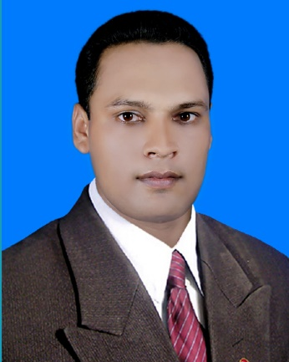
Teacher’s introducing
Mohammad Abdul Mazid
Assistant Teacher
Gopinathpur Modhyopara Govt. Primary School
Harirampur, Manikgonj.
Mobile:01716792017
Email: amazid2017@gmail.com

Slide 3
Lesson Introduching
Class: One
Subject: English
Topic: Number
Lesson: Unit 12
Time: 20 Minutes

Slide 4
What can you see?
Can you guess what we are going to learn today?

Slide 5
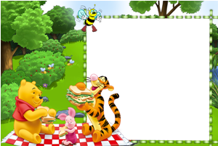
Today’s lesson
Numbers
Unite: 12

Slide 6
Learning outcomes
Students will be able-
Reading:
2.1.1 recognize and read cardinal numbers 1 to 5.
Writing:
2.1.1 write cardial numbers 1 to 5 in figures and in words

Slide 7
Let’s watch a video

Slide 8
Look, listen, say and count.
1
১1১১১
1
ball

Slide 9
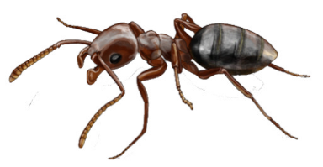
1
2
১১১১
2
ants

Slide 10
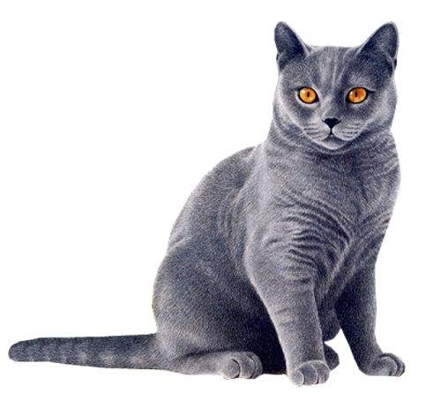
1
2
3
১১১১
3
cats

Slide 11
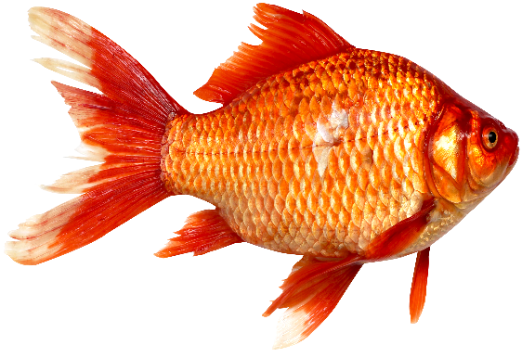
1
2
3
4
১১১১
4
fish

Slide 12
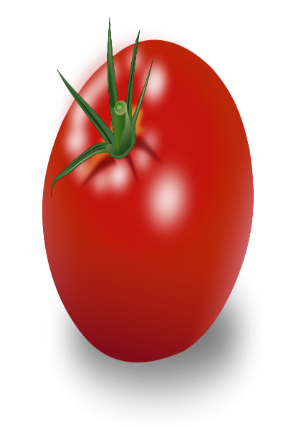
1
2
3
4
5
১১১১
5
tomato

Slide 13
Look and say.
1
2
3
4
5

Slide 14
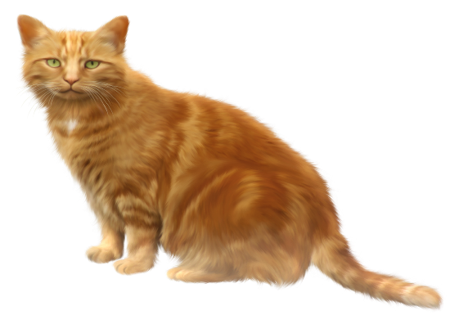
Group work
Count and write the number of the balls.
5
Group-A
3
Group-B
4
Group-C

Slide 15
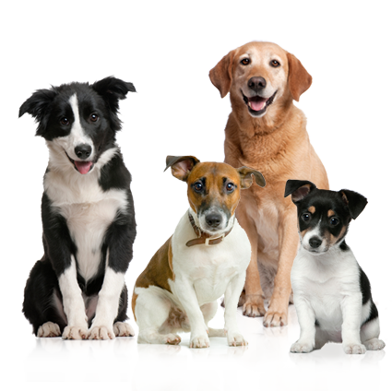
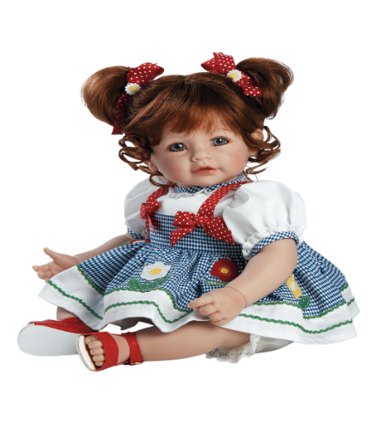
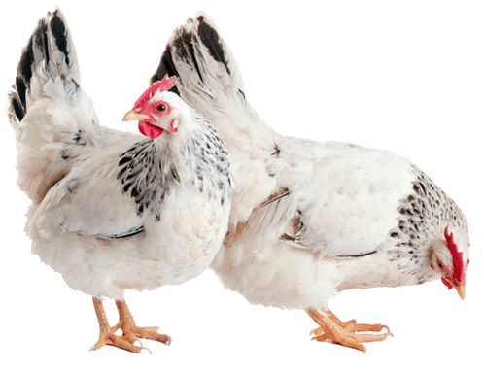
Match correctly:
P.W
1
2
3
4
5

Slide 16
Number
5
4
1
2
3

Slide 17
Open your book 24 pages

Slide 18
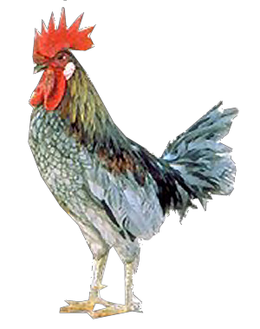
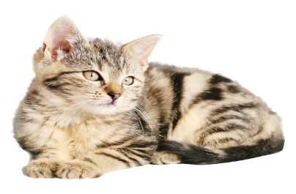
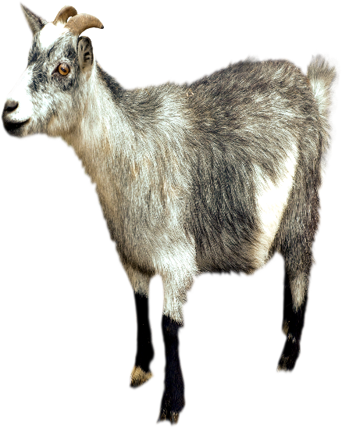
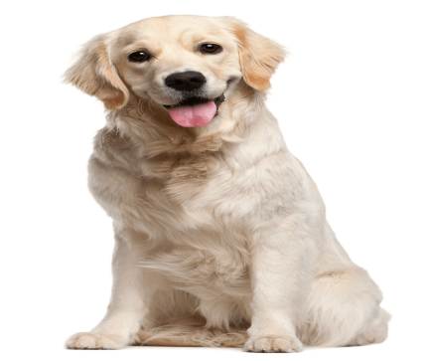
Evaluation
Count and write the numbers.
4
1
5
3
2

Slide 19
Say , trace and write.
1
1
2
2
3
3
4
4
5
5

Slide 20
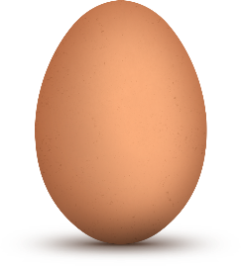
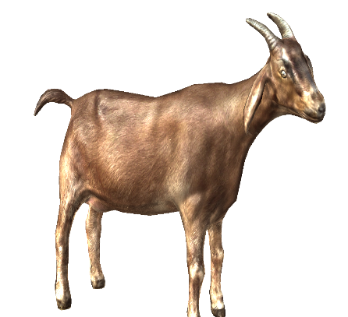
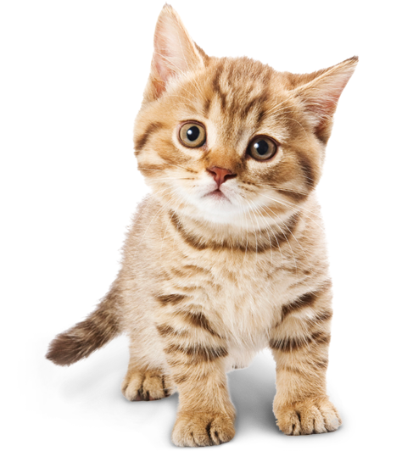
Count , trace and write.
5
4
1
goat
eggs
balls
2
3
dogs
cats

