Slide 1
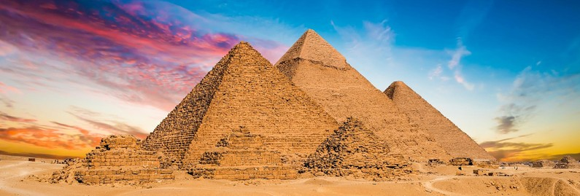

W
L
O
E
E
C
M

Slide 2
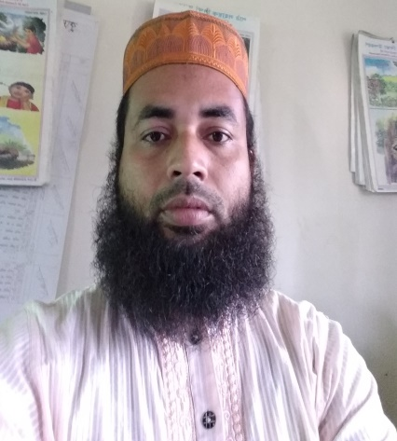
Teacher’s identity
Md.Afzal Hossain
Assistant teacher
Kuralia Govt. Primary School

Slide 3
Lesson’s identity
Subject: English
Class: Five
Unit: 8
Lesson: 1-2
Title of the unit: Eat healthy.

Slide 4
Learning outcomes:
The students will be able to-
Listening
1.1.1-recognize sound differences in the context of word.
3.4.1-understand statements made by teacher and students.
4.2.1-understand and enjoy simple stories.
Speaking
1.1.1-repeat after the teacher and say words, phrases and sentences with proper sounds and stress.
Reading
1.5.1-read words phrases and sentences in the text with proper pronunciation, stress and intonation.
1.7.1- read simple paragraphs, dialogues and simple letters.
7.1.1-recognize punctuation marks and read accordingly.

Slide 5
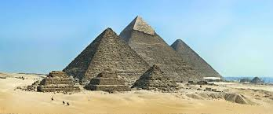
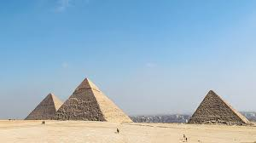
Let’s see some pictures
Pyramid

Slide 6
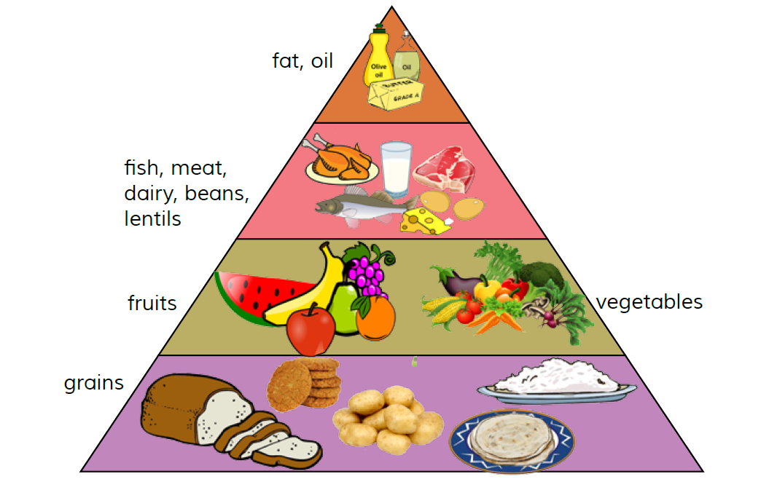
Food Pyramid

Slide 7
Today’s lesson
Food Pyramid

Slide 8

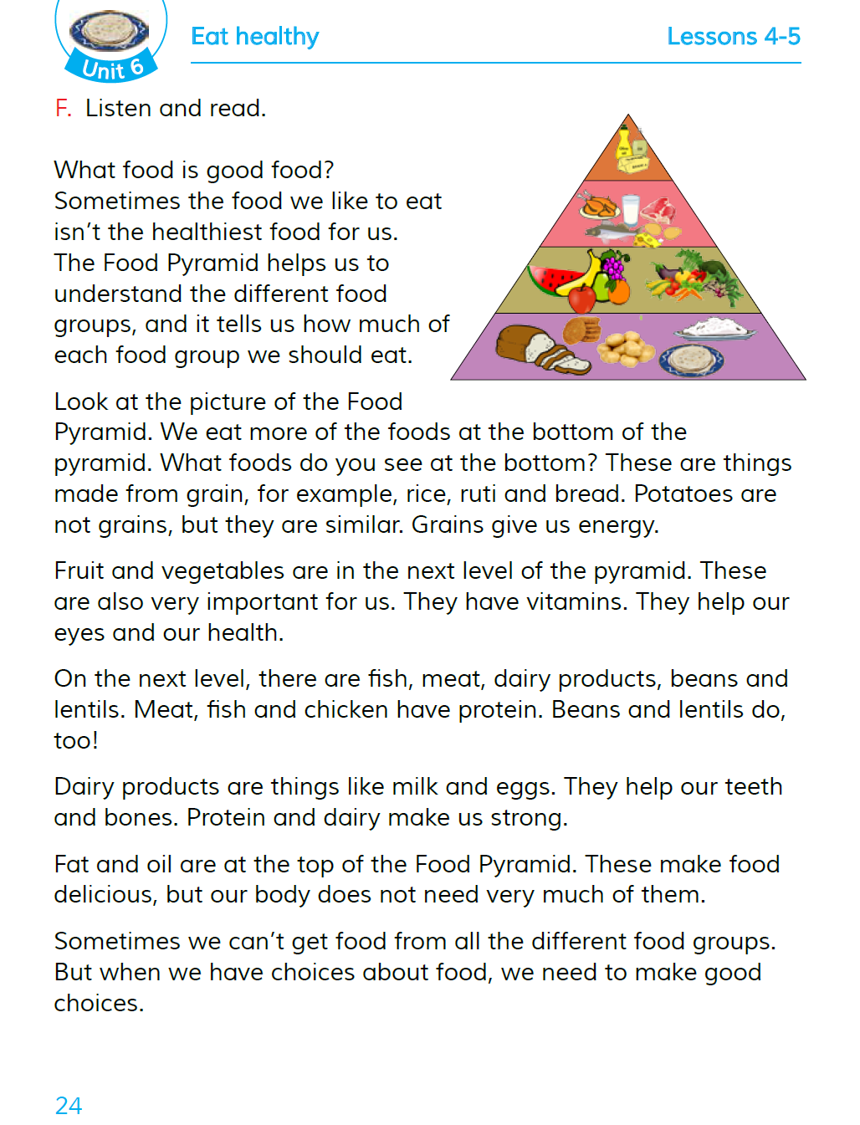
Open your book at page 24

Slide 9
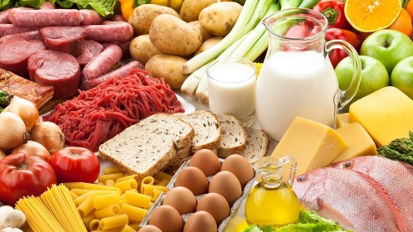
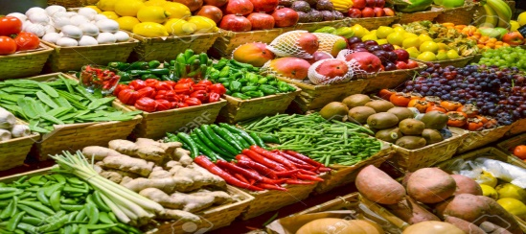
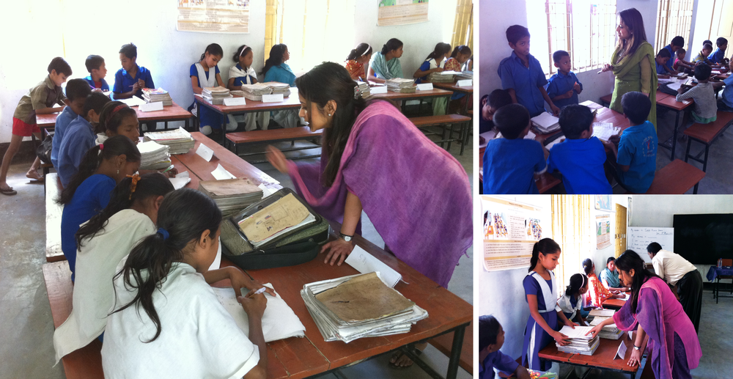
Let’s see some new words
Food
eatable things
Sometimes
now and then
Different
various
Group
a cluster

Slide 10
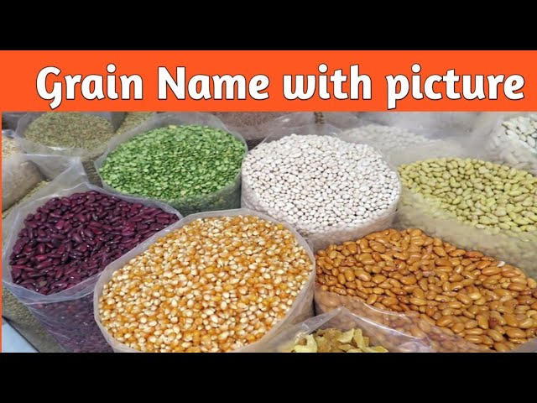
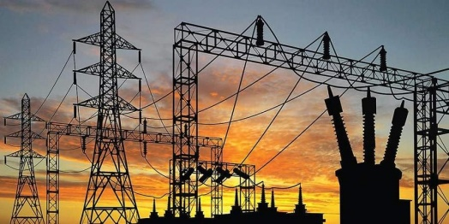
Pyramid
a pile of stone
Bottom
lower level
Grain
cereal
Energy
power
Important
necessary

Slide 11
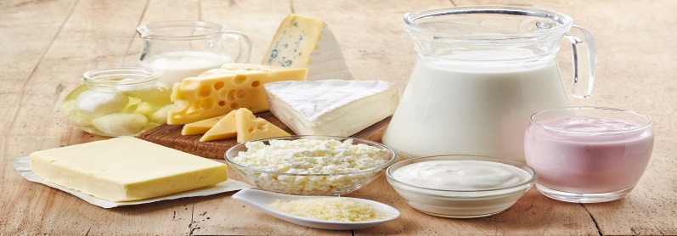
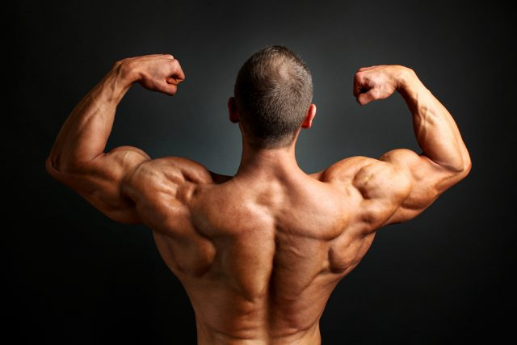
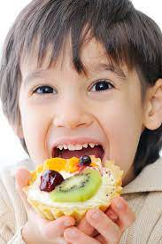
Dairy
things made from milk
Strong
powerful
Delicious
tasty

Slide 12
Match the words with their meanings
G.W
Column A | Column B
a) Food | i) power
b) Sometimes | ii) a pile of stones
c) Pyramid | iii) necessary
d) Important | iv) eatable things
e) Energy | v) now and then

Slide 13
Check your answer paper
a) Food – eatable things
b) Sometimes – now and then
c) Pyramid – a pile of stones
d) Important - necessary
e) Energy - power

Slide 14
Answer the following questions
P.W/ I.W
a) What is a food pyramid?
b) How does the food pyramid help us?
c) What food do you see in the bottom level?
d) How do vitamins help us?
e) Write two food items that we get from animal?
f) What food should you eat to be healthy?

Slide 15
Check your answer paper
Food pyramid is a chart of food that helps us to understand different food groups.
The food pyramid helps us to understand the different food groups, and it tells us how much of each food group we should eat.
In the bottom level we can see grains, for example, rice ruti and bread.
Vitamins help our eyes and our health.
We get milk and meat from the animals.
We should eat healthy food to be healthy.

Slide 16

I.W
Home work
Write five sentences about ‘Food Pyramid’.

Slide 17

Good bye.
Bye
Bye

