Slide 2
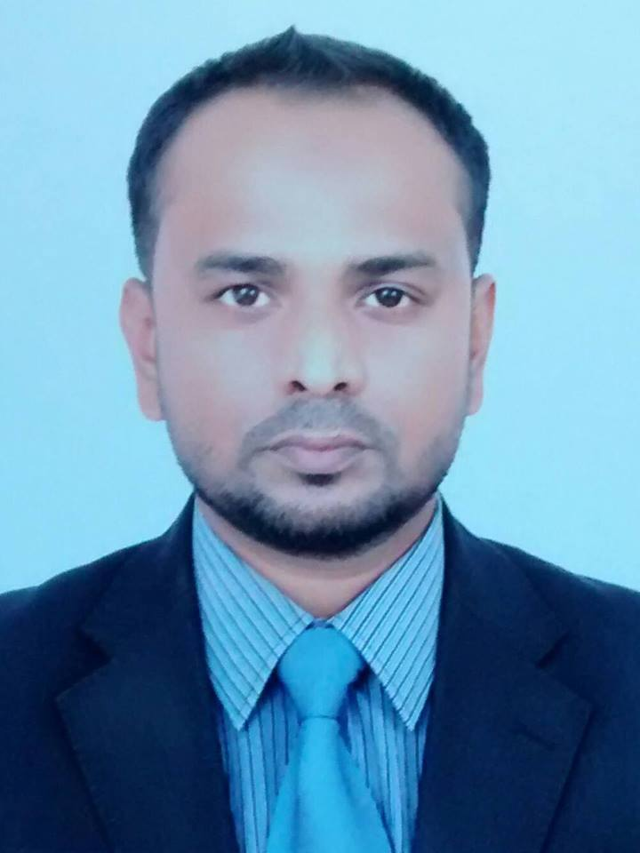
Introducing
Murshed Ahmed
Assistant Teacher
Raka G P S
Moulvibazar Sadar.

Slide 3
Introduction of the lesson
Class: Four
Subject: English
Unit: 12
Lesson: 1-2
Title: Days Of The Week
Time: 40 Min.

Slide 4
Learning outcome
After the end of the lesson students will be able to…..
1.1.1 Read words, phrases and sentences in the text with proper pronunciation, stress and intonation.

Slide 5
Lets watch a video

Slide 6
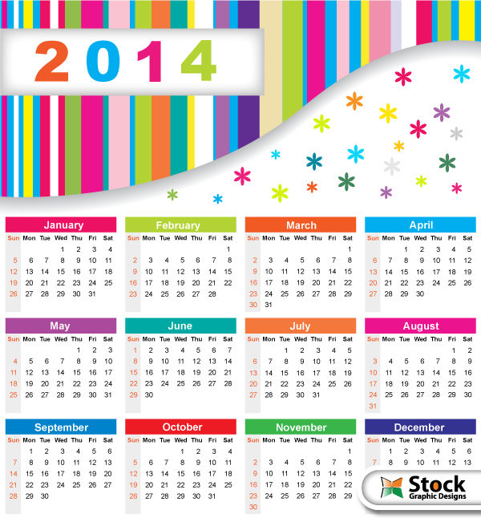
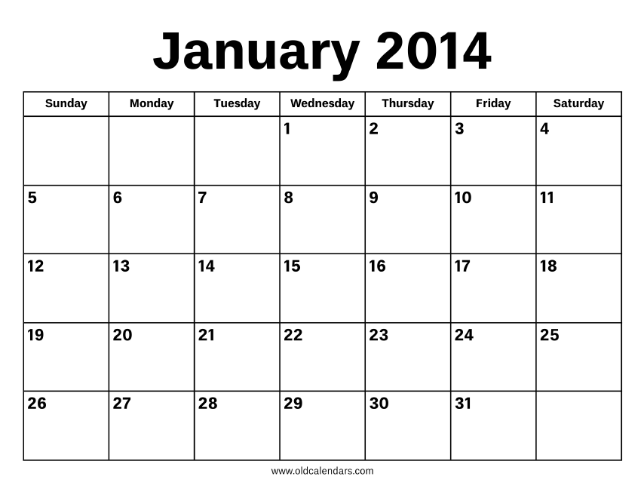
Look at the
calendar
Month
Year
Day
Date
What do
you
See?

Slide 7
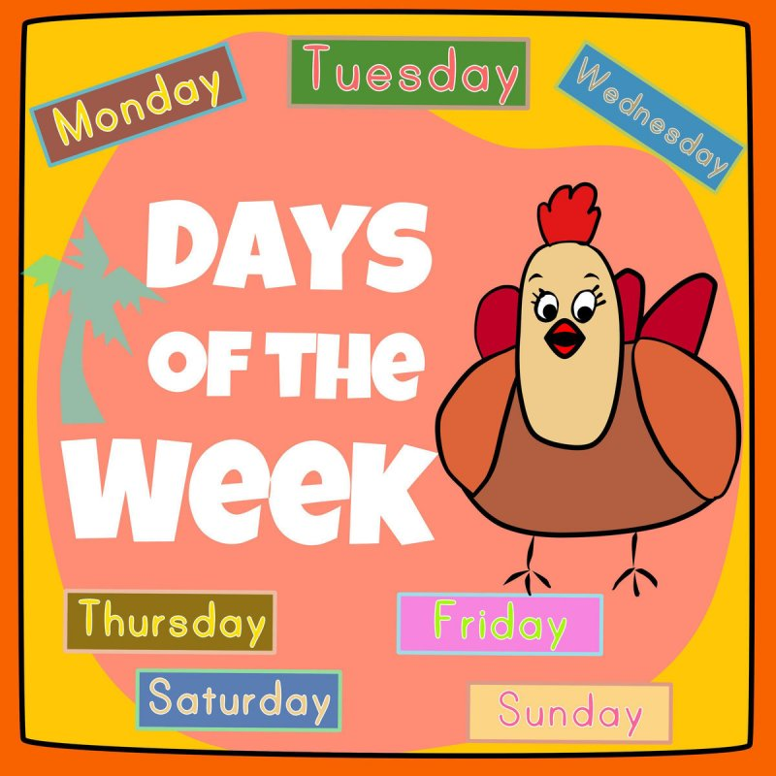
Tittle of the lesson

Slide 8
There are seven days in a week.
SATURDAY
FRIDAY
THURSDAY
SUNDAY
WEDNESDAY
MONDAY
TUESDAY

Slide 9
Saturday
is
the
first day of the week

Slide 10
Sunday
is
the
second day of the week

Slide 11
Monday
is
the
third day of the week

Slide 12
Tuesday
is
the
fourth day of the week

Slide 13
Wednesday
is
the
fifth day of the week

Slide 14
Thursday
is
the
sixth day of the week

Slide 15
Friday
is
the
seventh day of the week

Slide 16
How many days are there in a week?

Slide 17
Saturday
Days
Of
The
Week
Sunday
Monday
Tuesday
Wednesday
Thursday
Friday

Slide 18
Now ask and answer in pairs
1.What day is it today ?
2.What day was it yesterday?
3.What is the last day of the week?

Slide 19
Complete the sentences
with the correct day or ordinal number word.
Saturday is the _______ day of the week.
_______ is the second day of the week.
Monday is the _______ day of the week.
_______ is the fourth day of the week.
Wednesday is the _______ day of the week.
_______ is the sixth day of the week.
We don’t go to school on _______. It is weekend. We go to school on _______, _______, _______, _______, _______
and _______. These are weekdays, or working days.

Slide 20
What day is the weekly holiday in our country?

Slide 21
Raise your hand
HURRAY!
Friday

Slide 22
Home work
Everybody will make a day card by using colour paper

