Slide 1
WELCOME TO EVERYBODY

Slide 2
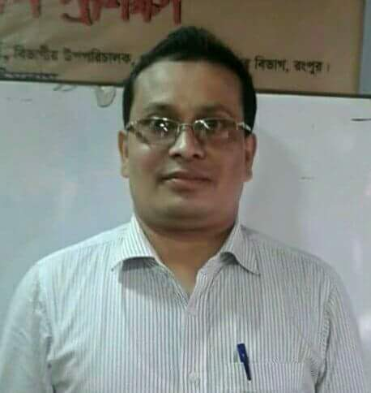
Teacher’s identity
Md. Rabiul Islam
Asst. teacher of
Boraibari Govt. Primary School
Gangachara , Rangpur.
ICT4E district ambassador
Mobile 01722667673
Email # rabiulrabi1981@gmail.com

Slide 3
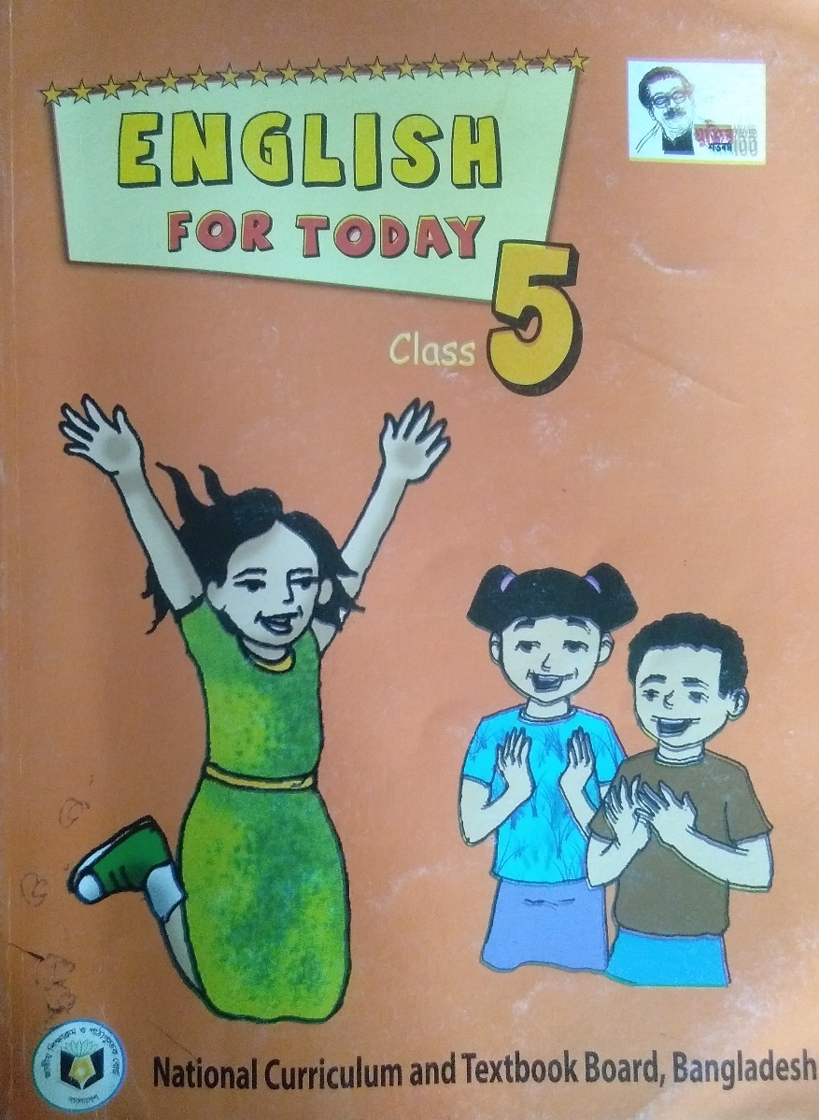
Lesson identity
Subject :English
Class: Five
Lesson : Cyclone Aila
Lesson’s part : By the evening……..live for the future.
Time:40 minutes
Date:22/11/2021

Slide 4
Learning outcomes
By the end of the lesson students will be able 1.1to know new words and make sentences.
1.2 to read the text with correct pronounciation.
1.3 to answer the short question about the topic.

Slide 5
Look at the Picture
What can you see in the picture ?

Slide 6
This is a picture of cyclone

Slide 7
Today’s lesson
Cyclone Aila

Slide 8
Word meaning

Slide 9
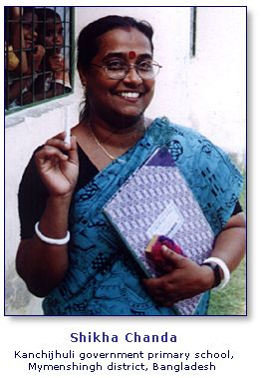
Government
সরকারি

Slide 10
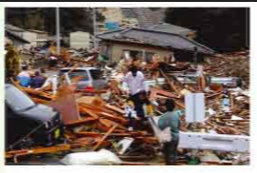
Earthquake
ভূমিকম্প

Slide 11
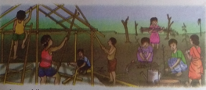
Repair
মেরামত করা

Slide 12
Afraid
ভীত

Slide 13
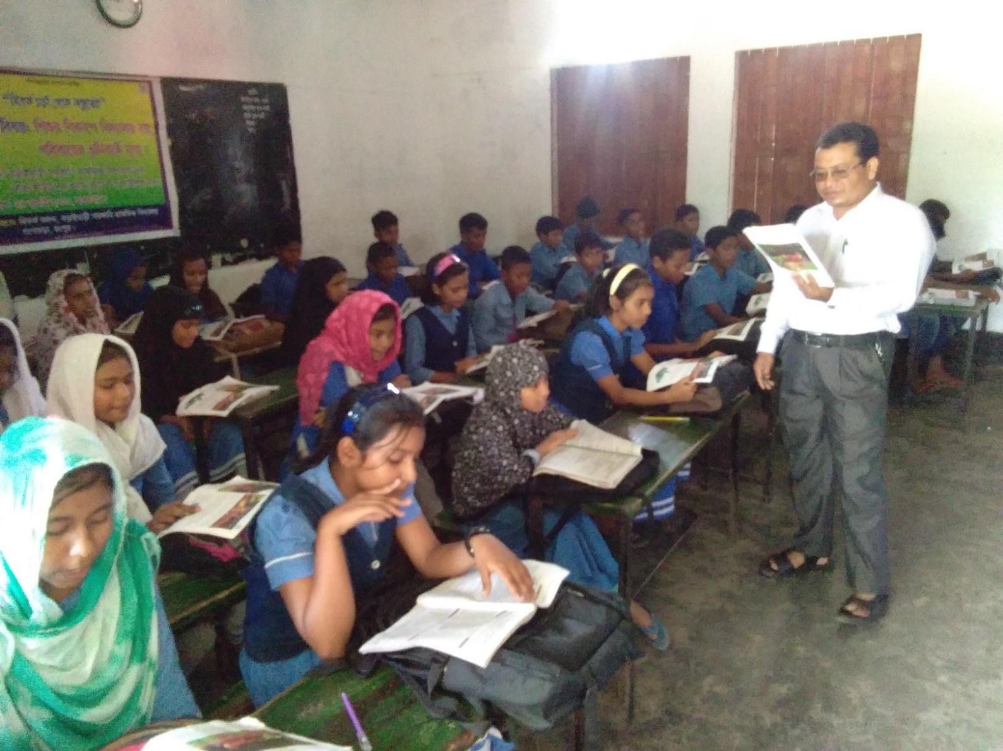
Teacher’s model reading
Open page at 95

Slide 14
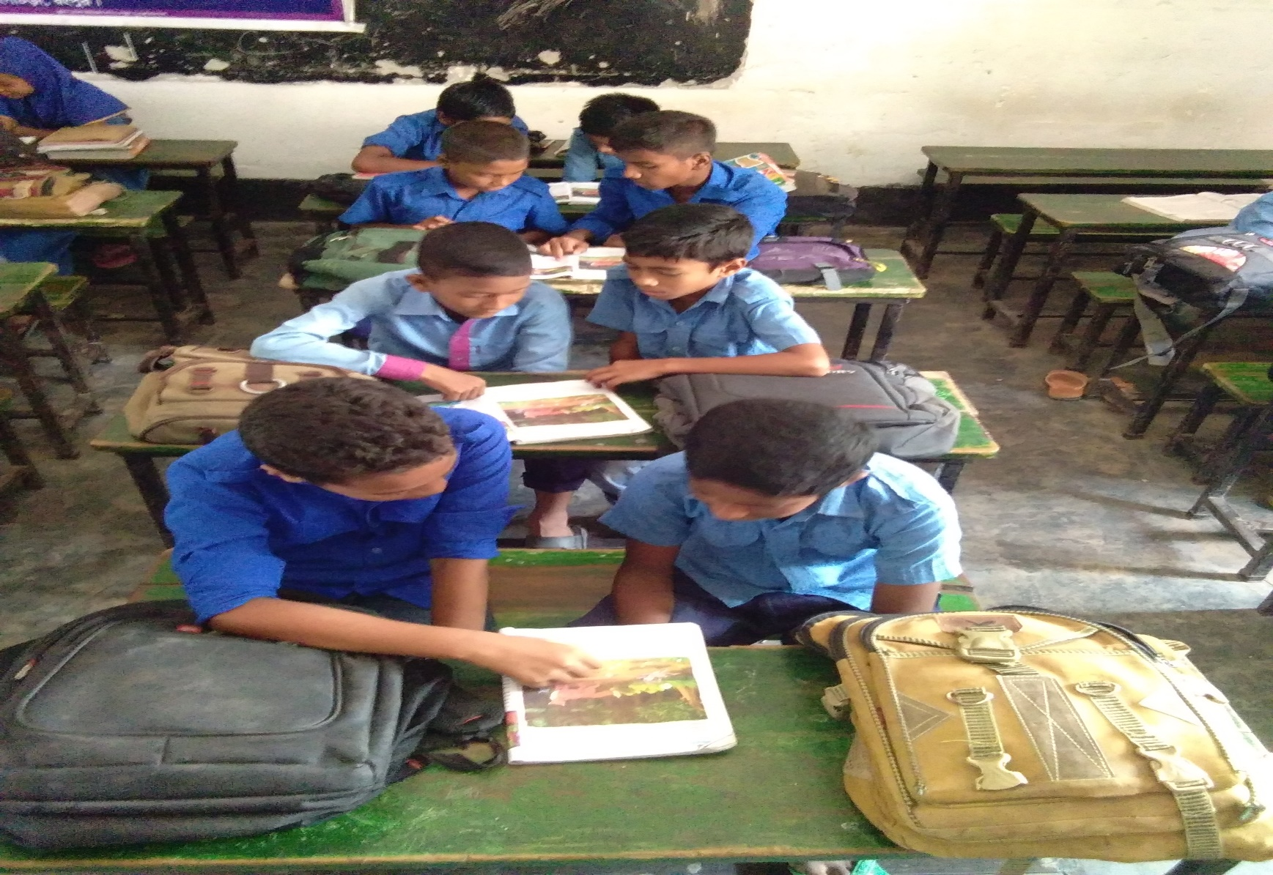
Everybody read the text individually

Slide 15
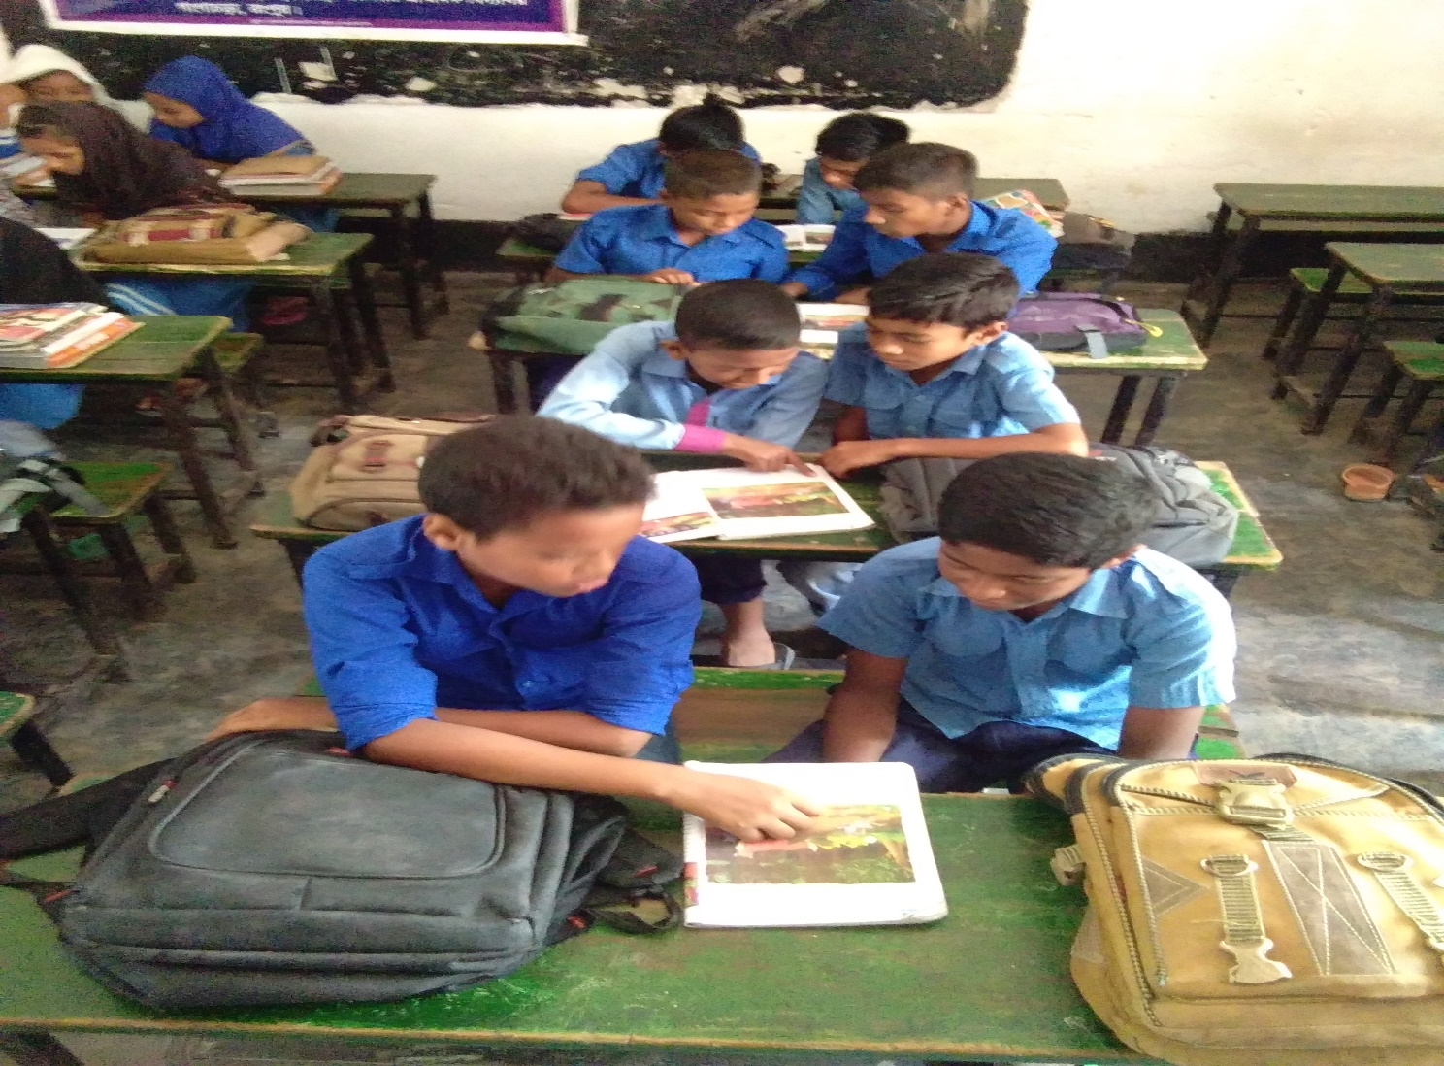
Work in pairs

Slide 16
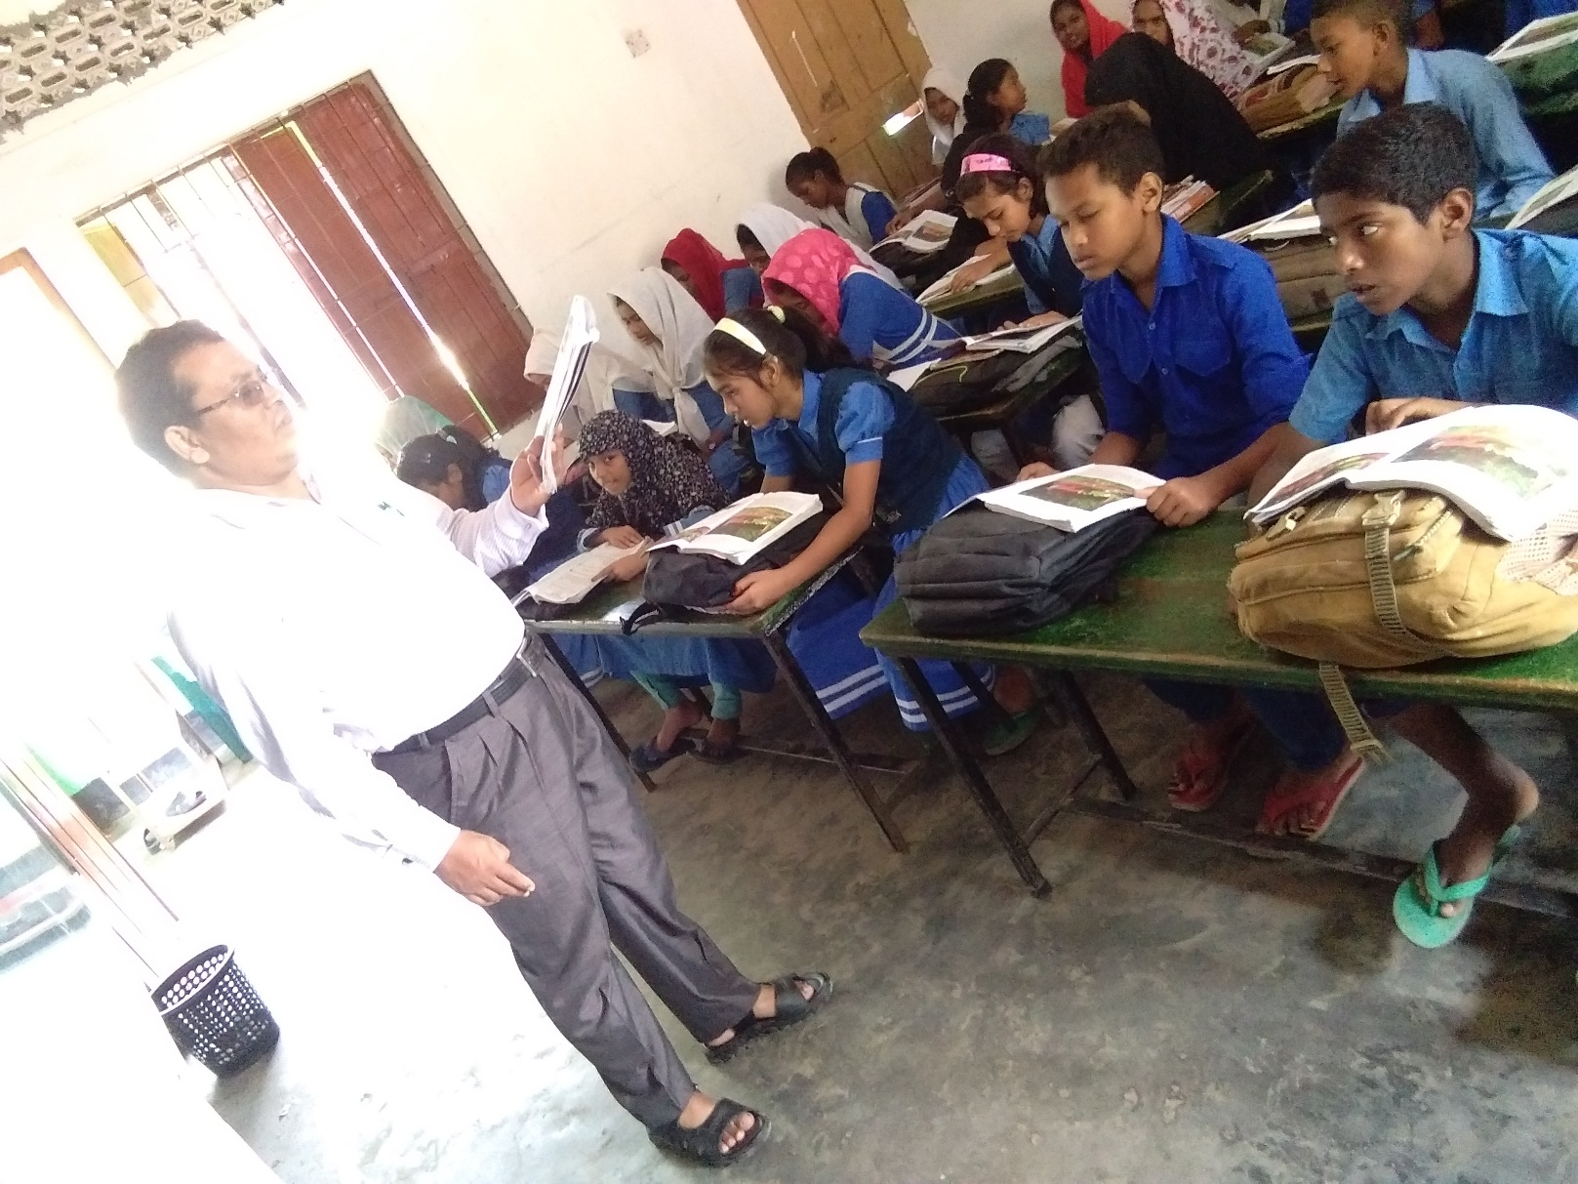
Student’s reading with teacher

Slide 17
Make sentences
Awful – It was an awful night .
Dark – It was a dark night .
Remember – I can’t remember anything .
Many – There is many birds in the tree .

Slide 18
Ask and answer the following questions -
a)Who worked together ?
b) What does Babul’s mother do ?
c)Who helped the people to recover from the disaster ?

Slide 19
Follow the answers :
a) People worked together .
b) Babul’s mother is a worker in a fish farm .
c) The government of Bangladesh and workers from NGOs helped the people to recover from disaster .

Slide 20
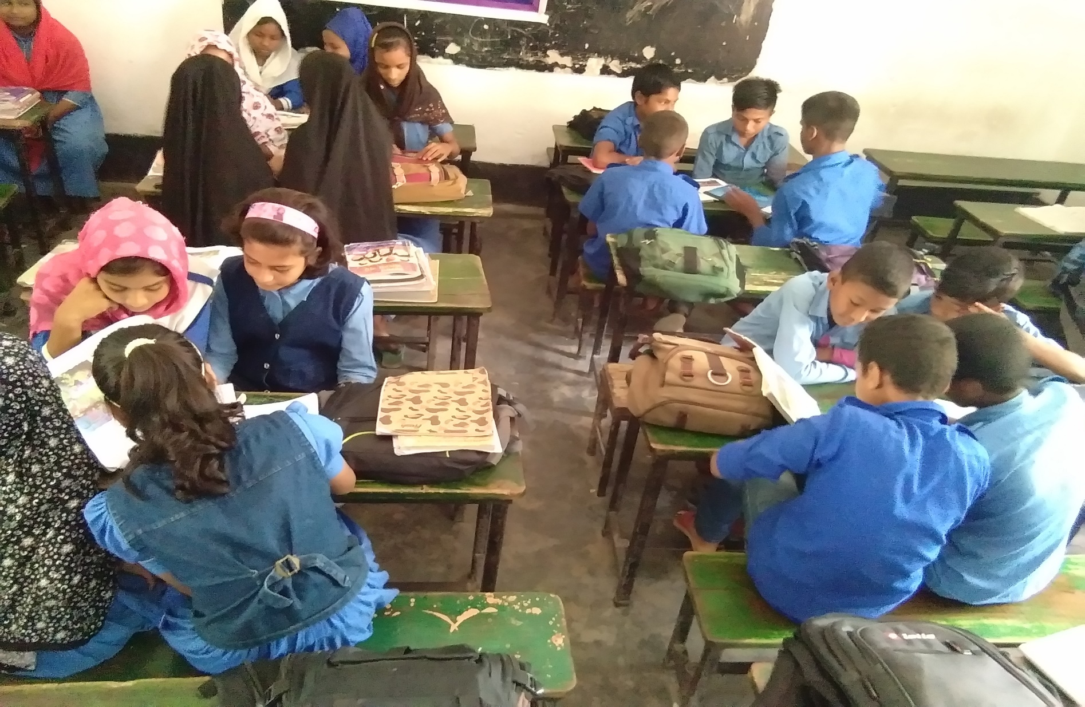
Group work

Slide 21
Babul
Write opposite word
Go
Build
remember
Crush
forget
Come

Slide 22
Nipa group
Use capital letters and punctuation in the following sentences
His grandmother says don’t be sad babul grandfather wants us to live for the future.

Slide 23
Follow the answer
His grandmother says, ‘’Don’t be sad , Babul . Grandfather wants us to live for the future.’’

Slide 24
One day one word
Crops
শস্য

Slide 25
Home work
1.Write five sentences about what will you do if your locality attack by a cyclone .

Slide 26
Thanks
Every body
Wear mask , wash your hands with soap .

