Slide 1
Welcome………..

Slide 2
Introduction of the Teacher
Faruk Ahmed
Assistant Teacher
Hossenpur government primary school
Narsingdi sadar, Narsingdi

Slide 3
Introduction of the leasson
Class one
Subject :English
Lesson:Alphabet
Part of lesson :Q ,R
Time :40 min.

Slide 4
Learning outcomes:
Listening:To become familiar with English sounds by listening to common Enlish words.
Speaking :To repeat after the teacher simple words and phrases.
Reading:To recognize and read the alphabet both small and capital.
Writing:To practice letter shapes/simple writing patternt.

Slide 5
Lets listen a music

Slide 6
Todays Lesson:
Alphabet:Q q,R r

Slide 7
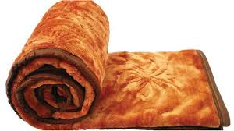
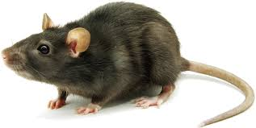
Look, Listen and say
Quilt = Q
Rat =R
rat = r
quilt= q

Slide 8
Book = page 43

Slide 9
Look, Listen and say
Rat =R
Quilt = Q
quilt= q
rat = r

Slide 10
Chequing learning
_uilt,
_at

Slide 11
Thanks All……….

