Slide 1
GOOD MORNING

Slide 2
Introduction of the teacher
Faruk Ahmed
Assistant Teacher
Hossenpur Govt. Primary School
Sadar, Narsingdi.

Slide 3
Introduction of the lesson
Class : One
Sub : English
Unit : 23
Lesson :1-3 (A)
Time : 40 mints

Slide 4
Learning outcomes:
By the end of the lesson the students will able to
Listening : 1.1.1-become familiar with English sounds by listening to common English Words.
Speaking : 1.1.1 –repeat after the teacher simple words and phrases.
1.1.2-say simple words and phrases.

Slide 5
In the room
Notes:
Lesson declaration

Slide 6
Open the book at page 46

Slide 7
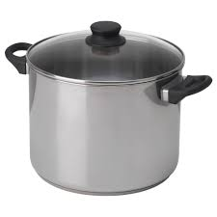
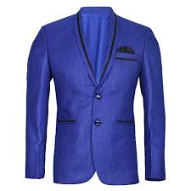
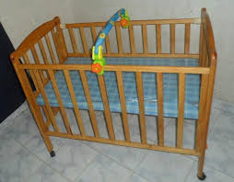
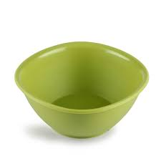
Look,Listen and Say
Coat
Pot
Cot
Dish
Notes:
Input

Slide 8
Coat
Pot
Listen to me
Cot
Dish
Notes:
Input

Slide 9
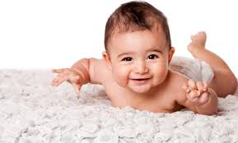
Coat
Pot
Cot
Dish
Listen and say
Notes:
Input

Slide 10
Whole class work
Cot
Pot
Dish
Coat
What is this?
Notes:
Practice

Slide 11
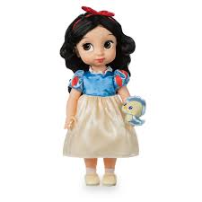
Pair work
Pot
Dish
Cot
Notes:
Practice

Slide 12
Cheeking Learning
Pot
Dish
Coat
Notes:
Indivisual work

