Slide 1
WELCOME …

Slide 2
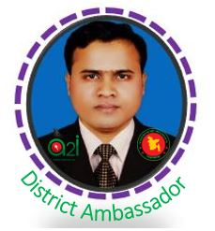
Teacher’s introduction
Md. Rafiqul Hasan
Assistant Teacher
Khonkarkhil Government Primary School
Sadar, Cox's Bazar.
email: rafiquecox1@gmail.com

Slide 3
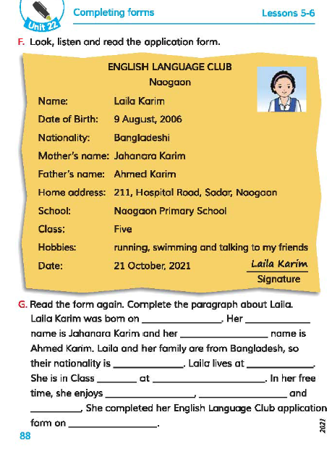
Lesson’s introduction
Class: 5, Sub: English
Unit: 22
Title: Completing Forms
Part of lesson: F & G
Page no: 88, Time: 45 Min.

Slide 4
Let’s sing a song.

Slide 5
Learning outcomes
Listening:
3.4.1 understand statements made by the teacher and students.
Reading:
1.5.1 read words, phrases and sentences in the text with proper proper pronunciation, stress and intonation.
1.7.1 read paragraphs, dialogues, stories, letters and other texts.
5.1.4 read silently with understanding personal letters and other texts materials.
Writing:
6.1.2 use capital letters for proper nouns.
12.1.1 fill in simple forms about oneself and others.

Slide 6
Look, read and write
Noakhali Library
Name
Home Address: _________________________________
School : _______________________________________
Class : __________________ Age: ___________________
Signature : ______________________________________

Slide 7
F. Look , listen and read the application form.
ENGLISH LANGUAGE CLUB
NAOGAON
Laila Karim
9 August , 2006.
Bangladeshi
Jahanara Karim
Ahmed Karim
211 , Hospital Road , Sadar , Naogaon
Naogaon Primary School
Five
Running, swimming and talking to my friends.
21 October, 2016
Name:
Date of birth:
Nationality:
Mother’s name:
Father’s name:
Home address:
School:
Class:
Hobbies:
Date:
Laila karim
Signature

Slide 8
Word meaning
Address
ঠিকানা
Address means place / name of place

Slide 9
Word meaning
Nationality
জাতীয়তা
Nationality means the status of belonging to a particular nation.

Slide 10
Word meaning
Hobby
শখ
Hobby means an activity done regularly in one's leisure time for pleasure.

Slide 11
Word meaning
Complete
সম্পূর্ণ করা
Complete means whole

Slide 12
Word meaning
Club
ক্লাব
Club means an association dedicated to a particular interest or activity.

Slide 13
Word meaning
Application
দরখাস্ত
Application means a formal request / request / claim.

Slide 14
G. Read the form again . Complete the paragraph about Laila.
Laila Karim was born on _____________________. Her ___________________ name is Jahanara Karim and her _________________name is Ahmed Karim. Laila and her family are Bangladesh, so their nationality is ________________. Laila lives at ____________________. She is in Class _____ at ___________________________. In her free time, she enjoys _________ , _______________ and ___________________. She completed her English Language Club application form on_____________________________________.

Slide 15
G. Read the form again . Complete the paragraph about Laila.
9 August , 2006
Laila Karim was born on _____________________. Her ___________________ name is Jahanara Karim and her _________________name is Ahmed Karim. Laila and her family are Bangladesh, so their nationality is ________________. Laila lives at ____________________. She is in Class _____ at ___________________________. In her free time, she enjoys _________ , _______________ and ___________________. She completed her English Language Club application form on_____________________________________.
mother’s
father’s
Bangladeshi
Naogaon
five
Naogaon Primary School
running
swimming
talking to her friends
21 October, 2016

Slide 16
Students today we will read Form Filling.
Read the text and answer the questions no: 13.
1. Suppose, you are Faiza Tabassum. You are a student of class five. Your date of birth is 5 June, 2015. You live with your parents in Dhaka. Your father’s name is Md. Rafiqul Hasan and mother’s name is Fahmida Najnine. You want to be a member of your school library. Now, fill up the following form using the given information.

Slide 17
Form Filling
Membership Form
1. Name :
2. Father’s name :
3. Mother’s name :
4. Date of birth :
5. Class :
6. Address : Signature

Slide 18
Form Filling
Membership Form
1. Name :
2. Father’s name :
3. Mother’s name :
4. Date of birth :
5. Class :
4. Address : Signature
Faiza Tabassum
Md Rafiqul Hasan
Fahmida Najnine
05-06-2012
Five
Dhaka
Faiza

Slide 19
Evaluation
Suppose, you are Adnan / Farhana. Your father is Mr. Habib Hasan and mother is Amena Begum. Your date of birth is 12 February, 2010. You are a student of class five. Now fill up the form by using Adnan’s / Farhana’s information.
Language Club Membership Form
1. Name :
2. Father’s name :
3. Mother’s name :
4. Date of birth :
5. Class :
Signature

Slide 20
Home work
Suppose, you are Tuhin. Your father is Mr. Tutul Mia and mother is Habiba Khatun. Your date of birth is 25 March, 2011. You are a student of class five. Now fill up the form by using Tuhin’s information.
Language Club Membership Form
1. Name :
2. Father’s name :
3. Mother’s name :
4. Date of birth :
5. Class :
Signature

Slide 21
That's all for today
See you tomorrow

