Slide 1
welcome

Slide 2
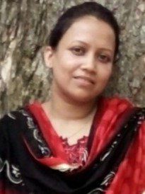
Nasrin jahan
Assistant teacher
53 no govt Batikamary primary school
Muksudpur , Gopalgonj.

Slide 3
LESSON IDENTITY Class:Three, Subject:English Lesson:Food we need ,Unit:36 Lesson:(1-3) Time:40 min

Slide 4
LEARNING OUTCOMES
Students will be able to-
Listening:1.1.1-Recognize English sound differences in the context of words
Speaking:1.1.3-Repeat words phrases &sentences after the teachers with proper sounds & stress.
Reading:1.4.1-Read & match words & sentences with pictures.
Writing:8.1.1-Write words from the text or model

Slide 5
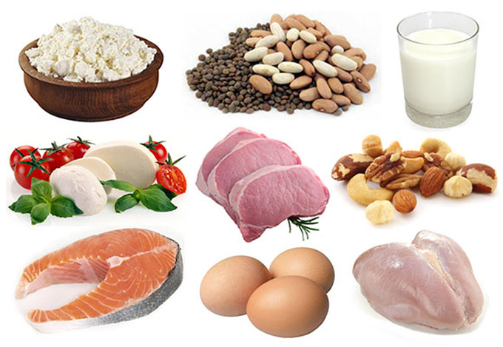
SEE THE PICTURE

Slide 6
LESSON DICLARETION
Food we need

Slide 7
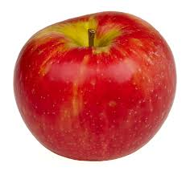
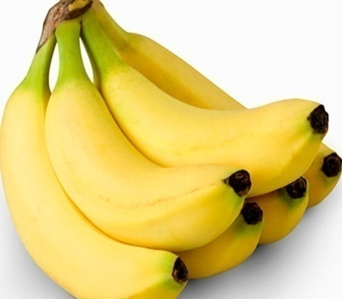
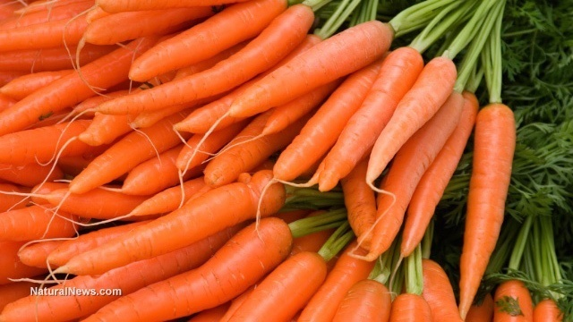
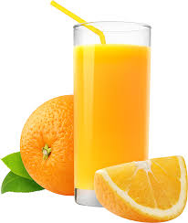
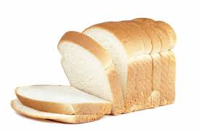
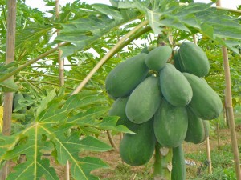
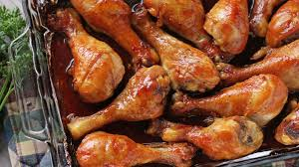
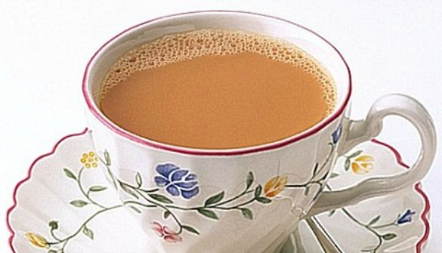
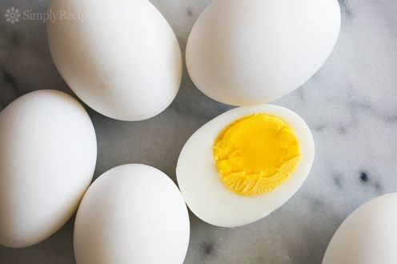
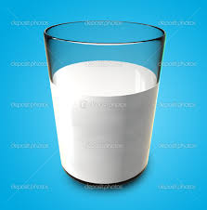
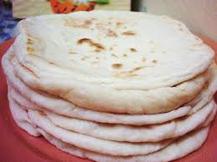
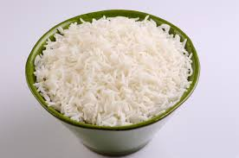
DIFFERENT KINDS OF FOOD

Slide 8
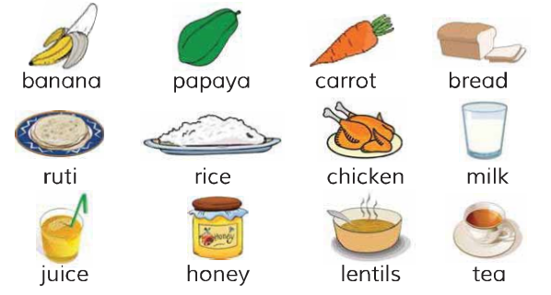
Write the food from beside activity in the correct list
Food from plants & trees | Food from animals
We read the text

Slide 9
1.Name other 5 foods .Are they from plants and trees or from animals.
EVALUTION

Slide 10
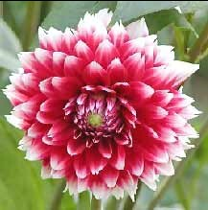
THANK YOU

