Slide 1
Welcome to all in my multimedia class “English For Today”

Slide 2

Md. Jakir Mallik
Assistant Teacher
Sholpur Govt.Primary School
Shopur, Kabirajpur,Rajoir, Madaripur
jakir1985c@gmail.com
Mobile : 01718306380
Teacher’s Identity

Slide 3
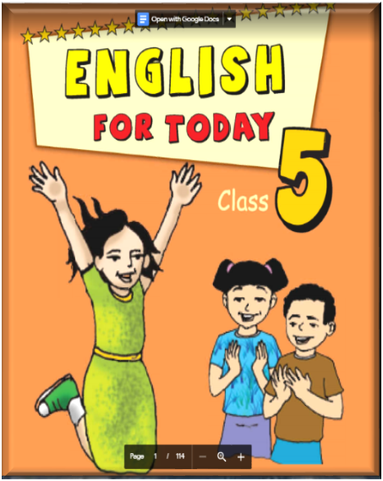

Subject’s Identity
Class: Five
Subject: English
Time: 40 Minute
Date: 05.12.2021

Slide 4
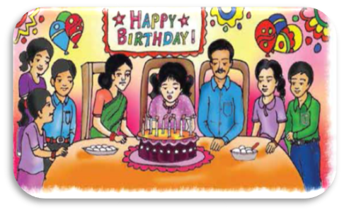
Let’s see some picture
Put out the candle
Birthday party
What kinds of picture do you see in the picture?Can you guess?Yes,I think,you can guess.This picture refers is …………okay,thank you.

Slide 5

Today we are going to read-
“Happy Birthday”
Unit-15, Lessons -1
Lesson part:A person’s..... and family. Page -58

Slide 6



Learning outcomes
By the end of the lesson students will be able to…
  Listening:4.2-to enjoy and understand simple stories.
Speaking:1.1.1-to say words, phrases and sentences with proper sounds, stress and intonation.
Reading:1.4-to read words, phrases and sentences in the text with proper pronunciation, stress and intonation.
Writing:5.1.1-to write words, phrases and sentences in the text.

Slide 7
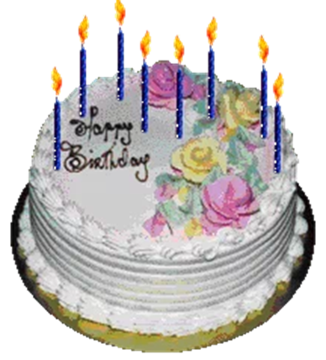

Introducing new words
Birthday
A birthday is a special day when a person was born.
name day or natal day
জন্মদিন

Slide 8
উদযাপন করা
observe
or, recognize
People around the world celebrate birthdays in different ways.
Celebrate

Slide 9

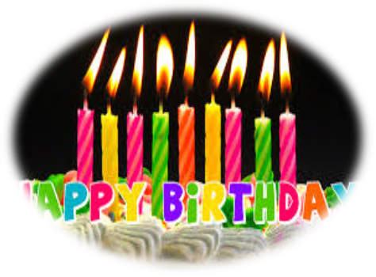
মোমবাতি
Wax light or rushlight
There is one candle for each year of the person’s life.
Candle

Slide 10
বিশেষ
A Person’s birthday is a special day.
Particular or certain
Special

Slide 11

রঙ্গিন
The gifts are wrapped in colourful paper.
bright
or, rainbow
Colourful

Slide 12
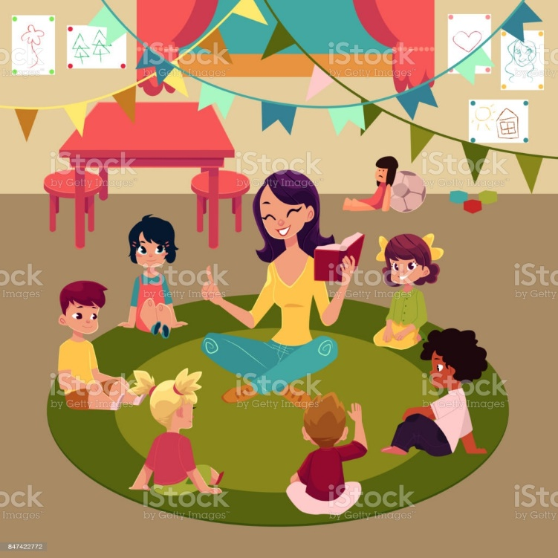
Teacher speaking
loudly

Slide 13
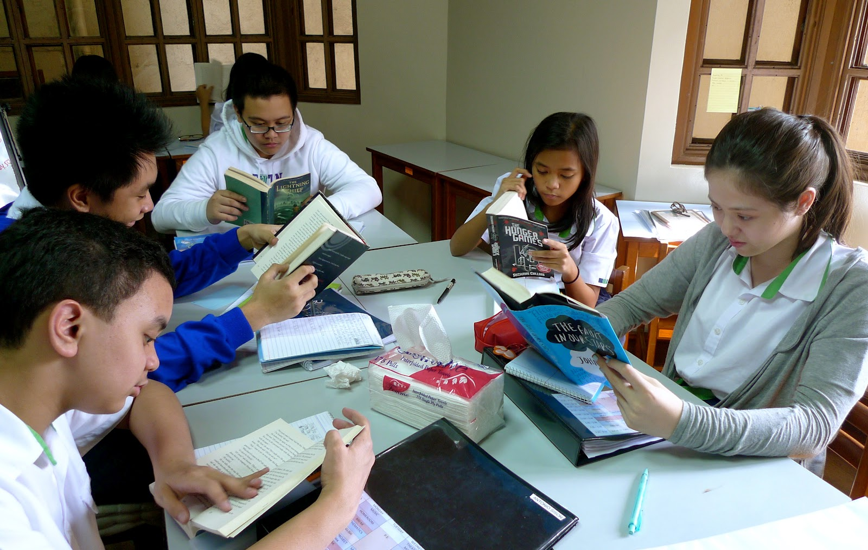
Students speaking loudly

Slide 14
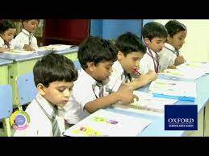
Students silent reading

Slide 15
Match the words of the column A with their meanings in column B
Column-A | Column-B
a. Blow out | i) to take something to a place.
b.Different | ii) to cover something completely.
c. Bring | Iii) to be extinguished by an air.
d.Wrap | iv) perceive with eyes.
e.Sing | v) without any doubt.
 | vi) not the same.
 | vii) to make musical sounds with the voice.

Slide 16
Fill in the blanks.
born
special
placed
eat
candles
a. A birthday is a ----------- day to a person.
b. We ----------- special foods on birthday party.
c. We light ----------- on the birthday cake.
d. Candles are ------------ on the birthday cake.
e.This is the day when someone was------------ .

Slide 17
Read the sentences. Write T for True or F for False
a) A birthday is the date when a person was born.
True
b) People celebrate birthdays in the same way around the wor.
False
c) The friends and family blow out the candles on a birthday cake.
False
d) Children in some countries in the same way around the worl
False
e) Gifts are the most important thing for celebrating a birthday.
False
True
f) Books are often given as a birthday gift.

Slide 18
Answer the following questions:
Question: 1. What is birthday ?
Ans:A birthday is a day when a person is born.
Question : 2. What is the most important thing on birthday?
Ans:The most important thing on a birthday is to enjoy the day and spend time with friends and family.
Question : 3. Who bring gifts for a child on its birthday?
Ans:A child’s friends bring gifts on its birthday.

Slide 19
Answer the following questions:
Question :4. What type of gifts are given on a birthday ?
Ans:The gifts are given on a birthday are toys,books,clothes etc.
Question: 5. What do the children do on a birthday?
Ans:On a birthday,the child play games,sing songs and enjoy the day.

Slide 20
Group work
I will ask the students to divided into several groups. They will
The Padma | The Meghna | The Jamuna | The Karnafully
Make Sentences: Using the following words: Birthday,Celebrate,Candle,Special,Colourful | Write word meaning: Birthday,Celebrate,Candle,Special,Colourful | Write true or false following the statement. 1Birthday is a very important day for a personl. 2.Newspapers are used to wrap the gifts. 3.Friends come to a child’s birthday party. 4.Candles are lit around the cake. . | Match the words of the column A with their meanings in column B flow the chart.

Slide 21
Pair work
I will deliver some questions and ask the students to discuss in pair and find out the correct answer following the text by reading the text silently.

Slide 22
Individual work
True or False
I will give some statements to the students to determine the true and false and ask them to read the text silently to find out the correct answer.
a) Birthday is the date when a person was born.
True
b) Birthday is a very important day for a person.
True
c) Newspaper are used to wrap the gifts.
False
d) Each candle indicates each month of a person’s life.
False
e) Candles are biown out at the beginning of the song.
False

Slide 23
Evaluation
What is birthday?
b) Who bring gifts for a child on its birthday?
c) Where do you put the candles?
d) How do you celebrate your birthday?
e) Whom do you invite?

Slide 24
One day one word
Gifts
উপহার
sentence making
Gifts are the most important thing for celebrating a birthday

Slide 25

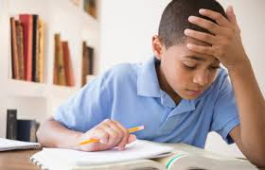
Home Task
Write five sentences about “Your birthday party”

Slide 26

My Birthday Party
My birthday is on 3 January .On my birthday,I always wear a new dress gifted by my parents .I celebrate my birthday with a cake .I put the candles on the cake .I invite my friends to my birthday party .My friends give me presents such as toys,books,clothes,etc.

Slide 27

Good by every one
Thanks to all
See you again.

