Slide 1
Welcome to you all

Slide 2
Welcome to you all

Slide 3
Teacher’s Information
Md. Shamsul Alam
BA(Hons.)MA in English.
Assistant Teacher( English)
Naboday Secondary Girl’s School
Shailkupa, Jenaidah.
Phone:01917-452052,01722-922691
Email:shamsul101085@gmail.com

Slide 4
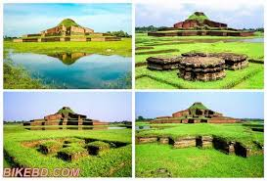
What do you see in the picture ?
Paharpur

Slide 5
Today’s lesson
The Somapura Mahavihara
English For Today
Class- Nine/Ten
Unit-Eight
Lesson-Two

Slide 6
Learning outcomes
After this lesson the students will be able to---
describe the picture.
know new vocabulary.
match the words.
choose the correct answer.
answer the questions.
write a paragraph.

Slide 7
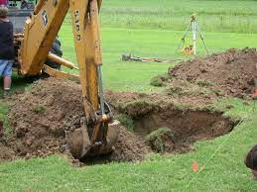
Word Meanings
Excavate
Dig out

Slide 8
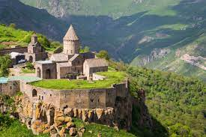
Monastery
a convent
Benefactor
helper

Slide 9
Match the words with their meanings
Group work
Words | Meanings
Archaeological Excavate Lofty Extensive Systematic Debris devout | Rubbles/wreckage Widespread Ancient cultural remains Pious Uncover something with difficulty Grand Done methodically

Slide 10
Answer
Archaeological =ancient cultural remains
Excavate = uncover something with dificulty
Lofty = grand
Extensive = widespread
Systematic = done methodically
Debris = rubbles/wreckage
Devout = pious

Slide 11
Individual work
Read the text in again A & choose the correct answer .
1. Paharpur is a----
a) typical Bangladeshi village. B) an extraordinary village. c)a very small village. D) a village on top of mountain
2. After excavation, the archaeologists discovered a huge……..
a) king’s place b)emperor’s courtyard. c) Buddhist monastery d) Hindu temple.
3.How many phases of excavation of ‘Paharpur’ has been mentioned in the text?
A) four b) five c)six d) seven.
4. What things indicates that the site was built by the second Pala king ?
a)earthen seals b) ceramic seals c) stone seals d) iron seals
5. The word ‘benefactors’ in the text means –
a) banker b) famous businessmen c) people with money d) financials supports

Slide 12
Work in pairs. Ask & answer the questions
Why is the village named Paharpur ?
Where is it located ?
What is it famous for ?
Why was the site officially stated to be preserved ?

Slide 13
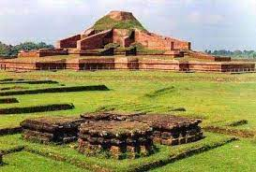
Why is the named Paharpur ?
The village is named paharpur according to the name ‘Pahar’ which means hill.

Slide 14
Where is it located ?
It is located in Naogan district of northern Bangladesh.

Slide 15
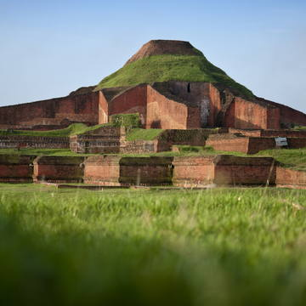
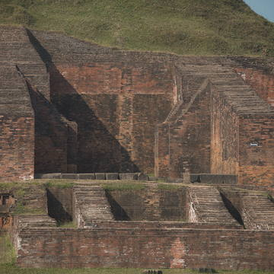
What it is famous for ?
It is famous for n archaeological site which is a lofty ruin of an ancient temple.

Slide 16
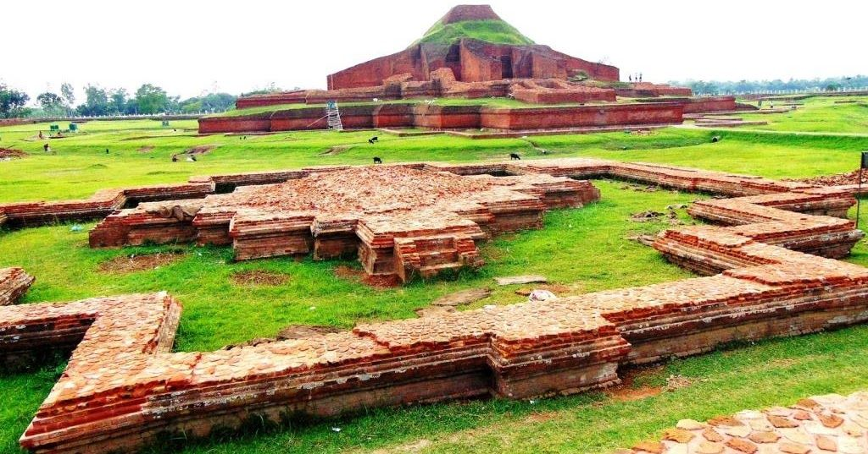
Why was the site officially stated to be preserved ?
The site was officially stated to be preserved because of its historical importance .

Slide 17
Evaluation
Who prevented an extensive excavation ?
When was Somapura Mahavihara discovered ?
Where is Paharpur situated ?
What is the height Cunninghum discovered a tower ?

Slide 18
Home work
1. Do you have any old or ancient relic in your city/ town/ village ? Write about it .

