Slide 1
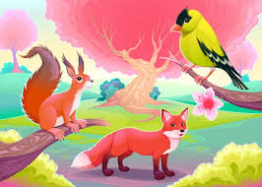
Welcome to my class.

Slide 2
TASLIMA BEGUM
ASSISTANT HEAD TEACHER
CHARFESSION T BARRET MODEL HIGH SCHOOL
CHARFESSION,BHOLA.
taslimabegum43@gmail.com
Class:- Nine
Subject:-English First Paper
Unit:-Three, Lesson:-05
Topic:-Independence Day

Slide 3
What can you see in the picture?
Living in trees
Living in boats
People have to live in trees and boats because of not having land for making houses.

Slide 4
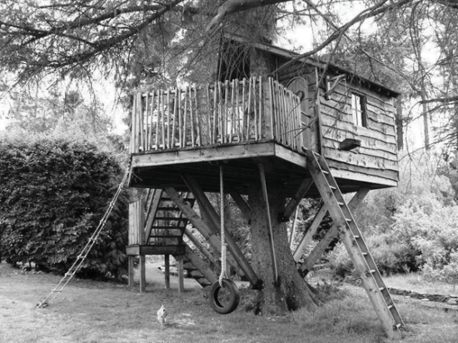
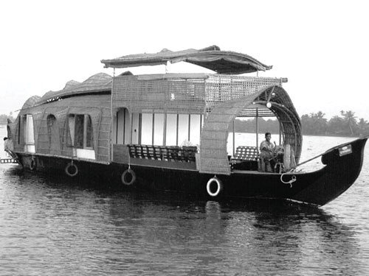
Look at the following picture.
What do the people do in the trees and the boats?
2. Why do they do so?

Slide 5
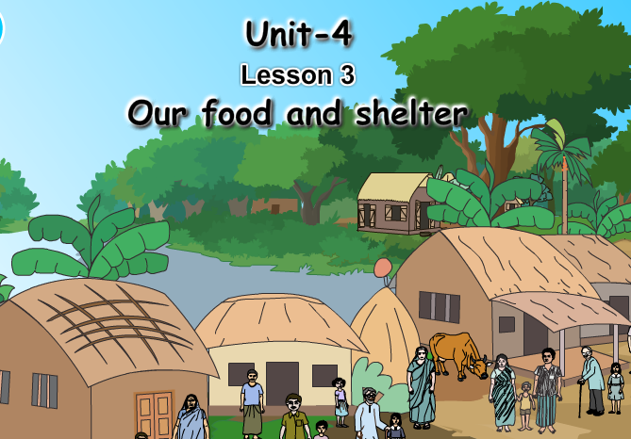
Our todays topic

Slide 6
Let’s watch a video

Slide 7
After the end of the lesson, the students will be able to…
Click
Ask and answer about problems. (Speaking test)
Tell the word meaning
Find out the problems of our shelter. (Listening Skill)
Narrate something in writing.
(Writing test)
Learning outcomes
write composition about one’s locality.
(Writing test)

Slide 8
Vocabulary
Read the text in section C and answer the following questions
How is your housing problems increasing day by day ?
Why is our land shrinking?
What will happen if the growth rate of population remains the same?

Slide 9
Fill in the gapes with appropriate form of the words in the list
Vocabulary
Stop
Answer
Reset
Work
Increasing
The population of Bangladesh is --------------in an alarming rate which affects on agriculture, housing, forestland etc. To…...………the increasing number of population, new house are being built……….. arable land and forest. Our food security will face serious problem and ecosystem will be…………..because of destroying arable land and forest. It is high time to take………......to control population growth.
Destroy
Accommodate
Destroy
Measure
Imbalance
Increase
Measures
Imbalance
Accommodation

Slide 10
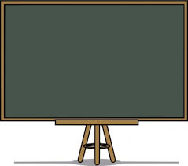
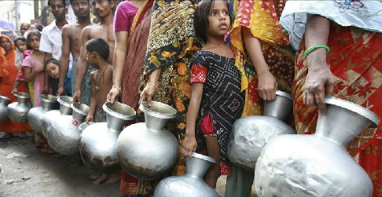
Meaning
Click on the word
When something is not easy to find or obtain.
Swing
Scarcity
Arable
Arial
Spoil
The scarcity of a pure water is a serious problem in many areas.

Slide 11
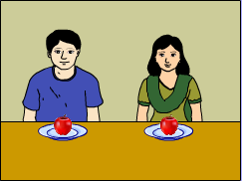
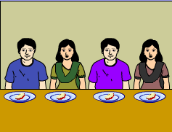
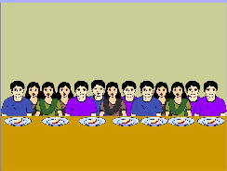
Pair Work

Slide 12
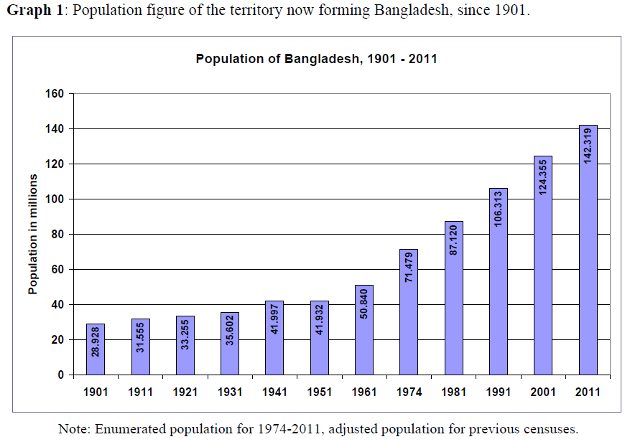
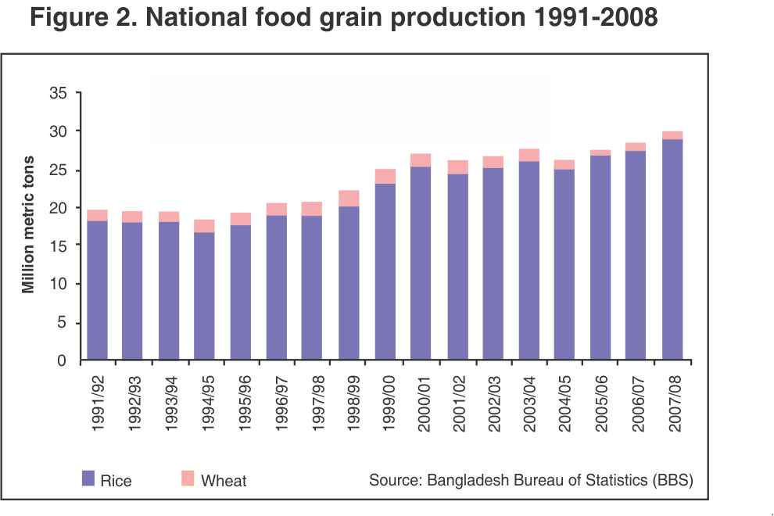
Population growth of BD
Food growth of BD
The rate of increase in food production cannot keep pace with the rate of population growth

Slide 13
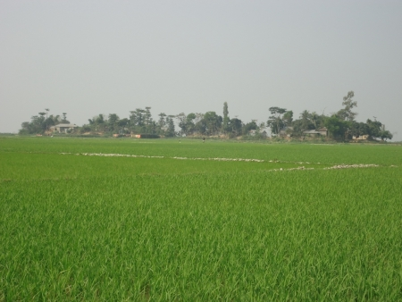
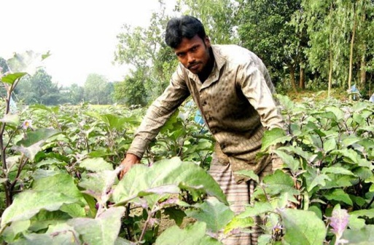
Our land and food
Our agriculturists have developed new varieties of rice and its per acre production has definitely increased
Notes:
The teacher will narrate the text showing the images to the students. Some times he will ask the student short questions about the slides.

Slide 14
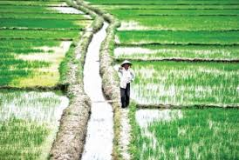
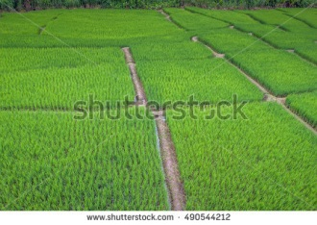
Land is dividing
On the other hand, our land is divided into small ones because of increasing population.

Slide 15
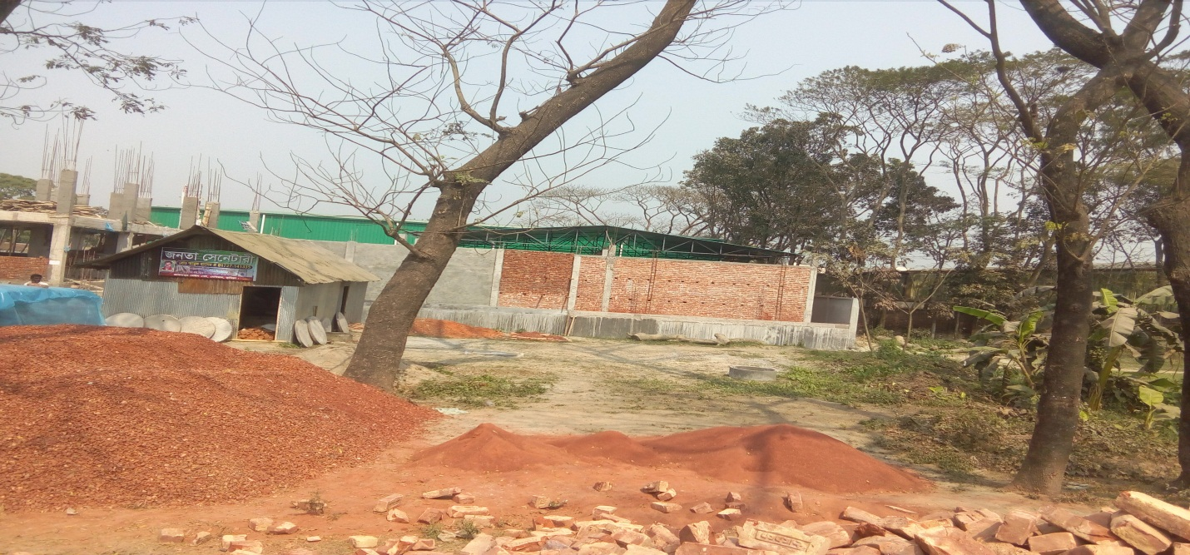
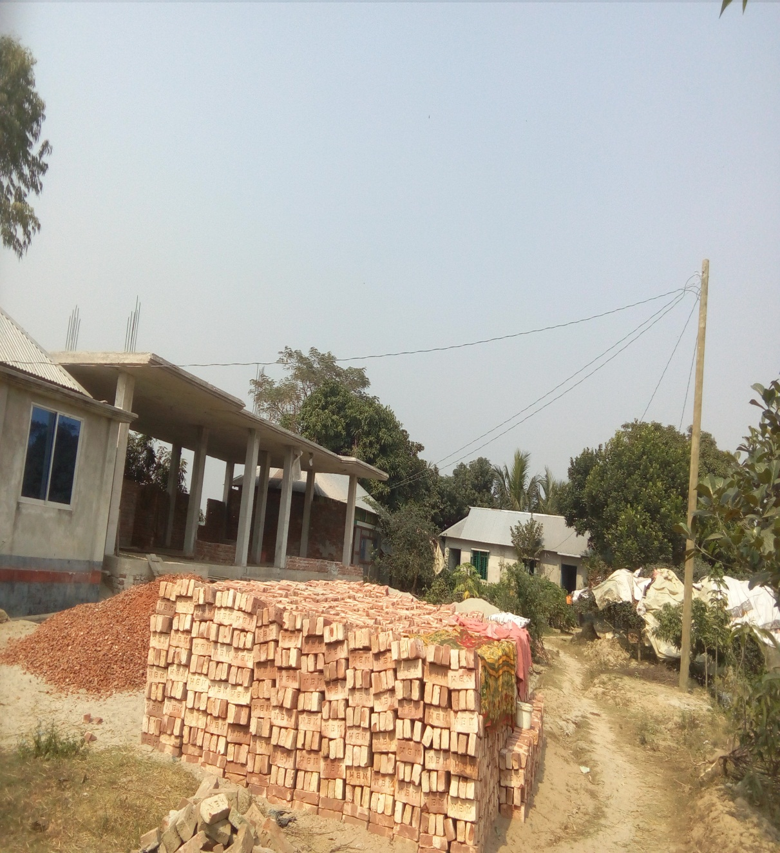
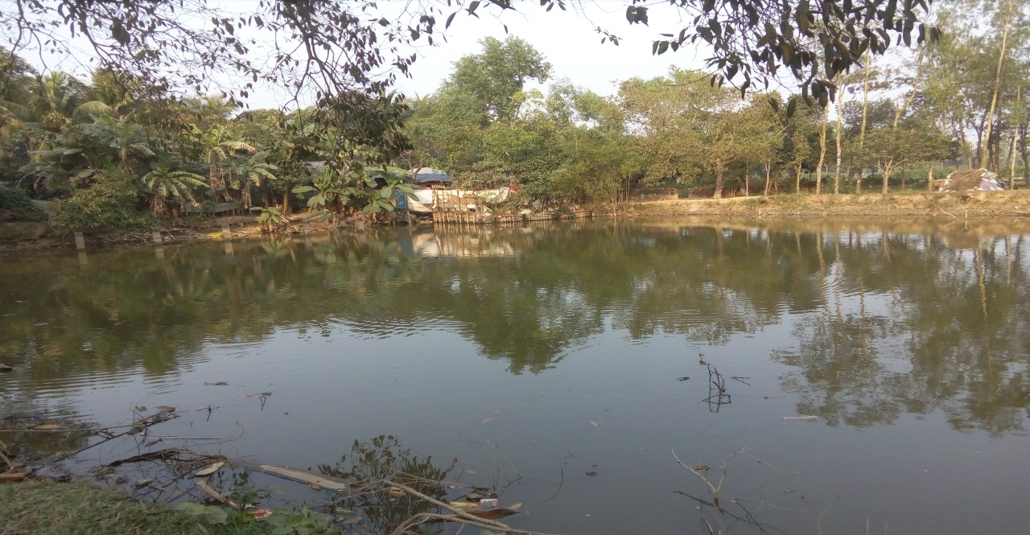
Lessening the cultivable land

Slide 16
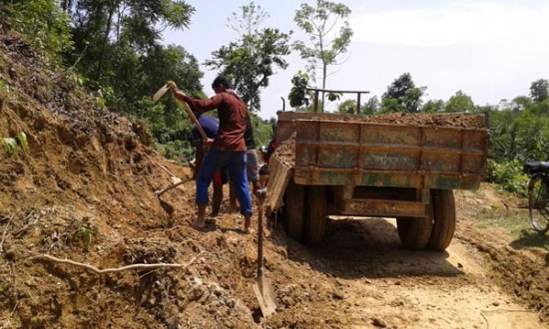
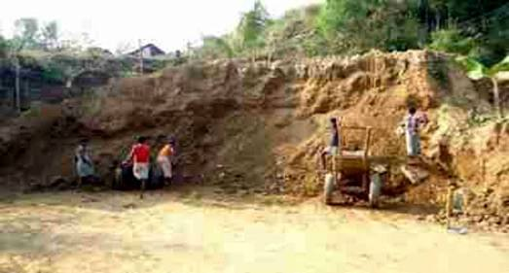
Hills are destroying
Hills are destroying for making houses or for the purpose of cultivation.

Slide 17
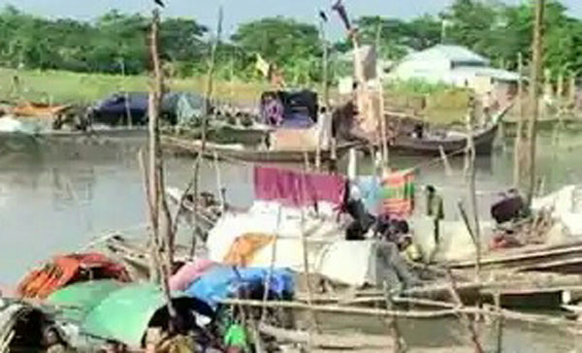
Our shelter problem
Another group leader comes up with the housing problem in the country

Slide 18
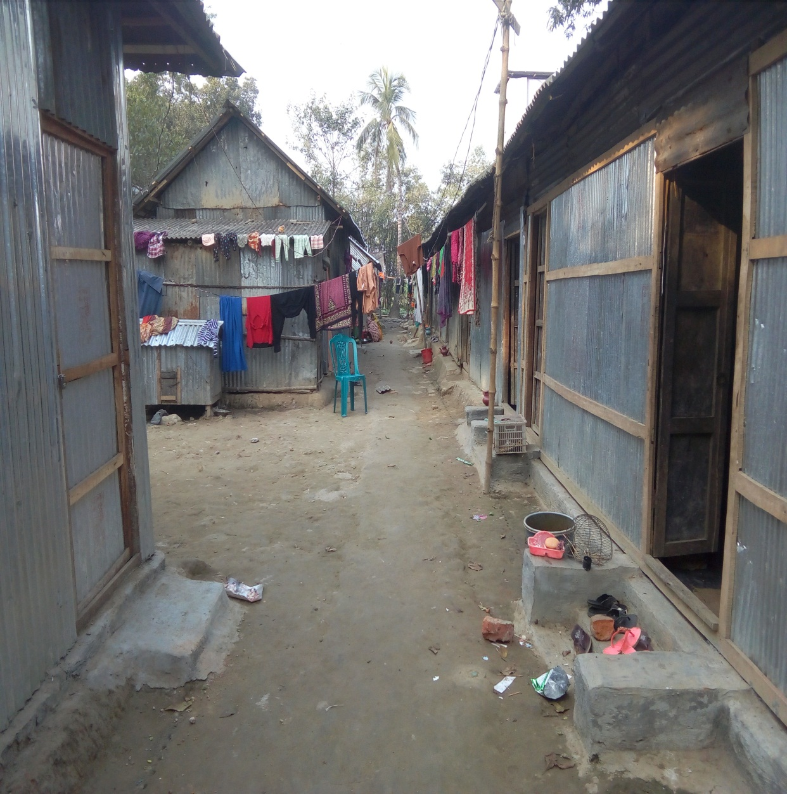
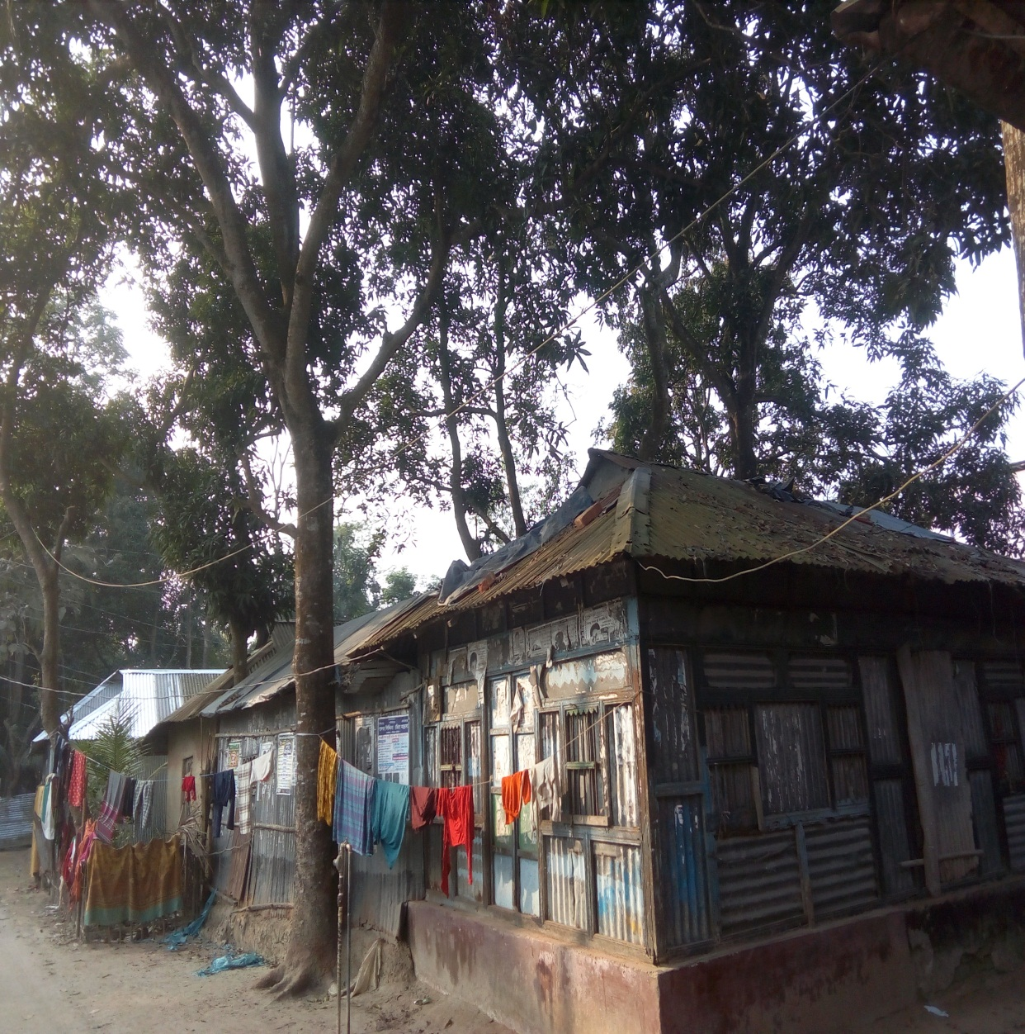
What can you guess?
More houses are being made and it is becoming environment pollution.
Notes:
The teacher will narrate the text showing the images to the students. Some times he will ask the student short questions about the slides.

Slide 19
Group Work
Make a list of things Ms Choudhury saw as a child in the village. How do you know from the text that she liked them?

Slide 20
Evaluation
Tick the best answer
Click here

Slide 21
Home Work
Write a composition about your village or locality. Describe any change in the things you have noticed over the years such as houses, fields, trees, plants, etc.

Slide 22
MAY ALLAH BLESS YOU

Slide 23
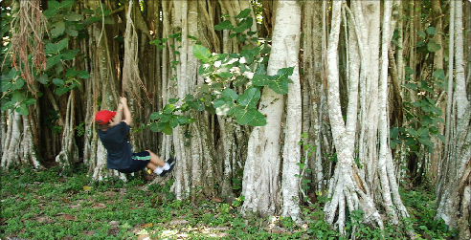
Meaning
Click on the word
To move easily and without interruption forwards and backwards.
Swing
Scarcity
Arable
Arial
Spoil
Children love swinging

Slide 24
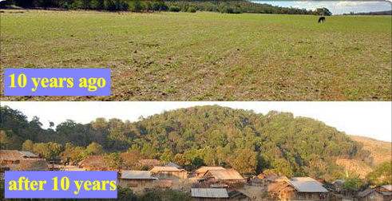
Meaning
Click on the word
Land is used that is suitable for growing crops
Swing
Scarcity
Arable
Arial
Spoil
The amount of arable land reducing for increasing population

Slide 25
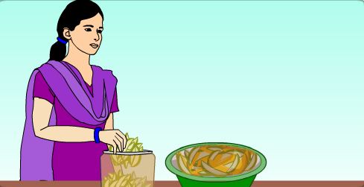
Meaning
Click on the word
Diminish or destroy the value or quality of something
Swing
Scarcity
Arable
Arial
Spoil
The pickles will spoil if you do not store them in a tight jar.

Slide 26
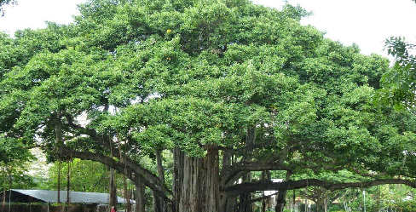
Meaning
Click on the word
Existing/ happening.
Swing
Scarcity
Arable
Arial
Spoil
A huge banyan tree whose aerial roots hung back down to the ground.

