Slide 2
Welcome

Slide 3
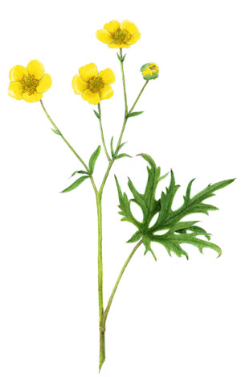
Subject: English
Class: 4
Topic: My trip
Lesson unit: My name… knowhim.
Date: ---------------
Md. Jubayer Hosssain Jewel
Asst. teacher
Ekannobigha Govt primary school
Singra, Natore.

Slide 4
Learning out comes
By the end of this lesson learners will be able to………………
10.1.1 Write short paragraph by answering a set of question.

Slide 5
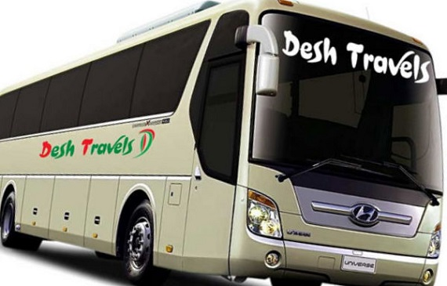
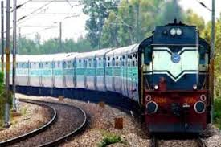
Lets See some picture
What have you seen in the picture?

Slide 6
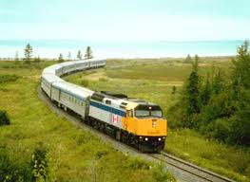
Why we use bus and train?
To go different places
Today we will read
My trip

Slide 7
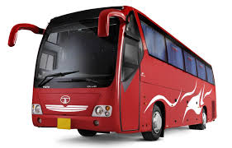
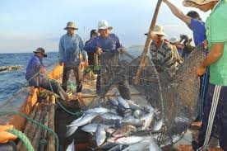
Key words
Trip
Journey
My trip was Chilmari last week.
Who catch fish
Fisherman
Kusuma’s grandfather was a fisherman.

Slide 8
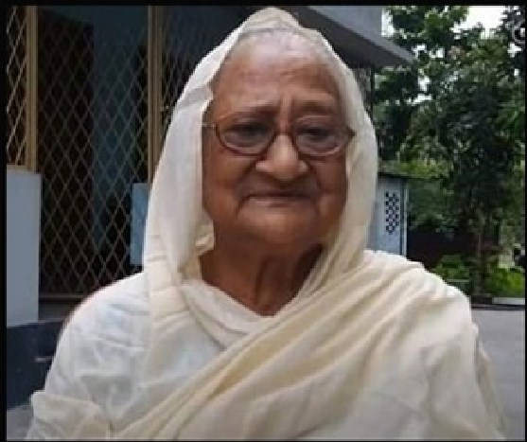
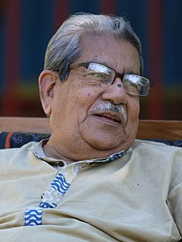
Key words
Grandmother
Father’s mother
My grandmother is 65 years old.
Father’s father
Grandfather
My grandfather was a teacher.

Slide 9
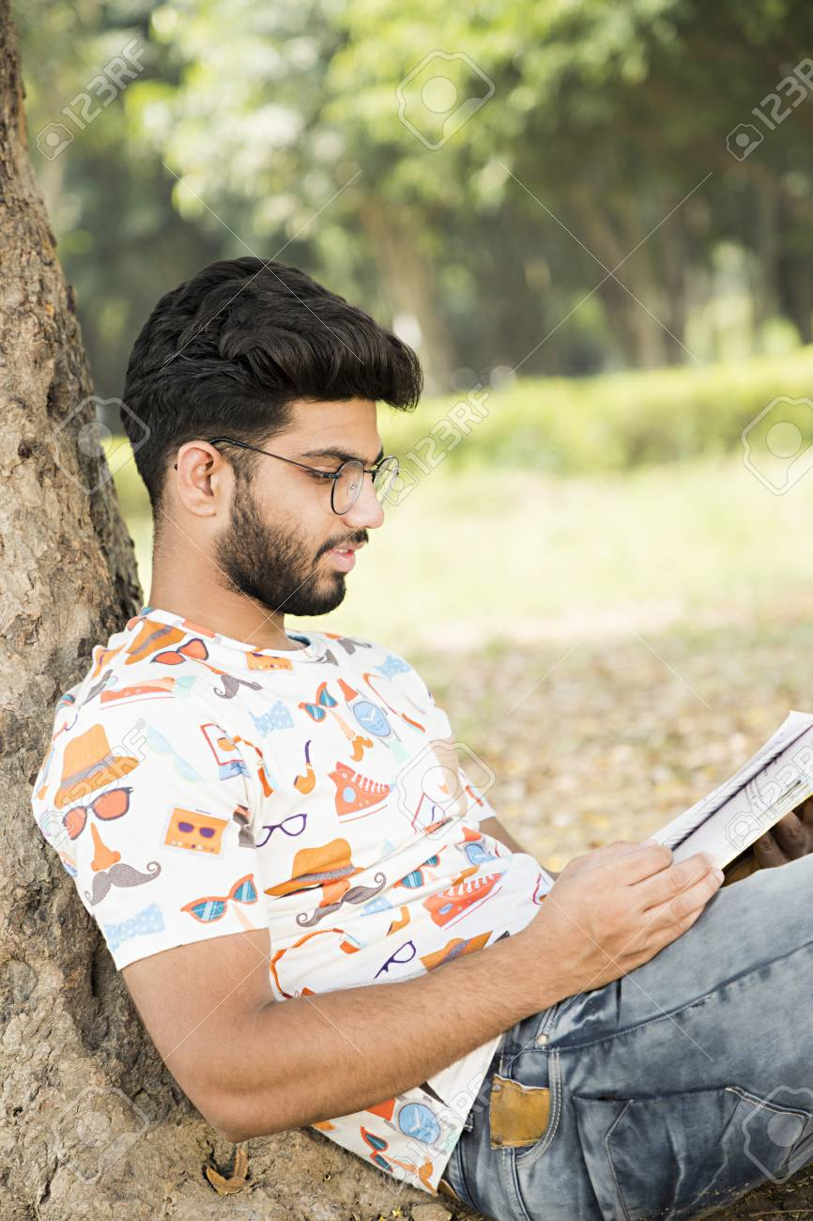
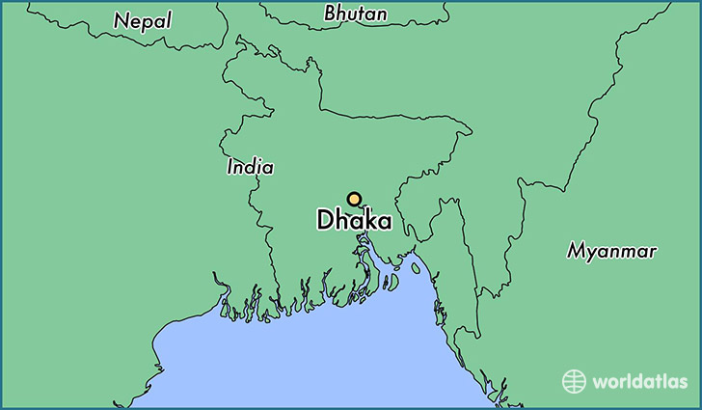
He is kusum.
He lives in Dhaka

Slide 10
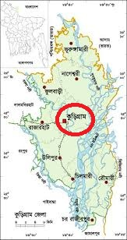
His family comes from Kurigram
They went to visit grandparents house in Chilmari.

Slide 11
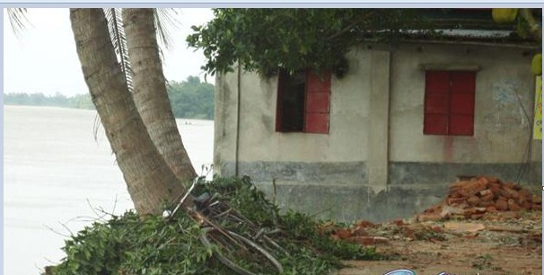
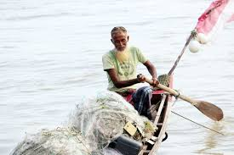
Their house is near the Jamuna river.
Her grandfather was a fisherman.

Slide 12
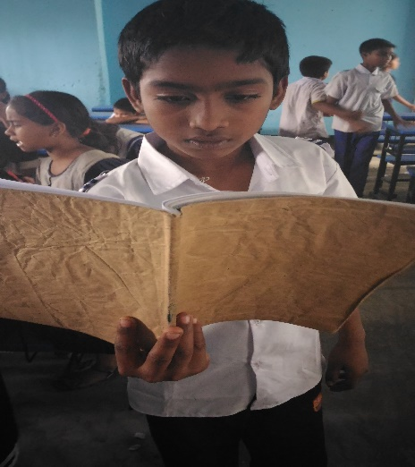
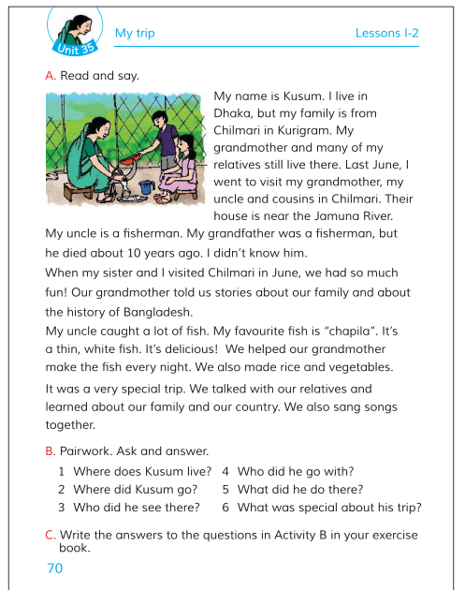
Now open at page no. 70
Listen attentively

Slide 13
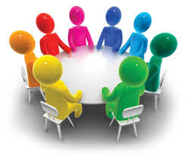
Group work
Lets try to write a short composition by this question.
1.Where did you?
2.When did you go there?
3. Who did you go with?

Slide 14
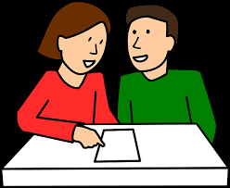
pair work
Rearrange the sentences
Now check your answer
ivtsi
visit
Live in dhaka i.
I live in Dhaka.
Know did not him I.
I didn’t know him.

Slide 15
Lets work alone
Lets play bingo game.
Fisherman
Trip
House
River
Relatives
Went

Slide 16
Now check your answer
Checking learning
Fill in the gaps:
near
Dhaka
fisherman
1.Kusum lives in ………
2.Their house is …….. the Jamuna river.
3.Her uncle is a ………….

Slide 17
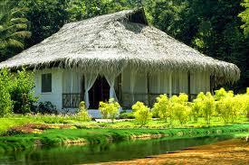
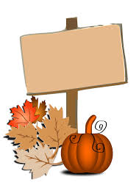
Home wok
Write three sentences about your own trip .

Slide 18
Thank You

