Slide 1
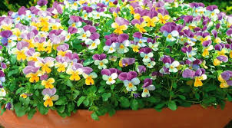
WELCOME

Slide 2
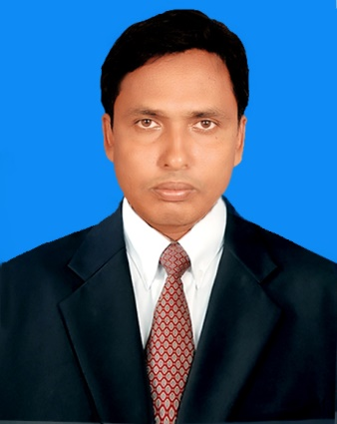
Teacher’s Identification
Md.Zakaria Ibne Mahatab Head Teacher Jagonnathpur Govt.Primary Shcool Chirirbandar,Dinajpur
Mobile No: 01723006285

Slide 3
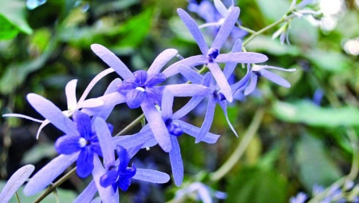
Lession Identification
Class: Three Time: 40 minutes
Subject: English For Today
Unit: 30 (Punctuation and Capital Letters)
Lession: 1-3
Activity: A
Date: 31-01-2021

Slide 4
Learning Outcomes

Slide 5
Let’s Sing a song
https://www.youtube.com/watch?v=CuI_p7a9VGs

Slide 6
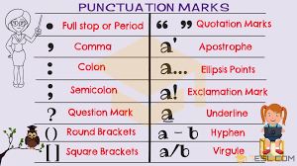
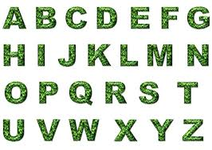
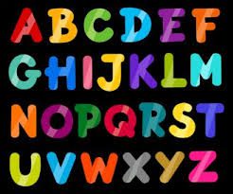
Punctuation and capital Letters

Slide 7
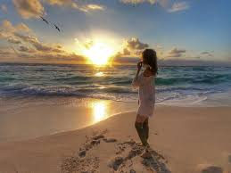
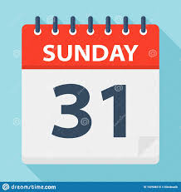
It is Sunday morning.

Slide 8
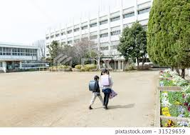
Riya and Mashuk are at school.

Slide 9
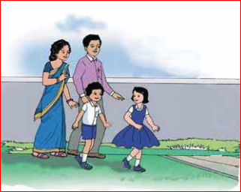
They are in the school yard with their teachers, Mr. Mahbub and Mrs. Fareha.

Slide 10
New Words
Sunday-(রবিবার) 2nd day of a week.
Morning-(সকাল) The first period of a day.
School-(বিদ্যালয়) Where student go for learning.
Teacher-(শিক্ষক) Who teach students.
Yard-(উঠান) It is an area of land immediately adjacent to building or a group of buildings.

Slide 11
At a glance
It is Sunday morning.
Riya and Mashuk are at school.
They are in the school yard with their teachers, Mr. Mahbub and Mrs. Fareha.

Slide 12
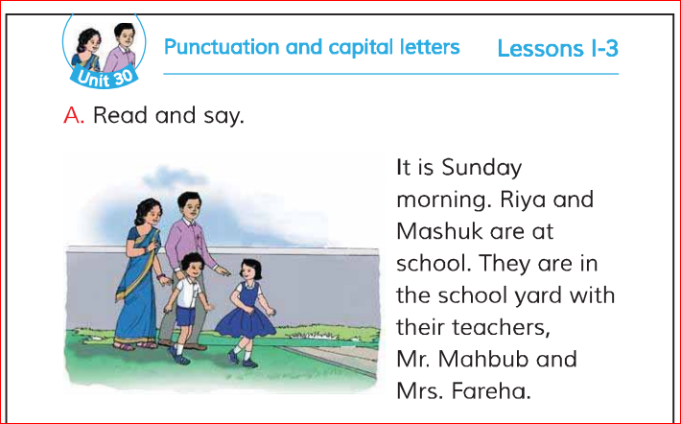
Teacher’s reading Open your book page at 60

Slide 13
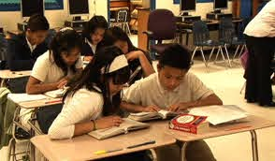
Pair Work
One student will read other will listen/say

Slide 14
1. When Riya and Mashuk go to school? 2. What is the name of Riya and Mashuk’s teacher?
Evalution

Slide 15
Home Work
*Read the text with correct pronunciation again and again
*Follow capital letter and punctuation mark.

Slide 16
Thanks

