Slide 1

WELCOME
BONGOBONDHU SHEIKH MUJIB DHAKA MARATHON -2021

Slide 2
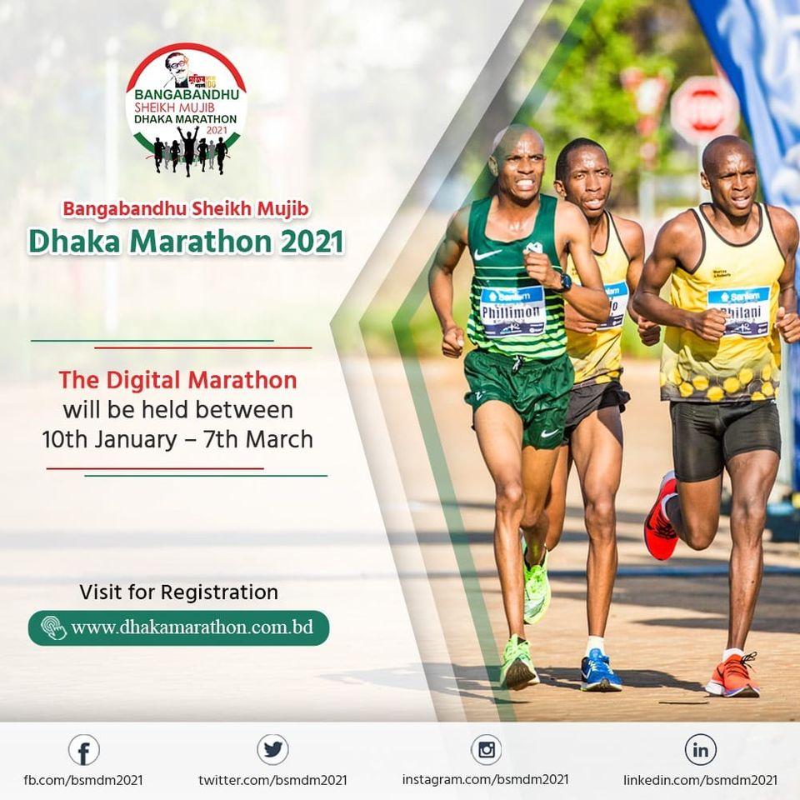
INTRODUCTION

Slide 3
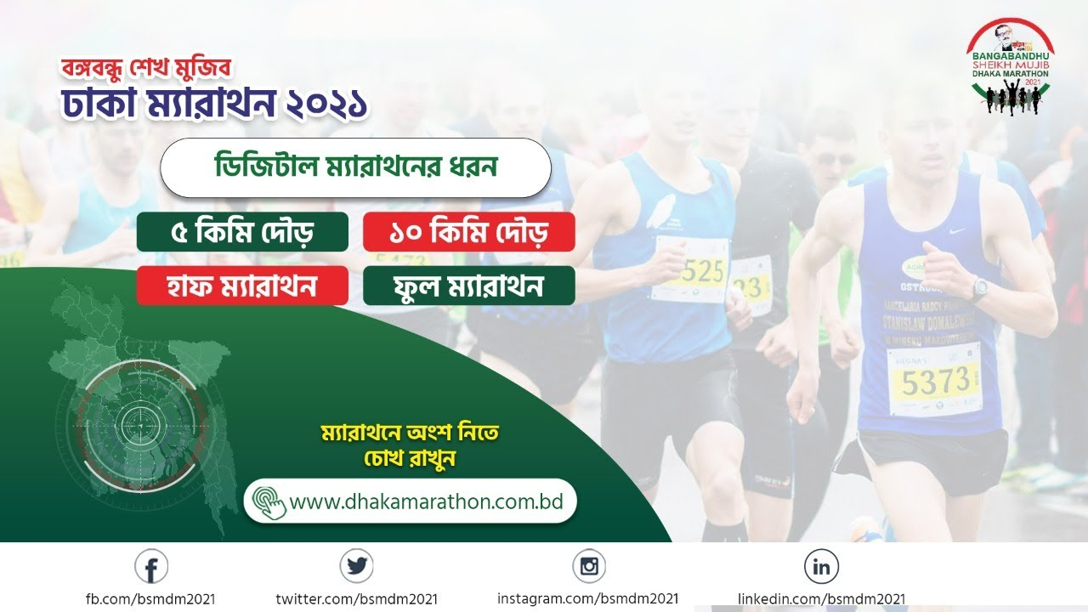
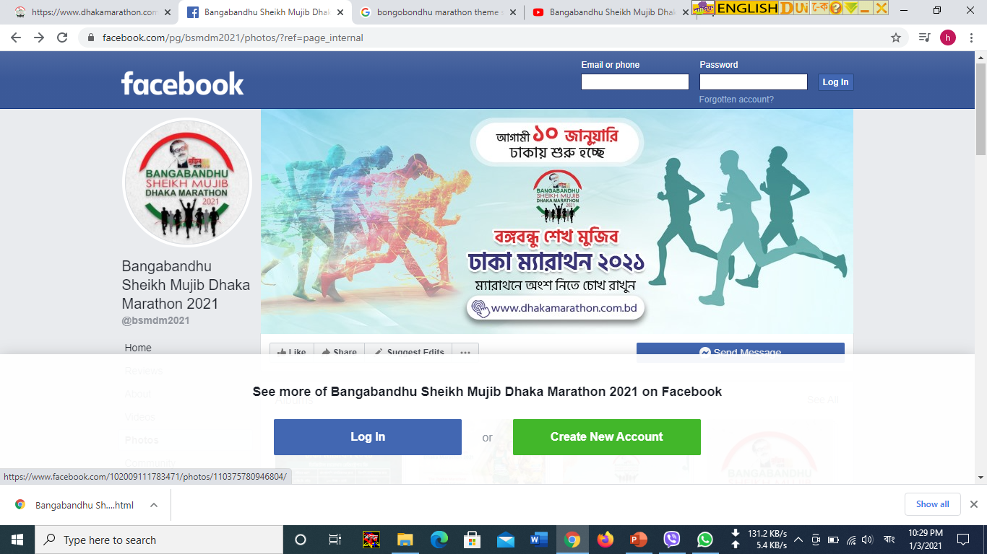
AIM
TO APPSISE YOU ABOUT THE FREE REGISTRATION PROCESS OF ‘BONGOBONGHU SHEIKH MUJIB DHAKA MARATHON-2021’

Slide 4
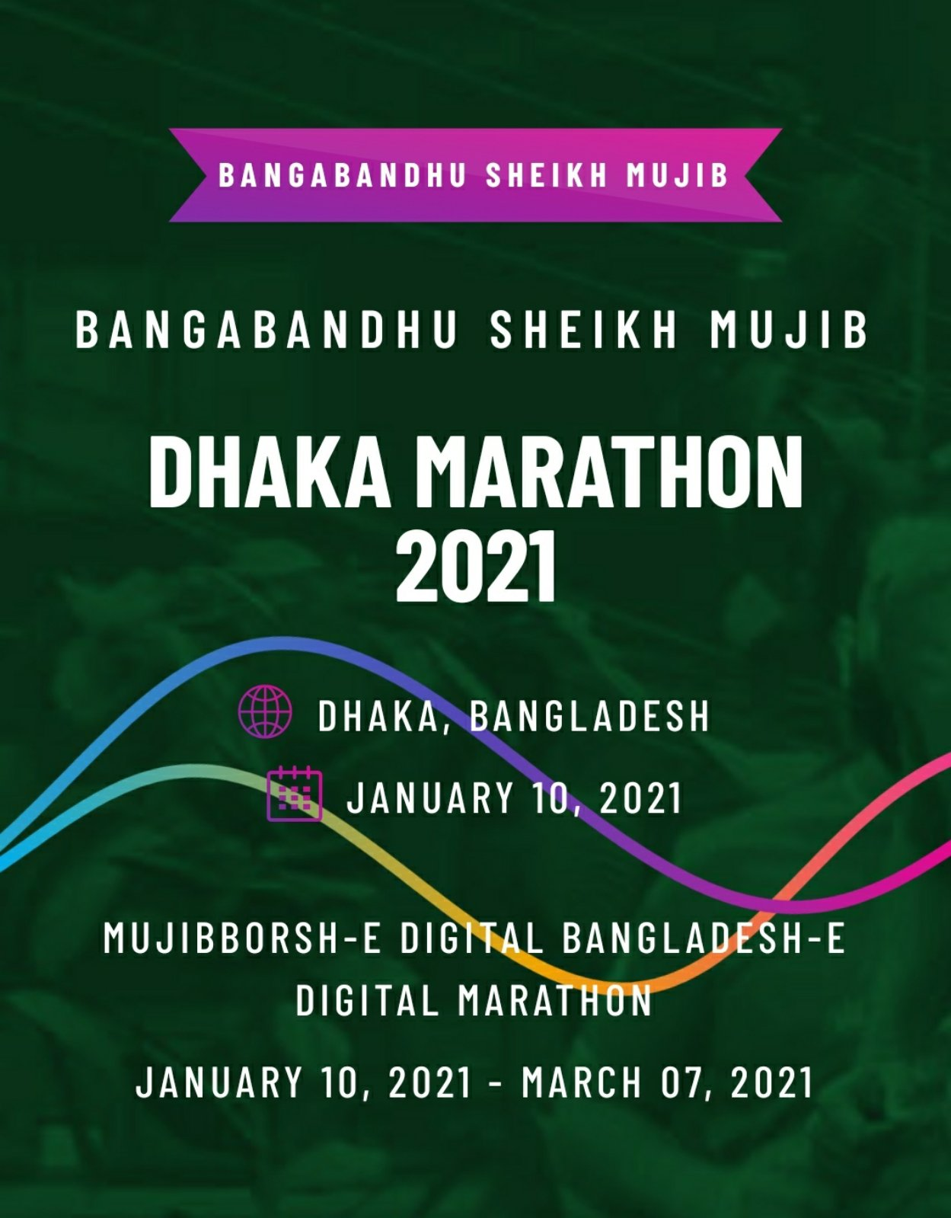
FREE REGISTRATION PROCESS

Slide 5
REGISTRATION PROCESSS
CONDITIONS FOR REGISTRATION
Already registered e-mail ID can’t be used
One e-mail ID can be used only once for registration
If Dhaka Marathon App is downloaded from Play Store directly then for registration 100 taka fee will be applicable
For free registration this process must be followed without skiping any step

Slide 6
REGISTRATION PROCESSS
STEP - 1
OPEN YOUR WEB BROWSER AND TYPE
http://dhakamarathon.com.bd/login

Slide 7
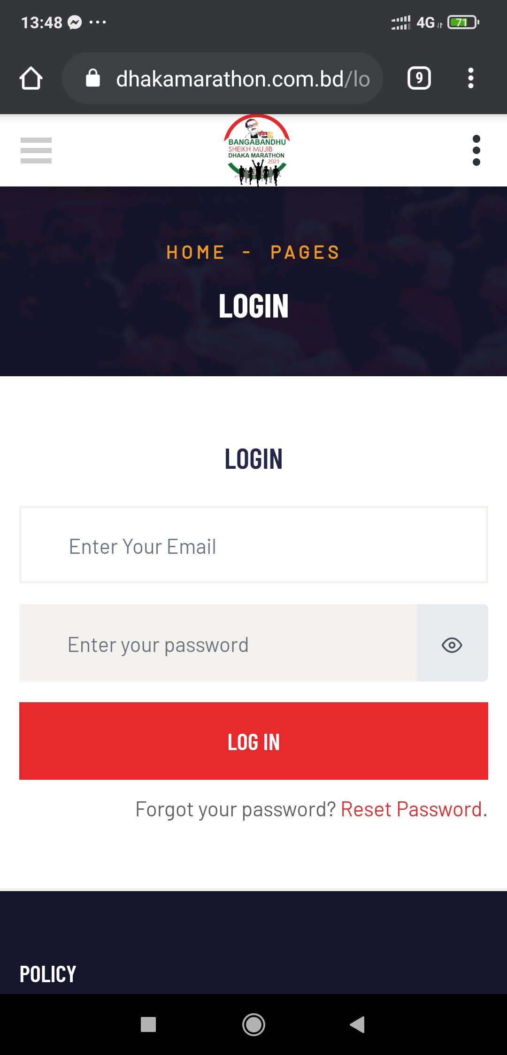
STEP - 1

Slide 8
STEP - 1
User: freeadmin1@marathon.com.bd
Password: freeadmin@1
OR
User: freeadmin2@marathon.com.bd
Password: freeadmin@2

Slide 9
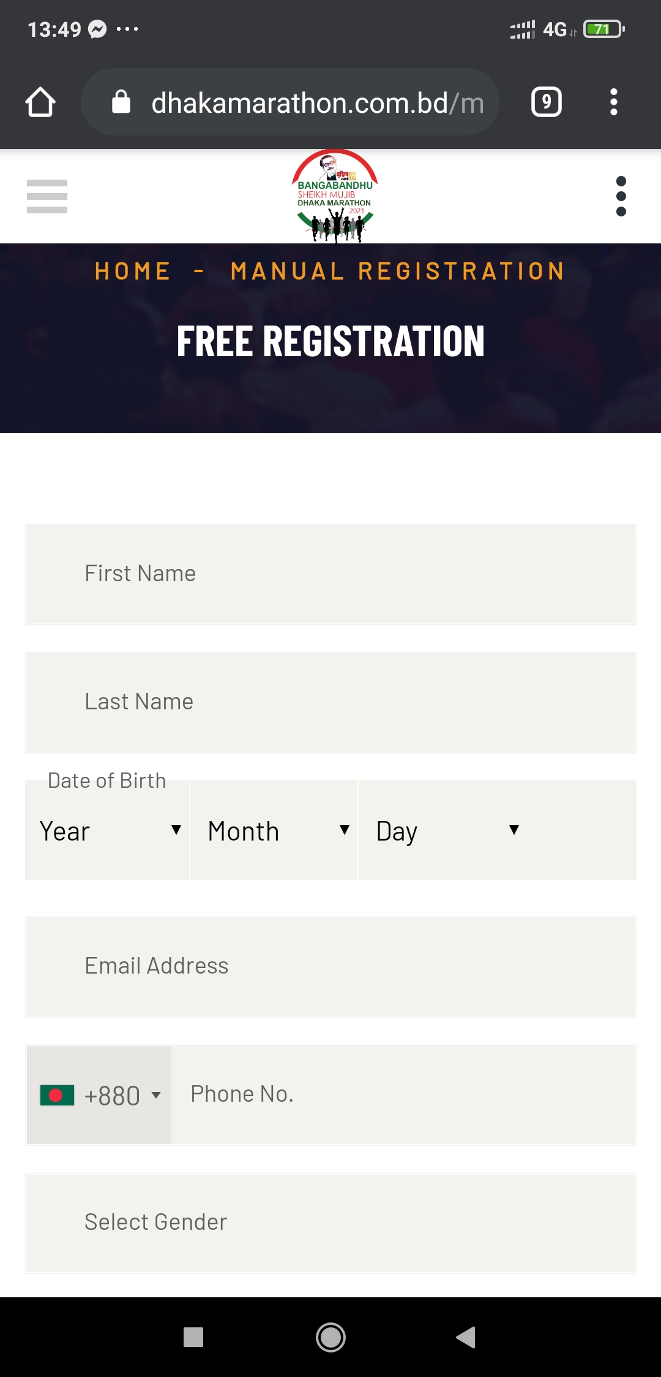
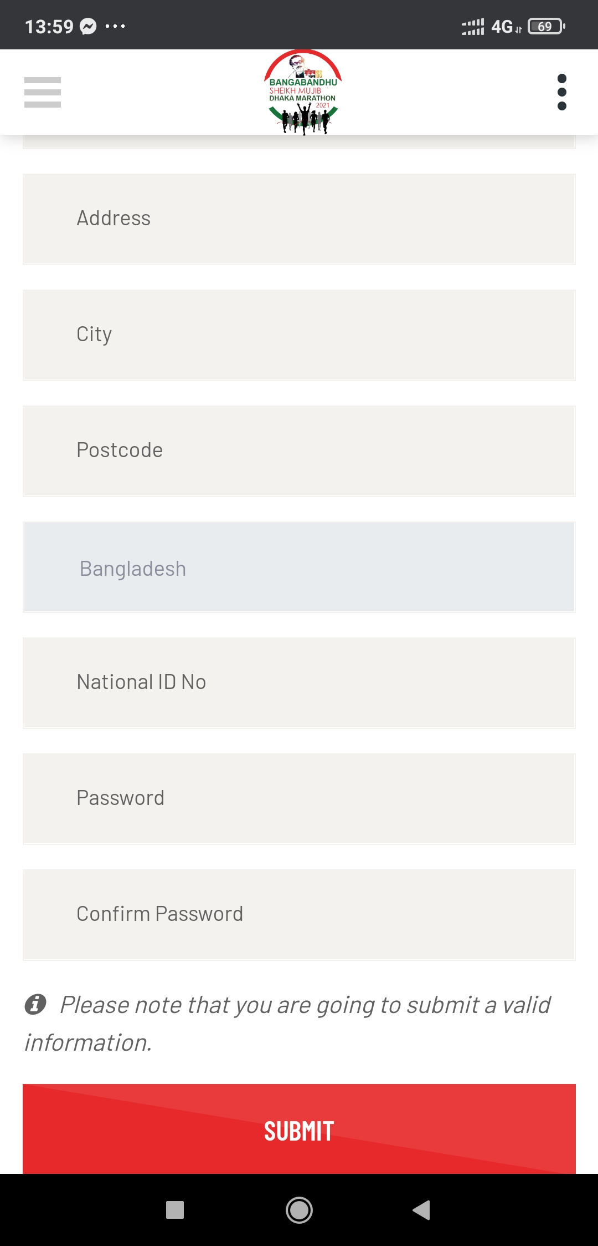
STEP – 2

Slide 10
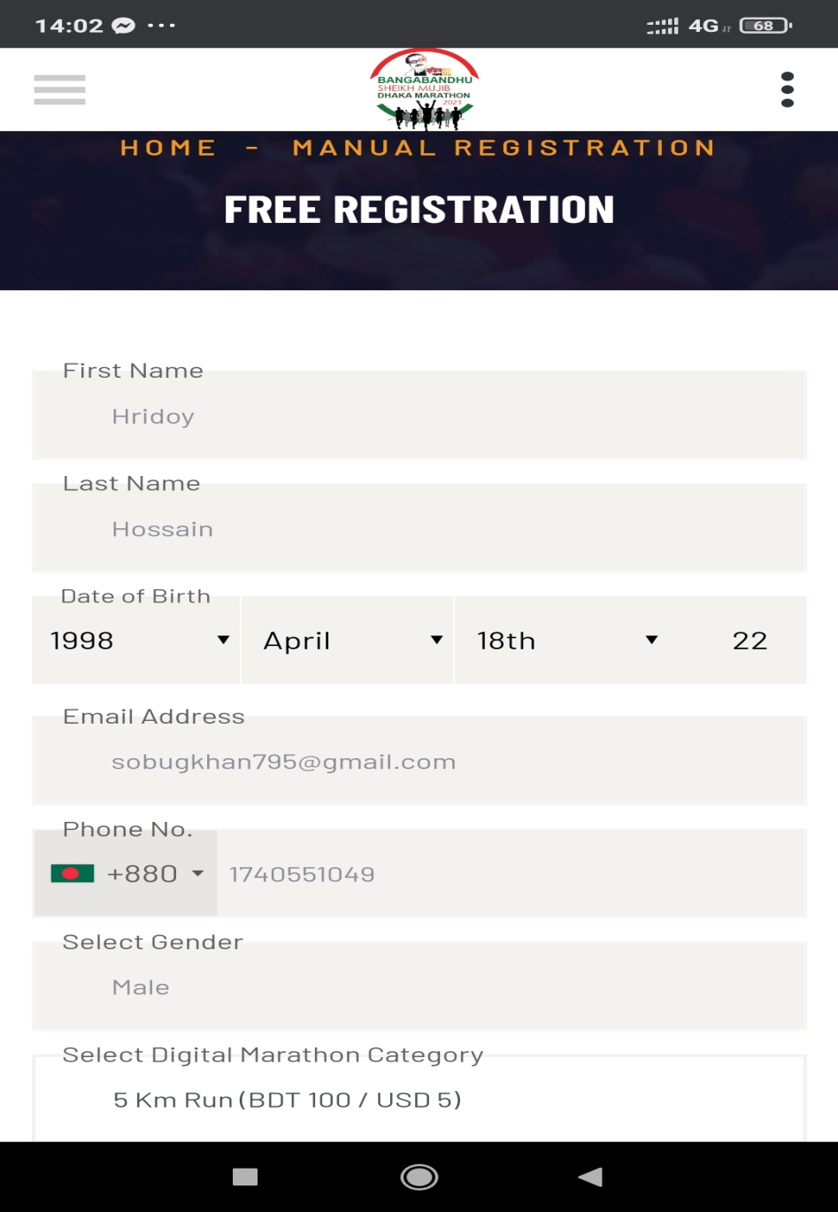
STEP - 3
PROVIDE NECESSARY INFORMATION
Enter first part of your name
Enter last part of your name
Year
Month
Date
Enter your active and correct E-mail address
Enter your mobile number
Select your Gender
Select 5 Km Run from the catagories

Slide 11
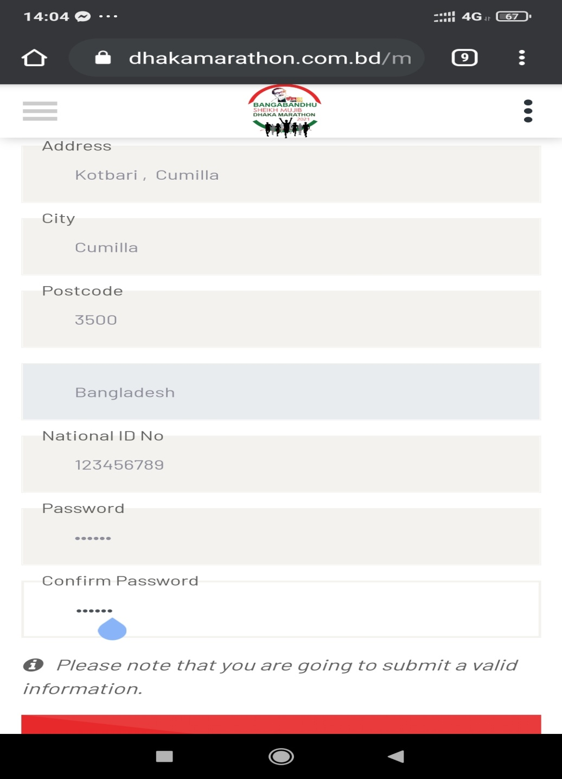
STEP - 3
PROVIDE NECESSARY INFORMATION
Enter your correct address
Enter your city “CUMILLA”
Enter your postcode “3500”
Enter Any Number / NID No
Enter your password
Confirm your Password
SUBMIT

Slide 12
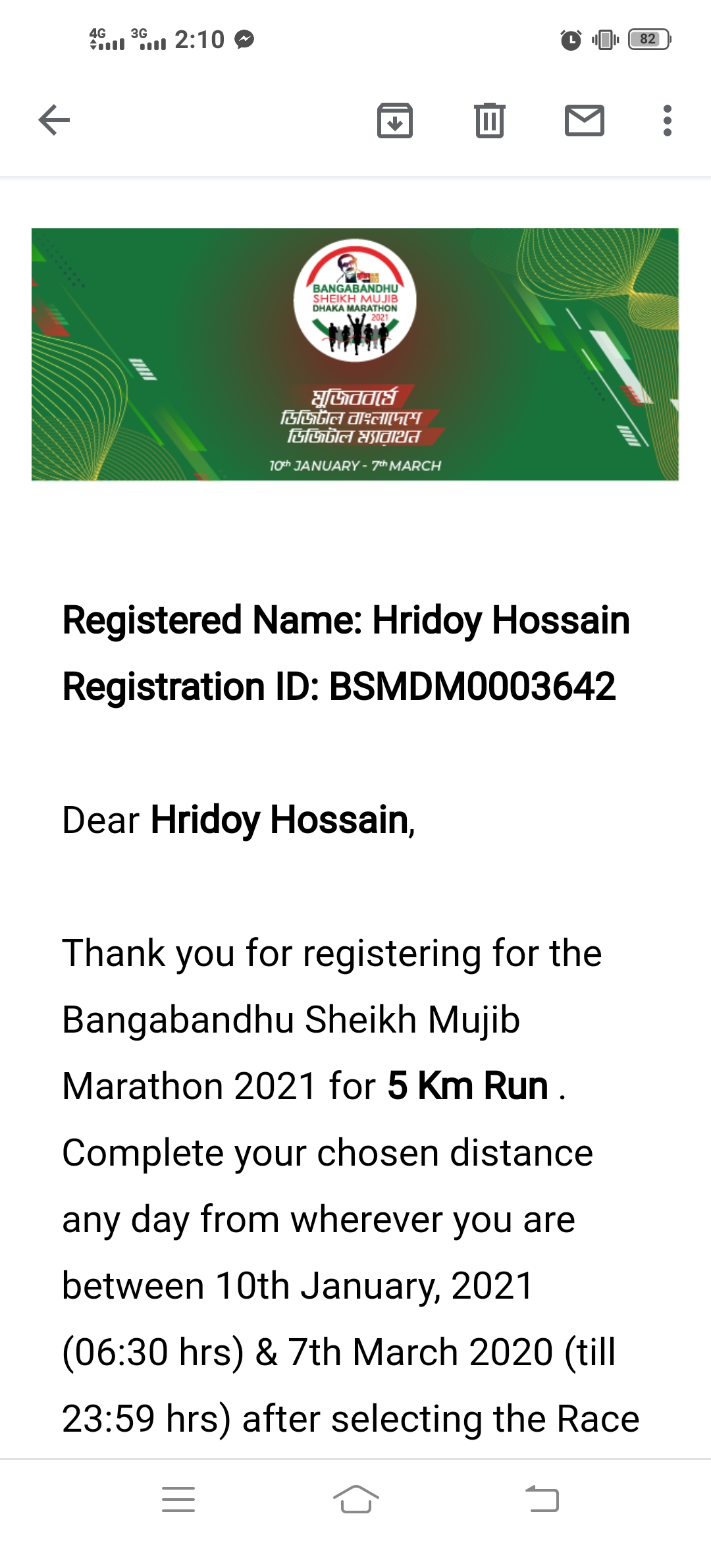
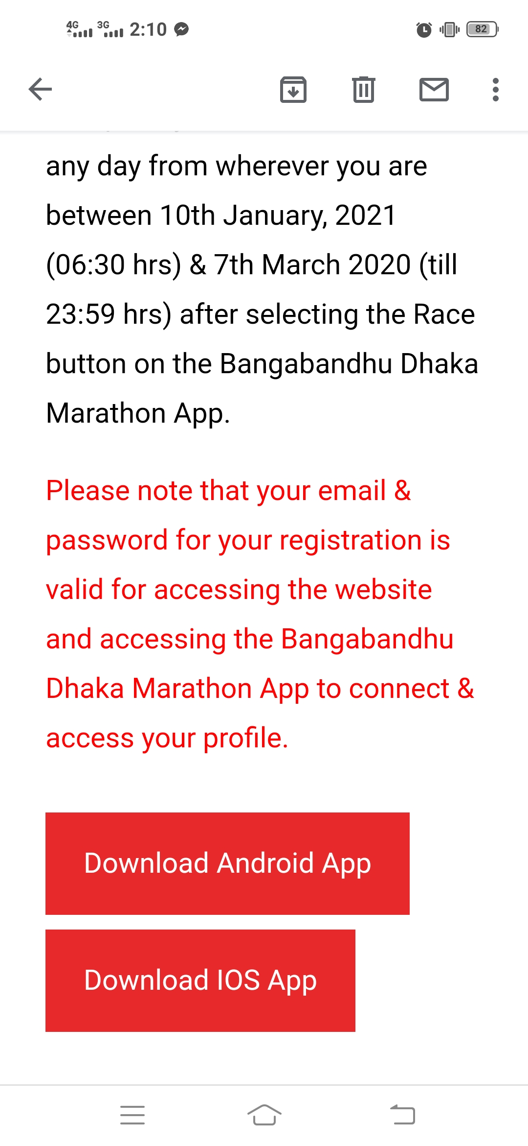
STEP - 4
OPEN THE E-MAIL SENT TO YOUR GIVEN E-MAIL ADDRESS

Slide 13
STEP - 5
CLICK THE RED MARKED PLACE OF YOUR E-MAIL AND DOWNLOAD ‘DHAKA MARATHON’ APP FOR YOUR MOBILE

Slide 14
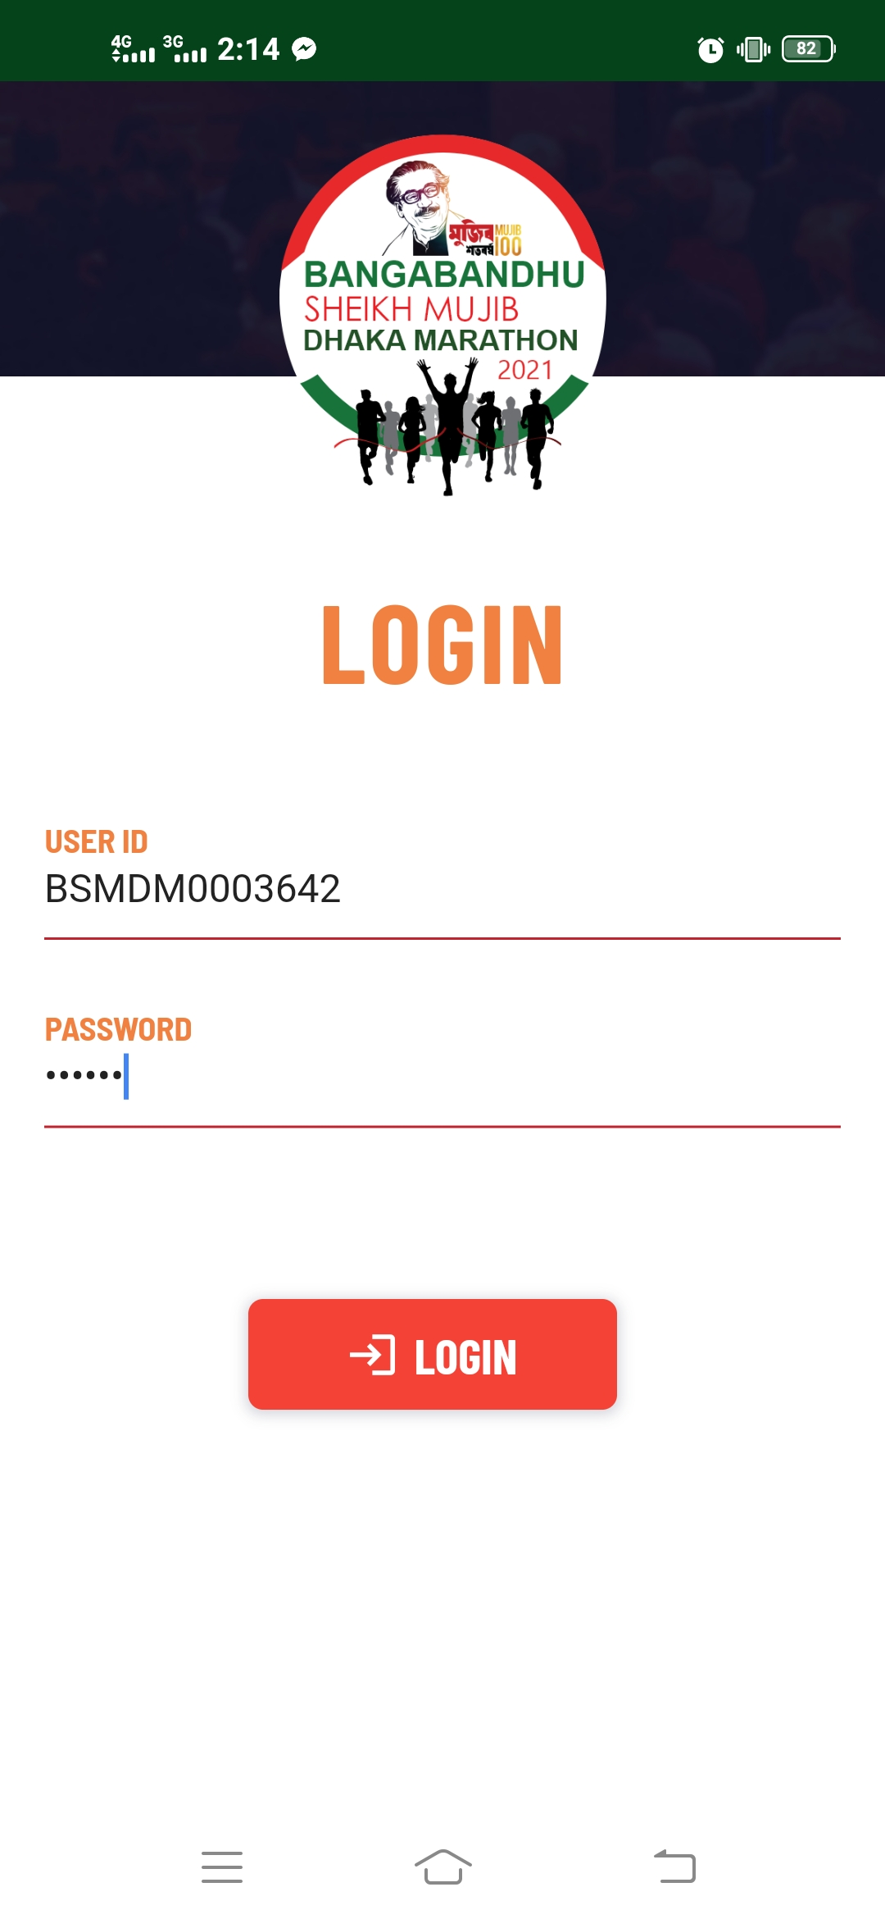
STEP - 6
OPEN THE APP BY ‘USER ID’ SENT TO YOUR E-MAIL AND YOUR PERSONAL PASSWORD
USER ID
PASSWORD

Slide 15
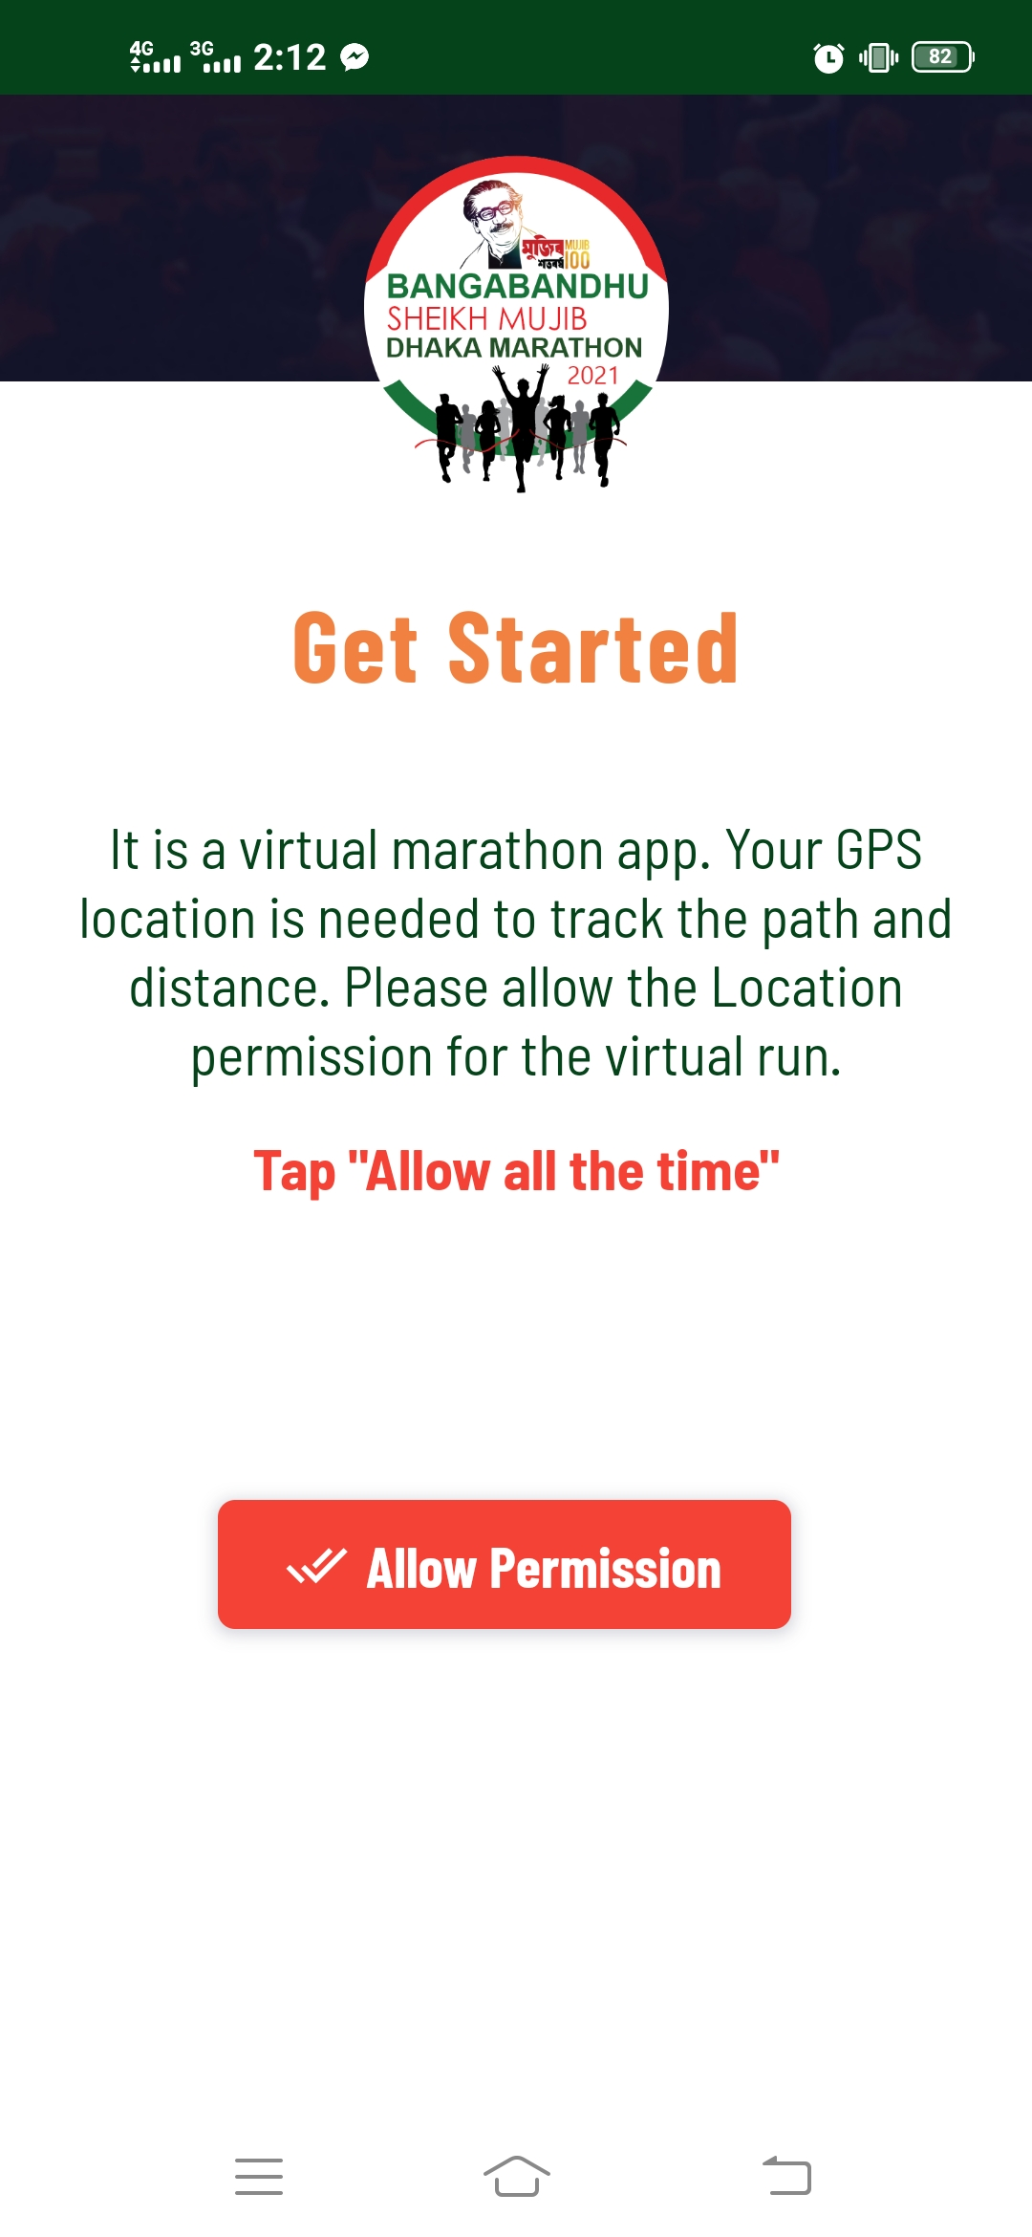
STEP - 7
ALLOW PERMISSION FOR GPS

Slide 16
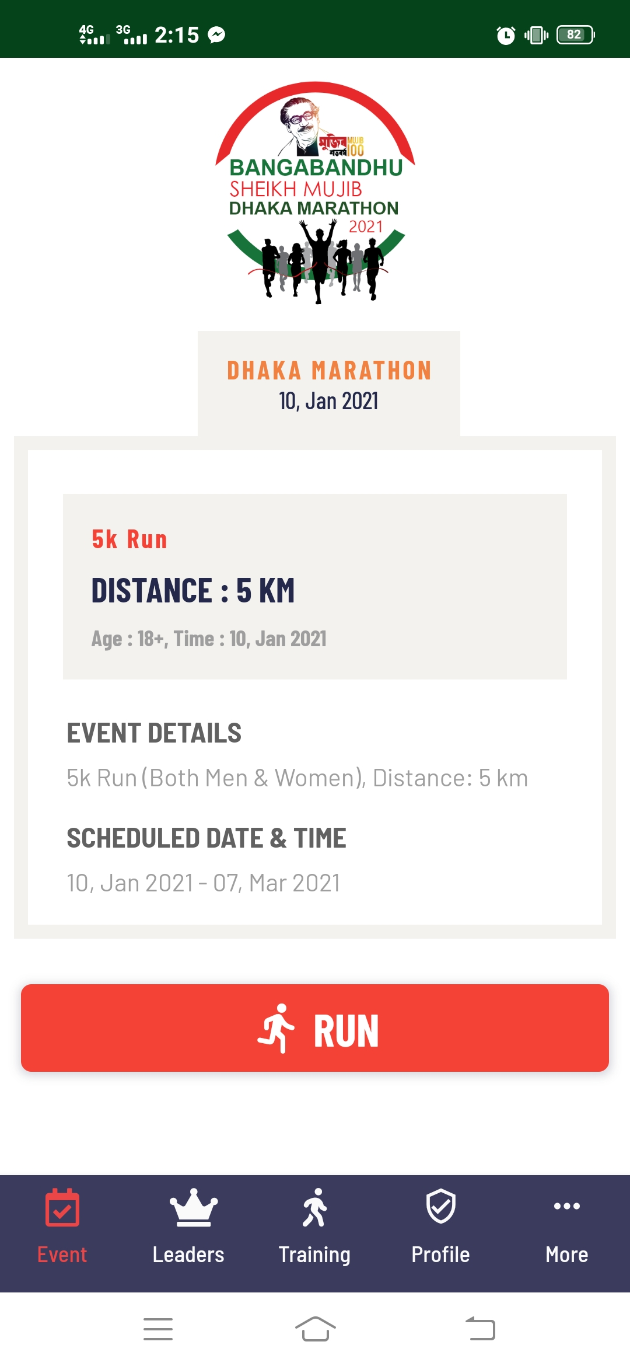
STEP - 8
OPEN DHAKA MARATHON APP BEFORE RUNNING CLICK ON “RUN”

Slide 17
CHALLENGE FACED DURING REGISTRATION
Already used E-mail ID for further attempt
Sometimes E-mail sending process is delayed
Difficulty for ios users

Slide 18
REGISTRATION HELPLINE
HELPLINE - 09612021100

Slide 19
OPEN FORUM

Slide 20
THANK YOU

