Slide 1

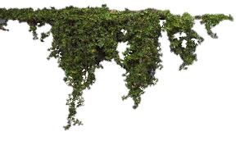

Hello my students

Slide 2
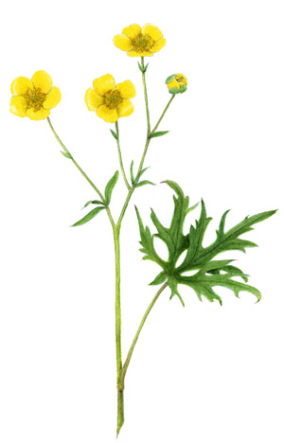
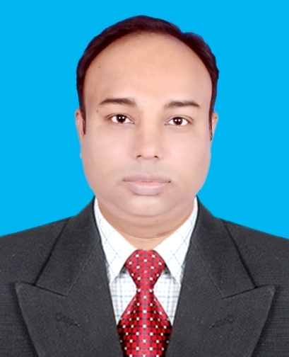
Identification
Majharul Hoque
Assistant teacher
Shibpur Model Government Primary school,
Shibpur , Narsingdi.
Subject : English
Class : Two
Topic : Shapes
Unit:19
Lesson:1-3
Page:38
Class Duration:50 minutes.

Slide 3
Lets watch a video clip
What have you watched?
Could you guess?
Yes , Shapes

Slide 4
Lessons declarations
Todays lesson is our ….
Shapes

Slide 5
At the end of this lesson learners will be able to….
1.1.1. become familiar with English sounds by listening to common English words.
1.1.2. say simple words and phrases with proper sounds and stress.
1.4.1. read words and phrases with the help of visual clues .

Slide 6
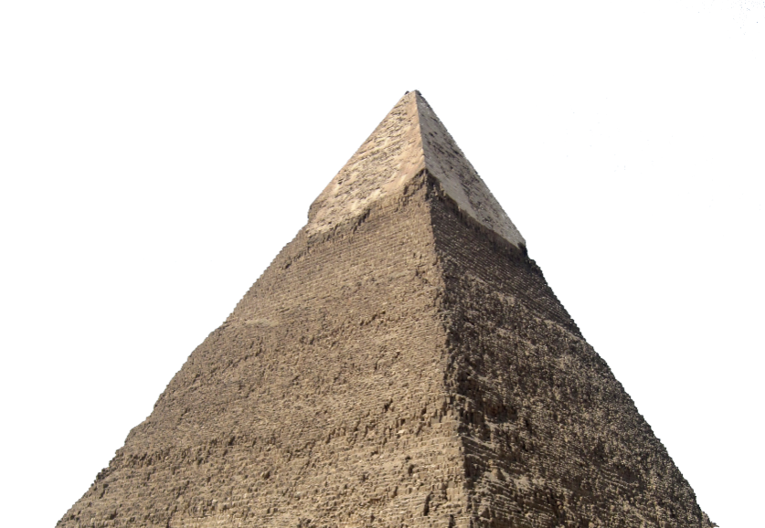
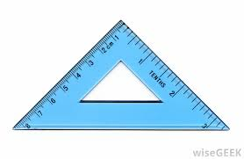
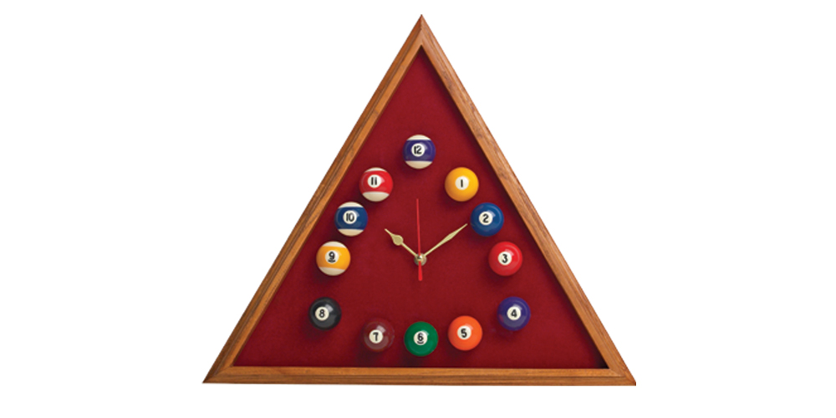

Lets see some objects
Triangle
These objects has three sides.

Slide 7



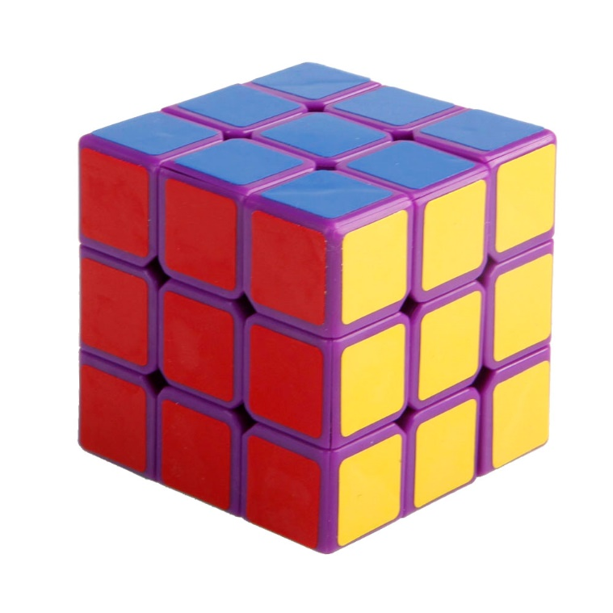
Square
These objects has four sides

Slide 8

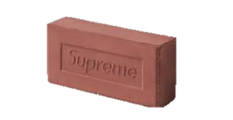

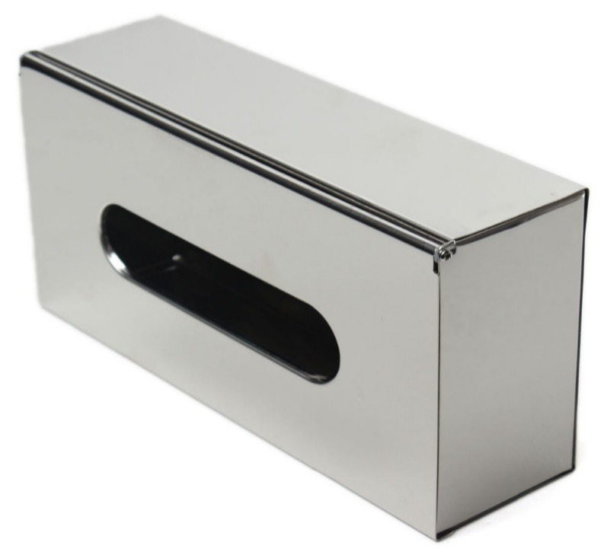
Rectangle
But two are long and two are short
These objects has also four sides

Slide 9




circle
These objects are round

Slide 10
Look listen and say
square
circle
triangle
rectangle

Slide 11
Say, read and match
Group work
Open your book at page-38
square
triangle
rectangle
triangle
square
circle
rectangle
circle

Slide 12
Look and say
Pair work
square
circle
triangle
rectangle

Slide 13
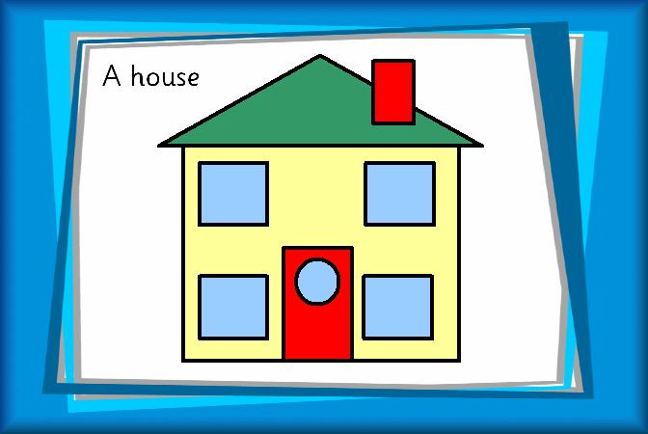
Individual work
Watch and tell what are the shapes here?

Slide 14
Evaluations
Answers the questions orally?
What shape has three sides?
triangle
What shape is round?
circle
What shape has four sides?
square
What shape has straight sides?
rectangle

Slide 15

Home work
Draw a quadrilateral and color it.

Slide 16

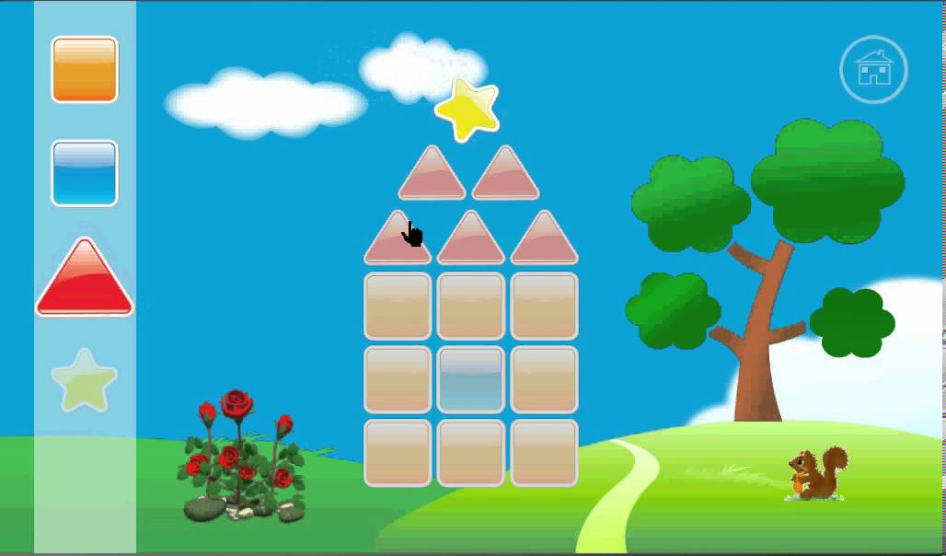
That’s all for today
See you soon!

