Slide 1
Good morning my dear students.

Slide 2
Md Shafiqul islam
Identity
Assistant teacher
Sonatan darussannat dakhil madrasah kaunia, Rangpur.
Mail:shafiqulislam42347@gmail.com
Class-Eight
English 1st Paper
Date: 09/02/2021

Slide 3
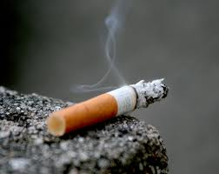
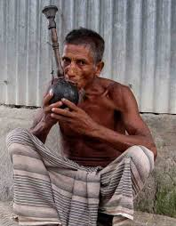
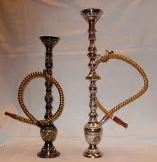
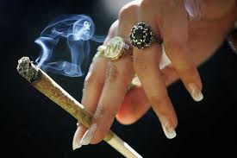

Slide 4
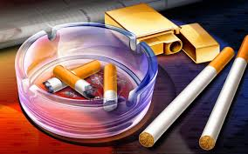
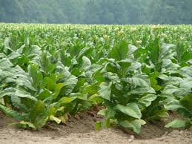
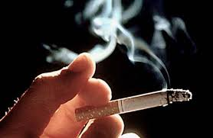
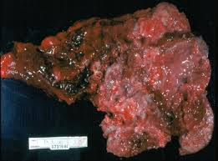
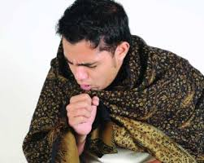
Smoking

Slide 5
Our Today’s Lesson is-
A paragraph
‘’Bad Effect of smoking/Danger of smoking”

Slide 6
Learning outcomes
After we have studied this lesson we will be able to-
know information
ask and answer questions
avoid smoking
write a paragraph.

Slide 7
What is smoking?
Smoking is inhaling smoke through cigarettes or other components. It is a combination of tobacco and fire.

Slide 8
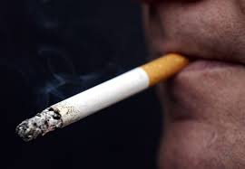
What kind of habit is it?
It is a very bad habit.

Slide 9
But why is it bad?
It causes many fatal diseases like

Slide 10
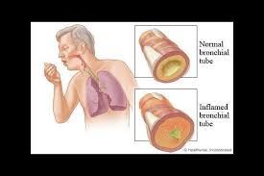
cough
bronchitis

Slide 11
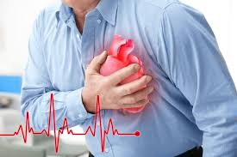
heart attack
cancer

Slide 12
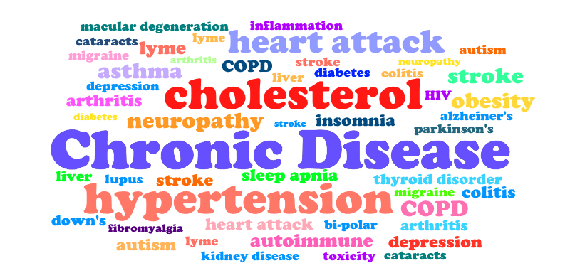
and many other chronic diseases.

Slide 13
What is a saying about cancer?
There is a saying about cancer,” Where there is cancer, there is no answer.

Slide 14
What does smoking contain?
It contains some serious poisonous elements.

Slide 15
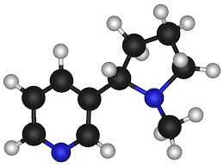
What are they?
They are-
nicotine

Slide 16
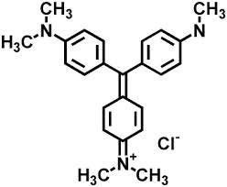
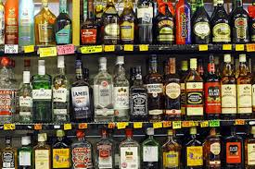
methyl
alcohol

Slide 17
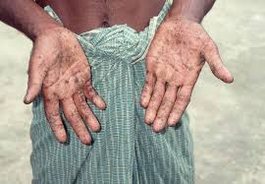
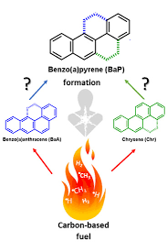
arsenic
Benzo(a)pyrene

Slide 18
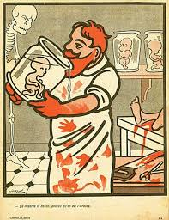
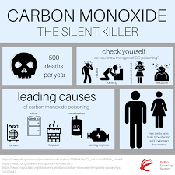
formaldehyde
carbon monoxide

Slide 19
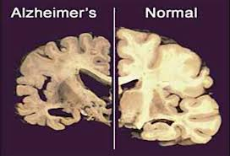
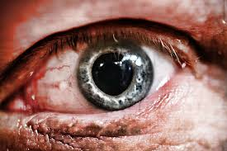
What does it damage in our body?
It damages -
Damaged
our brain
our eyes

Slide 20
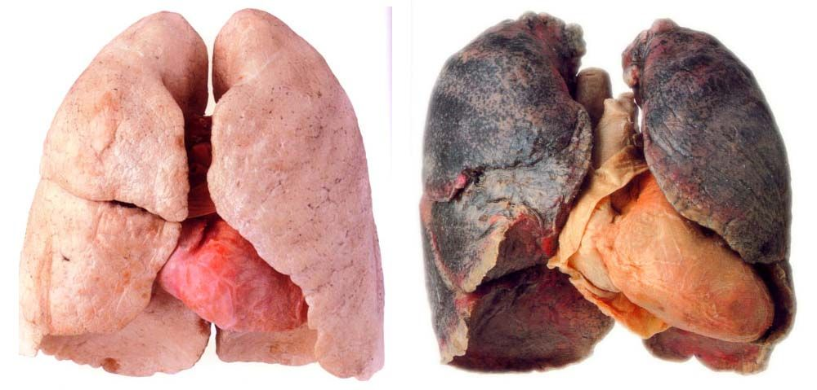
Before smoking
After smoking
It causes a great harm to our lungs.

Slide 21
Group Work
Make a logical assemble with tobacco, fire, nicotine, alcohol, lungs, problem, get rid of, government, young people and so on to write a paragraph on Danger of smoking.

Slide 22
Evaluation
What is smoking?
What does smoke contain?
How does it harm to body?
What does it result in future?
What should we do to get ride of the problem?

Slide 23
Universal
“Avoid smoking to lead a better life”
.

Slide 24
Home Work
Write a paragraph on-
Bad Effect of Smoking/Dangers of smoking”

Slide 25
Smoking is inhaling smoke through cigarettes or other components. It is a combination of tobacco and fire. It is a very bad habit. It causes many fatal diseases like cough, bronchitis, heart attack, cancer. and many other chronic diseases. There is a saying about cancer that the man who has cancer, has no answer. It contains alcohol, methyl, arsenic, carbon monxide and other ingredients. It damages our brain, eyes, skins, lips, teeth and look. It causes a great harm to our lungs. Smoking is not only injurious for health but it also causes a heavy damage of money. Gradually it leads a man to be habituated to take ganja, heroine, marijuana, whisky, Yabba. and other dangerous addiction. At last it results a smoker to be a thief, hijacker, terror and killer. Generally middle aged people are in the habit of smoking but now a days young people are becoming seriously addicted to smoking. In order to get rid of the problem we should be very sincere of the bad effect of smoking. We have to realize that life is more precious than anything. So to reach the goal of life it is most essential to avoid smoking. The government should also take proper steps to discourage smoking mentioning its negative sides in the text books and media.

