Slide 1
English 2nd Paper class

Slide 2
Identity
Sabina Yeasmin
Lecturer in English
Baridhara Nazmul Ulum Alim Madrasah
Badda, Dhaka

Slide 3
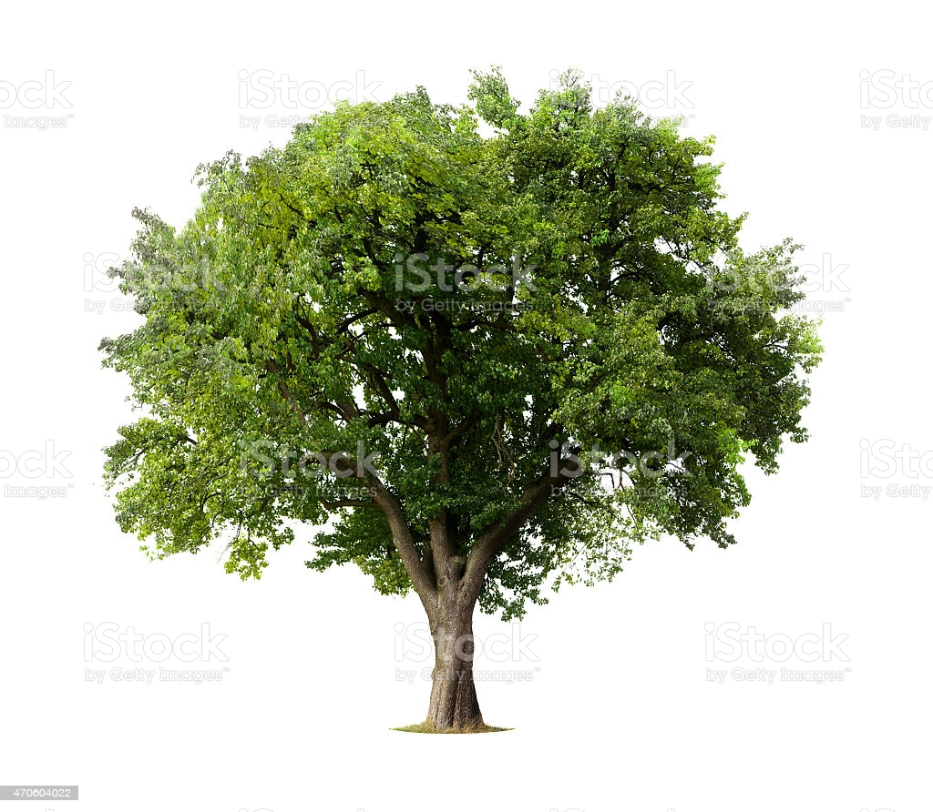
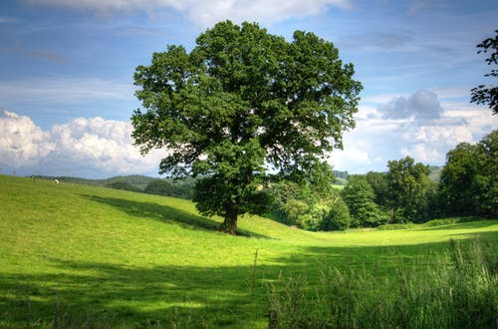
Let’s watch some images attentively
This is a tall tree.
This tree is a taller than first one.
This tree is the tallest of all trees.

Slide 4
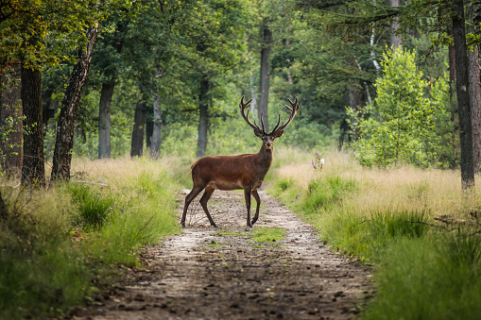
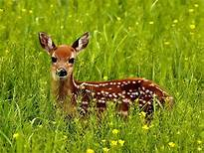
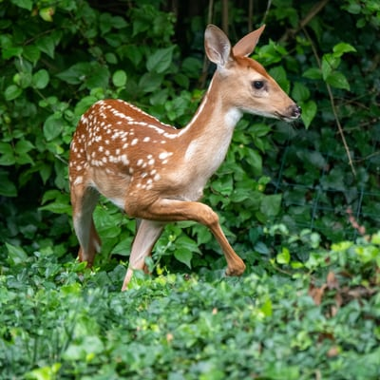
Let’s watch more images attentively
It is a beautifuall deer.
It is more beautiful deer than the first deer.
This is the most beautiful of all deer.

Slide 5
Can you guess what’s the today’s topic by watching these images and texts?
Exactly today’s topic is-
Part-1
Degree
Comparison of Adjectives

Slide 6
Learning outcome
At the end of the lesson, students will be able to-
Tell the definition of Degree
1
Identify various forms of degree.
2
Apply the form of degree in different categories.
3

Slide 7
This is a big ball.
This ball is bigger than the red ball.
This ball is the biggest of all balls.
Comparison of Adjective/Degree means to compare with one, two or more persons, places and things in three forms of adjectives.
#. এক, দুই বা ততোধিক ব্যক্তি, বস্তু ও প্রাণীর মধ্যে দোষ গুণের তুলনা করার পদ্ধতিকে degree বলে।

Slide 8
There are three form of Adjectives
Positive forms
Comparative forms
Superlative forms
Basic form of Adjective
Compared with other
Highest form of Adjective

Slide 9
Positive Degree
Structure: Subject + verb+ a/an +adjective +extension
Viz: Sazeed is a good boy.
# Positive Degree: The positive degree of an adjective is used to describe a single thing or person. It simply describes the existence of a quality. It does not refer to any compare.

Slide 10
Comparative Degree
Structure: Subject+ verb + comparative (er/more/less) form of adjective + than + extension.
Viz: Yusha is better than Sazeed.
Comparative degree: The comparative degree is used to compare two or more things or persons. It simply describes the higher or lower quality.

Slide 11
Superlative Degree
Structure: Subject+ verb + comparative (er/more/less) form of adjective + than + extension
Viz: Suham is the best of all boys.
Superlative degree: The superlative degree refers to the highest quality of things or persons.

Slide 12
How dgrees are formed
এক syllable বিশিষ্ট positive degree কে comparative করতে হলে positive এর শেষে ‘er’ এবং superlative এ ‘est’ যোগ করতে হবে।
Positive | Comparative | Superlative
Cheap (সস্তা ) | Cheaper | Cheapest
Close (নিকটবর্তী ) | Closer | Closest
Deep (গভীর ) | Deeper | Deepest
Fine (সুন্দর) | Finer | Finest

Slide 13
Great (বড়) | Greater | Greatest
Hard (শক্ত) | Harder | Hardest
Light (হালকা) | Lighter | Lightest
Low (নিচু) | Lower | Lowest
Rich (ধনী) | Richer | Richest
Short (খাটো) | Shorter | Shortest
Soft (নরম) | Softer | Softest
Small (ছোট) | Smaller | Smallest
Young (কম বয়সী) | Younger | Youngest

Slide 14
Adjective এর শেষে যদি ‘e’ থাকে তাহলে comparative এর ক্ষেত্রে ‘r‘ এবং superlative এর ক্ষেত্রে ‘st‘ হবে।
Positive | Comparative | Superlative
Able (সক্ষম) | Abler | Ablest
Blue (নীল) | Bluer | Bluest
Brave (সাহসী) | Braver | Bravest
Close (নিকটবর্তী) | Closer | Closest
Fine (সুন্দর) | Finer | Finest
Large (বড়) | Larger | Largest
Noble (মহৎ) | Nobler | noblest

Slide 15
Adjective এর শেষ অক্ষর যদি consonant হয় এবং তার পূর্বে যদি single vowel থাকে তাহলে consonant টি double হবে এবং comparative ও superlative এর ক্ষেত্রে পর্যায়ক্রমে er ও est যুক্ত হবে।
Positive | Comparative | Superlative
Big (বড়) | Bigger | Biggest
Fit (উপযুক্ত) | Fitter | Fittest
Fat (মোটা) | Fatter | Fattest
Red (লাল) | Redder | Reddest
Sad (বিষণ্ণ/দুঃখী) | Sadder | Saddest
Thin (পাতলা) | Thinner | Thinnest

Slide 16
আর যদি Adjective এর শেষে‘ y‘ থাকে তাহলে comparative এর সময় ‘ier’এবং superlative এর সময় ‘iest’ হবে।
Positive | Comparative | superlative
Busy (ব্যস্ত) | Busier | Busiest
Dry (শুষ্ক) | Drier | Driest
Easy (সহজ) | Easier | Easiest
Happy (সুখী) | Happier | Happiest
Heavy (ভারী) | Heavier | Heaviest

Slide 17
Hungry (ক্ষুধার্ত) | Hungrier | Hungriest
Lazy (অলস) | Lazier | Laziest
Lovely (সুন্দর) | Lovelier | Loveliest
Ugly (কুৎসিত) | Uglier | Ugliest
Wealthy বিত্তবান) | Wealthier | Wealthiest
কিন্তু ‘y’এর পূর্বে যদি Vowel থাকে সেক্ষেত্রে ‘y’ এর পরে পর্যায়ক্রমে শুধু er, est যুক্ত হয়।
Positive | Comparative | Superlative
Gay (উৎফুল্ল) | Gayer | Gayest
Grey (ধুসর) | Greyer | Greyest

Slide 18
দুই বা ততোধিক syllable বিশিষ্ট positive degree এর Adjective এর পূর্বে সাধারণত more বসিয়ে comparative এবং most বসিয়ে Superlative degree গঠন করা হয়।
Positive | Comparative | Superlative
Active (কর্মঠ) | More active | Most active
Attentive | More attentive | Most attentive
Beautiful (সুন্দর) | More beautiful | Most beautiful
Comfortable (আরামদায়ক) | More comfortable | Most comfortable
Difficult (কঠিন) | More dificult | Most difficult

Slide 19
Dutiful | More dutiful | Most dutiful
Diligent | More deligent | Most deligent
Important | More important | Most important
Intelligent | More intelligent | Most intelligent
Learned | More learned | Most learned
Useful | More useful | Most useful

Slide 20
নিম্নলিখিত Adjective গুলোর Comparative ও Superlative এর রূপ Irregular ভাবে গঠিত হয়।
Positive | Comparative | Superlative
Bad/evil/ill | Worse | Worst
Far (দূরবর্তী) | Farther | Farthest
Fore (অগ্রবর্তী) | Former | Foremost/First
Good/ well (ভালো) | Better | Best
Little (কম/ ছোট) | Less | Least

Slide 21
Many/ Much (অনেক) | More | Most
Out (বাইরে) | Outer | Outmost/ Utmost
Up (উপরে) | Upper | Uppermost
Late (দেরি) | Later/Latter | Last/Latest
Old (বয়স্ক) | Older/Elder | Oldest/Eldest

Slide 22
Thank you so much
For watching

