Slide 1
WELCOME

Slide 2
INTRODUCTION
Md. Anowarul Islam
Assistant Teacher (ICT)
Shimulbari Islamia Dakhil Madrasha
Fulbari, Kurigram.

Slide 3
Let's see a video-----
What do you see in the video ?who are they?

Slide 4
So our Today’s Lesson
River gypsis in Bangladesh

Slide 5
Learning outcome
The students will be able to-
talk about the picture.
read the passage.
answer the questions.
choose the right answer from the the alternative objectives.

Slide 6
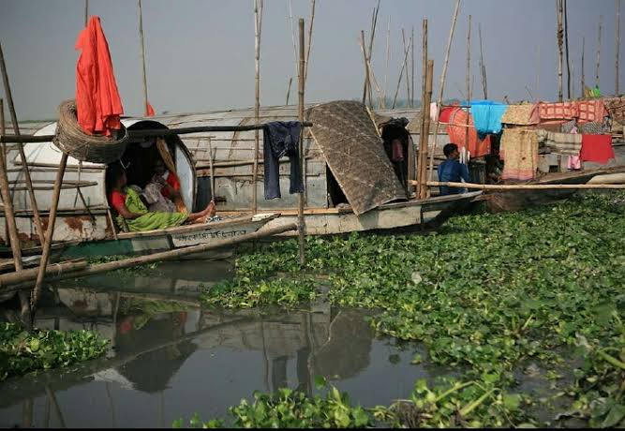
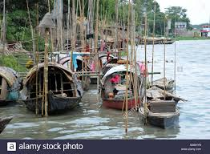
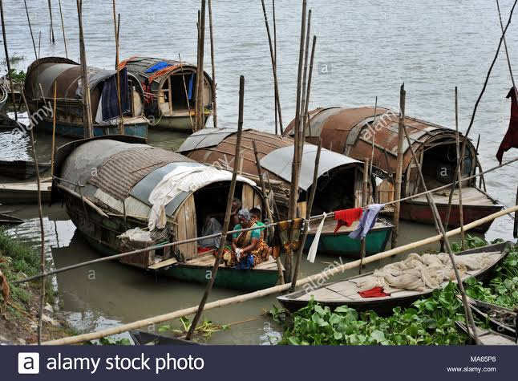
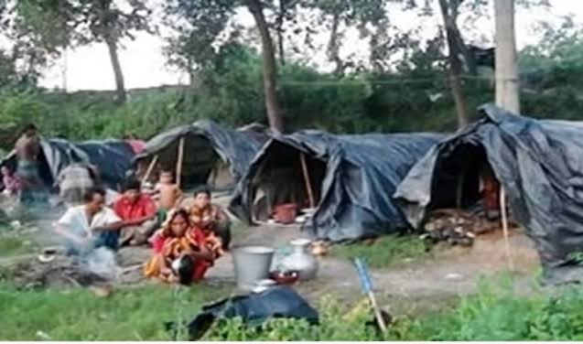
Look at the picture and talk about them.

Slide 7
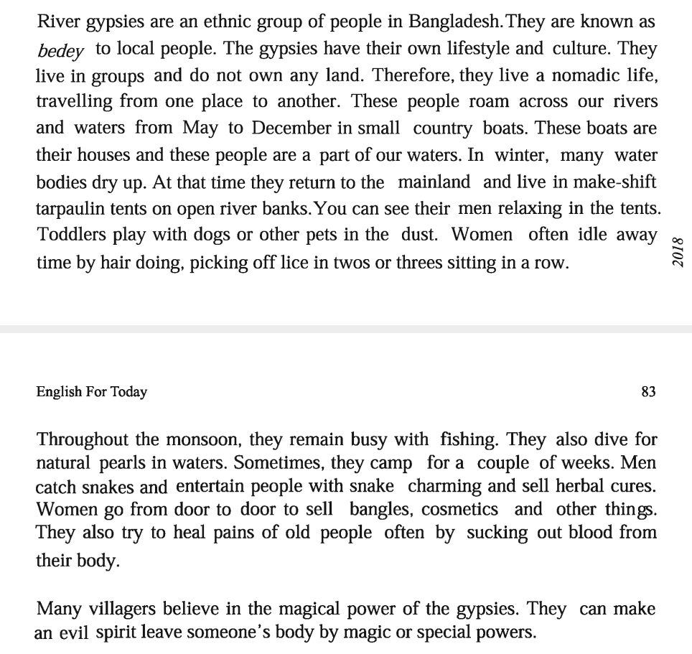
B.Read the text and find out new words from the text-----

Slide 8
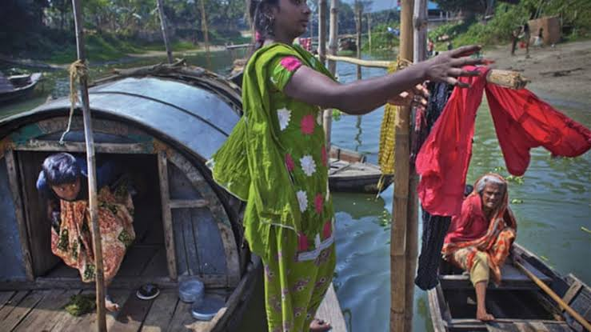
gypsy
An ethnic group of people
River gypsies are an ethnic group in Bangladesh.

Slide 9
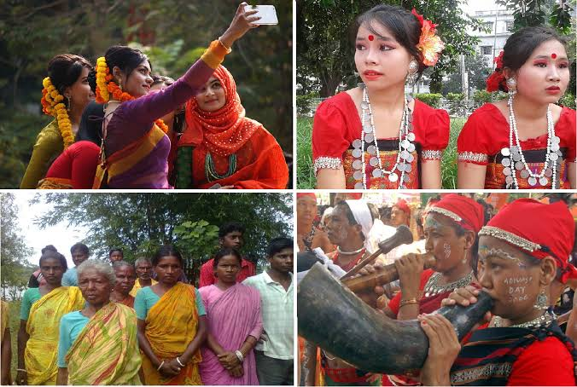
ethnic
racial
The ethnics have their own identity.

Slide 10
nomadic
The people who move from one place to another and who have no permanent livings.
The river gypsies live a nomadic life.

Slide 11
roam
Moving one place to another place.
The river gypsies roam across the river.

Slide 12
tarpaulin
One of the plastic made thin things which we use to make tents.
In winter the river gypsies leave in a tarpaulin tents.

Slide 13
Individual Work
1. Who are river gypsies?
Ans: river gypsies are an ethnic group of people.
2. How do they live?
Ans: They live a nomadic life.
3. What do river gypsy men do for living?
Ans: The river gypsy men catch fishes and so snacks charming.

Slide 14
Pair Work
B. Discuss with your partner and choose the best answer.
1. The term 'ethnic' is connected to -
a. People
b. Plants
c. Animals
d. Fishes

Slide 15
2. River gypsies roam around on their boats about-------- months a year
a. Six
b. Seven
c. Eight
d. Nine

Slide 16
3. River gypsies live in tents in-
a. Summer
b. Winter
c. Monsoon
d. Spring

Slide 17
4. The term 'nomadic' refers to a person who-
a. stays permanently at a place.
b. travel from place to place.
c. lives in ones own house.
d. lives in a rented house.

Slide 18
Group Work
D. Have you ever seen any gypsies bedey/ snake charmers or any person selling things from door to door in your area . Write your experience about any of them.

Slide 19
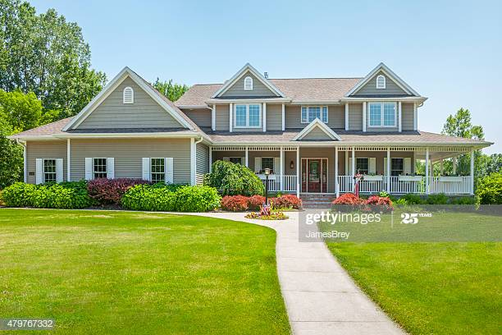
h
HOME WORK
Write five things that are essential for the development of the river gypsis life.

