Slide 1
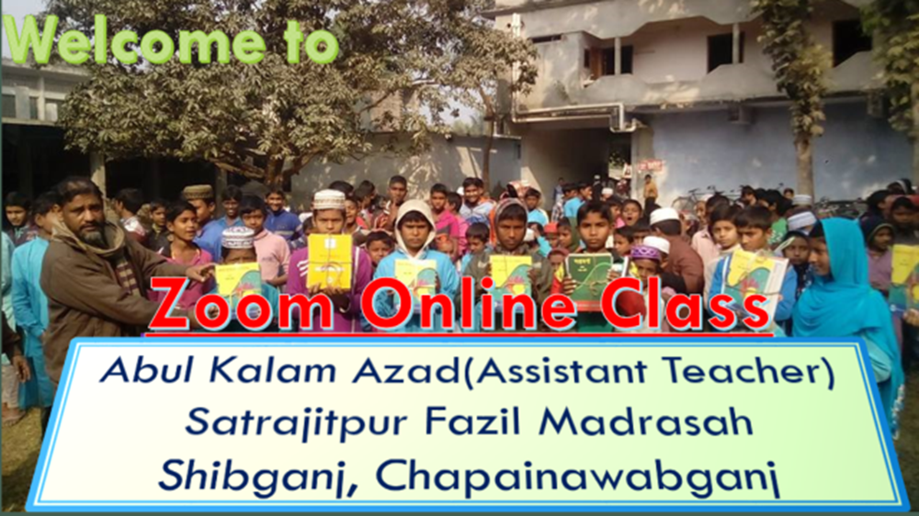

Slide 2
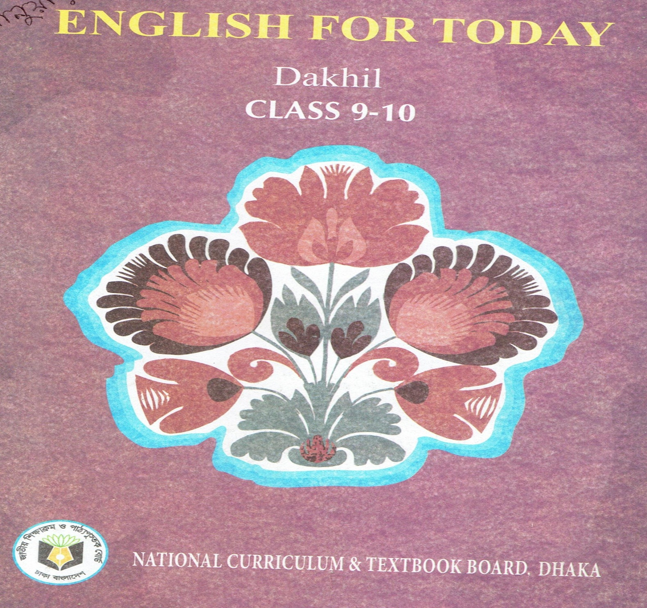
Lesson Identity
Unit: 6
Lesson : 4
Time : 45 m.
Date :

Slide 3
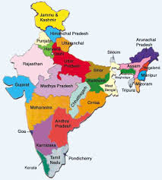
Look at the pictures
What do you see in the pictures?
Map of India

Slide 4
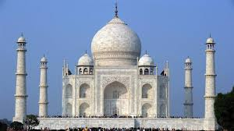
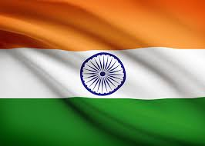
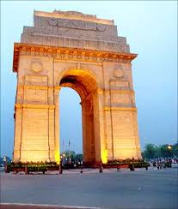
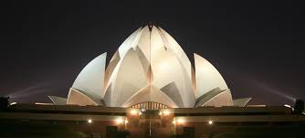
Look at the pictures
What do you see in these pictures?
What do you see in these pictures?
Tajmahal, India
Flag of India
The sceneries of India

Slide 5
Lesson title
India

Slide 6
Learning outcome
BY the end of the lesson the learners will be able to
Chose the best answer.
learn new English words meaning.
. Fill in the gap.

Slide 7
Silent reading
Open at page 82

Slide 8
Group work
Discuss with your partner and circle the right answer :
The word ‘coincide’ means
i) accord. Ii) agree. Iii) be identical. iv) all the options.
b) The disintegration of the Mughal Empire - the way regional state.
i) restricted. ii) inhibited iii) paved. Iv) impeded.
c) – got the power of India in the 7th century.
i) The Portuguese. Ii) The native Indian. Iii) The English . Iv) The Danish.
d) Warren Hastings war appointed the – Governor General of India.
i) first. Ii) last. Iii) second . Iv) none of the above.
e) In- India came under the British rule completely.
i) 1774. Ii) 1876. Iii) 1875 . Iv) 1874.

Slide 9
Answer
a) (iv) all the options.
b) (iii) paved.
c) (iii) The English.
d) (i)first.
e) (ii) 1876.

Slide 10
New Vocabulary
Over populated
populous
Flourish
develop
establish
found

Slide 11
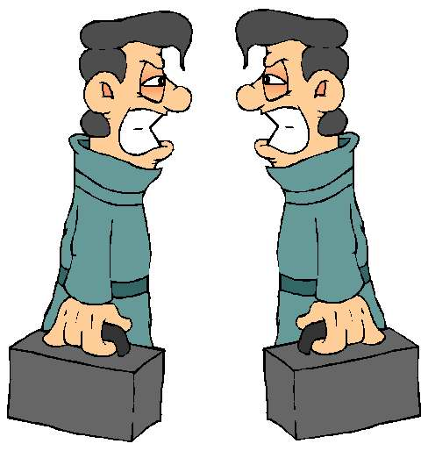
coincide
resemble
emerge
transpire
amazing
astonishing

Slide 12
Individual work
Fill in the gap-
India is (a)- country. There is (b)- cultural diversity throughout the country. Each State (c) – its own (d)- cultures and has (e) – outs its own cultural (f)- without saying that there is (h) – any culture in the world that is as (i) – as India. That’s why India is a tourist’s (j).
Answer: a) unique. b) amazing. c) has. d) distinct. e) carved. f) distinction. g) goes. h) hardly. i) varied. j) attraction.

Slide 13
a) When did the Europeans come to India ?
b) When did warren Hastings join as the first Governor General of India?
c) When did India totally lose its power ?
d) How many years did the British rule India?
e) When did India get its independence?
Evaluation

Slide 14
Answer
The European came to India in the seventh century.
Warren Hosting joined as the first Governor General in India in 1774.
India totally lost its power in 1876.
The British ruled India for almost two hundred years.
India got its independence in 1947.

Slide 15
Homework
Write a short paragraph about
India.

Slide 16
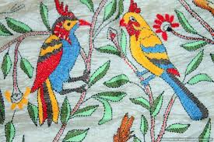
Thanks
To
All
Good bye

