Slide 1
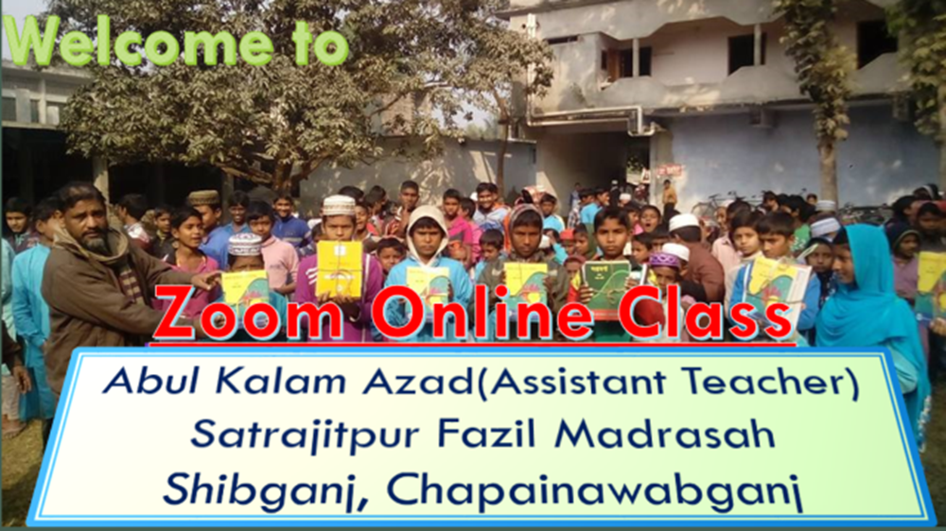
Welcome
To all students

Slide 2
Lesson Identity
Unit: 5
Lesson :4
Time : 45 m.
Date :

Slide 3
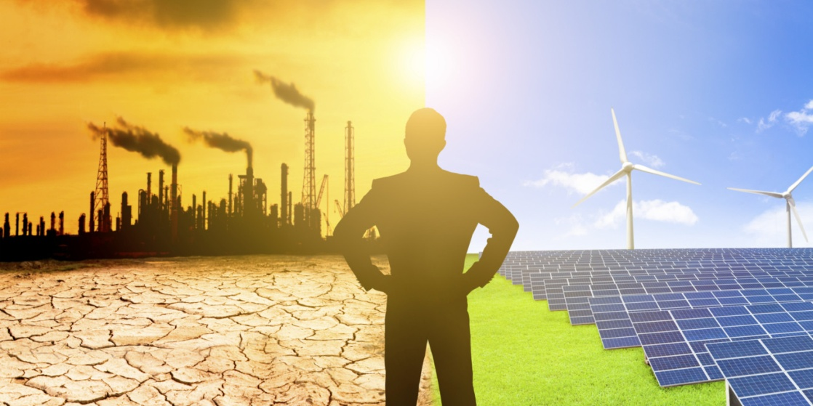
Look at the pictures
What do you see in the pictures?
Man and pollution

Slide 4
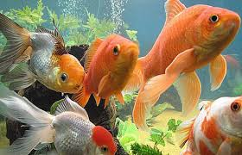
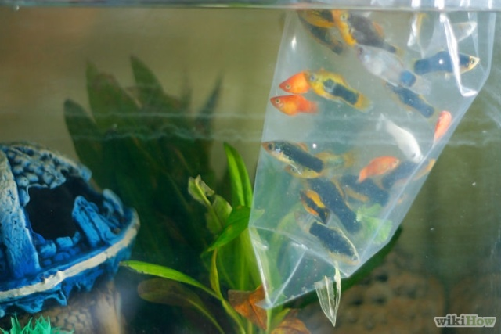
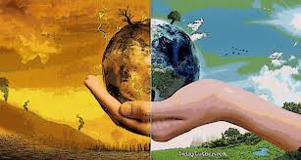
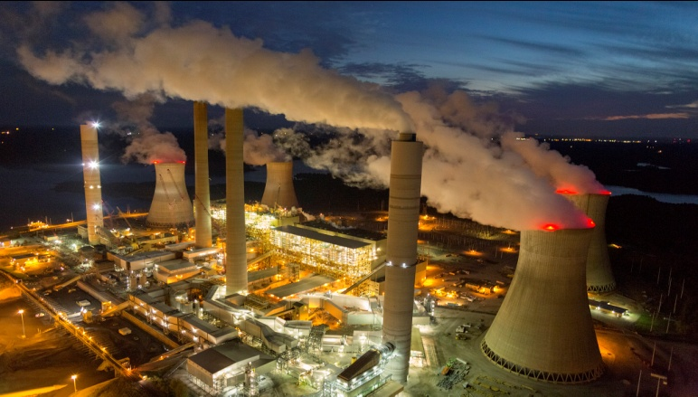
Look at the pictures
What do you see in these pictures?
What do you see in these pictures?
Fishes
Fishes in the river
Global warming

Slide 5
Lesson title
Putting our fish in hot water

Slide 6
Learning outcome
BY the end of the lesson the learners will be able to
Chose the best answer.
learn new English words meaning.
. Question and answer.

Slide 7
Silent reading
Open at page 65

Slide 8
Group work
Discuss with your partner and circle the right answer :
Climate change is- the water in river
i) enlarging. Ii) lengthening Iii) maximizing. iv) all the option.
b) Climate change creates less-
i) foodstuff . ii) carbon dioxide iii) oxygen Iv) i & iii.
c) The word offspring means- .
i) descendant Ii) child. Iii) baby. Iv) all the option.
d) The word extinct is- .
i) noun. Ii) adjective. Iii) verb. Iv) adverb.
e) Climate change increases the –on fish population.
i) adversity. Ii) affliction. iii) constraint . Iv) all the option.

Slide 9
Answer
a) (iv) all the option .
b) (iv) i & iii
c) iv) all the option .
d) (ii) adjective
e) (iv) all the option ..

Slide 10
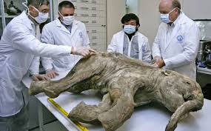
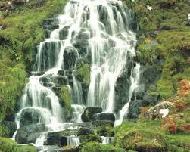
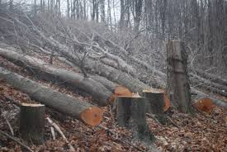
New Vocabulary
extinct
disappear
source
origin
reduce
diminish

Slide 11
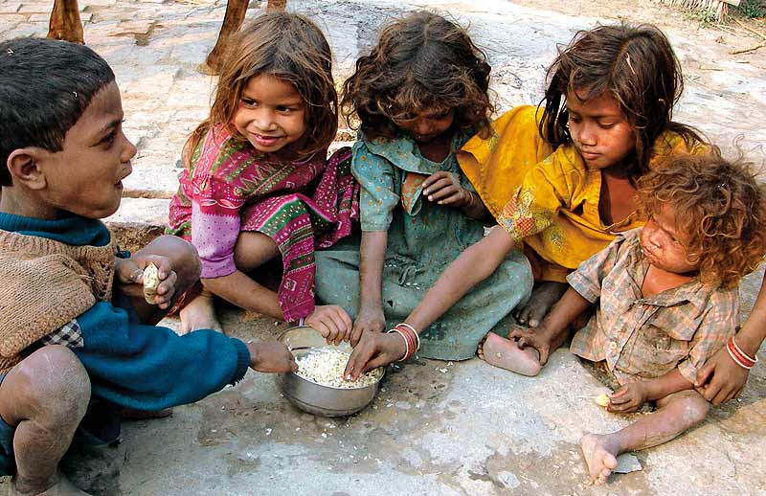
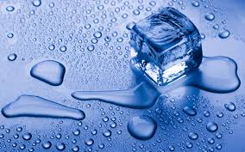
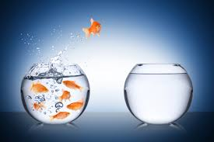
poverty
destitution
melt
liquidity
change
alter

Slide 12
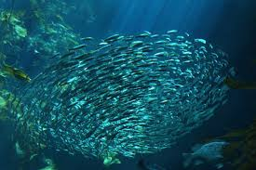
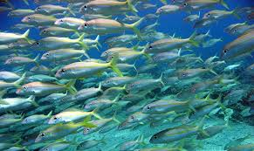
Individual work
Look at the pictures and answer these question.
a) What can be the appropriate title of the passage?
Ans. a) Fish population and it’s problem can be the appropriate title of the passage.

Slide 13
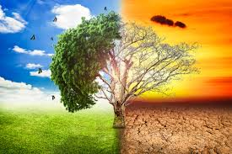
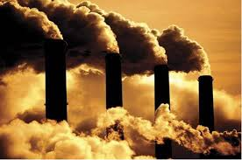
Individual work
Look at the pictures and answer these question.
b) What is the main threat of fish population ?
Ans. b) Global warming is the main threat of fish population.

Slide 14
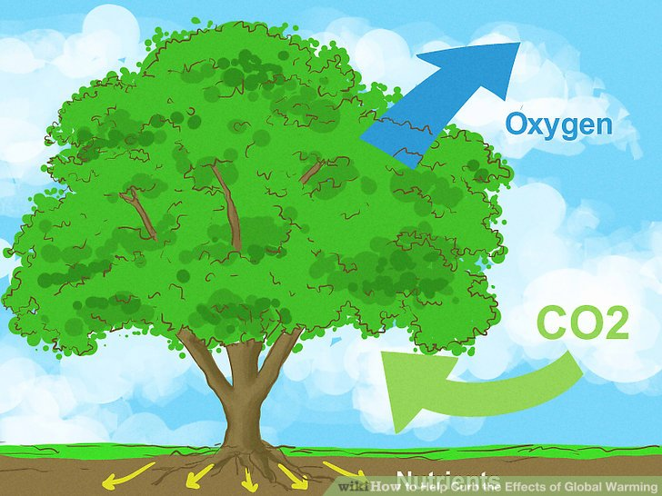
Individual work
Look at the pictures and answer these question.
c) What problem will fish face due to climate change?
Ans. c) There will be less food and oxygen available for fish due to climate change.

Slide 15
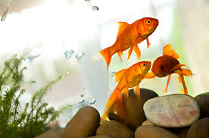
Individual work
Look at the pictures and answer these question.
d) What is the most valuable biological asset?
Ans. D) Fishes is the most valuable biological asset.

Slide 16
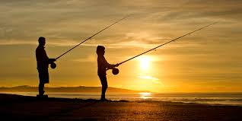
Individual work
Look at the pictures and answer these question.
e) Should we ban the hobby of fishing & why?
Ans. e) Yes, we should ban the hobby of fishing to protect fish population.

Slide 17
Evaluation
Fill in the gap-
Fish population is in danger (a)- be Cause of so many (b)- . Global warming is a (c)- of (d)- for us as it is (e)- the water (f)- in rivers, lakes, cannels etc. It (g)- fish will enjoy (h)- food (i)- oxygen for its (j)- habitation.
Answer: a) zone b). factors. c) matter. d) concern. e) increasing. f) temperature. g) means. h) less i) as well as. j) natural.

Slide 18
Homework
Write a short paragraph about
Fish population.

Slide 19
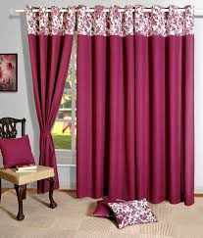
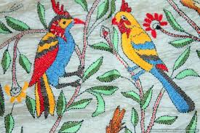
Thanks
To
All
Good bye

