Slide 1
W
E
L
COME

Slide 2
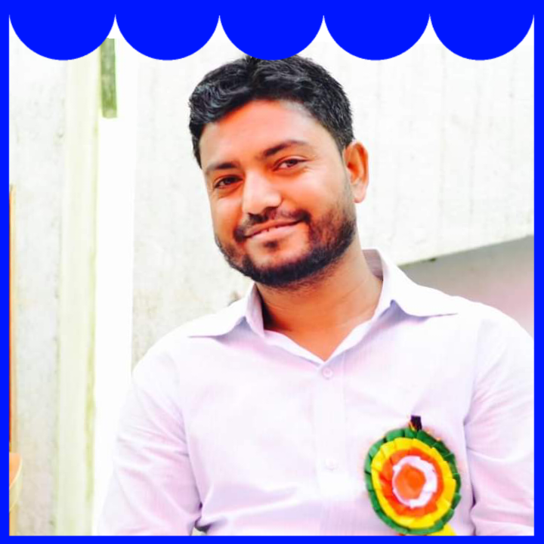
Teachers Identification
Md. Al Amin
Assistant Teacher
Kaitkuna Govt. Primary school
Alamin4bd@gmail.com

Slide 3
Class: Five
Subject: English
Unit:22, Completing forms
Lesson:1-2
Part: Activity A,B,C

Slide 5
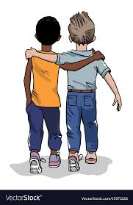
What are the names of your friends?
Today’s we are going to learn about two friends..

Slide 6
Introducing new words
Friend- a person who you know and like a lot- বন্ধু
Different- not the same- আলাদা
Run- to move faster- দৌড়ানো
Active- always busy in work- প্রাণবন্ত/কর্মঠ
Talkative- liking to talk a lot- বেশি কথা বলে যে, বাচাল

Slide 7
Individual Work
Make one sentence by the following words-
Friend-
Run-
Talkative-

Slide 8
Let’s see a picture
Do you know them?
Let’s find their identity

Slide 9
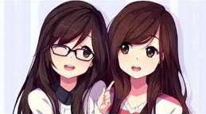
Laila and Bithi are friends.
But they are very different.

Slide 10
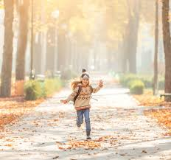
Laila likes to run in the park and swim . She is very active. She also likes to talk. Her mother says ,” oh, Laila! You’re so talkative.”

Slide 11
Reading with a group
Reads these sentences with your name-
Laila likes to run in the park and swim . She is very active. She also likes to talk. Her mother says ,” oh, Laila! You’re so talkative.”

Slide 12
On the other hand , Bithi is a quiet person. She doesn’t like running or swimming. She enjoys reading. She especially loves stories about other countries.

Slide 13
Students reading

Slide 14
Bithi
Laila

Slide 15
Group Work

Slide 16
Clever—My friend Ritu is very clever. She can makes other fool easily.
Funny– My brother is very funny . He tells us interesting jokes.
Kind- My grandfather is very kind. He helps poor always.
Quiet—My elder sister is very quiet.She likes to draw pictures.
Talkative- My cousin , Keya is very talkative . She talks a lot all the day.

Slide 17
Home Task
Write 5 sentences about About your friend.

Slide 18
Goodbye

