Slide 1
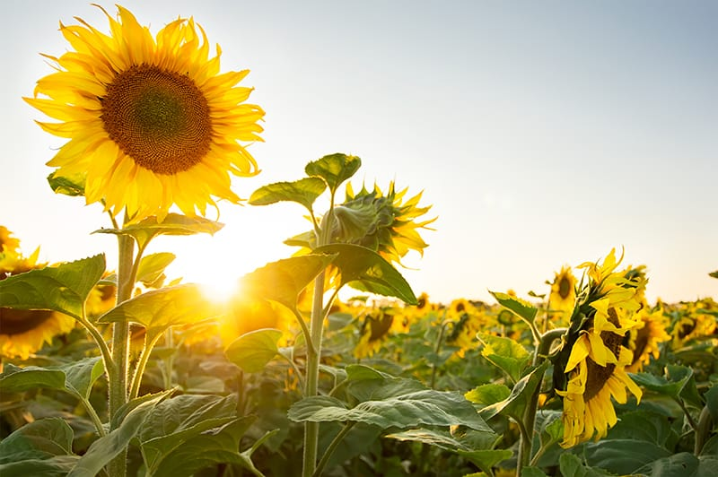
Welcome

Slide 2
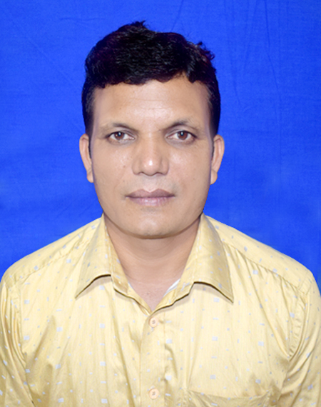
A F M Saiful Islam
Head Teacher
Musrat Madati Govt. Primary School
Kaligonj, Lalmonirhat .

Slide 3
Class:2
Subject: English
Unit:6
Lesson: 1-3
Time: 4omn

Slide 4
Learning outcomes
Reading:
2.1.1 Recognize and read cardinal numbers up to 30.
Writing:
2.1.1 Write cardinal numbers up to 30 in figures .
4.1.2 Write numbers up to 10 in figures and in words.

Slide 5
Look at the picture and count.
9
8
10

Slide 6
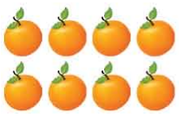
How many orange?
8
eight

Slide 7
How many orange?
9
nine

Slide 8
How many orange?
10
ten

Slide 9
Count and say the number
9
8
10

Slide 10
Match the number with word
8
ten
9
eight
10
nine

Slide 11
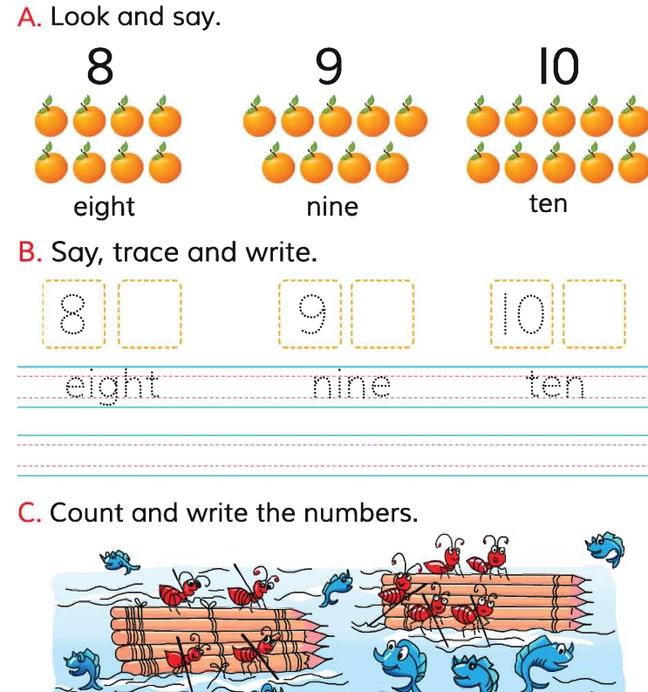
Students open at page 12

Slide 12
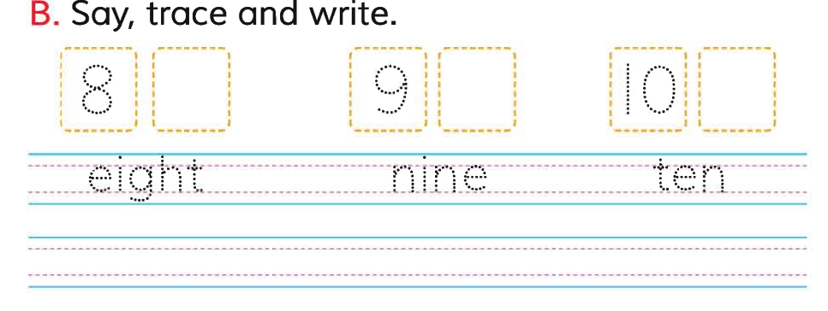

Slide 13
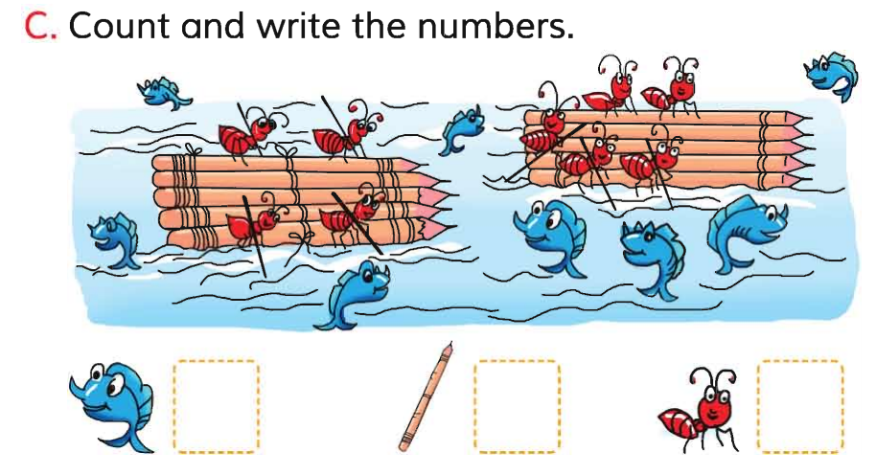

Slide 14
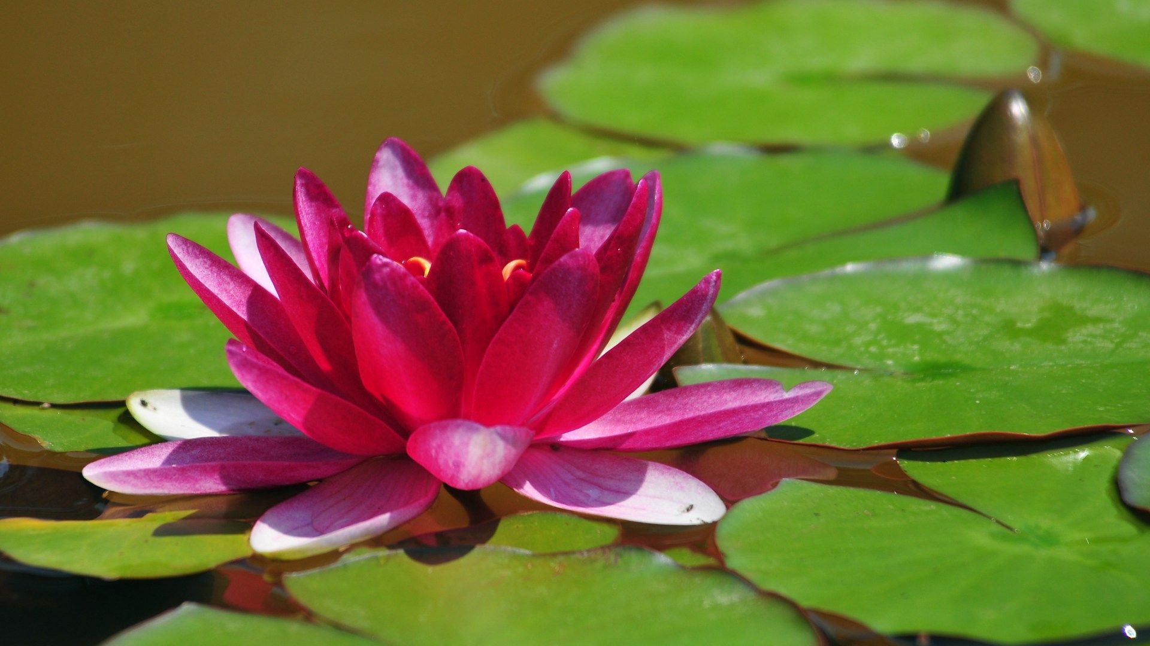
Thanks

