Slide 2
How to write a good paragraph
Class : Eight
Subject : English (Grammar Part)

Slide 3
How to write a good paragraph
What is Paragraph?
A paragraph is a group of a sentence about one topic. There are three parts of a paragraph :
Introduction
Middle
Conclusion

Slide 4
How to write a good paragraph
The parts of a Paragraph:
Introduction: The introduction of a paragraph contains an introductory sentence. It is called a topic sentence. Generally a paragraph begins with it. The topic sentence introduces your topic.
To write a good topic sentence:
State the topic clearly so that the reader can understand what you are going to write about
Your topic sentence should be attractive.

Slide 5
How to write a good paragraph
The parts of a Paragraph:
2. Middle: The middle of a paragraph contains contains supporting idea. Here you narrate, explain and that support what you said in the introduction. It should contain the details of your description.
To write the middle:
Narrate everything you want to write about your topic.
If needed, classify your ideas.
Put them clearly one after another and make a link between them.

Slide 6
How to write a good paragraph
The parts of a Paragraph:
3. Conclusion: The conclusion of a paragraph is the last part. Here you make a final say about your topic. To write a conclusion ---- avoid repetition and sum up your ideas.

Slide 7
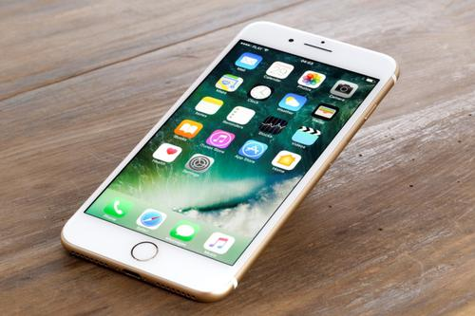
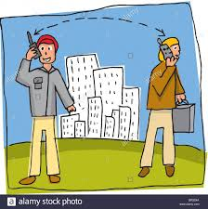
How to write a good paragraph
Below is a sample paragraph with different parts about Mobile Phone:
Mobile Phone
Introduction
The mobile phone is a important device of communication. It helps us to communicate with others in the shortest possible time.

Slide 8
How to write a good paragraph
The main facility of the mobile phone is that you can take it any where with you. It is very popular for many reasons. Firstly, it is not very expensive. So, most of the people can buy it. Secondly, we can also use it for other purposes like sending text messages, taking photographs and selfies, storing data, exploring websites. Now the mobile phone is widely used for internet communication. The mobile phone is a wonderful blessing of modern communication system.
Middle

Slide 9
How to write a good paragraph
Conclusion
We can not imagine our life without it

Slide 10
How to write a good paragraph

Slide 11
Thanks to all

